Slide 1
Hall B:User Software Contributions
Gerard Gilfoyle
University of Richmond
12 GeV Upgrade Software Review
Jefferson Lab
November 6-7, 2014

Slide 2
Goals and Outline
Committee Charge - 1.c
Are users engaged at a sufficient level to demonstrate usability and readiness from a user’s perspective?
Has the CLAS Collaboration identified appropriate mechanisms to support utilization of the software by the entire collaboration?
Is the level of user documentation appropriate for this point in time?
Outline of talk
TOF reconstruction software: detectors, methods, results, and status.
User experience: developers, workflow.
Connection with committee charge.

Slide 3
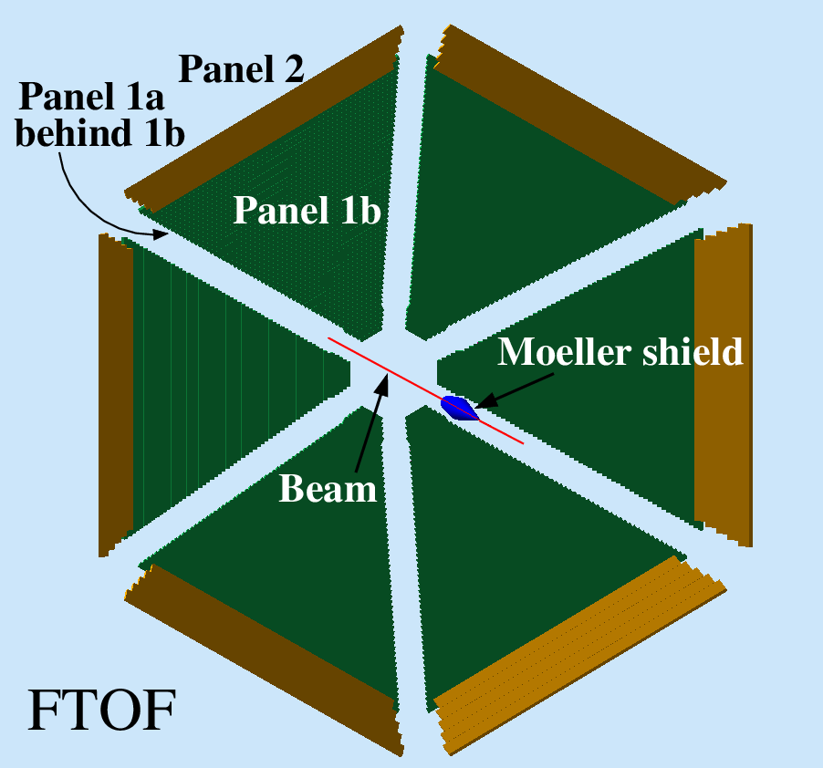
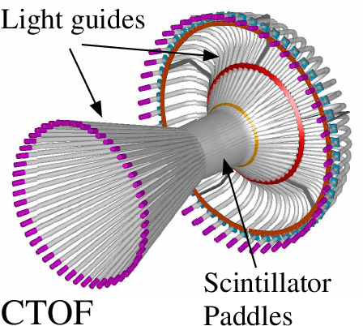
TOF Reconstruction
Forward Time-of-Flight (FTOF)
6 sectors, double-sided PMT readout.
Paddles: Panel 1a - 23, Panel 1b - 62, Panel 2 – 5.
Central Time-of-Flight (CTOF)
48 paddles, double-sided PMT readout.
form hermetic barrel around target.
Outputs
Times
Positions
Hit times
Deposited energy

Slide 4
TOF Reconstruction Methods
Single TOF paddles and clusters
adjacent hits grouped based on cuts on Δy_{hit} and Δt_{hit}.
TDC Time (T_{L}, T_{R})
Apply time walk corrections and calibration
Clusters - energy-weighted average.
Deposited Energy (E_{dep})
Apply ADC calibration and E_{dep} = √E_{L}•E_{R}
Clusters – sum E_{dep}’s
Position (y_{hit})
Use T_{L}-T_{R} to get y_{hit} relative to paddle center.
Clusters - energy-weighted average.
Hit time (T_{hit})
Average T_{L}, T_{R}
Clusters - energy-weighted average vs. earliest hit.

Slide 5
Code Validation
Simulation is primary testing tool of TOF reconstruction code.
CLAS12 Simulation – gemc
Simulations done on Richmond cluster and copied to JLab.
Accessible, well-documented, bug reporting, website.
JLab staff member (M. Ungaro).
Event generation
disgen – proton DIS
Range of final states and momenta.
Local
QUEEG – quasielastic scattering from deuterium
Local, under svn,
CLAS-NOTE 2014-008.

Slide 6
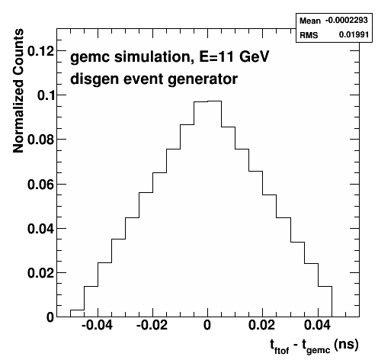
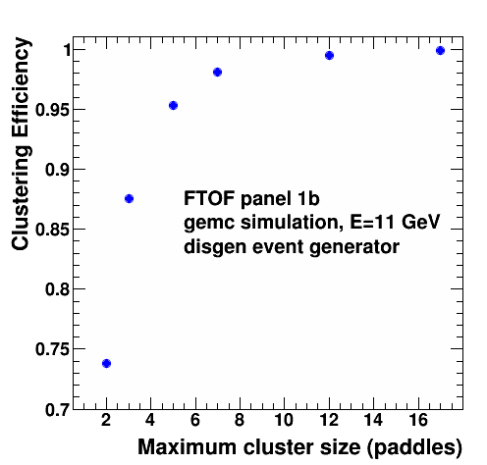
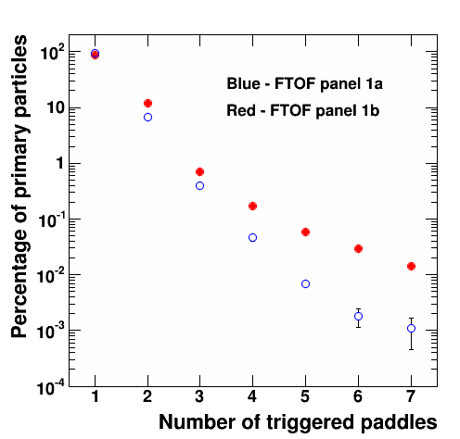
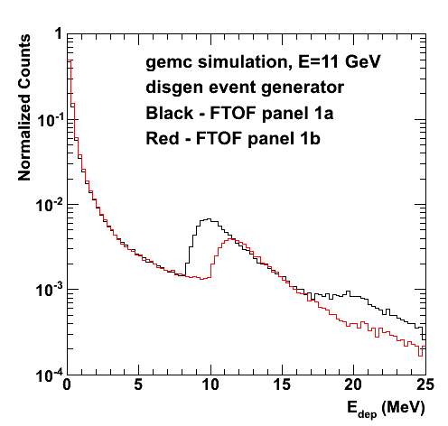
FTOF Standalone Reconstruction Results
Time difference with gemc.
Measured N_{adj} dependence.
Optimized clustering parameters.
Cluster efficiency.
E_{dep}.
CLAS12-NOTE 2014-003.

Slide 7
Current Status
CLAS12 generation 1 TOF reconstruction completed
December, 2013.
Standalone versions for FTOF and CTOF.
Working as a service in analysis chain.
Validated in stress test.
Optimized parameters for forming cluster from multiple-paddle hits.
CLAS12 NOTE 2014-003.
Updated to new clasio libraries, bankefs, summer 2014.
New test version for event builder development.
First version of code to match drift chamber track from hit-based tracking with FTOF hit.
Geometry parameters read from service.
Streamlined code.

Slide 8
People
Developer categories: A – environment programmers,
B – service developers, C – physics-only users
Time-of-flight reconstruction software developers
Alex Colvill, master’s student, University of Surrey, 2013
Created full set of reconstruction software
optimized algorithms for forming clusters
G.P.Gilfoyle, spring 2014
work done at University of Richmond
updated FTOF to new clasio, bankdefs (with JLab help)
E.Golovach, summer-fall 2014
periodic visitor to JLab from Moscow State
Working on FTOF reconstruction now (track matching).
JLab support – V.Ziegler, G.Gavalian

Slide 9
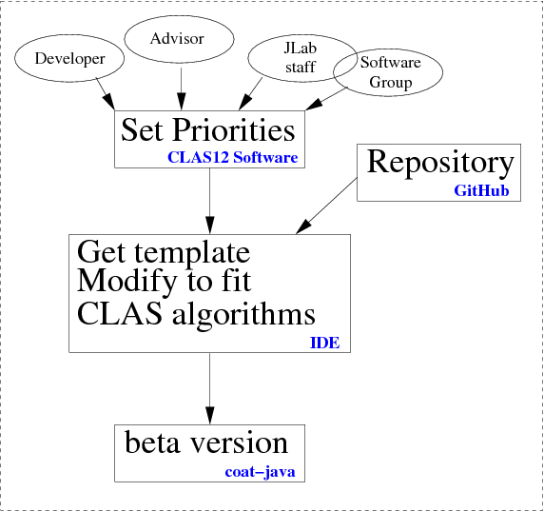
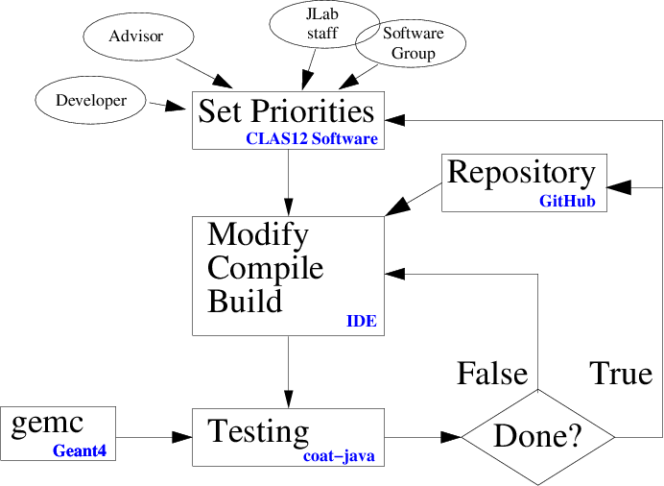
User Workflow
Getting Started
Development Cycle

Slide 10
Connection to Charge
Are users engaged at a sufficient level to demonstrate usability and readiness from a user’s perspective?
Gilfoyle (Richmond), Golovach (Moscow State) and their students have been able to make significant contributions to the time-of-flight reconstruction package.
Time spent on-site is crucial for start-up.
Has the CLAS Collaboration identified appropriate mechanisms to support utilization of the software by the entire collaborations?
For TOF project the common tools are far enough along for off-site users to make contributions.
Simulations with gemc and analysis in the Clara framework are ongoing at Richmond and MSU.
Is the level of user documentation appropriate for this point in time?
Lots of material for FTOF, but should be localized (CLAS12 wiki?).
Bug reporting, access to JLab staff for support can be crucial to get software working offsite.

Slide 11
Additional Slides

Slide 12
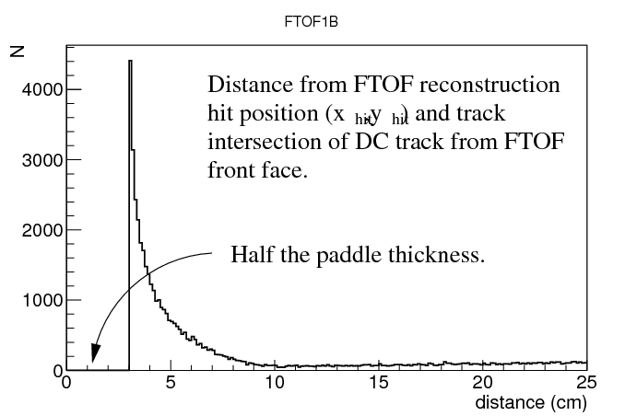
Track Matching with Drift Chambers
Match drift chamber track with FTOF hit.
Hit-based tracking results are used now.
DC track is propagated from last DC plane to front face of FTOF panel (B=0) using geometry service tools.
FTOF returns (z_{hit},y_{hit}) where z_{hit} is in the center of the paddle.
Consider only single paddle clusters.
First results:

Slide 13
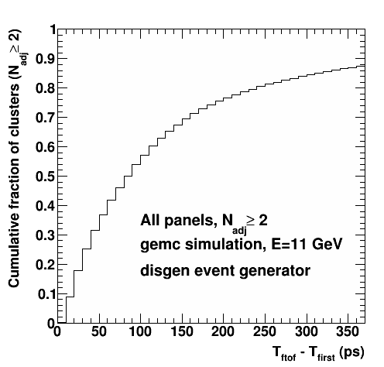
Energy-weighted T_{hit} vs. Earliest T_{hit}
Cluster hit times have been calculated as the energy-weighted sum of the paddle hit times.
We also considered taking the earliest T_{hit} among the paddles of each cluster.

