Slide 1
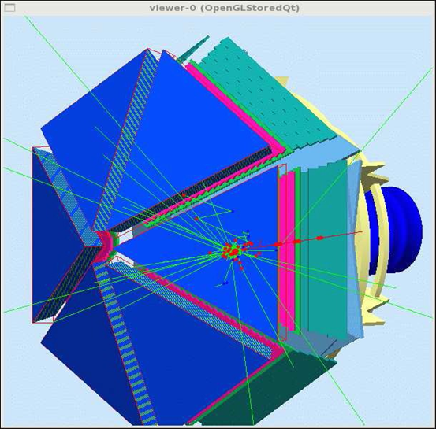
Time-of-Flight Software Status
Jerry Gilfoyle, Evgeny Golovach, Dan Carman, Veronique Ziegler, Gagik Gavalian
Outline:
Motivation
Time-of-Flight subsystem
Status
Validation results
Timing resolution
Summary
CLAS12 Workshop Jefferson Lab
February 23, 2016

Slide 2
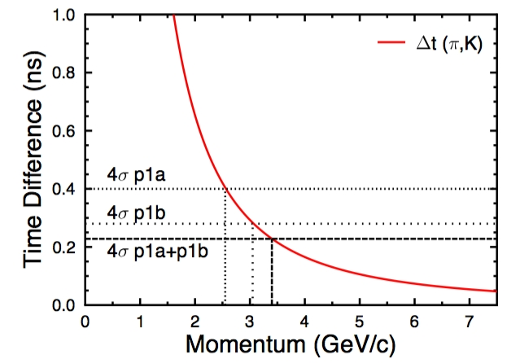
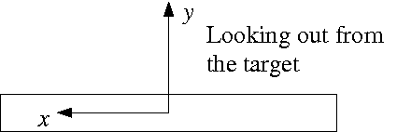
TOF Reconstruction
Goal for FTOF: combined timing resolution in the range 35-80 ps.
→ Main focus here.
$π−K$ separation rises to p=3.4 GeV from 3.0 GeV.
$π−p$ separation rises to p=6.6 GeV from 6.0 GeV.
$K−p$ separation rises to p=5.8 GeV from 5.2 GeV.
Outputs
Times (T_{L}, T_{R} from TDCs)
Positions (x_{cluster} =v_{eff} (T_{L} – T_{R} )/2, y_{cluster} depends on cluster size)
Hit times (T_{hit} from (T_{L} + T_{R})/2)
Deposited energy (E_{dep} from ADCs)
page 3

Slide 3
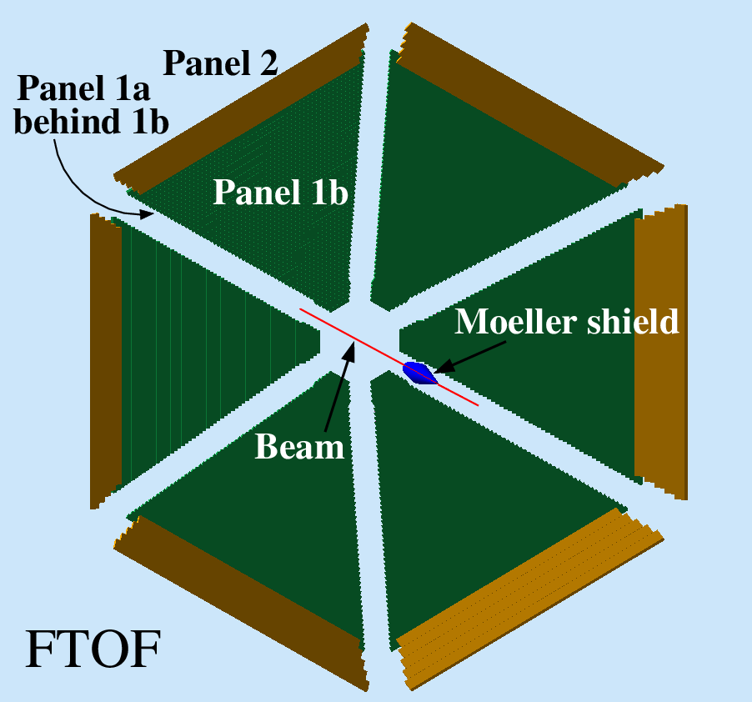
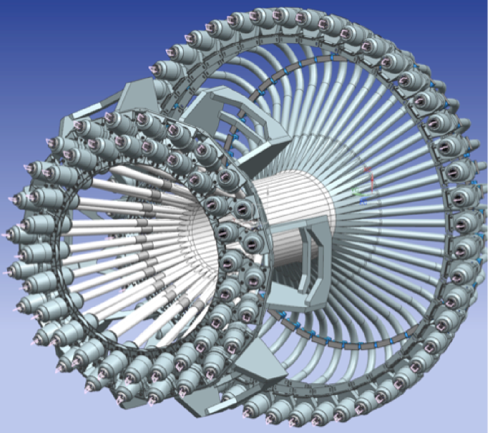
TOF Reconstruction
Forward Time-of-Flight (FTOF)
6 sectors, double-sided PMT readout.
Paddles:
Panel 1a - 23, 15-cm wide, 70-130 ps timing requirement.
Panel 1b - 62, 6-cm wide, 40-100 ps timing requirement.
Panel 2 – 5, 15-cm wide, 140-165 ps timing requirement .
Central Time-of-Flight (CTOF)
48 paddles, double-sided PMT readout.
form hermetic barrel around target.
60-ps timing resolution requirement.
page 2

Slide 4
FTOF Software Status
First version of standalone TOF reconstruction code (CLAS-NOTE 2014-003) ported to coatjava.
Results of DC reconstruction used to extrapolate track to FTOF panels.
Geometry obtained from Java package for FTOF reconstruction and gemc.
Updated to latest versions of Common Tools.
Part of upcoming Common Tools 2.5 release.
Validation studies on going (results below).

Slide 5
FTOF Software Validation Studies
Run Conditions:
Studies
Particles: $e^{′}, p, π^{+}{, π}^{−}$
Quantities: $∆X= X_{gemc} −X_{recon}$
$∆Y= Y_{gemc} −Y_{recon}$
$∆\overset{⃑}{R}= {|\overset{⃑}{R}}_{gemc} −{\overset{⃑}{R}}_{recon}$|
$∆T=T_{gemc} −T_{recon}$
$Y_{recon}$ versus $X_{recon}$
$E_{dep}, ADCL, ADCR$
$TDCR, TDCL$
JLab software v1.2 | gemc v2.2
coatjava 2.0 | Single paddle hits.
Event generators – uniform distributions | $$ep→e^{′}p$$ $$ep→e′π^{+}π^{−}$$

Slide 6
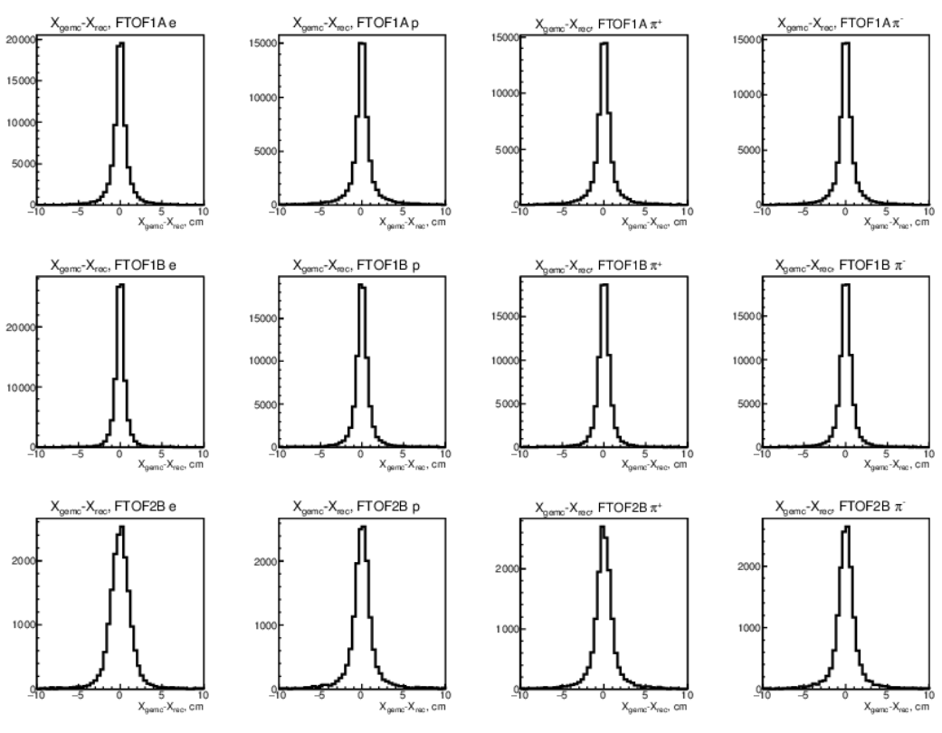
Position Studies- 1
$$e^{−}$$
$$p$$
$$π^{+}$$
$$π^{−}$$
Magnetic fields set to zero.
Panel widths:
1A – 15 cm
1B – 6 cm
2 – 22cm
1A
1B
Panels show increase in width expected for current digitization in gemc.
2
Geometry used in coatjava 2.0 from same database used by gemc.
$$∆X=X_{gemc}−X_{recon}$$

Slide 7
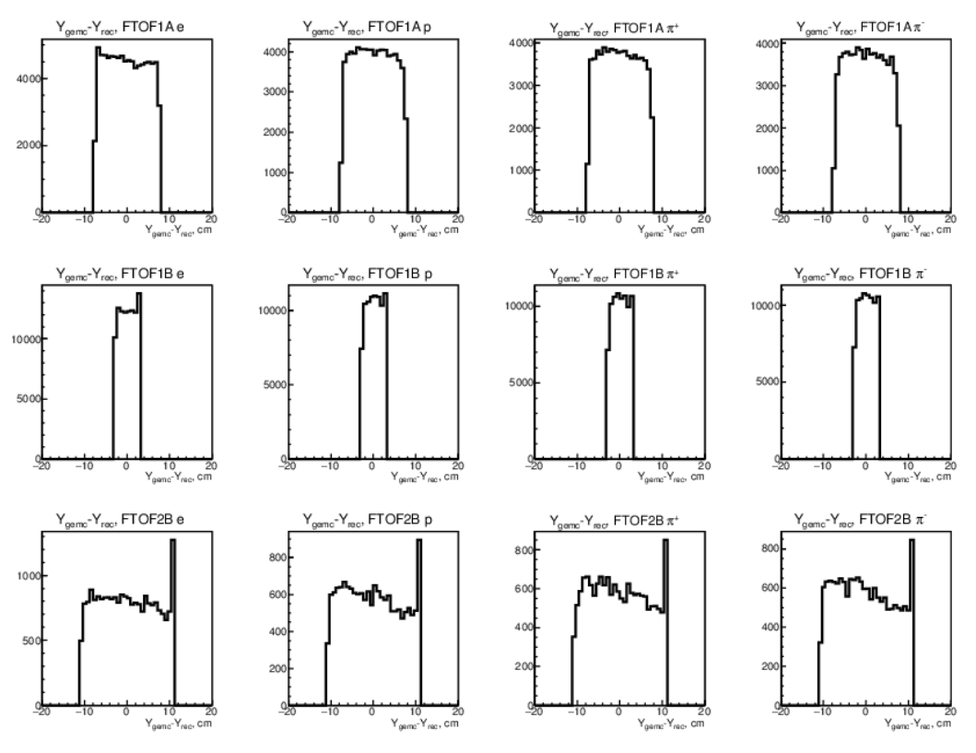
Position Studies- 2
$$e^{−}$$
$$p$$
$$π^{+}$$
$$π^{−}$$
Magnetic fields set to zero.
Panel widths:
1A – 15 cm
1B – 6 cm
2 – 22 cm
1A
1B
Widths reflect geometry of each paddle.
Spike in panel 2 and a wee bit in panel 1b likely due to hit in neighboring counter. Under investigation.
2
$$∆Y= Y_{gemc} −Y_{recon}$$

Slide 8
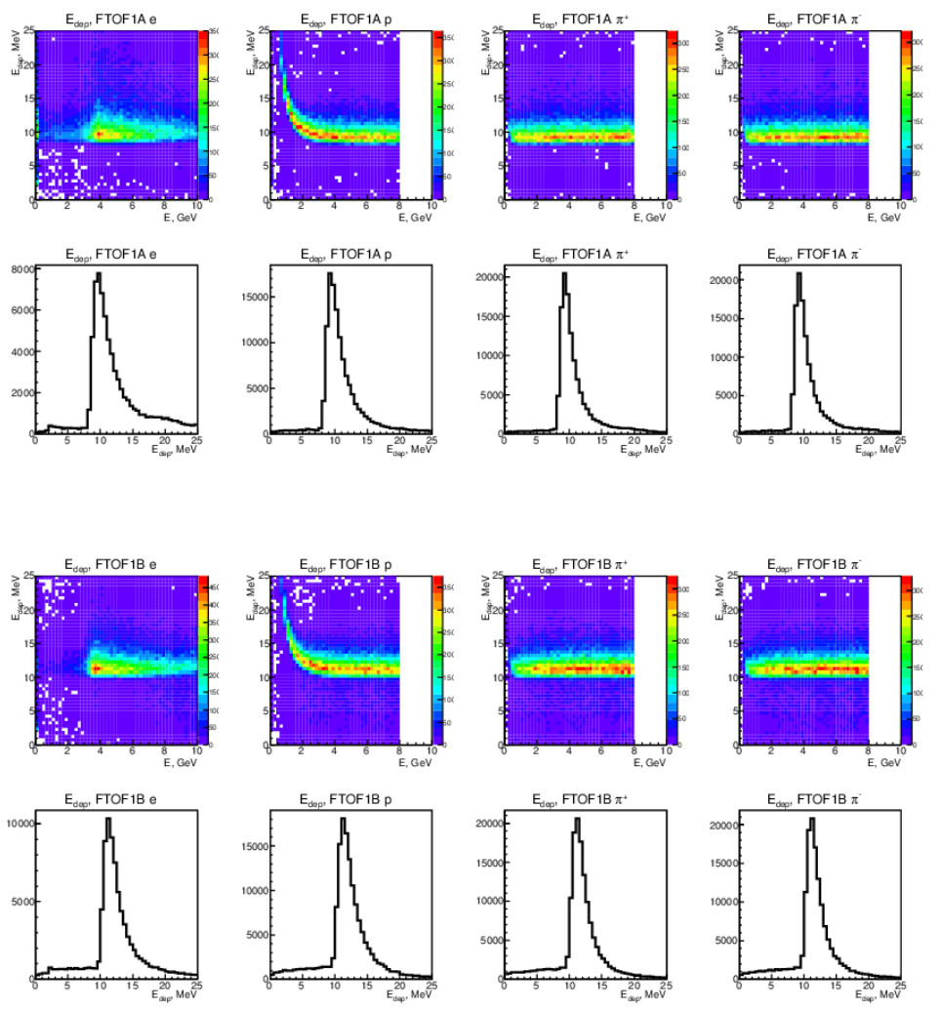
Deposited Energy and ADCs
$$e^{−}$$
$$p$$
$$π^{+}$$
$$π^{−}$$
$$E_{dep}$$
Magnetic fields set to zero.
Panel thickness:
1A – 5 cm
1B – 6 cm
2 – 5 cm
1A
$$E$$
1A
$$E_{dep}$$
$$E_{dep}$$
Position of E_{dep} peak consistent with past measured response and thickness of the paddle.
1B
$$E$$
1B
$$E_{dep}$$

Slide 9
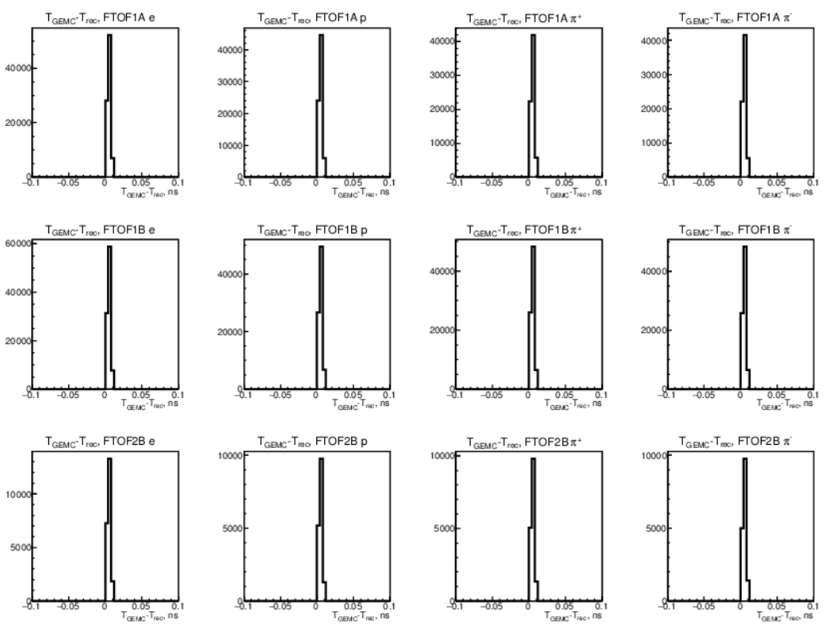
Timing
$$e^{−}$$
$$p$$
$$π^{+}$$
$$π^{−}$$
Timing resolutions
Panel 1a: 70-130 ps
Panel 1b: 40-100 ps
Panel 2: 140-165 ps.
1A
TDC digitization in gemc needs to be made more realistic.
1B
Required timing resolution is in the range 35-80 ps for combined panels 1a and 1b.
2
$$∆T=T_{gemc} −T_{recon}$$

Slide 10
Time Resolution - 1
Start with ‘gold’ events first: single hits in panels 1a and 1b, all signals present.
Cluster coordinates:
$x_{cluster}= \frac{v_{eff}}{2}({TDC}_{L} −{TDC}_{R}$) $y_{cluster}=$middle of counter
Cluster matching within a panel
$x_{cluster}^{1a}−x_{track}^{1a}<{parm}_{1a}^{x}$ Panel 1a $x_{cluster}^{1b}−x_{track}^{1b}<{parm}_{1b}^{x}$ Panel 1b
$y_{cluster}^{1a}−y_{track}^{1a}<{parm}_{1a}^{y}$ $y_{cluster}^{1b}−y_{track}^{1b}<{parm}_{1b}^{y}$
Cluster matching across panels.
${(x}_{cluster}^{1a}−xcorr) − x_{cluster}^{1b}<{parm}_{1ab}^{x}$
${(y}_{cluster}^{1a}−ycorr) − y_{cluster}^{1b}<{parm}_{1a}^{y}$
where $x_{corr}/y_{corr}$is an extrapolation back to the panel 1b hit location and the
${ parm}_{i}^{j}$ are to be determined.

Slide 11
Time Resolution - 2
5. Compute correct hit time using
$$t_{corr}= \frac{\frac{t_{cluster}^{1b}}{1/σ_{1b}^{2}}+\frac{t_{cluster}^{1a} − ∆r/β}{1/σ_{1a}^{2}}}{\frac{1}{σ_{1b}^{2}}+\frac{1}{σ_{1a}^{2}}}$$
where the $σ_{1a}$ and $σ_{1b}$ are the counter time resolutions. The times $t_{cluster}^{1a}$ and $t_{cluster}^{1b}$ are the hit times relative to the RF. The term $∆r/β$ accounts for the path length difference between the panel 1b cluster hit coordinate and the panel 1a one (depends on tracking).
6. Study time resolutions by comparing the widths of the distributions:
$σ\left[\left(t_{1b}− t_{RF}\right)−t_{1b}^{hit}, p\right]$, $σ\left[\left(t_{1a}− t_{RF}\right)−t_{1a}^{hit}, p\right]$, $σ\left[\left(t_{corr}− t_{RF}\right)−t_{1b}^{hit}, p\right]$
which are also functions of momentum.

Slide 12
Time Resolution - 3
Use ‘silver’ events: multiple paddle hits in panels 1a and 1b, all signals present.
$x_{cluster}= \frac{\sum_{i=1}^{nhits}{\frac{x_{hit}^{i}}{E_{i}^{2}}}}{\sum_{i=1}^{nhits}{E_{i}^{2}}}$ $y_{cluster}= \frac{\sum_{i=1}^{nhits}{\frac{y_{hit}^{i}}{E_{i}^{2}}}}{\sum_{i=1}^{nhits}{E_{i}^{2}}}$
Cluster matching – same as above for gold events.
Hit time for cluster
$t_{cluster}^{1b}= \frac{\sum_{i=1}^{nhits}{ \frac{t_{1b}^{i}}{1/σ_{1b}^{2}}}}{\sum_{i=1}^{nhits}{1/σ_{1b}^{2}}}$ $t_{cluster}^{1a}= \frac{\sum_{i=1}^{nhits}{ \frac{t_{1a}^{i}}{1/σ_{1a}^{2}}}}{\sum_{i=1}^{nhits}{1/σ_{1a}^{2}}}$
Corrected hit time – same as above for gold events.
Time resolutions – same as above for gold events.
Bronze/broken-beer-bottle events – single paddle hits, one signal missing.
$E_{i} ≡$deposited energy
$nhits≡$cluster size

Slide 13
Summary
GEMC
Standalone TOF reconstruction software updated and in coatjava 2.5.
Matching between DC track and FTOF hits done.
Reading ccdb database for calibration constants.
Validation studies ongoing.
Timing resolution studies starting.
page 4

