Slide 1
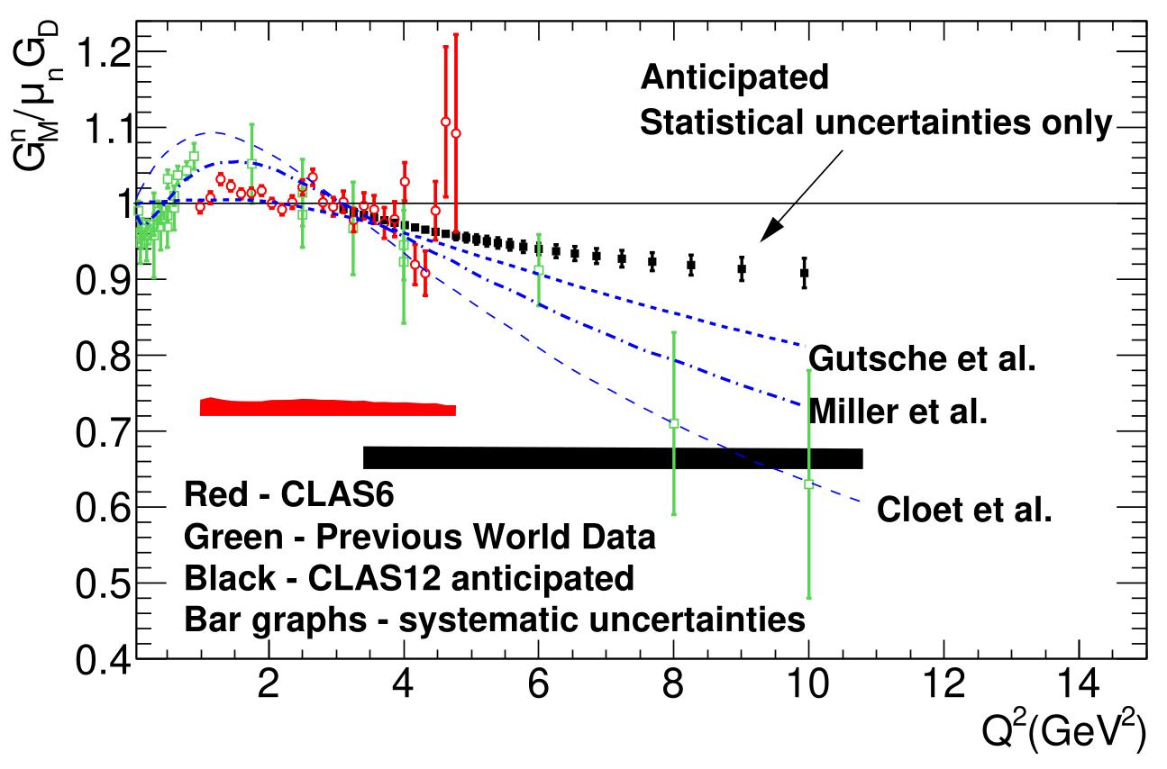
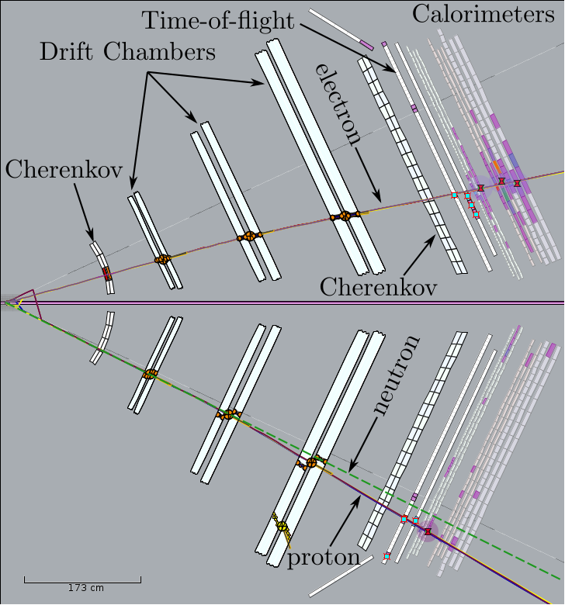
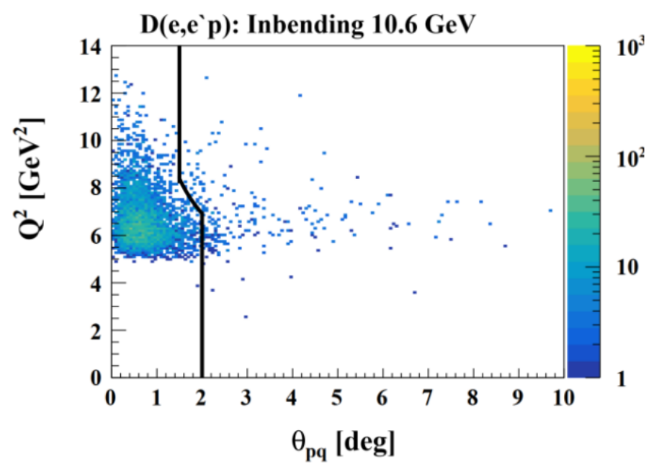
Measurement of the Neutron Magnetic Form Factor GM^{n} at High Q² Using the Ratio Method on Deuterium
L.Baashen (KSU), B.A.Raue (FIU), G.P.Gilfoyle (Richmond)
$R=\frac{d\left(e,e'n\right)p}{d\left(e,e'p\right)n}$
Goal: Extract GM^{n} at high Q² using the ratio of quasi-elastic e-n and quasi-elastic e-p events on deuterium:
=
1. The neutron magnetic form factor is a fundamental observable related to the distribution of magnetization in the neutron.
2. Figure to the left shows world’s data for GMn including anticipated results.
3. Curves show recent theoretical calculations from Gutsche et al. (PRD 97, 054011, 2018))and Miller et al. (arXiv 1912.07797 [nucl-th], 2020).
4. Considerable progress has been made. The Pass 1 extraction of GMn is complete and was the topic of L.Baashen’s doctoral thesis at Florida International University.
5. The group is now analyzing the Pass 2 data which has increased statistics and improved resolution.
6. Additional RGB run time will extend the reach in Q² and improve the statistical precision.
Acceptance Matching
1. Need to have the same solid angle Ω for e-n and e-p events.
2. Start with a good electron. Assume elastic scattering and a stationary nucleon.
3.Swim a proton and a neutron through CLAS12 and require both to hit the PCAL/ECAL.
4. Complete the analysis of the event.
Quasi-Elastic e-n and e-p Event Selection
1. Use e-n and e-p scattering angles for electron and nucleon to calculate beam energy. Require 1σ cut on result.
2. Require reaction products to lie in the same plane: |Δφ| < 1.7 deg.
3. Require θpq < 2-3 deg where θpq is the angle of the nucleon relative to the 3-momentum transfer.
θpq cut

Slide 2
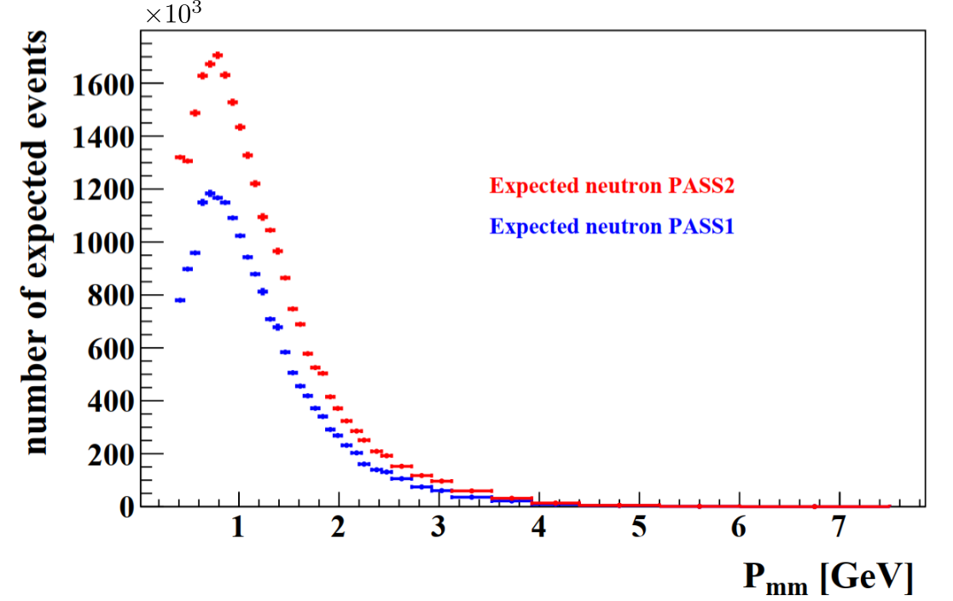
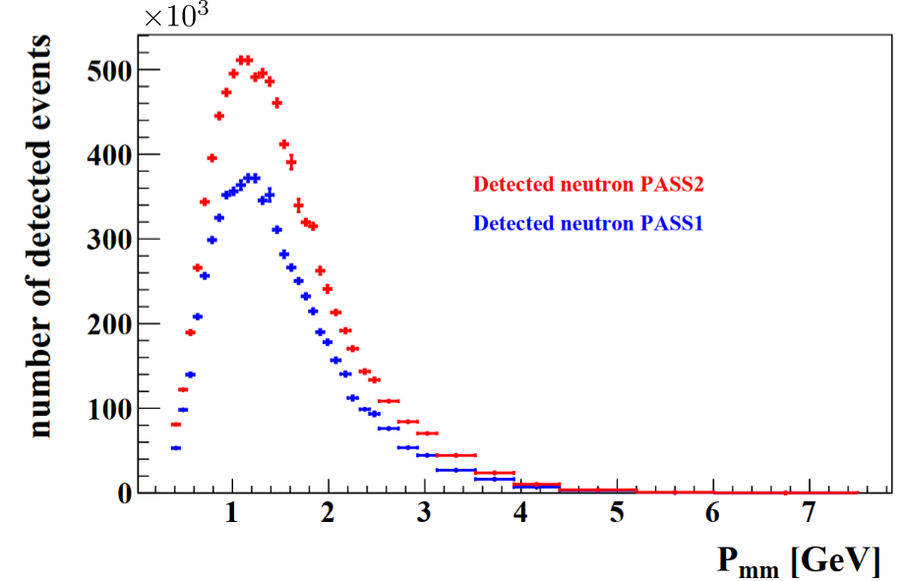
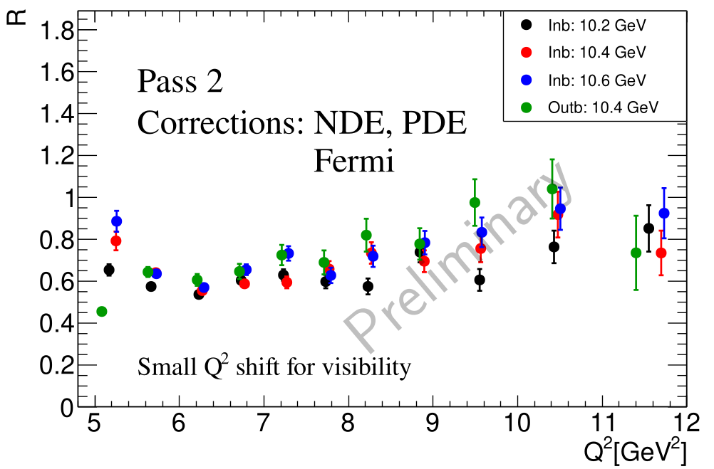
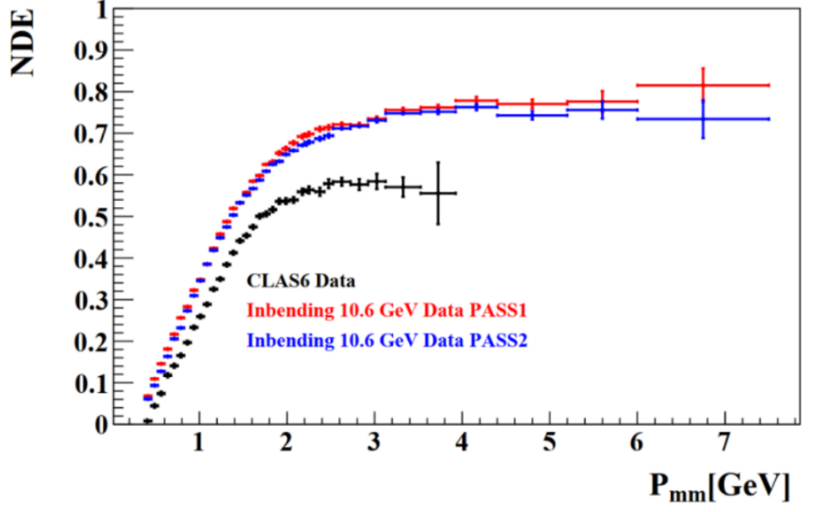
Corrections to the e-n/e-p Ratio
Measuring the neutron detection efficiency (NDE) for quasi-elastic e-n
Other Corrections
1. Proton Detection Efficiency (PDE)
2. Fermi Correction
3. Radiative Correction
4. Nuclear Correction
Corrections 1-3 above have been completed for Pass 1 and are ongoing for Pass 2. Radiative corrections are very close to one. We are working with two theorists on the nuclear correction.
1. Use ep e’π⁺n from Run Group A on LH2 target and to obtain tagged neutrons.
2. In each event require a good electron and π⁺ and then predict the neutron trajectory.
3. If the trajectory intersects the PCAL/ECAL this is an expected event. See below.
4. Search for a neutral hit near the intersection. If found, this is a detected event.
5. Note the increase in the number of Pass 2 events below compared with Pass 1.
6. The NDE is the ratio of detected events to expected ones.
Comparison of Pass 1 and Pass 2 NDE
The NDE extracted as described above for both Pass 1 and Pass 2 is shown. They agree within 2-3%. Plot shows the CLAS6 results too.

