Slide 1
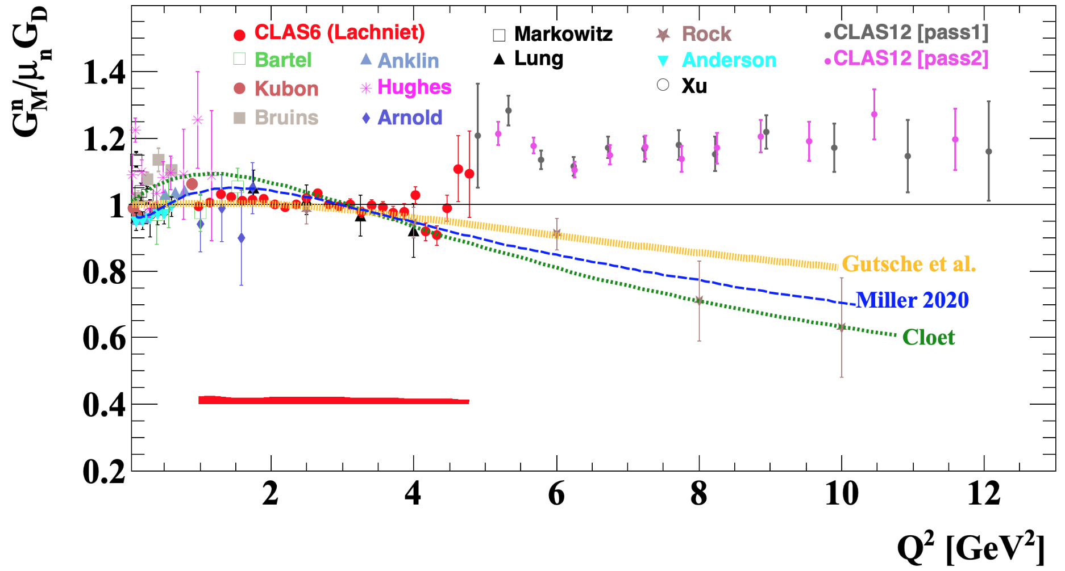
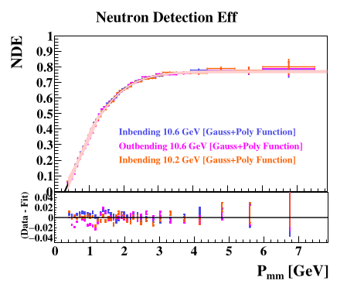
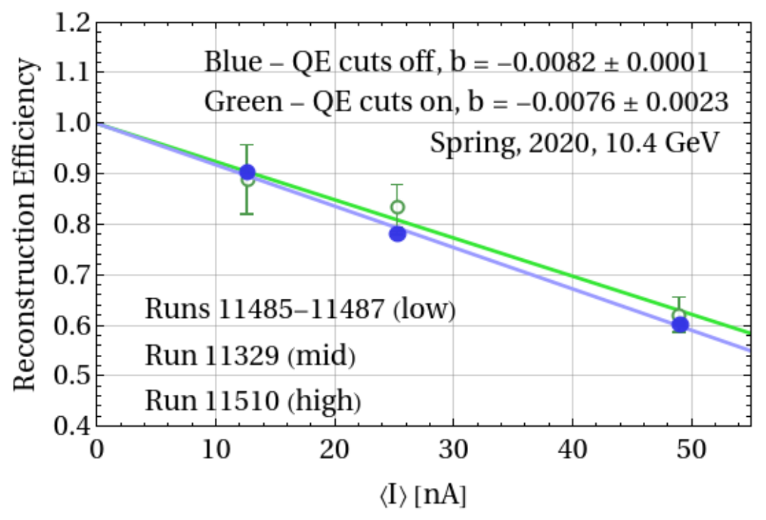
Measurement of the Neutron Magnetic Form Factor GM^{n} at High Q² Using the Ratio Method on Deuterium
L.Baashen (KSU), B.A.Raue (FIU), J.Carvajal (FIU), G.P.Gilfoyle (Richmond)
Goal: Extract GM^{n} at high Q² using the ratio of quasi-elastic e-n and quasi-elastic e-p events on deuterium.
Introduction
1. The neutron magnetic form factor is a fundamental observable related to the distribution of magnetization in the neutron.
2. The form factor is extracted from the e-n/e-p ratio.
3. Figure to the left shows world’s data for GM^{n} including preliminary CLAS12 results that still require corrections.
4. Pass 1 extraction of ratio is complete – L.Baashen’s FIU doctoral thesis.
5. Pass 2 data shows increased statistics and improved resolution.
Preliminary
Gutsche et al. (PRD 97, 054011, 2018)
Miller et al. (arXiv 1912.07797 [nucl-th], 2020)
Cloet et al. (Few-Body Syst, 46(1):1-36)
Luminosity Correction
1. The ratio of the number of ep to electron events, Nep/Ne, is normalized to unity at zero to form the reconstruction efficiency. See figure below. Also see CLAS-NOTE-2020-005 for more details.
2. Plot below shows the reconstruction efficiency for one data set for quasi-elastic (QE) events (green) and with the QE cuts turned off (blue) to increase the statistics. Slopes are consistent. Slopes for all data sets have been extracted and are consistent with each other.
3. Tests of analysis code on SIDIS data consistent with that analysis.
4. Low-luminosity data with added, high-luminosity background data are now being studied to validate the analysis.
Completed corrections to the e-n/e-p ratio R.
The e-n/e-p ratio has been corrected for nuclear effects, Fermi motion, radiative corrections, and the proton and neutron detection efficiencies.
Neutron Detection Efficiency (NDE) Method
1. NDE is the biggest ratio correction.
2. Detect a p(e,e’π⁺)Xn event and predict if the neutron strikes CLAS12 (expected neutrons). If it fails drop the event.
3. Search for neutron and, if found, include it as a detected neutron. The ratio of detected to expected forms the NDE.
4. Extract the missing mass distributions for 36 missing momentum bins in the range Pmm = 0.41-6.75 GeV.
5. Figure to the right shows the NDE for three measurements from Run Group A. Bottom panel is the residuals between the measured NDE and a parameterization.
6. Draft of CLAS12-NOTE ongoing.
Reconstruction Efficiency

