Slide 1
CLAS12 Software User Environment
Introduction: Software tasks, users, projects. Tools.
Simulation. Reconstruction. Visualization Physics Analysis. Summary.

Slide 2
Introduction - Tasks and Users
Software Categories:
Calibration (not discussed here) Simulation
Reconstruction Visualization Physics analysis
User Categories
A - environment developers. B - service developers.
C - physics users.
Focus on off-site physics users.
Access, ease-of-use, extent of use, support.

Slide 3
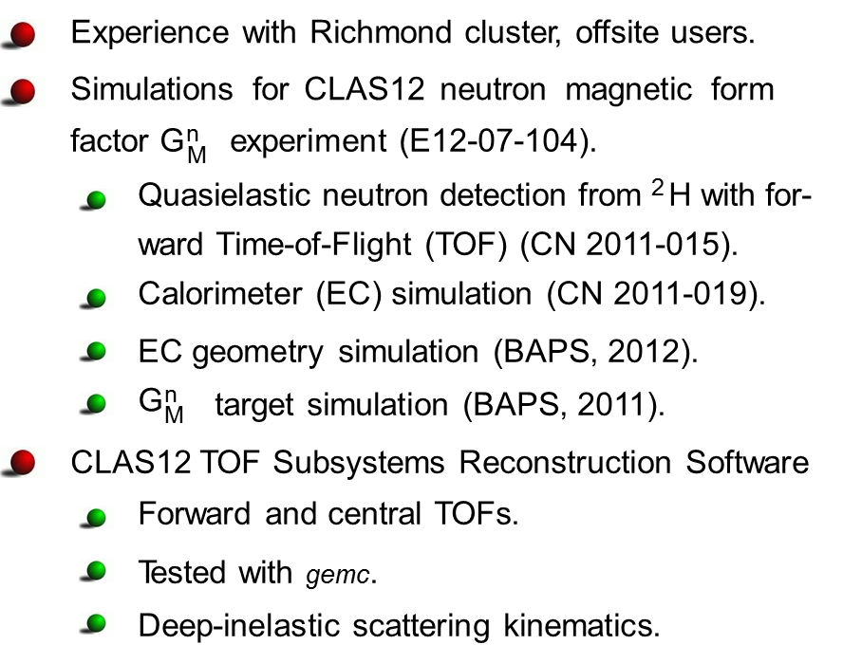
Introduction - Physics Projects
Neutron Detection Efficiency
0.14
0.12
E = 11 GeV, gemc simulation
NDE with P1B removed
0.1
0.08
0.06
0.04
Blue - gemc results Black - CLAS6
measurement
0.02
0
0 1 2 3 4 5 6 7 8 9
p (GeV/c)
n
Normalized Counts
1
CLAS12 simulation 11 GeV disgen event generator
Black filled squares - panel 1a Red open circles - panel 1b
₁₀-1
₁₀-2
₁₀-3
₁₀-4
10
-5
₁₀-6
0
2
4
6
8 10 12 14
^{N}adj

Slide 4
Software Tools
General
Package | Description | Package | Description
subversion | Version control utility | scons | software construction tool
mysql | Open source database | qt4 | widget toolkit
clhep | C++ library of utility classes for HEP | geant4 | simulation of particles passing through matter
Locally Developed
Package | Description | Package | Description
Clara | CLAS12 analysis envi- ronment | clasJLib | CLAS12 utilities - JMath, ced, cMsg
JToolbox | evio, bank handling classes, property lists | ccdb | mysql geometry and cali- bration database

Slide 5
Simulation
Event Generators pythia
local programs: disgen, ppgen, genev, ...
Use - Pythia is a mature, widely-used program. Other codes vary in ease of use. Support - Pythia well supported by Lund and CERN. Varied support for others. Single JLab staff member (H.Avakian).
CLAS12 Simulation - gemc
JLab program for CLAS12 and others.
Uses evio data format common among the halls. Use - Scripts used for building offsite -
time-consuming, but reliable.
Support - Complete web-page, bug reporting. Single JLab staff member (M. Ungaro).
See Veronique Ziegler’s talk.

Slide 6
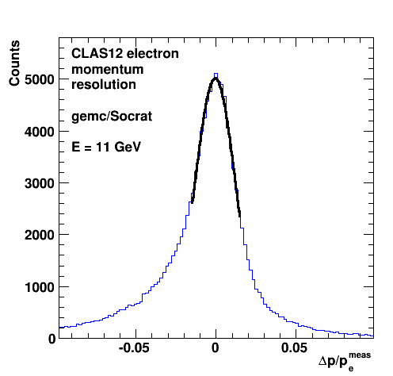
Reconstruction
Socrat (SOftware for Clas12 Reconstruction And Tracking)
Local, generation one, C++ code for electrons in
forward detector (author - Sebastien Procureur).
Use - Compiled with Root libraries (ACLiC),
complex code.
Support - CLAS-NOTE 2008-015, limited
Collaboration support.
TRAC (Track Reconstruction Application for CLAS12)
Current focus of main development effort on full CLAS12 reconstruction.
See Veronique Ziegler’s talk.
Use - Applied to other reconstruction projects - Forward tagger - R. De Vita,
Barrel Silicon Tracker - Y. Gotra.
Support - CLAS-NOTE in preparation.
Single JLab staff member (V. Ziegler).

Slide 7
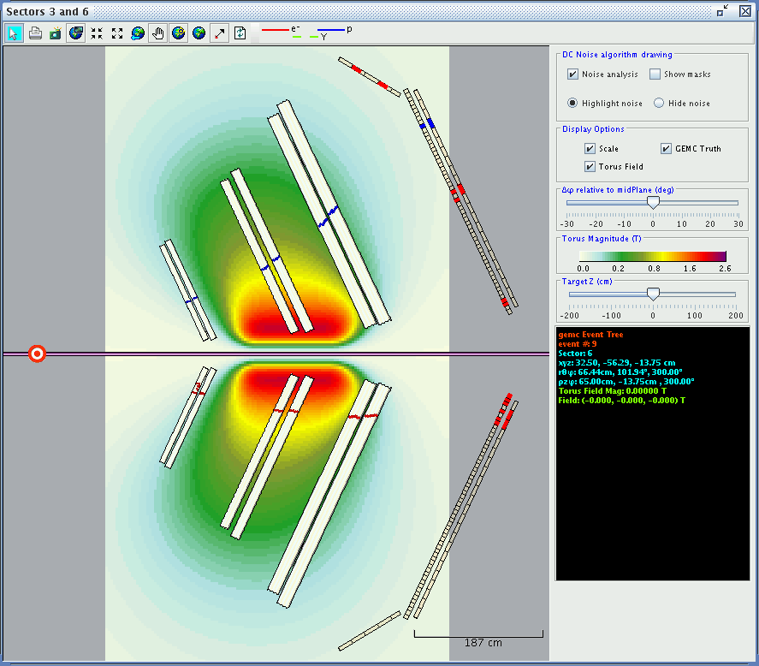
Visualization - ced12
ced12 (cLAS eVENT dISPLAY) is the 12 GeV version of the 6 GeV application.
Use - Built on top of the bCNU libraries. Easy to use. Support - Single
Collaboration member
(D.Heddle).

Slide 8
Physics Analysis
The evio data format is common to all halls.
Different groups have their own analysis codes.
evio2root
Converts evio data into root ntuples. Generation 2 version in development.
Use - Generation 1 is easy to build, but cumbersome to adapt to new banks.
Support - Generation 2 being developed by one JLab staff member (M.Ungaro).
Generation 1 no longer supported.

Slide 9
Summary
Event generators - pythia, ppgen, disgen, and other locally developed ones.
Simulation - gemc is complete, mature and in wide use. Reconstruction - generation 3 development far along.
Visualization - ced12 event display well developed and widely used.
Physics analysis - common data format among all halls with many tools under development.
Use - Many packages accessible to offsite users. TRAC just starting to spread offsite.
Support - single Collaboration or JLab staff support for each software subsystem (often the original author).

