Slide 1
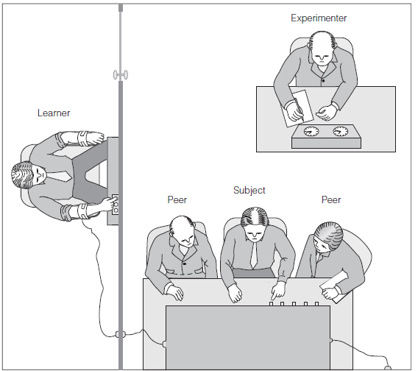
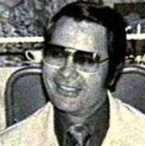
8
Power
Power is essential to group life. Authorities coordinate members’ activities and guide them toward their goals, but members exert influence in return by forming cooperative alliances. But power can be used against the group, for authorities sometimes demand actions that members would otherwise never consider. We would not be social beings if we were immune to the impact of power, but power can corrupt.
What are the limits of an authority’s power over group members?
What are the sources of power in groups?
Who seeks power and what group processes limit their success?
How do people react when they use their power to influence others?
How do those without power react when power is used to influence them?

Slide 2
Power
Obedience to Authority
Milgram Study
Power
Processes
Bases of Power
Power Tactics
Metamorphic Effects
Impact of power
Reactions to power
Power in Groups
Keltner’s
Model
Kelman’s
Model
Who seeks power?
Complementarity
Commitment
Dominance hierarchies
Roles
Agentic state

Slide 3
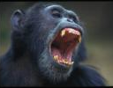
Power
Power tends to corrupt, and absolute power corrupts absolutely.
Lord Acton
Whom the gods would destroy, they first make mad with power. Charles Beard
Power is all around us, continuously confirmed and contested, and perceived with great accuracy
Frans B. M. de Waal

Slide 4
What Are the Limits of an Authority's Power over Group Members?
Which force is stronger: power or hypnosis?
Can people be compelled to act in ways they would never consider acting?
How can we explain the Holocaust?
Where does power come from?
What would happen to you if you had lunch with someone from the “Unificationist Church”.

Slide 5
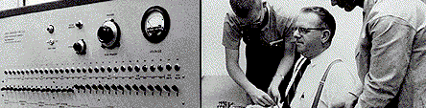
Milgram’s Studies
Rigged drawing (teacher, learner)
Shock machine
Basic condition: series of errors, pounding on the wall at 300 volts, refused to answer at 315 volts
Prods: "The experiment requires that you continue"

Slide 6
Results: 65% obedience
450
300 volts: first 5 refuse
65% obey to the end
Number of Participants Remaining at Each Shock Level

Slide 7
Variations on the theme

Slide 8
Replications and Controversies
Methodological Challenges
Ethical Challenges
Applications
Replications
Obedience on flight decks

Slide 9
Sources of Power in Groups
Obedience to Authority
Power
Processes
Bases of Power
Power Tactics
Metamorphic Effects
Power in Groups

Slide 10
French & Raven's power bases theory
Reward:
Coercive:
Legitimate:
Referent:
Expert:
Informational:
rewards given or offered
threaten or punish
sanctioned right to influence
identification, respect, and attraction
skills and abilities
access to and control of information

Slide 11
Power Tactics
Soft/hard
Collaboration, socializing, ingratiation
Bully, threaten, economic rewards
Rational/
nonrational
Reasoning, logic, persuastion
Evasion, ingratiation
Unilateral/
bilateral
Fait accompli, demands, disengagement
Discussion, negotiation

Slide 12
Power Processes
Who seeks Power?
Hierarchies of Dominance
Interpersonal complementarity hypothesis
Role demands: Zimbardo’s Stanford Prison study
Agentic state (lowered responsibility)
Behavioral commitment
Foot-in-the-door technique
Brainwashing
The fundamental attribution error (FAE) and obedience
Need for Power
Social Dominance Orientation
Cults—or, radical religious groups…..

Slide 13


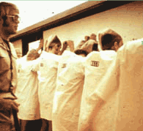

Zimbardo's Stanford Prison Study
  Basic method (Haney, Banks, & Zimbardo, 1973).
  Results: study was aborted because situation overpowered the subjects

Slide 14
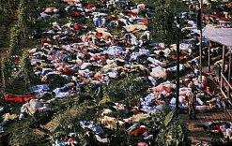

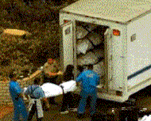
Cults
  Brainwashing? No, most change is achieved through subtle methods

Slide 15
Sources of Power in Groups
Obedience to Authority
Power
Processes
Metamorphic Effects
Impact of power
Reactions to power
Keltner’s
Model
Kelman’s
Model

Slide 16
Metamorphic Effects of Power
Keltner’s Approach-inhibition model of power
Power leads to approach behavior (positive affect, automatic processing, action)
Powerlessness leads to inhibition (negative affect, controlled processing, inaction)

Slide 17
Impact on the Powerholder
Positive Effects of Power
Proactive
Big picture focus
Negative Effects of Power
Too self-confident
Engaged
Goal focused
Positive Emotions
Seeking out rewards, resources
Changes in the perceptions of subordinates
Reliance on power to influence others
Michel’s iron law of oligarchy powerholders protect their power

Slide 18
How Do Those Without Power React When Power is Used to Influence Them?
Kelman’s three-stage model of conversion
Compliance
Identification
Internalization
Resistance to influence
Revolutionary coalitions
Reactance
Conflict and rebellion authority (the ripple effect)

Slide 19
Power
Review
Obedience to Authority
Milgram Study
Power
Processes
Bases of Power
Power Tactics
Metamorphic Effects
Impact of power
Reactions to power
Power in Groups
Keltner’s
Model
Kelman’s
Model
Who seeks power?
Complementarity
Commitment
Dominance hierarchies
Roles
Agentic state

