Slide 1
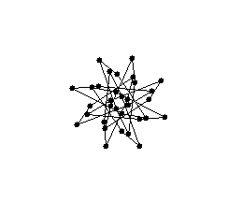
Chapter 3
Inclusion and Identity
6
Structure
Group processes are shaped by unobservable, but influential, group structures. All but the most ephemeral groups develop written and unwritten norms that dictate conduct in the group, expectations about members’ roles, and networks of connections among the members.
What is group structure?
Why do norms, both formal and informal, develop to regulate group behavior?
What kinds of roles are common in groups and how do they influence members?
How can the social structure of a group be measured?
What are status, attraction, and communication networks?

Slide 2
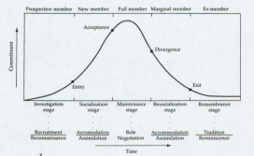
Preview
Group
Structure
Norms
Roles
Intermember
Relations
Sherif
Study
Examples
Role
Differentiation
Role
Stress
Status
Attraction
Group
Socialization
Communication
Social network
analysis

Slide 3
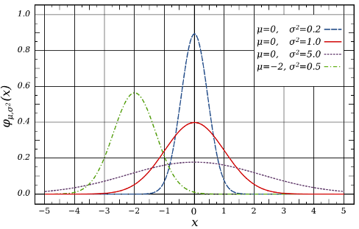
What Are Norms?
Consensual and often implicit standards that describe what behaviors should and should not be performed in a given context.

Slide 4
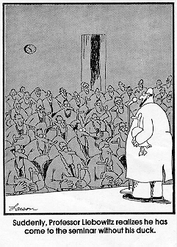
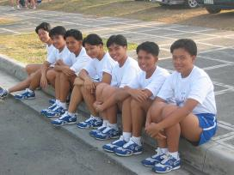
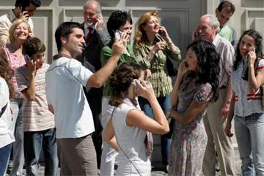
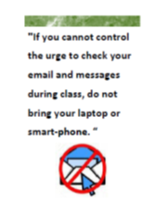
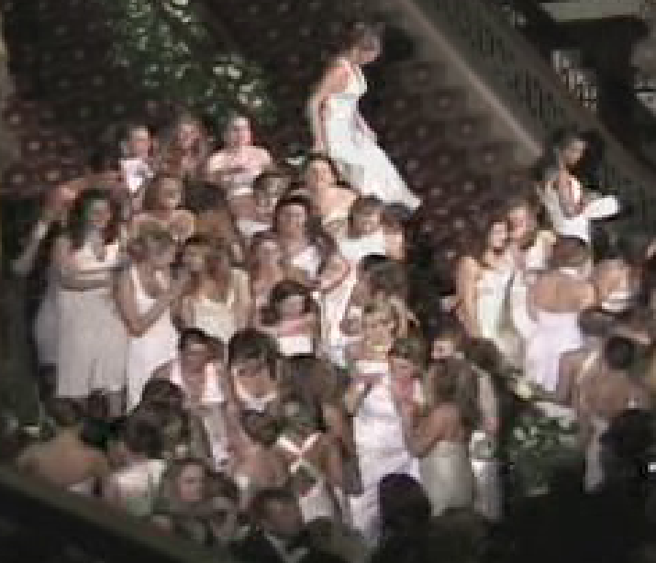
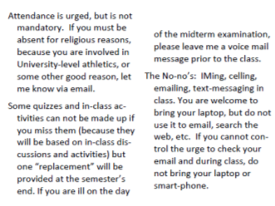
Examples
Everyday activities, such as fashion, etiquette, “normal” activities

Slide 5

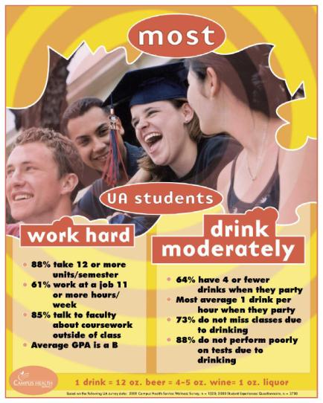

Examples
Health-related behaviors (social norm marketing)

Slide 6
Acceptable reasons for missing a class
Excuse | Students who approve | Faculty who approve
Funeral | 94% | 100%
I had financial problems to take care of | 64% | 25%
I got held up in a meeting | 73% | 35%
I had a sore throat | 29% | 50%
I had plane reservations for that day | 65% | 5%
My roommate had problems with his/her boyfriend/girlfriend | 9% | 22%
Alarm did not go off | 41% | 10%
I went on vacation | 44% | 0%

Slide 7
Nature of Norms
Feature | Description
Descriptive | describe how most members act, feel, and think
Consensual | shared among group members, rather than personal, idiosyncratic beliefs
Injunctive (or normative) | define which behaviors are "bad" or "wrong" and which are "good" or "acceptable"
Prescriptive | set the standards for expected behaviors
Proscriptive | identify behaviors that should not be performed
Informal | describe the unwritten rules of conduct in the group
Implicit | often so taken for granted members follow them automatically
Self-generating | emerge as members reach a consensus through reciprocal influence
Stable | once they develop, resistant to change and passed from current members to new members

Slide 8

Development of Norms
Sherif's (1936) autokinetic effect studies
Judged distance a dot of light moved in a darkened room

Slide 9
Autokinetic Effect
It moved about
3.5 inches
A stationary dot of light will seem to move

Slide 10
What if people make their judgments with others, and state estimates aloud?
Looks like 1 inch
I’d say 2 inches
7.5 inches

Slide 11
Birth of a NORM!
Initially, they differ; but over trials, they converge
Person A
Convergence
Average distance
estimates
Person B
Person C
Alone
Group
Session 1
Group
Session 2
Group
Session 3

Slide 12
Do norms take on a life of the own?
Feature | Description
Descriptive | describe how most members act, feel, and think
Consensual | shared among group members, rather than personal, idiosyncratic beliefs
Injunctive (or normative) | define which behaviors are "bad" or "wrong" and which are "good" or "acceptable"
Prescriptive | set the standards for expected behaviors
Proscriptive | identify behaviors that should not be performed
Informal | describe the unwritten rules of conduct in the group
Implicit | often so taken for granted members follow them automatically
Self-generating | emerge as members reach a consensus through reciprocal influence
Stable | once they develop, resistant to change and passed from current members to new members

Slide 13
When Sherif put in a confederate in some groups who made exaggerated distance judgments others (B, C) conformed
X
Confederate
Average distance
estimates
Person B
Person C
New Member, Person F
Alone
Group
Session 1
Group
Session 2
Group
Session 3

Slide 14
Person B
Person C
Average distance
estimates
Person D
Group
Session 4
Group
Session 1
Group
Session 2
Group
Session 3
Even when the confederate was replaced, the norm remained
New
member

Slide 15
Person C
Person D
Average distance
estimates
Person F
Group
Session 4
Group
Session 1
Group
Session 2
Group
Session 3
The exaggerated norm lasted for many “generations” of replacements

Slide 16
Group
Structure
Norms
Roles
Intermember
Relations
Sherif
Study
Examples
Role
Differentiation
Role
Stress
Status
Attraction
Group
Socialization
Communication
Social network
analysis

Slide 17
What Are Roles?
Roles: The types of behaviors expected of individuals who occupy particular positions within the group (e.g., roles in a play)
  Independent of individuals
  Flexible, to an extent
  Structure interaction, create patterns of action
Examples:

Slide 18
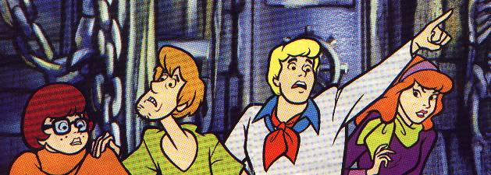
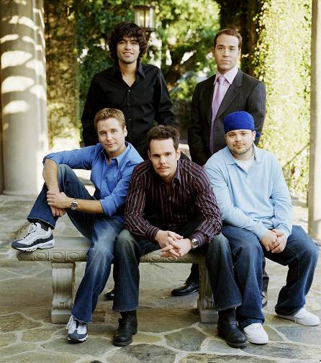


Slide 19
Role differentiation
The emergence and patterning of role-related actions
  Roles tend to become specialized over time
  Task and relationship role demands tend to be incompatible with one another
Task Roles
Relationship Roles

Slide 20
Task Roles
Initiator/contributor: Recommends novel ideas about the problem at hand, new ways to approach the problem, or possible solutions not yet considered
Information seeker: Emphasizes getting the facts by calling for background information from others
Opinion seeker: Asks for more qualitative types of data, such as attitudes, values, and feelings
Information giver: Provides data for forming decisions, including facts that derive from expertise
Opinion giver: Provides opinions, values, and feelings
Elaborator: Gives additional information examples, rephrases
Coordinator: Shows the relevance of each idea and its relationship to the topic
Orienter: Refocuses discussion on the topic whenever necessary
Evaluator/critic: Appraises the quality of the group’s methods, logic, and results
Energizer: Stimulates the group to continue working when discussion flags
Procedural technician: Cares for operational details, such as materials, machinery, and so on
Recorder: Takes notes and maintains records

Slide 21
Relationship Roles
 | Encourager: Rewards others through agreement, warmth, and praise
 | Harmonizer: Mediates conflicts among group members
 | Compromiser: Shifts his or her own position on an issue in order to reduce conflict in the group
 | Gatekeeper/expediter: Smooths communication by setting up procedures and ensuring equal participation from members
 | Standard setter: Expresses or calls for discussion of standards for evaluating the quality of the group process
 | Group observer/commentator: Points out the positive and negative aspects of the group’s dynamics and calls for change if necessary
 | Follower: Accepts the ideas offered by others and serves as an audience for the group

Slide 22
Individualistic Roles
Aggressor: Expresses disapproval of acts, ideas, and feelings of others; attacks the group
Blocker: Negativistic; resists the group’s influence; opposes the group unnecessarily
Dominator: Asserts authority or superiority; manipulative
Evader/self-confessor: Expresses personal interests, feelings, and opinions unrelated to group goals
Help seeker: Expresses insecurity, confusion, and self-deprecation
Recognition: seeker Calls attention to him- or herself; self-aggrandizing
Playboy/girl: Uninvolved in the group; cynical, nonchalant
Special-interest pleader: Remains apart from the group by acting as representative of another social group or category
Return

Slide 23
Group Socialization
Moreland and Levine's group socialization theory
  Mutual: both individual and group change
  Key variables: time and commitment
  Key concepts: types of members, stages, processes, transition points

Slide 24
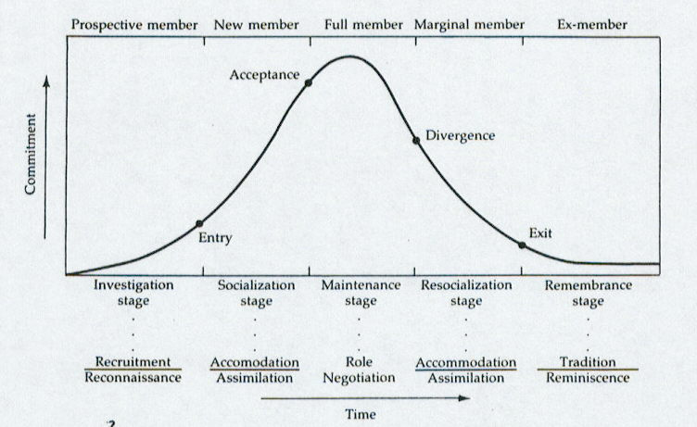
Group Socialization: Moreland & Levine
Types
Transitions
Stages
Processes

Slide 25
Member B
Member A
Member C

Slide 26
Roles Stress
  Role ambiguity: Unclear expectations for role occupant and/or perceivers
  Role conflict: inconsistencies
  interrole conflict
  intrarole conflict
  Role fit: person-role incongruities

Slide 27
Group
Structure
Norms
Roles
Intermember
Relations
Sherif
Study
Examples
Role
Differentiation
Role
Stress
Status
Attraction
Group
Socialization
Communication
Social network
analysis

Slide 28
Status Networks
Status network: Stable pattern of variations in authority and power

Slide 29
1
2
3
7
4
6
5

Slide 30
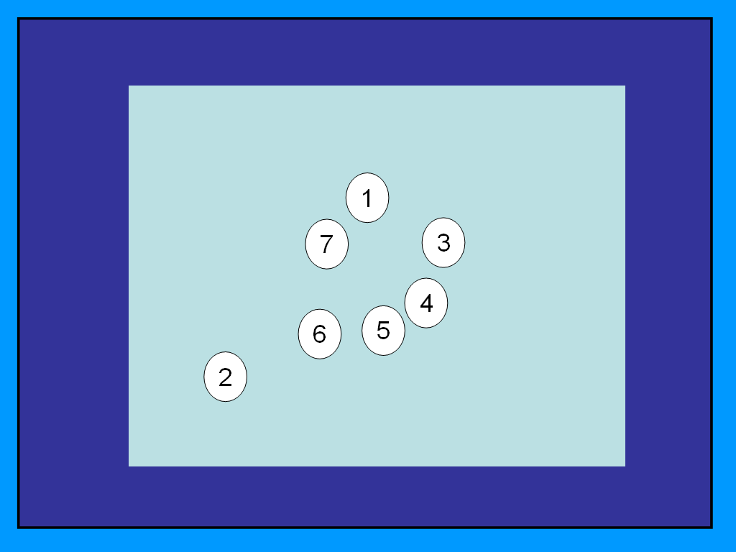

Slide 31
Status differentiation
  Competition for status (pecking orders)
  Perceptions of status
  Expectation-states theory: diffuse and specific status characteristics

Slide 32
Status Generalization
Status generalization: when irrelevant characteristics influence status allocation
  Minorities, solos denied status
  Online groups and the status equalization effect

Slide 33
Attraction Networks
1
1
7
7
3
3
2
4
4
6
5
6
5
2
Status
Attraction
Attraction network (sociometric structure): Stable patterns of liking-disliking

Slide 34
Sociometric differentiation
Types of group members: stars, rejected, neglected
Features: reciprocity, transitivity, homophily (clusters)
Heider's balance theory: likes and dislikes are balanced
A
A
A
+
+
-
+
+
-
B
C
B
C
B
C
+
+
-

Slide 35
Communication Networks
1
1
7
7
3
3
2
2
4
4
6
6
5
5
Attraction
Communication
Communication network: formal and informal paths that define who speaks to whom most frequently

Slide 36
Centralization
  Centralized vs. uncentralized
7
1
7
3
3
1
2
2
4
4
6
6
5
5
Centralized
De-centralized

Slide 37
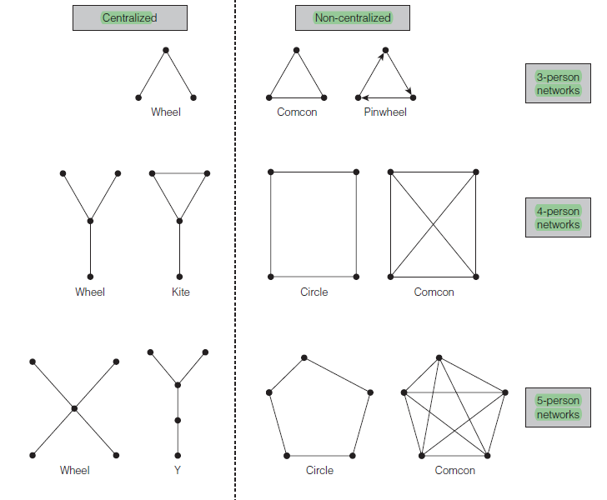
Communication Networks

Slide 38
Communication and Performance
Network and location in the network influences many processes
  Information saturation: centralized networks are most efficient unless information overload
  Individuals who occupy more central positions are more influential (and more satisfied) than those located at the periphery.
  Hierarchical networks and information flow: More information flows downward and unrealistically positive information flows upward

Slide 39
Social Network Analysis
Creating spatial maps of groups based on structure
Clique 2
Clique 1

Slide 40
Social Network Analysis
Creating spatial maps of groups based on structure
5
Subgroup A
4
6
8
3
9
7
10
2
11
Subgroup B
1

Slide 41

Key Terms
5
Subgroup A
4
6
8
3
9
7
10
2
11
Subgroup B
1
Nodes
Ties (directed) Density
Degree centrality
Outdegree
Indegree
Betweenness
Closeness
19
12
20
18
13
17
Subgroup C
14
16
15

Slide 42
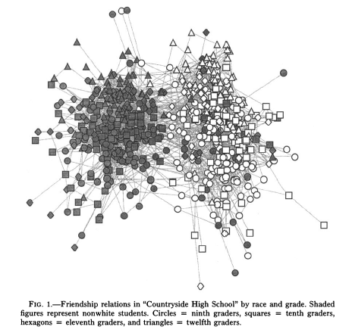
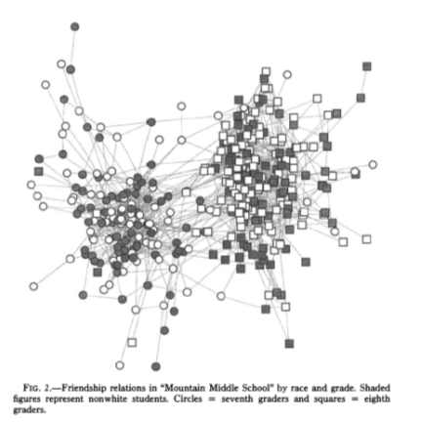
Example: Schools

Slide 43
Example: Schools

Slide 44
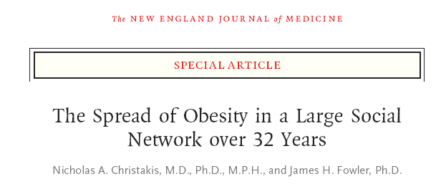
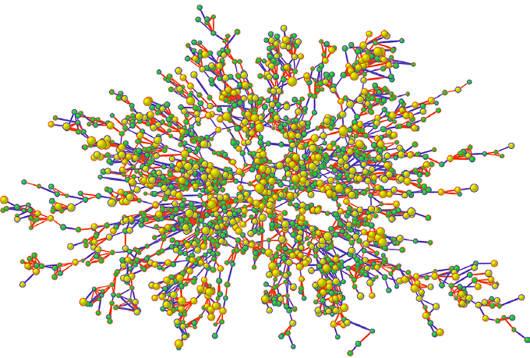
http://content.nejm.org/content/vol357/issue4/images/data/370/DC2/NEJM_Christakis_370v1.swf

Slide 45
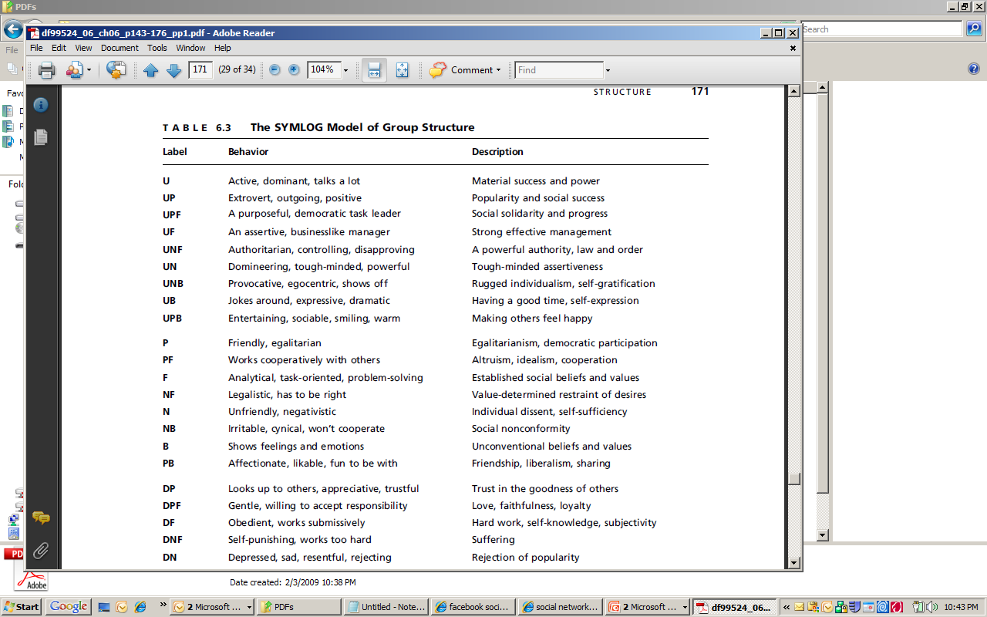
SYMLOG
Dominance-submission (Up/Down)
Positive-Negative
Acceptance of task oriented authority
(Forward-backward)

Slide 46
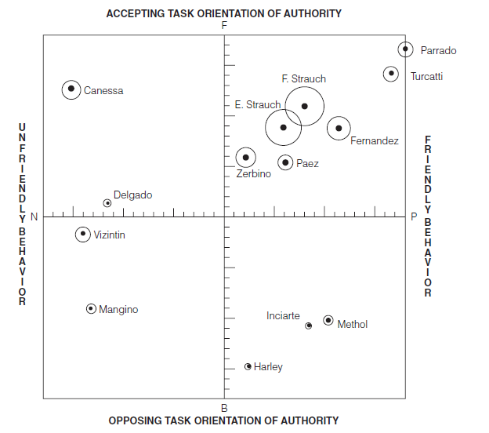
Example SYMLOG

Slide 47
Review
Group
Structure
Norms
Roles
Intermember
Relations
Sherif
Study
Examples
Role
Differentiation
Role
Stress
Status
Attraction
Group
Socialization
Communication
Social network
analysis

