Slide 1
Chapter 5 Cohesion and Development
Groups, like all living things, develop over time. The group may begin as a collection of strangers, but uncertainty gives way to cohesion as members become bound to their group by strong social forces. Cohesion, though, is not just group unity or the friendliness of members, but a multifaceted process that influences a wide range of interpersonal and intragroup processes. As cohesion and commitment ebb and flow with time, the group’s influence over its members rises and falls.
What is group cohesion?
Why do some groups, but not others, become cohesive?
How does cohesion develop over time?
What are the positive and negative consequences of cohesion?

Slide 2
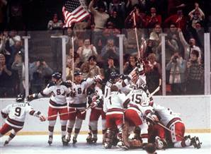
Topics
Rights: Associated Press

Slide 3
The Nature of Cohesion
“The total field of forces which act on members to remain in the group”
Festinger, Schachter, & Back, 1950, p. 164
Multicomponent-multilevel model
Multiple
Components
(attraction, unity, etc.)
Multiple
Levels
(individual, group, etc.)

Slide 4
Components of Cohesion
Components
Levels
Social Cohesion
Task Cohesion
Perceived Cohesion
Emotional Cohesion
Attraction
between
members
Attraction
to the
group-as-a-whole

Slide 5
Components of Cohesion
Components
Levels
Social Cohesion
Task Cohesion
Perceived Cohesion
Emotional Cohesion
Teamwork
Self-efficacy
Collective efficacy

Slide 6
Components of Cohesion
Components
Levels
Social Cohesion
Task Cohesion
Perceived Cohesion
Emotional Cohesion
Group Unity
Belonging (part of the group)

Slide 7
Components of Cohesion
Components
Levels
Social Cohesion
Task Cohesion
Perceived Cohesion
Emotional Cohesion

Slide 8
Antecedents of Cohesion
Interpersonal attraction
Stability of membership
Group size

Slide 9
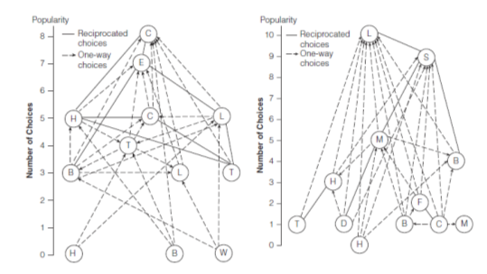
Antecedents of Cohesion
Interpersonal attraction
Stability of membership
Group size
Structural features
Initiations

Slide 10
Bulldogs
Red Devils
Sherif & Sherif, 1953, 1956

Slide 11
Initiations: Hazing
Hazing, or severe initiations, can increase members’ commitment to the group
Festinger, Schachter’s and Back’s classic study of the “Seekers” suggested initiations create dissonance
Aronson and Mill’s study of severe initiations
Alternative interpretations and the dangers of hazing

Slide 12
Initiations: Hazing
Hazing, or severe initiations, can increase members’ commitment to the group
Festinger, Schachter’s and Back’s classic study of the “Seekers” suggested initiations create dissonance
Aronson and Mill’s study of severe initiations
Alternative interpretations and the dangers of hazing

Slide 13
Group Development
Tuckman’s 5 stage model of group developlment
Forming
Storming
Norming
Performing
Adjourning
Performing
Norming
Task
Storming
Adjourning
Forming
Source: Forsyth, 2010

Slide 14
Stage | Major Processes | Characteristics
Orientation: Forming | Members become familiar with each other and the group; dependency and inclusion issues; acceptance of leader and group consensus | Communications are tentative, polite; concern for ambiguity, group’s goals; leader is active; members are compliant
Conflict: Storming | Disagreement over procedures; expression of dissatisfaction; tension among members; antagonism toward leader | Criticism of ideas; poor attendance; hostility; polarization and coalition formation
Structure: Norming | Growth of cohesiveness and unity; establishment of roles, standards, and relationships; increased trust, communication | Agreement on procedures; reduction in role ambiguity; increased “we-feeling”
Work: Performing | Goal achievement; high task-orientation; emphasis on performance and production | Decision making; problem solving; mutual cooperation
Dissolution: Adjourning | Termination of roles; completion of tasks; reduction of dependency | Disintegration and withdrawal; increased independence and emotionality; regret
Source: Forsyth, 2010

Slide 15
Cyclical vs. Stage Models
Tuckman: A successive stage model
Bale’s Equilibrium model: a cyclical model
Punctuated equilibrium model
Task Orientation
Relationship Orientation

Slide 16
Consequences of Cohesion
Positive Consequences
Problematic Consequences
Enhanced member satisfaction
Reduced tension, stress
Higher group engagement
Reduced turnover
Longer duration of membership
Intensification of emotional and social processes
Increased influence, pressure
Hostility
Groupthink
What about productivity?

Slide 17
Do Cohesive Groups Outperform Less Cohesive Groups?
Sources: Mullen & Copper, 1994; Beal et al., 2003; Gully et al., 1995
.51
Social cohesion
.17
.,17
Cohesion
.25
Performance
Unity
(Group Pride)
.24
.24
Task Cohesion (teamwork)
.25
Task Interdependence
Norms are also critically important

Slide 18
Studies suggest that the productivity of cohesive groups depends on the norms of that group: if the group norms do not support hard work, then cohesive groups will be strikingly unproductive!
Groups with norms that stress productivity
P r o d u c t i v i t y
Groups with norms that stress low productivity
Low Cohesion
High Cohesion

Slide 19
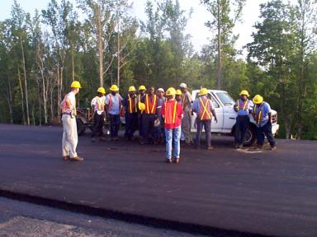
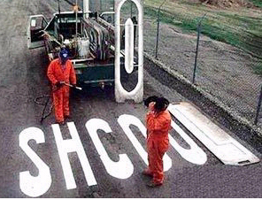
In Sum….

