Slide 1
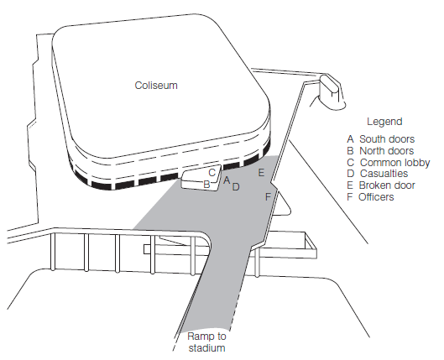
17 Crowds and Collective Behavior
The science of group dynamics is based on one core assumption: People act collectively. Much of this collective action occurs in relatively small groups, but people sometimes join larger collectives,
including crowds, mobs, audiences,
fads, crazes, and social movements.
For well over a century, most theorists and researchers have assumed that crowds are unique social aggregations, but collectives are, at their core, groups.
What is collective behavior?
What theories explain collective behavior?
How different are collectives from other types of groups?

Slide 2
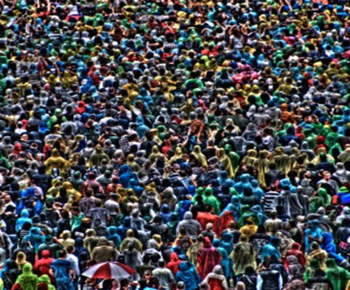

Slide 3
Preview
Crowds and Collectives
The Nature of Collectives
Collective Dynamics
Collectives are groups
Myth of the Madding Crowd
Definitions
Crowds
Contagion
Convergence
Deindividuation
Studying groups
Movements
Emergent norms
Social identity

Slide 4
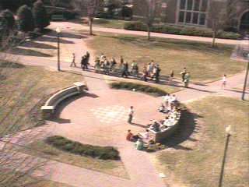
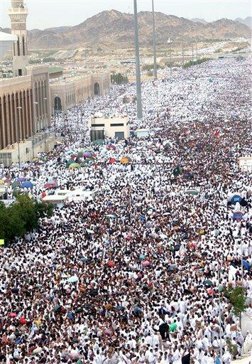
What is Collective Behavior?
Hajj to Mecca
Collectives: Relatively large aggregations of individuals who display similarities in action and outlook.
Examples…………..
Queue: Naashon Schalk/AP

Slide 5
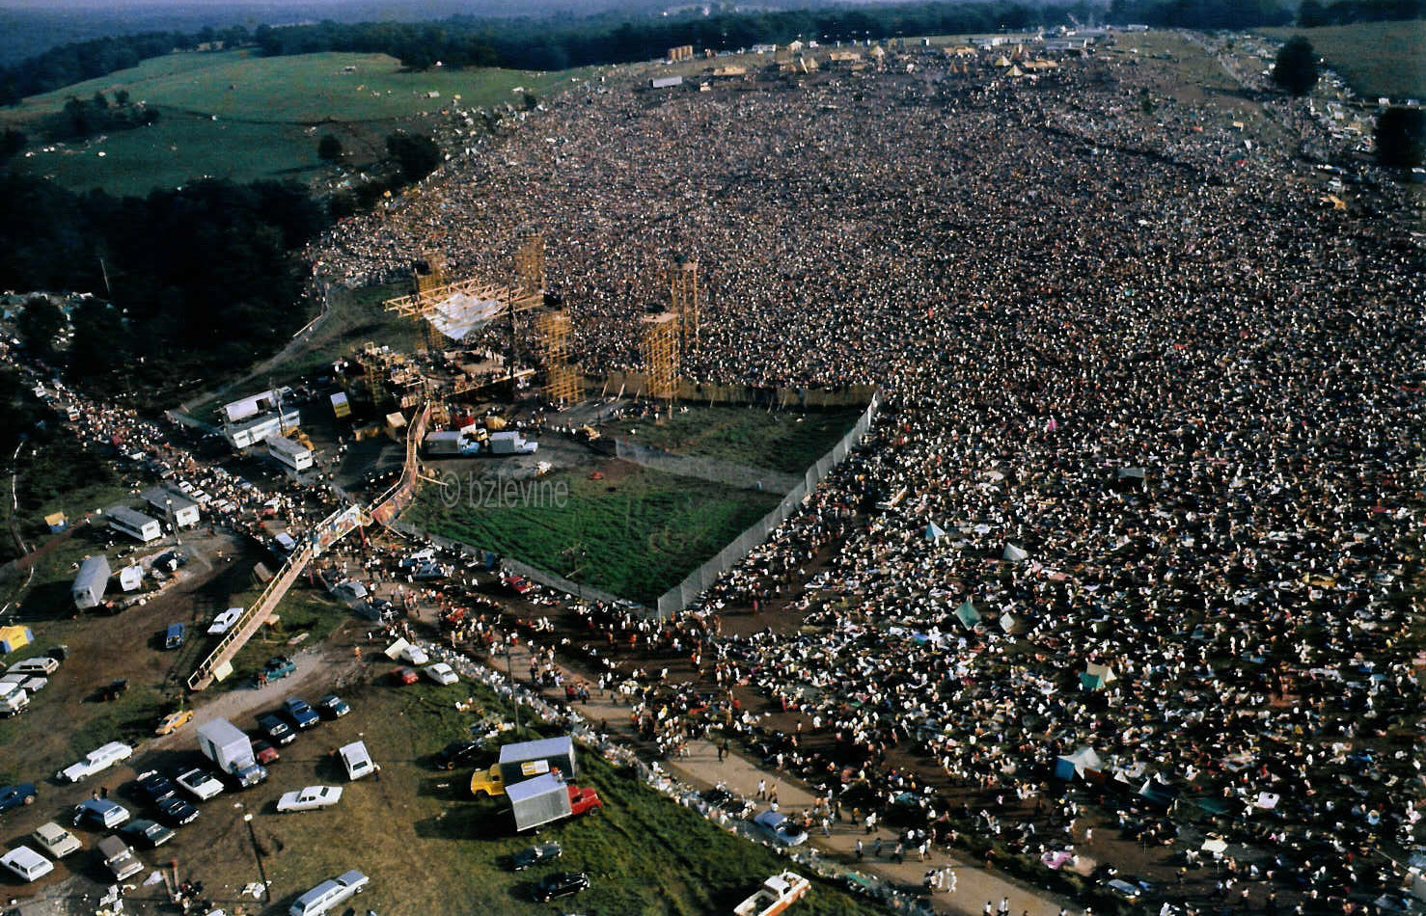
Woodstock

Slide 6
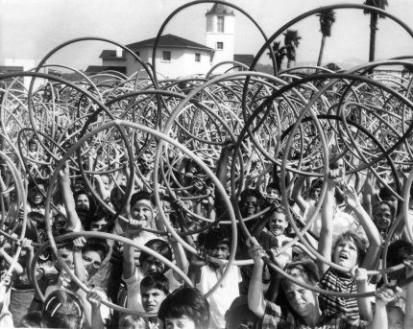
Characteristics of Collectives
Size: large rather than small
Proximity: together or disbursed
Duration: form and disband rapidly (but not always)
Conventionality: sometimes members’ actions are atypical, unconventional, or aberrant
Relationships among members: weak associations rather than cohesive
Hula Hoops in US Fads

Slide 7
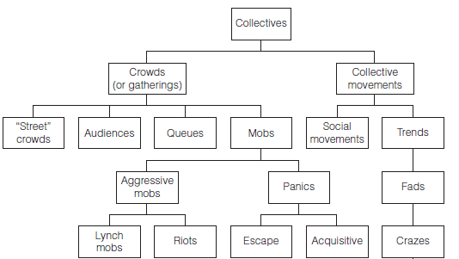
Forms of Collective Behavior

Slide 8
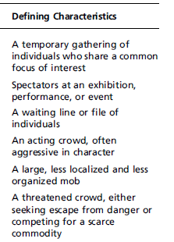
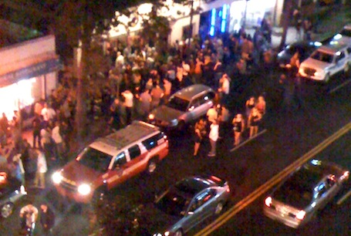
Crowds
Common crowds: street crowds or public gatherings, audiences, queues
formation processes and crowd crystals

Slide 9
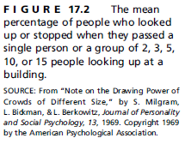
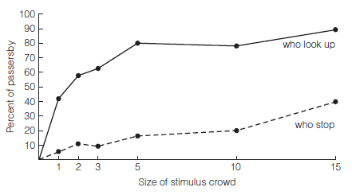
Milgram’s Study of Crowd Formation

Slide 10
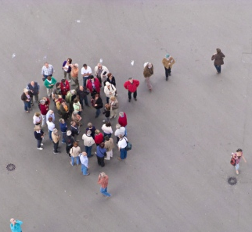
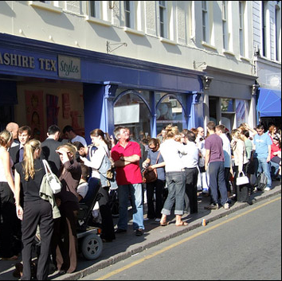
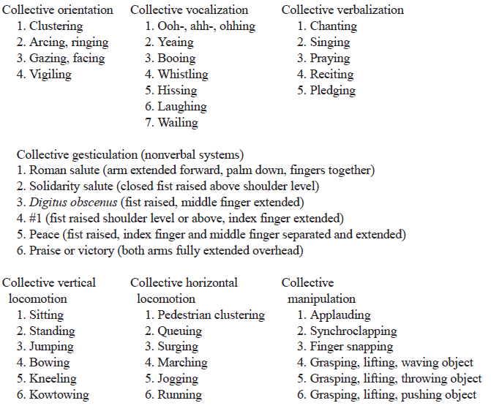
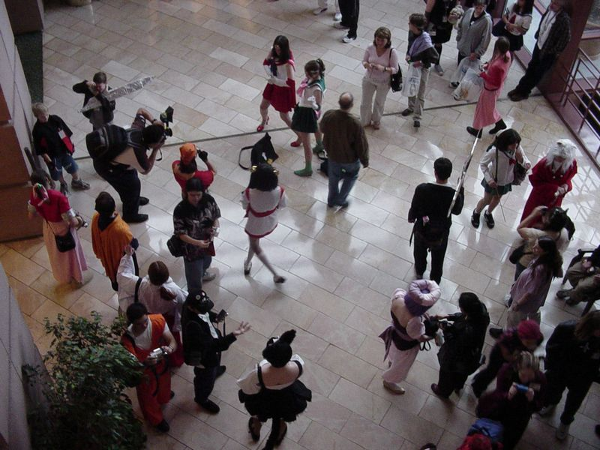
Studying Crowds
McPhail, Schweingrube, & Turner’s observation system

Slide 11
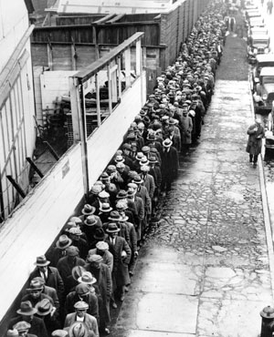
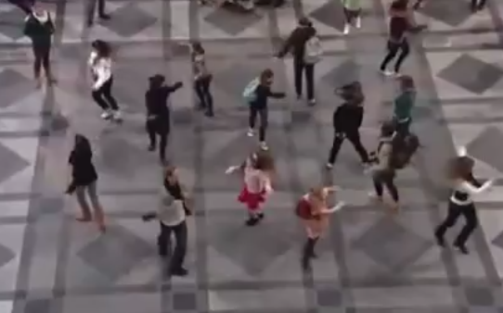
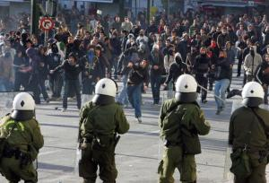
Queues, Mobs, Panics
Queues
shapes of lines and electronic queues
Milgram’s studies of linebreaking
Mobs
lynch mobs
hooliganism
riots
flash
Panics
escape
acquisition
Sound of Music Flash Mob
http://oddculture.com/weird-news-stories/black-friday-mob-history/

Slide 12
Collective Movements
Rumors as collective processes
Mass hysteria
The War of the Worlds broadcast
Psychogenic illness

Slide 13
Trends, Social Movements
Trends
Fads
Social Movements
Reformist
Crazes
Trends (fashion, etc.)
Revolutionary
Reactionary
Communitarian

Slide 14
Collective Dynamics
Contagion Theories
Deindi-viduation Theory
Emergent
Norm Theories
Social Identity Theory

Slide 15
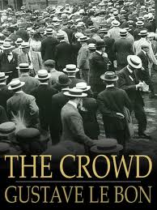
Contagion
Le Bon’s crowd psychology
Contagion: The spread of behaviors, attitudes, and affect through social collectives
Gladwell’s Tipping point analysis of social trends as contagious
connectors
mavens
salespeople

Slide 16
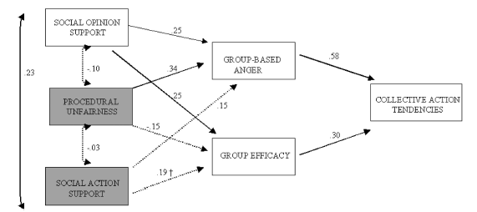
Convergence Theory
“Every man has a mob self and an individual self, in varying proportions”
D. H. Lawrence
Similarities among those who join crowds and collectives
Relative deprivation: people whose attainments fall below their expectations are more likely to join social movements.
van Zomeren et al., 2004

Slide 17
Zimbardo’s deindividuation theory
Conditions of Deindividuation
Anonymity
State of Deindividuation
Loss of self-awareness
↓
Loss of self-regulation
1. Low self-monitoring
2. Failure of normative control
3. Decline in self-generated reinforcements
4. Failure to form long-range plans
Deindividuated Behaviors
Behavior is emotional, impulsive, irrational, regressive, with high intensity
Responsibility
Group membership
Others (overload, drug usage, chanting)
1. Not under stimulus control
2. Counternormative
3. Pleasurable

Slide 18
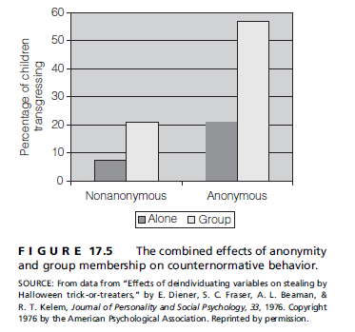
Zimbardo’s deindividuation theory
reduced responsibility (diffusion of responsibility)
membership in large groups
heightened state of physiological arousal

Slide 19
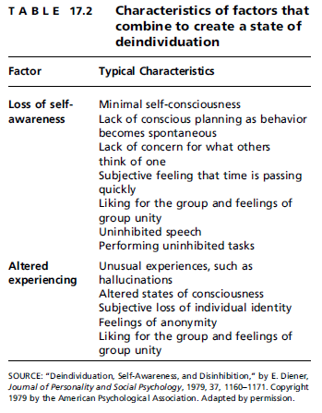
The Deindividuated State
Research suggests that the deindividuated state has two basic components:
reduced self‑awareness (minimal self‑consciousness, etc.)
altered experience (disturbances in concentration and judgment, etc.)
Support for this model is limited

Slide 20
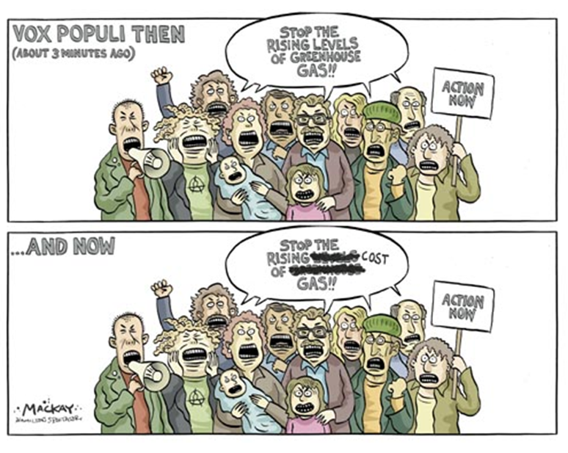
Emergent Norm Theory
Turning the strange into the normal
Turner and Killian’s emergent norm theory
Crowds often develop unique standards for behavior and that these atypical norms exert a powerful influence on behavior.
Example: Baiting Crowds

Slide 21
Social Identity Theory
Collective behavior is sustained by identity processes
collectives sustain rather than undermine individuals’ identities
ingroup/outgroup processes increase self-categorization
individuation: collective behavior in some cases represents an attempt to reestablish a sense of individuality

Slide 22
Conclusions about Collectives
The “crowd‑as‑mad” assumption: Collectives differ from more routine groups in kind rather than in degree
This view of collectives is questionable: Like groups in general, collectives are often misunderstood and mismanaged

Slide 23
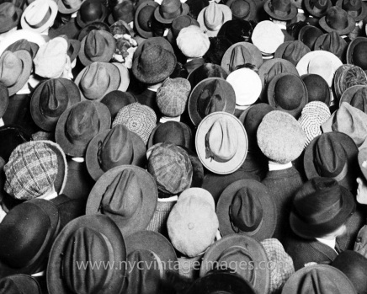
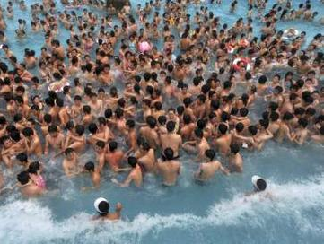
Review
Crowds and Collectives
The Nature of Collectives
Collective Dynamics
Collectives are groups
Myth of the Madding Crowd
Definitions
Crowds
Contagion
Convergence
Deindividuation
Studying groups
Movements
Emergent norms
Social identity

