Slide 1
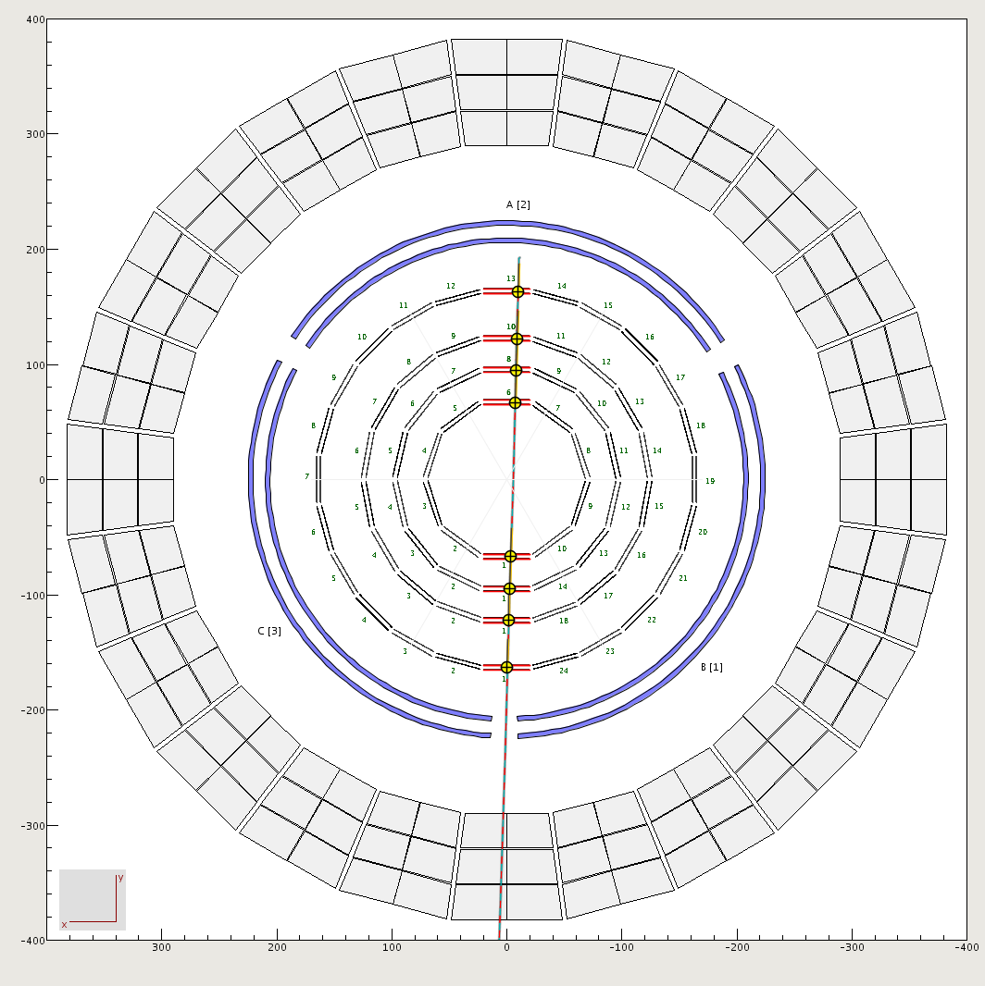
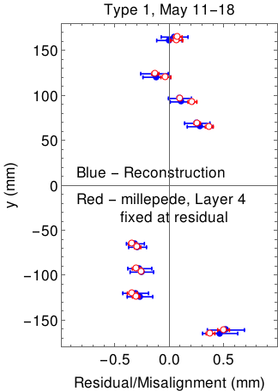
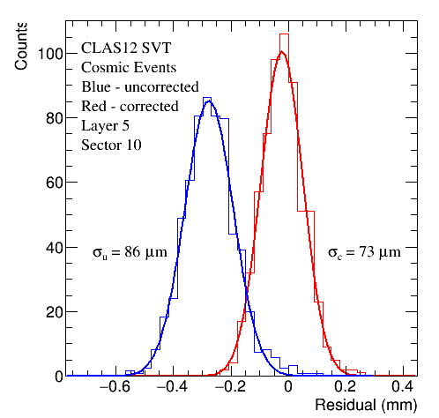
Alignment of the Silicon Vertex Tracker (SVT)
Track-based alignment of SVT requires fitting many parameters: N_{sectors} x N_{layers} x N_{trans} x N_{rot} = 66 x 2 x 3 x 2 = 792
Program millepede does linear least squares with many parameters.
Uses matrix form of least squares method and divide the elements into two classes.
Global parameters – the geometry misalignments. Same in all events.
Local – individual track fit parameters. Change event-to-event.
Calculate first partial derivatives of the fit residuals with respect to the
local (i.e. fit) parameters and global parameters (geometry misalignments).
Manipulate the linear least squares matrix to isolate the global parameters
(geometry) and invert the results to obtain the solution.
Type 1 tracks – sensors are horizontal.
Apply to a ‘simple’ example – Type 1 tracks.
Use gemc cosmics for testing and validation.
Shift layers 1-2 (Region 1) by 2-500 microns in x.
millepede reproduces all shifts.
Apply to Type-1 cosmic ray sample from SVT.
5.9M events collected May 11-18.
Fixed layer 4 in millipede fit to SVT residual.
Good agreement between millipede mis-
alignment and residuals.
Fit residual and resolution improve.
Analysis chain for full set of events complete.
First millipede fits obtained.
Testing on Type 1 events now.

Slide 2
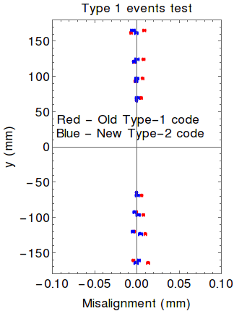
Ideal Geometry Validated – less than 3μm difference between engineering drawings and ideal geometry.
Geometry package
Common Java utility for
gemc and reconstruction.
Full inventory of material
in SVT plus survey data.
CLAS-NOTE 2017-008.
Contributors
Sereres Johnston – ANL postdoc, see summary below.
Charles Platt – University of Surrey masters student.
Type-2 Events
Include non-horizontal modules.
Type-2 code written and tested first with type-1 events.
Using gemc.4a.2.0/coatjava.7.5.
For ideal geometry, misalignments < 5 μm as expected.
Testing with full-fledged type-2 events reveals some
issues with the reconstruction - under investigation.

