Slide 1
Hall B:User Software Contributions
Gerard Gilfoyle
University of Richmond
Internal Software Review Jefferson Lab
November 6-7, 2014

Slide 2
Goals and Outline
Committee Charge - 1.c
Are users engaged at a sufficient level to demonstrate usability and readiness from a user’s perspective?
Has the CLAS Collaboration identified appropriate mechanisms to support utilization of the software by the entire collaboration?
Is the level of user documentation appropriate for this point in time?
Outline of talk
Example of user software development:
TOF reconstruction software
detectors, methods, results, and status.
User experience: developers, projects, workflow.
Connection with committee charge.
page 2

Slide 3
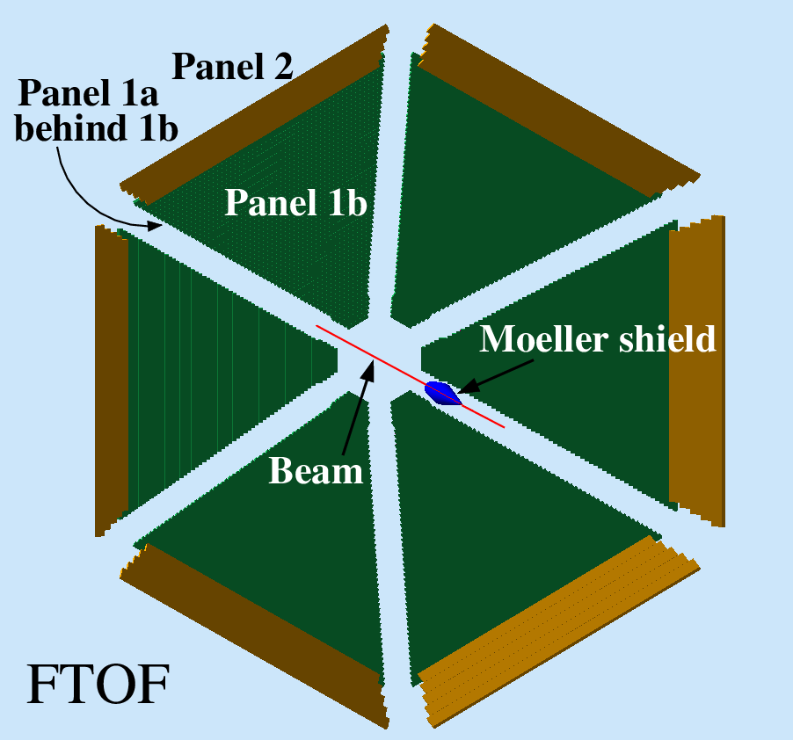
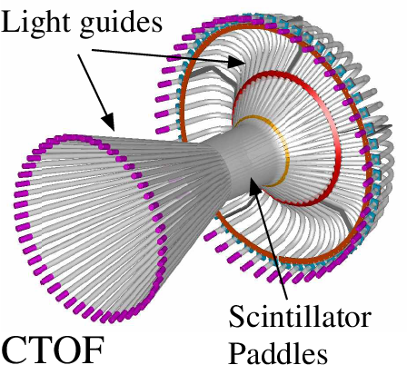
TOF Reconstruction
Forward Time-of-Flight (FTOF)
6 sectors, double-sided PMT readout.
Paddles: Panel 1a - 23, Panel 1b - 62, Panel 2 – 5.
Central Time-of-Flight (CTOF)
48 paddles, double-sided PMT readout.
form hermetic barrel around target.
Outputs
Times (T_{L}, T_{R} from TDCs)
Positions (y_{hit} from T_{L} – T_{R})
Hit times (T_{hit} from (T_{L} + T_{R})/2)
Deposited energy (E_{dep} from ADCs)
page 3
Notes:
Reconstruction of detector sub-system using GEMC simulated data. The detectors for which reconstruction is either done or ongoing are highlighted and I will now talk about the status of the reconstruction.

Slide 4
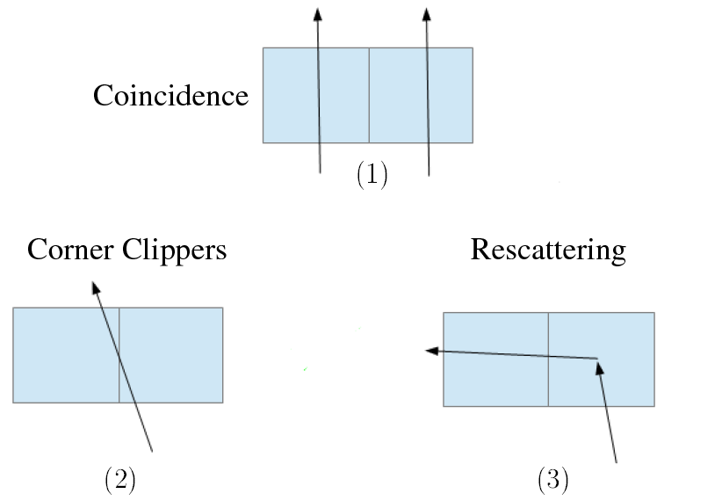
TOF Reconstruction Methods
GEMC
Single TOF paddles and clusters
adjacent hits grouped based on cuts on Δy_{hit} and ΔΤ_{hit}.
TDC Time (T_{L}, T_{R})
Apply time walk corrections and calibration.
Clusters - energy-weighted average.
Deposited Energy (E_{dep})
Apply ADC calibration and E_{dep} = √E_{L}•E_{R}•e^{y}
Clusters – sum E_{dep}’s
Position (y_{hit})
Use T_{L}-T_{R} to get y_{hit} relative to paddle center.
Clusters - energy-weighted average.
Hit time (T_{hit})
Average T_{L}, T_{R}
Clusters - energy-weighted average vs. earliest hit.
page 4

Slide 5
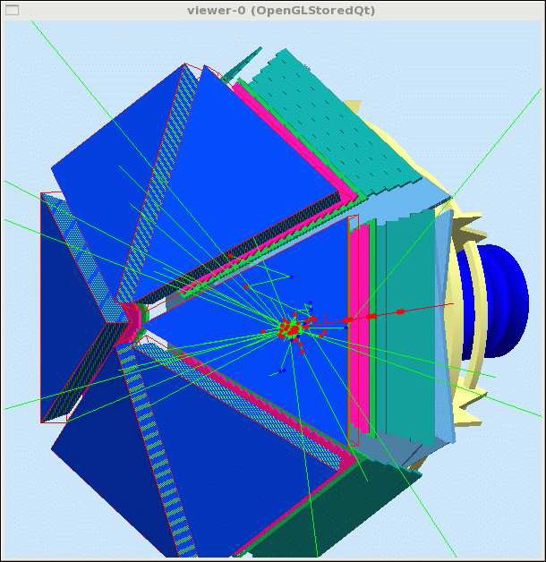
Code Validation
Simulation is primary testing tool of TOF reconstruction code.
CLAS12 Simulation – gemc
Simulations done on Richmond cluster and copied to JLab.
Accessible, well-documented, bug reporting, website.
JLab staff member (M. Ungaro).
Event generation
disgen – proton DIS
Range of final states and momenta.
Local
QUEEG – quasielastic scattering from deuterium
Local, under svn.
CLAS-NOTE 2014-008.
page 5

Slide 6
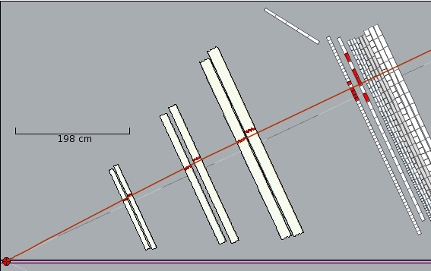
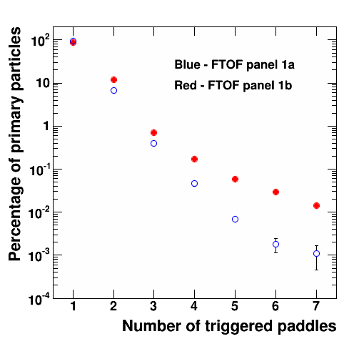
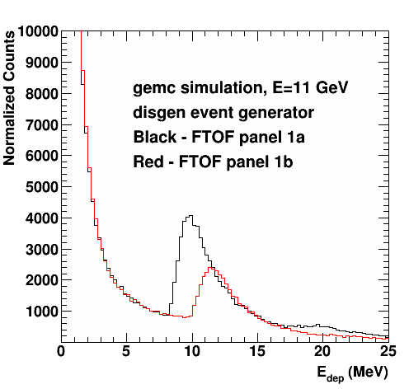
FTOF Standalone Reconstruction Results
Validated in stress tests.
Time difference with gemc.
Measured N_{adj} dependence.
Optimized clustering parameters.
E_{dep}.
CLAS12-NOTE 2014-003.
Clusters
page 7

Slide 7
TOF Status
CLAS12 generation 1 TOF reconstruction completed
Standalone versions for FTOF and CTOF.
Working as a service in analysis chain.
Validated in stress test.
Documentation: CLAS12-NOTE 2014-003.
Updated to new clas-io libraries, bank definitions.
New test version for event builder development.
First version of code to match drift chamber track from hit-based tracking with FTOF hit.
Geometry package in use.
Streamlined code.
page 8

Slide 8
People and Projects
Developer categories: A – environment programmers,
B – service developers, C – physics-only users
Time-of-flight reconstruction
Alex Colvill: Surrey master’s student, gen1 TOF developer
G.P.Gilfoyle: Richmond
E.Golovach, Moscow State
periodic visitor to JLab from Moscow State
Working on DC-FTOF track matching.
Forward Tagger Reconstruction
Raffaella DeVita INFN (Genova)
ced12 development
Dave Heddle (CNU)
Central Neutron Detector reconstruction
Daria Sokhan (Glasgow)
PCAL reconstruction
Mike Wood (Canisius)
Validation suite and BST calibration
Justin Ruger (CNU)
All project use the CLAS12 Common tools: ClaRA, coatjava, gemc, ced12,…
page 9

Slide 9
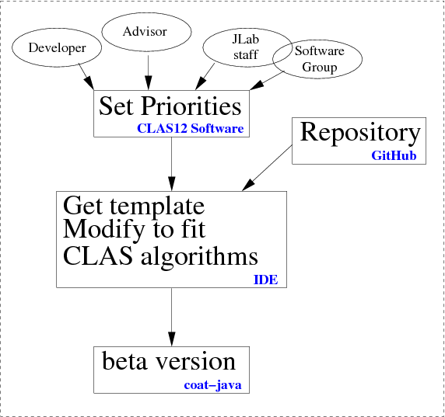
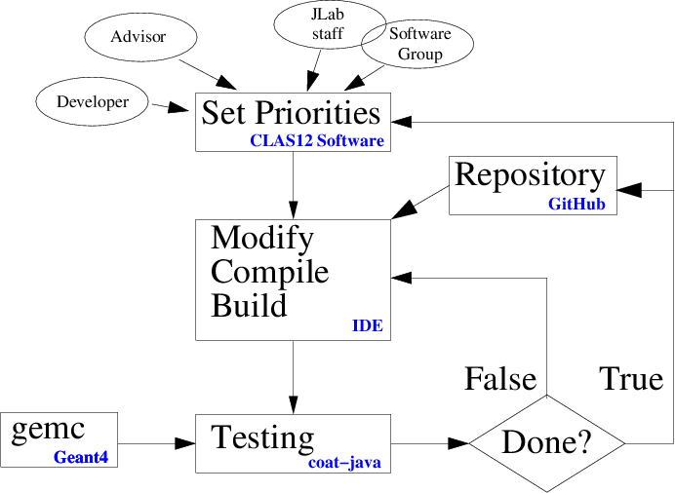
User Workflow
Getting Started
Development Cycle
page 10
Notes:
conditional probability P(E|Ai) that a particle of a given type Ai causes a detector response E

Slide 10
Connection to Charge
Are users engaged at a sufficient level to demonstrate usability and readiness from a user’s perspective?
Gilfoyle (Richmond), Golovach (Moscow State) and their students have been able to make significant contributions to the time-of-flight reconstruction package.
More CLAS collaborators using common tools (six projects now).
Time spent on-site is crucial for start-up.
Has the CLAS Collaboration identified appropriate mechanisms to support utilization of the software by the entire collaborations?
For TOF project the common tools are far enough along for off-site users to make contributions.
Simulations with gemc and analysis in the ClaRA framework are ongoing at Richmond, MSU, and spreading to other CLAS Collaboration groups.
Is the level of user documentation appropriate for this point in time?
Lots of material for FTOF, but should be localized (CLAS12 wiki?).
Starting to centralize documentation, tutorials, etc.
Bug reporting, access to JLab staff for support is crucial to get software working offsite.
page 11
Notes:
conditional probability P(E|Ai) that a particle of a given type Ai causes a detector response E

Slide 11
Additional Slides

Slide 12
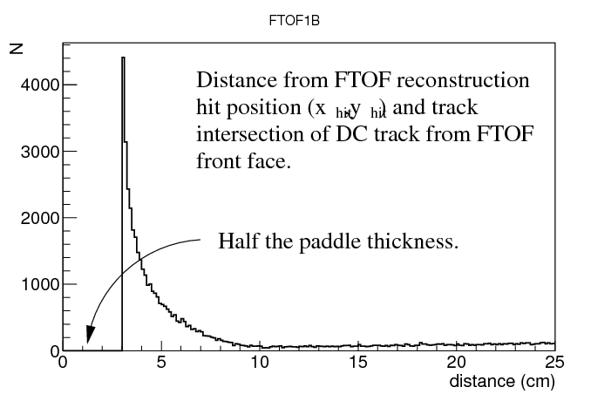
Track Matching with Drift Chambers
Match drift chamber track with FTOF hit.
Hit-based tracking results are used now.
DC track is propagated from last DC plane to front face of FTOF panel (B=0) using geometry service tools.
FTOF returns (x_{hit},y_{hit},z_{hit}) where x_{hit}, z_{hit} are in the center of the paddle.
Consider only single paddle clusters.
First results:

Slide 13
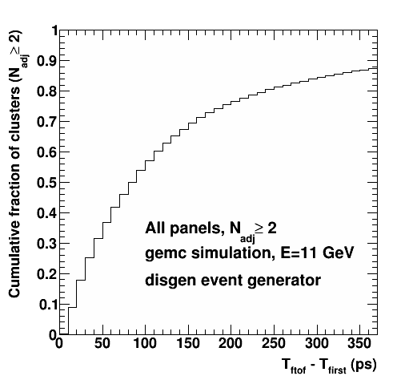
Energy-weighted T_{hit} vs. Earliest T_{hit}
Cluster hit times have been calculated as the energy-weighted sum of the paddle hit times.
We also considered taking the earliest T_{hit} among the paddles of each cluster.

