Slide 1
Hall B:User Experience and Utilization
Gerard Gilfoyle
University of Richmond
12 GeV Software and Computing Review
Jefferson Lab
February 10-11, 2015

Slide 2
Goals and Outline
Committee Charge - 1.c
  Are the halls getting users engaged at an appropriate level to demonstrate usability and readiness from a user’s perspective?
  Has the collaborations identified effective and appropriate mechanisms to support utilization of the software by the entire collaboration?
  Is the level of user documentation appropriate for this point in time?
Outline of talk
  Example of user software work: TOF reconstruction
  User experience: developers, projects, workflow.
  Connection with committee charge.
page 2

Slide 3
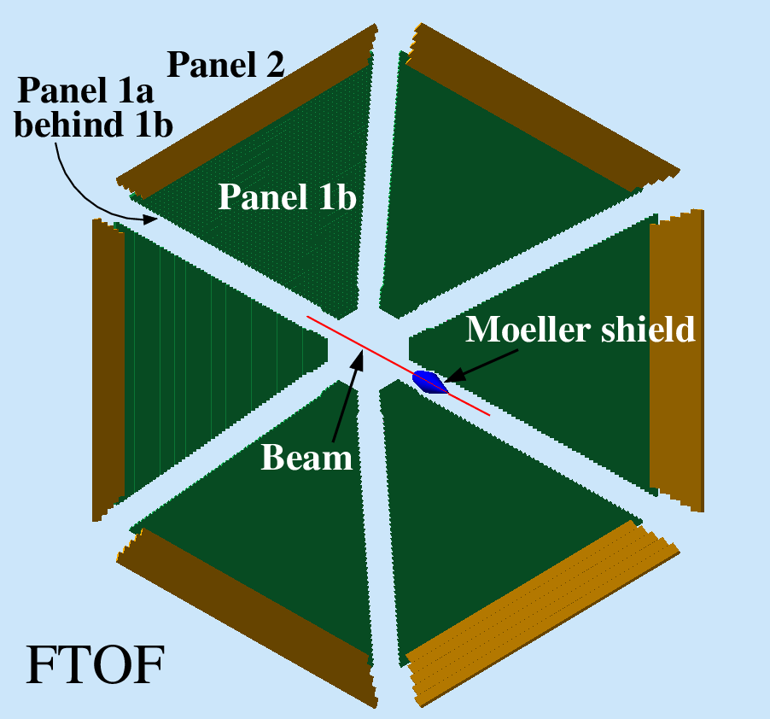
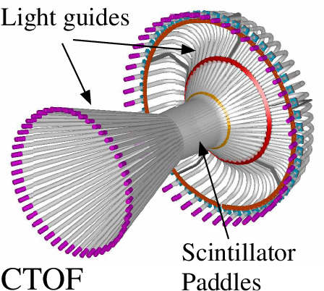
TOF Reconstruction
Forward Time-of-Flight (FTOF)
  6 sectors, double-sided PMT readout.
  Paddles: Panel 1a - 23, Panel 1b - 62, Panel 2 – 5.
Central Time-of-Flight (CTOF)
  48 paddles, double-sided PMT readout.
  form hermetic barrel around target.
Outputs
  Times (T_{L}, T_{R} from TDCs)
  Positions (y_{hit} from T_{L} – T_{R})
  Hit times (T_{hit} from (T_{L} + T_{R})/2)
  Deposited energy (E_{dep} from ADCs)
page 3

Slide 4
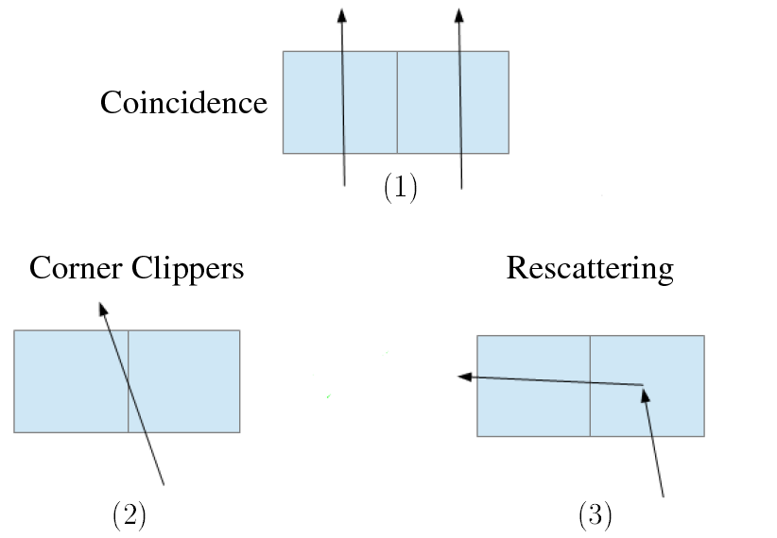
TOF Reconstruction Methods
GEMC
Single TOF paddles and clusters
  adjacent hits grouped based on cuts on Δy_{hit} and ΔΤ_{hit}.
TDC Time (T_{L}, T_{R})
  Apply time walk corrections and calibration.
  Clusters - energy-weighted average.
Deposited Energy (E_{dep})
  Apply ADC calibration and E_{dep} = √E_{L}•E_{R}•e^{y}
  Clusters – sum E_{dep}’s
Position (y_{hit})
  Use T_{L}-T_{R} to get y_{hit} relative to paddle center.
  Clusters - energy-weighted average.
Hit time (T_{hit})
  Average T_{L}, T_{R}
  Clusters - energy-weighted average vs. earliest hit.
page 4

Slide 5
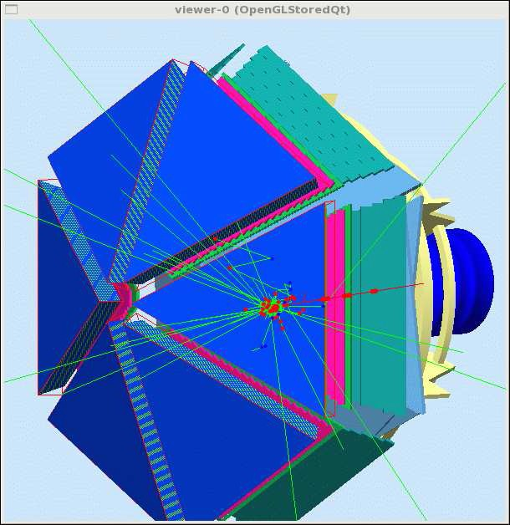
Code Validation
Simulation is primary testing tool of TOF reconstruction code.
CLAS12 Simulation – gemc
Simulations done on Richmond cluster and copied to JLab.
  Accessible, well-documented, bug reporting, website.
  JLab staff member (M. Ungaro).
Event generation
  disgen – proton DIS
    Range of final states and momenta.
    Local
  QUEEG – quasielastic scattering from deuterium
    Local, under svn.
    CLAS-NOTE 2014-008.
  Pythia (more in V.Ziegler talk)
    Pythia6 - now in use.
    Pythia8 - no electroproduction
page 5

Slide 6
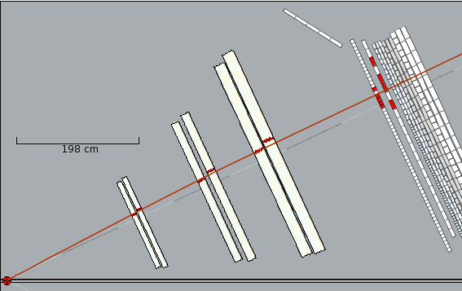
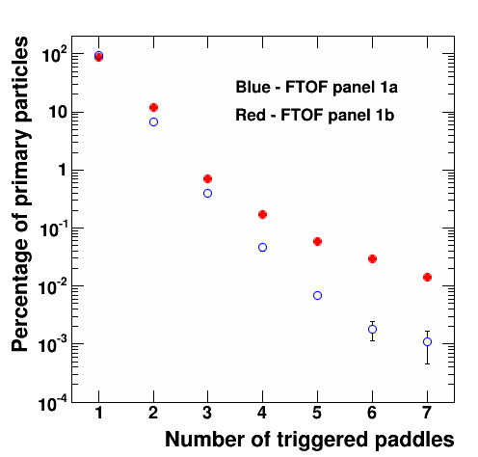
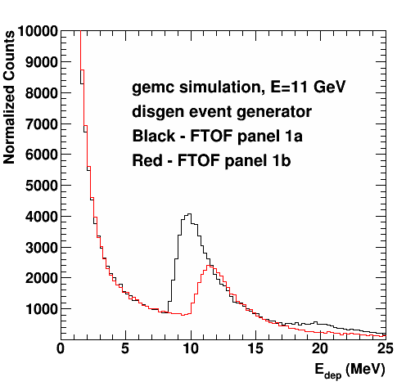
FTOF Standalone Reconstruction Results
Validated in stress tests.
Time difference with gemc.
Measured N_{adj} dependence.
Optimized clustering parameters.
E_{dep}.
CLAS12-NOTE 2014-003.
Clusters
page 6

Slide 7
TOF Status
CLAS12 generation 1 TOF reconstruction completed
  Standalone versions for FTOF and CTOF.
  Working as a service in analysis chain.
  Validated in stress test.
  Documentation: CLAS12-NOTE 2014-003.
Updated to new clas-io libraries, bank definitions.
New test version for event builder development.
First version of code to match drift chamber track from hit-based tracking with FTOF hit.
Geometry package in use.
Streamlined code.
page 7

Slide 8
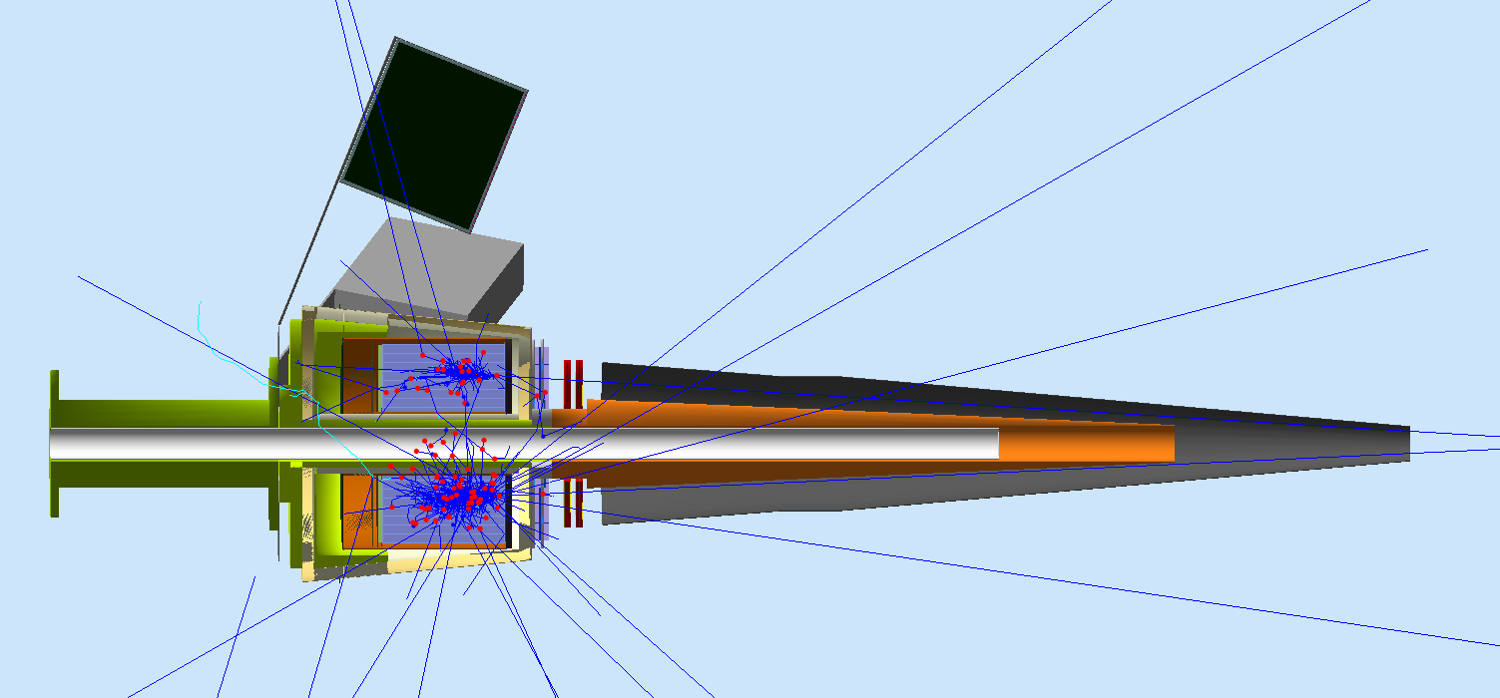
More Projects and People
Forward Tagger (FT)
  Simulation and validation (gemc)
  Reconstruction (coatjava, evio-Root)
  Raffaella De Vita (Genova)
Example:
Simulation of π⁰→γγ events with full FT geometry
γγ invariant mass spectrum show clear π⁰ peak
GEMC visualization of two photons from pi0 decay going through the calorimeter
L. Lanza (Universita di Roma Tor Vergata and INFN-Roma2)
page 8

Slide 9
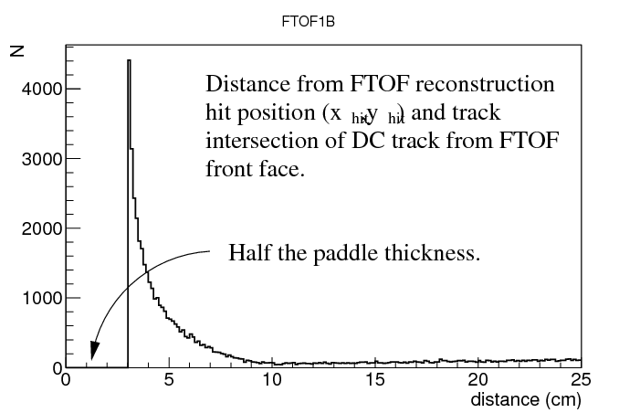
People and Projects
Use of gemc is widespread.
Time-of-flight reconstruction
  E.Golovach (Moscow State)
  G.P.Gilfoyle (Richmond),
FT Reconstruction
  Raffaella De Vita (Genova)
ced12 development
  Dave Heddle (CNU)
Central Neutron Detector reconstruction
  Daria Sokhan (Glasgow)
DC geometry
  Jeremiah Hankins (CSUDH)
Validation suite and BST calibration
  Justin Ruger (CNU)
RICH simulation and validation
  Silvia Pisano (INFN)
Barrel Silicon Tracker reconstruction
  Yuri Gotra (JLab)
Projects listed use gemc and the CLAS12 common tools: ClaRA, coatjava, gemc, ced12,…
page 9

Slide 10
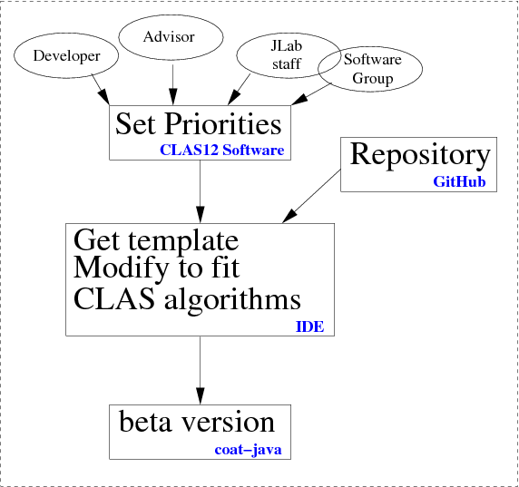
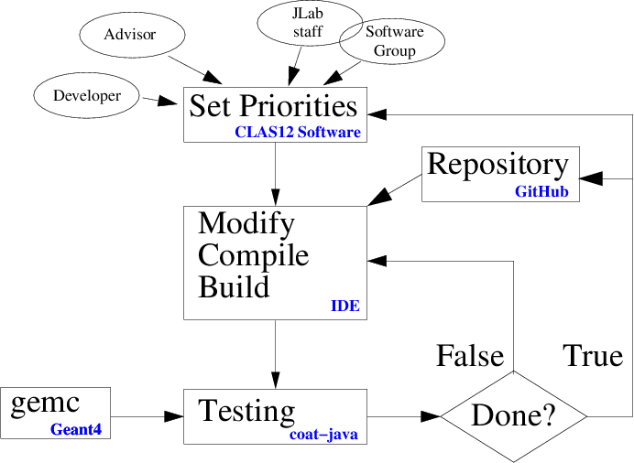
User Workflow
Getting Started
Development Cycle
page 10
Notes:
conditional probability P(E|Ai) that a particle of a given type Ai causes a detector response E

Slide 11
Connection to Charge
  Are the halls getting users engaged at an appropriate level to demonstrate usability and readiness from a user’s perspective?
    Gilfoyle (Richmond), Golovach (Moscow State) and their students have made significant contributions to the TOF reconstruction package.
    Use of common tools is ramping up.
    Time spent on-site is crucial for start-up.
  Have the collaborations identified effective and appropriate mechanisms to support utilization of the software by the entire collaboration?
    For TOF project the common tools are far enough along for off-site users to make contributions.
    Simulations with gemc and analysis in the ClaRA framework are ongoing at Richmond, MSU, Genova, Saclay, and INFN and spreading to other CLAS Collaboration groups.
  Is the level of user documentation appropriate for this point in time?
    Well developed for gemc.
    Material for TOF and EC/PCAL, but need better user interface.
    Starting to centralize documentation, tutorials, etc.
    Bug reporting, access to JLab staff for support, crucial for offsite users.
page 11
Notes:
conditional probability P(E|Ai) that a particle of a given type Ai causes a detector response E

Slide 12
Summary and Conclusions
  CLAS12 simulation (gemc), framework (Clara), data formats (evio), event display (ced12) are mature packages and readily accessible to collaboration members.
  Reconstruction tools (coatjava) are now being used for testing, validation, and development by an increasing number of users.
  Documentation status is diverse – some needs updating, better organization.
Hi, Jerry.
It works! Thanks.
I was also able to easily run your reconstruction and produce an EVIO output file.
—Jeremy
During an internal CLAS12 software review one of the reviewers, Jeremy McCormick (SLAC) asked about using the CLAS12 event display. He was able to download the package from gitHub, reconstruct events, and view them in ced12 in a matter of minutes.
page 12
Notes:
conditional probability P(E|Ai) that a particle of a given type Ai causes a detector r

Slide 13
Additional Slides
page 13
Notes:
conditional probability P(E|Ai) that a particle of a given type Ai causes a detector r

Slide 14
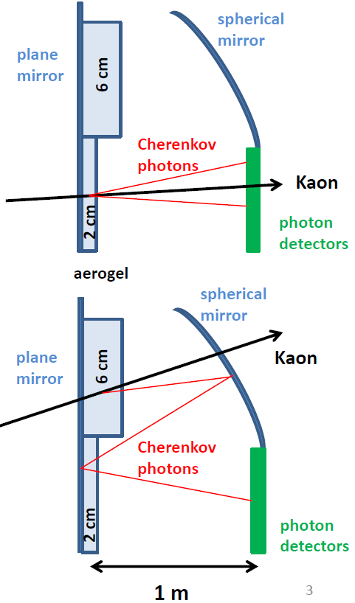
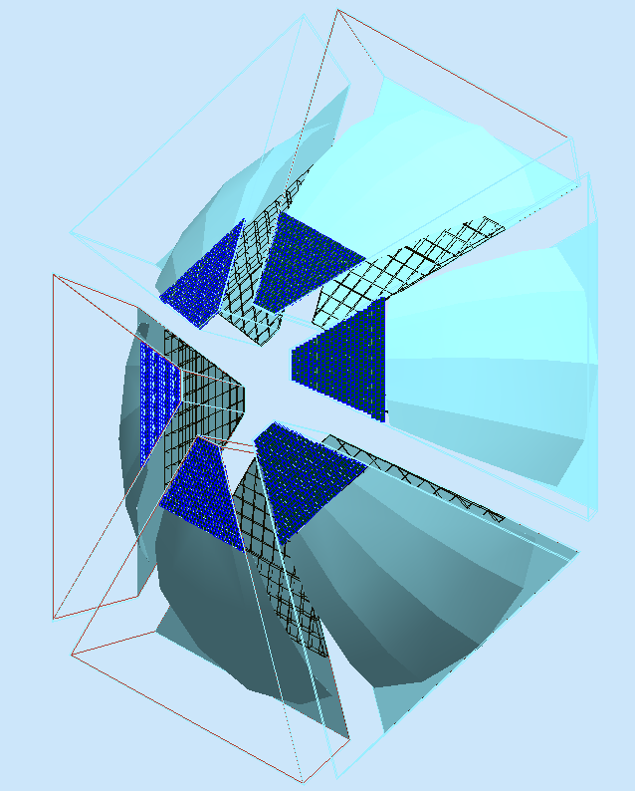
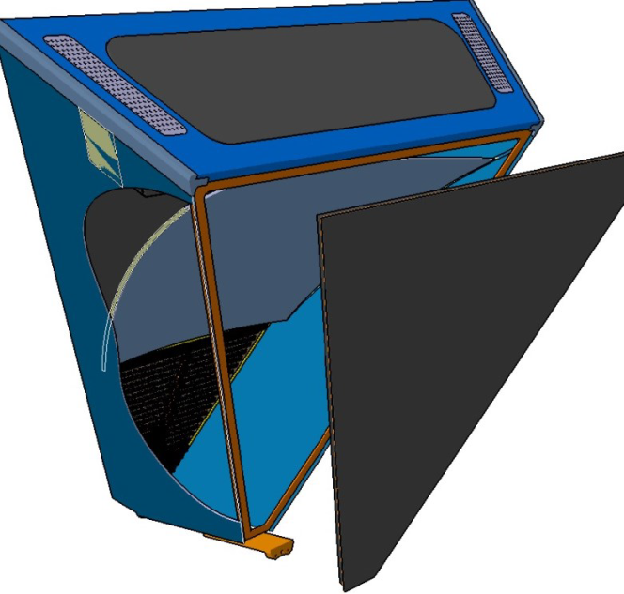
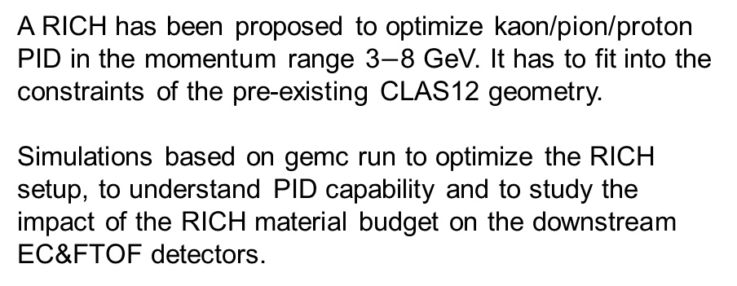
A RICH for the CLAS12 Detector
A RICH has been proposed to optimize kaon/pion/proton PID in the momentum range 3$−$8 GeV. It has to fit into the constraints of the pre-existing CLAS12 geometry.
Simulations based on gemc run to optimize the RICH setup, to understand PID capability and to study the impact of the RICH material budget on the downstream EC&FTOF detectors.
6-sector RICH in gemc
page 14
Notes:
conditional probability P(E|Ai) that a particle of a given type Ai causes a detector r

