Slide 1
Hall B: Software Utilization
Gerard Gilfoyle
University of Richmond
12 GeV Upgrade Software Review Jefferson Lab
November 25-26, 2013

Slide 2
CLAS12 Software User Environment
Introduction: Software tasks, users, projects. Tools.
Simulation. Reconstruction. Visualization Physics Analysis. Summary.

Slide 3
Introduction - Tasks and Users
Software Categories:
Calibration (not discussed here) Simulation
Reconstruction Visualization Physics analysis
User Categories
A - environment developers. B - service developers.
C - physics users.
Focus on off-site physics users.
Access, ease-of-use, extent of use, support.

Slide 4
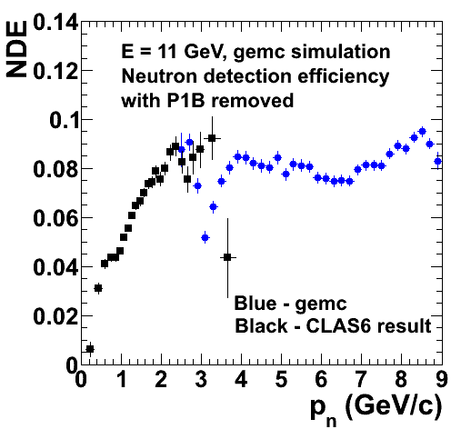
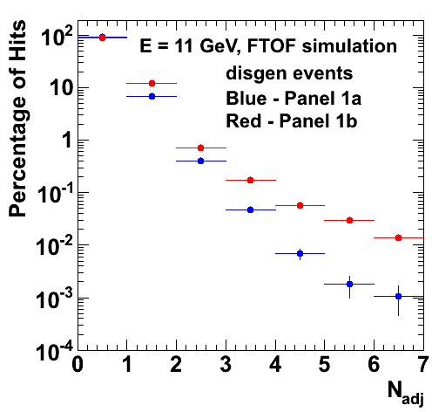
Introduction - Physics Projects
Experience with Richmond cluster, offsite users.
Simulations for CLAS12 neutron magnetic form
factor G_{M}^{n} experiment (E12-07-104).
Quasielastic neutron detection from ²H with forward Time-of-Flight (TOF) (CN 2011-015).
Calorimeter (EC) simulation (CN 2011-019).
EC geometry simulation (BAPS, DNP, 2012).
G_{M}^{n} target simulation (BAPS, DNP, 2011).
CLAS12 TOF Subsystems Reconstruction Software Forward and central TOFs.
Tested with gemc.
Deep-inelastic scattering event generator.
Richmond cluster is development and test bench for CLARA – used by environment developers.

Slide 5
Software Tools
General
Tool | Description |  | Tool | Description
subversion | Version control utility |  | scons | software construction tool
mysql | Open source database |  | qt4 | widget toolkit
clhep | C++ library of utility classes for HEP |  | geant4 | simulation of particles passing through matter
Locally Developed
Tool | Description |  | Tool | Description
Clara | CLAS12 analysis envi- ronment |  | clasJLib | CLAS12 utilities - JMath, ced, cMsg
JToolbox | evio, bank handling classes, property lists |  | ccdb | mysql geometry and calibration database

Slide 6
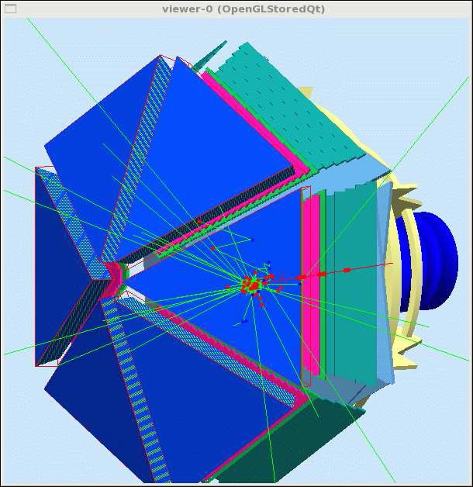
Simulation
Event Generators pythia
local programs: disgen, ppgen, genev, ...
Use - Pythia is a mature, widely-used program. Other codes vary in ease of use. Support - Pythia well supported by Lund and CERN. Varied support for others. Point-of-contact JLab staff (H.Avakian).
CLAS12 Simulation - gemc
JLab program for CLAS12 and others.
Uses evio data format common among the halls. Use - Scripts for offsite installation: time-consuming, but reliable: being improved.
Support - Complete web-page, bug reporting. JLab staff member (M. Ungaro).
See Veronique Ziegler’s talk.

Slide 7
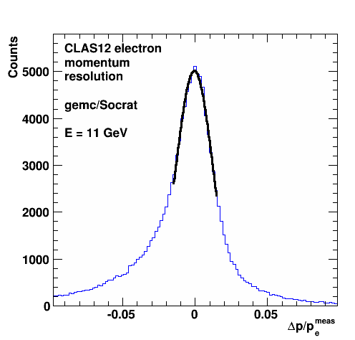
Reconstruction
Socrat (SOftware for Clas12 Reconstruction And Tracking)
Local, generation one, C++ code for electrons in
forward detector (S. Procureur author).
Use - Compiled with Root libraries (ACLiC),
complex code.
Support - CLAS-NOTE 2008-015, limited
Collaboration support.
TRAC (Track Reconstruction Application for CLAS12)
Current focus of main development effort on full CLAS12 reconstruction.
See Veronique Ziegler’s talk.
Use - Applied to other reconstruction projects - Forward tagger (offsite) - R. De Vita,
Barrel Silicon Tracker - Y. Gotra.
Support - CLAS-NOTE in preparation.

Slide 8
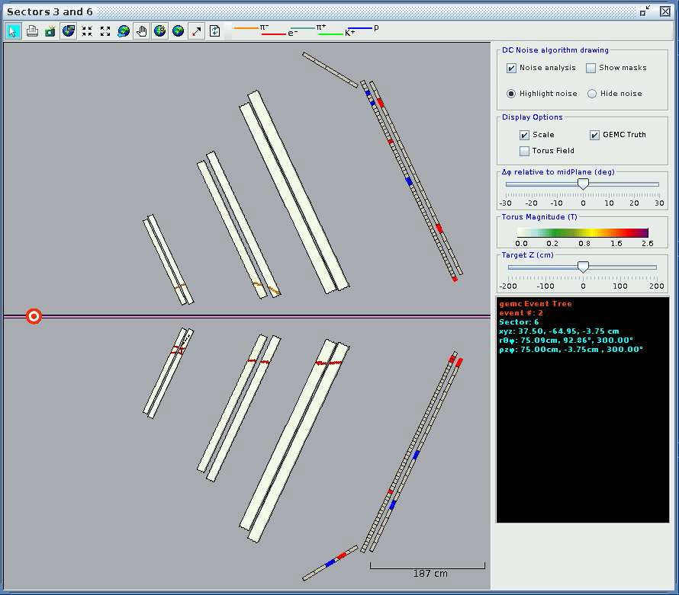
Visualization - ced12
ced12 (cLAS eVENT dISPLAY) is the 12 GeV version of the 6 GeV application.
Use - Built on top of the bCNU libraries. Easy to use. Support - Single
Collaboration member
(D.Heddle).

Slide 9
Physics Analysis
evio2root
Converts evio data into root ntuples. Generation 2 version in development.
Use - Generation 1 is easy to build, but cumbersome to adapt to new banks.
Generation 2 being developed by one JLab staff member (M.Ungaro). Generation 1 no longer supported.

Slide 10
Summary
Event generators - pythia, ppgen, disgen, and other locally developed ones.
Simulation - gemc is complete, mature and in wide use. Reconstruction - generation 3 development far along.
Visualization - ced12 event display well developed and widely used.
Physics analysis – evio2root gives access to root; improved, generation two version being developed.
Ease-of-Use - Many packages accessible to offsite users. TRAC just starting to spread offsite.
Support - Faculty or JLab staff contacts for each major software subsystem (often the original author).

