Slide 1
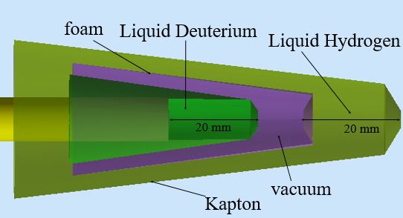
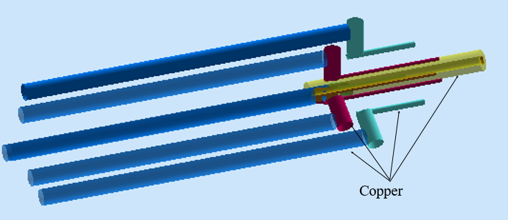
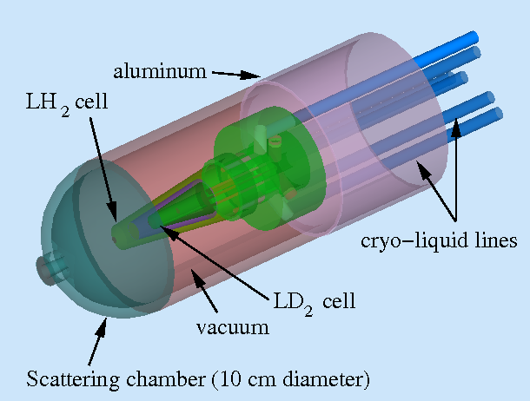
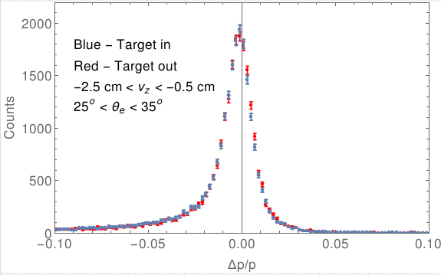
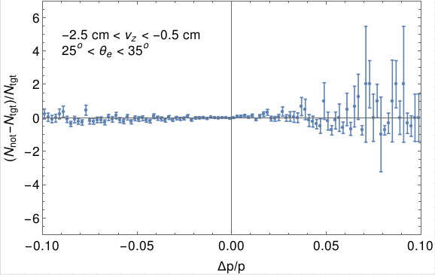
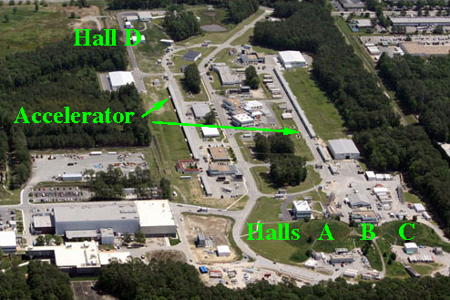
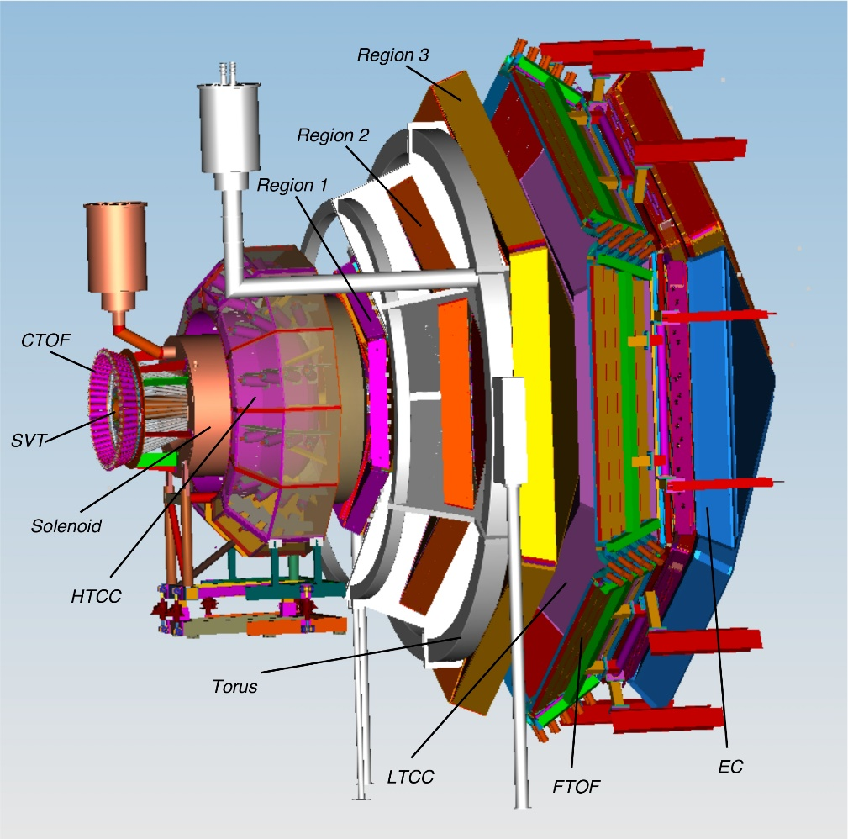
Dual Target Design for CLAS12
Omair Alam and Gerard Gilfoyle
Department of Physics, University of Richmond
Introduction
Measuring the Neutron Magnetic Form Factor
One of the fundamental goals of nuclear physics is to understand the structure and behavior of strongly interacting nuclei in terms of its basic constituents, quarks and gluons. An important step towards this goal is the characterization of the internal structure of the nucleon; the elastic electric and magnetic form factors of the proton and neutron are key ingredients of this characterization. The elastic electromagnetic form factors are directly related to the charge and current distributions inside the nucleon and are among the basic observables of the nucleon.
An experiment to measure the neutron magnetic form factor(G^{n}_{m}) is planned for the new CLAS12 (JLab Experiment E12-07-104). This form factor is extracted from the ratio of quasielastic electron-neutron to electron-proton scattering off a liquid deuterium target. A collinear liquid hydrogen target will be used to measure efficiencies at the same time as production data is collected from the liquid deuterium target. To test target designs, we have simulated the dual-target geometry, support structures and cryogenic transport systems for CLAS12.
Figure 3: Dual Target
Figure 4: Cryogenic Transport System
Figure 5: Dual Target with Support Structures and Cryogenic transport
Results
Dual Target Simulation
Figure 6 shows the distributions of the percent momentum difference, $\frac{∆p}{p}= \frac{p_{reconstructed}−{ p}_{generated}}{p_{generated}}$ , where $p_{reconstructed}$ is the reconstructed momentum and $p_{generated}$ is the generated momentum, for an electron scattering angle θ for 25 ͦ< θ < 35 ͦ and vertex position along the beam axis v_{z} for -2.5 cm < v_{z} < -0.5 cm. There is little difference between the two distributions.
Figure 7 represents the difference between the $\frac{∆p}{p}$ distributions for target in and target out. There is no statistically significant difference between the two distributions within uncertainties.
We wrote a Perl script that utilized the CLAS12 Monte Carlo code gemc and Geant4 API (Application Program Interface) to define specific geometries and materials for the target. Figure 3 shows the positions and geometries of the two target cells as well as the structures holding them. We made the following design decisions in order to make the target structures easy to modify and the Perl script easy to reuse and read:
Made separate procedures for each target component to make replacement or modification of individual parts of the target easy.
Established proper dependencies between all the target components to ensure that changes made to any substructure would reflect across the whole target therefore making changes easy to implement. Some of the geometries such as hemispherical caps with conical craters were made using advanced features of Geant4 such as addition and subtraction of solids.
Extensively documented and commented the Perl script to increase code readability.
The target cells are surrounded by support structures and tubing for transporting cryogenic liquids for cooling the target system. There are three sets of two tubes arranged around the target cells at intervals of 120 degrees as shown in Figure 4. We added these ancillary systems to the target definition script because:
These structures could potentially alter the properties of the particles scattered from the targets upon interaction.
They might produce background particles when the primary reaction products pass through them.
The output of the Perl script is a set of database entries read by gemc at runtime.
Figure 5 shows the complete target structure consisting of all the aforementioned components along with the scattering chamber and the aluminum outer casing.
The Laboratory
Jefferson Lab (JLab), located in Newport News Virginia, focuses on understanding the nature of the quark-gluon interaction that binds protons, neutrons, and nuclei together. The central scientific instrument at JLab is the Continuous Electron Beam Accelerator Facility (CEBAF) (See Figure 1). CEBAF creates a precise, continuous, beam of electrons that allows exclusive measurements (detect multiple particles from each event) to be made. CEBAF now runs at energies up to 12 GeV. Hall B currently houses the CEBAF Large Acceptance Spectrometer (CLAS12) (See Figure 2). CLAS12 consists of eight detector subsystems for the base equipment with more than 60,000 channels. There are two major parts, the forward detector and the central detector. It will detect and measure the properties of charged and neutral particles produced in collisions with the electron beam.
Figure 6: Momentum difference distribution with Target In and Out
Figure 7: Difference in count between that for target in and target out
Summary and Conclusion
Testing the Program
We simulated the CLAS12 Dual Target geometry including supporting structures and cryogenic transport systems. An initial study of the impact of this dual-target structure revealed limited effects on the electron momentum and angular resolutions.
Electron-nucleon events are produced first with the QUasiElastic Event Generator (QUEEG) which models the internal motion of the nucleons in deuterium[1]. These results are used as input to the CLAS12, physics-based simulation Monte Carlo, GEMC. This Geant4-based program simulates the particle’s interaction with each component of CLAS12, including the target material, the supporting systems and the cryogenic transport systems and is used as a tool to study the response of the detector. We used straight tracks with no magnetic field to match the gemc geometry with the assumed target geometry. For more complex analysis, Clara, a data analysis framework developed by Jefferson Lab scientists, was used for event reconstruction and to study the effect of the target material on large angle electron scattering in CLAS12.
References
Figure 1: CEBAF site and end station
Figure 2: Design Drawing of CLAS12
[1] G.P. Gilfoyle and O. Alam et. al. CLAS-NOTE 2014-007, Jefferson Lab., 2014

