Slide 1
Electron Momentum Correction...

Slide 2
Data Set used in this talk:
RGB ep event ~ 107 runs = 5,809,240 / 376,988,554
/lustre19/expphy/cache/clas12/rg-b/production/recon/fall2019/torus+1/pass1/v1/dst/train/gmn

Slide 3
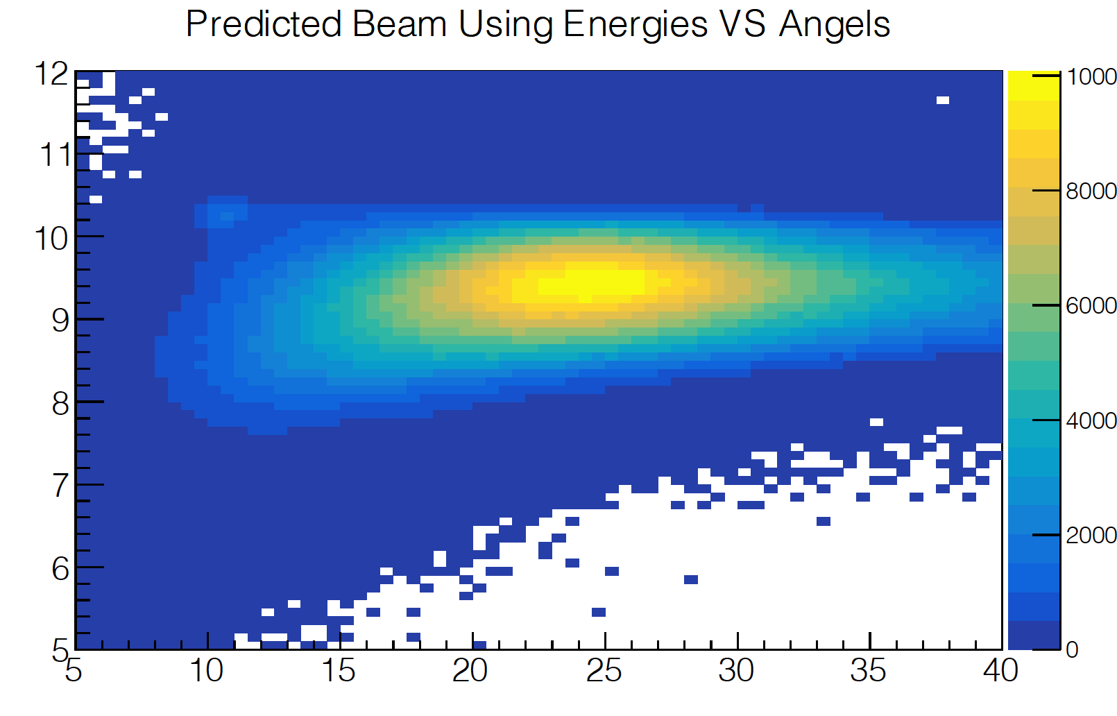
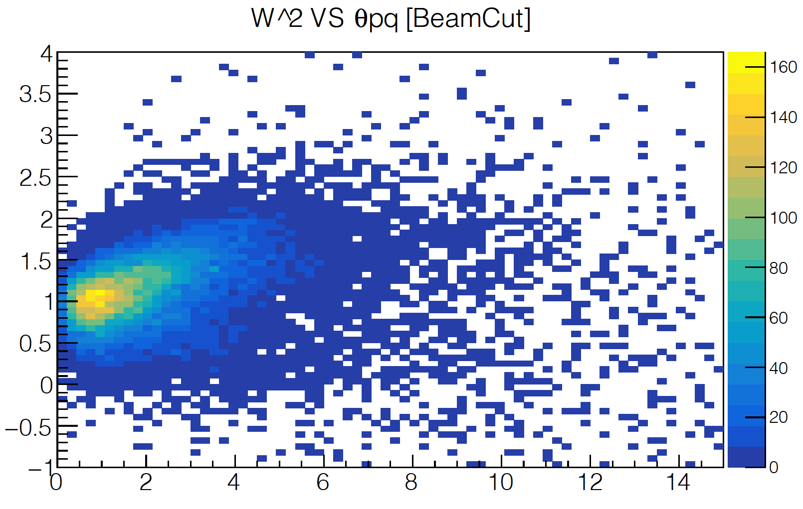




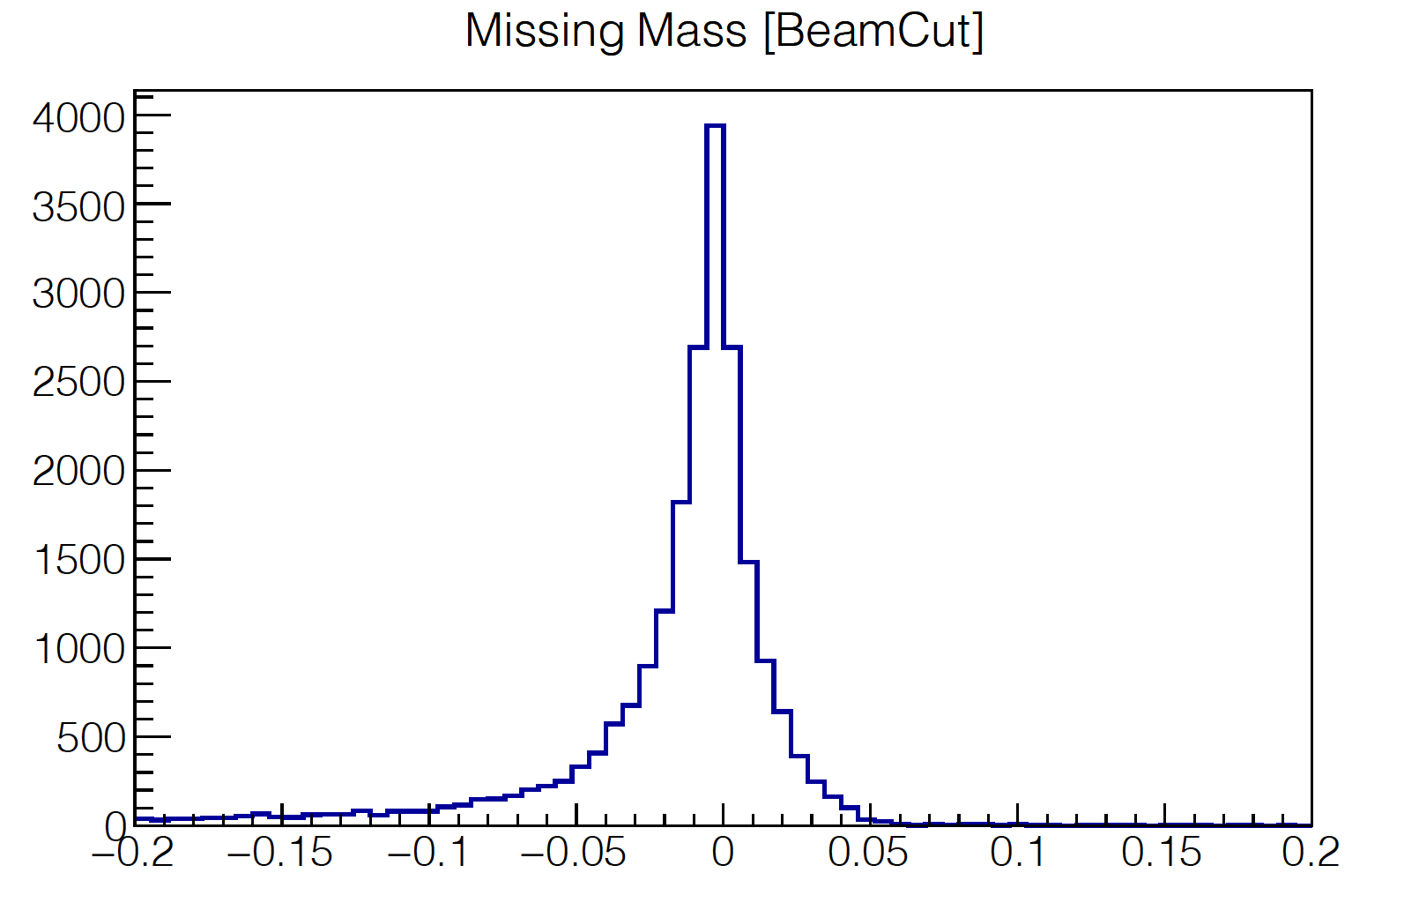
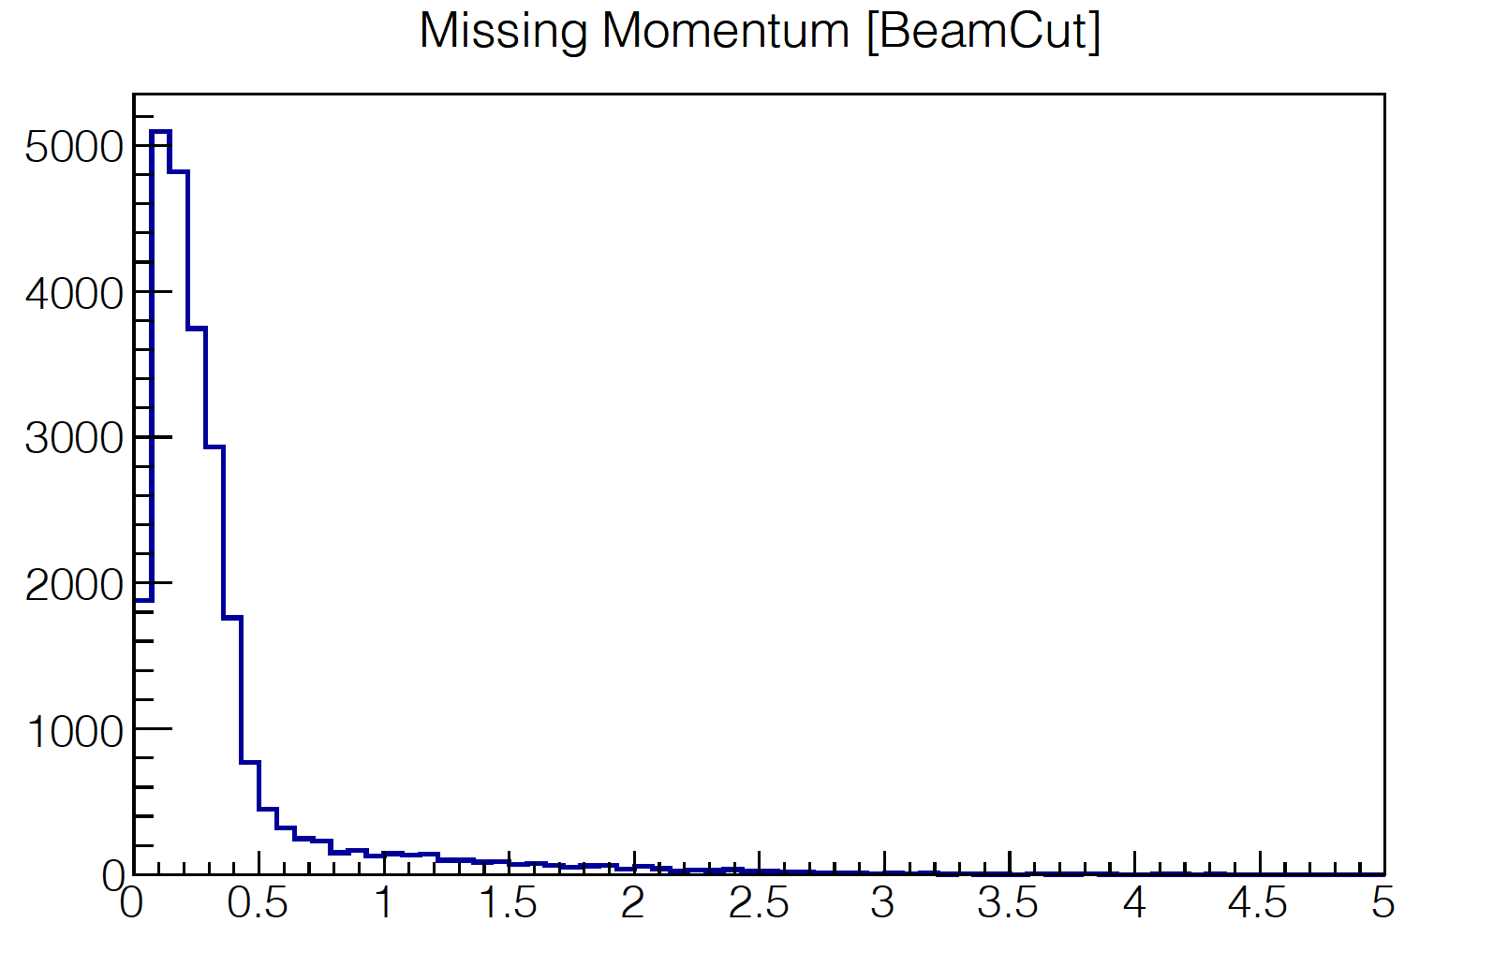

Cut Applied to select quasi-elastic ep peak
11.5 > E_{beam} using angles > 9
10.7 > E_{beam} using Energies > 10
< 5
[
E_{beam} calculated using Energies
$θ_{pq}$
E_{beam} calculated using Angels

Slide 4
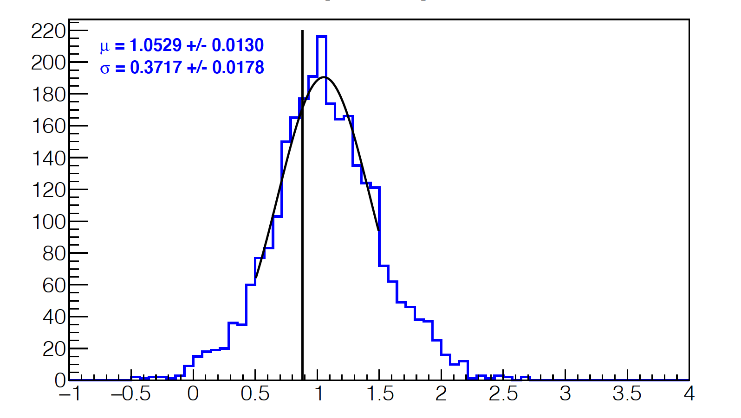
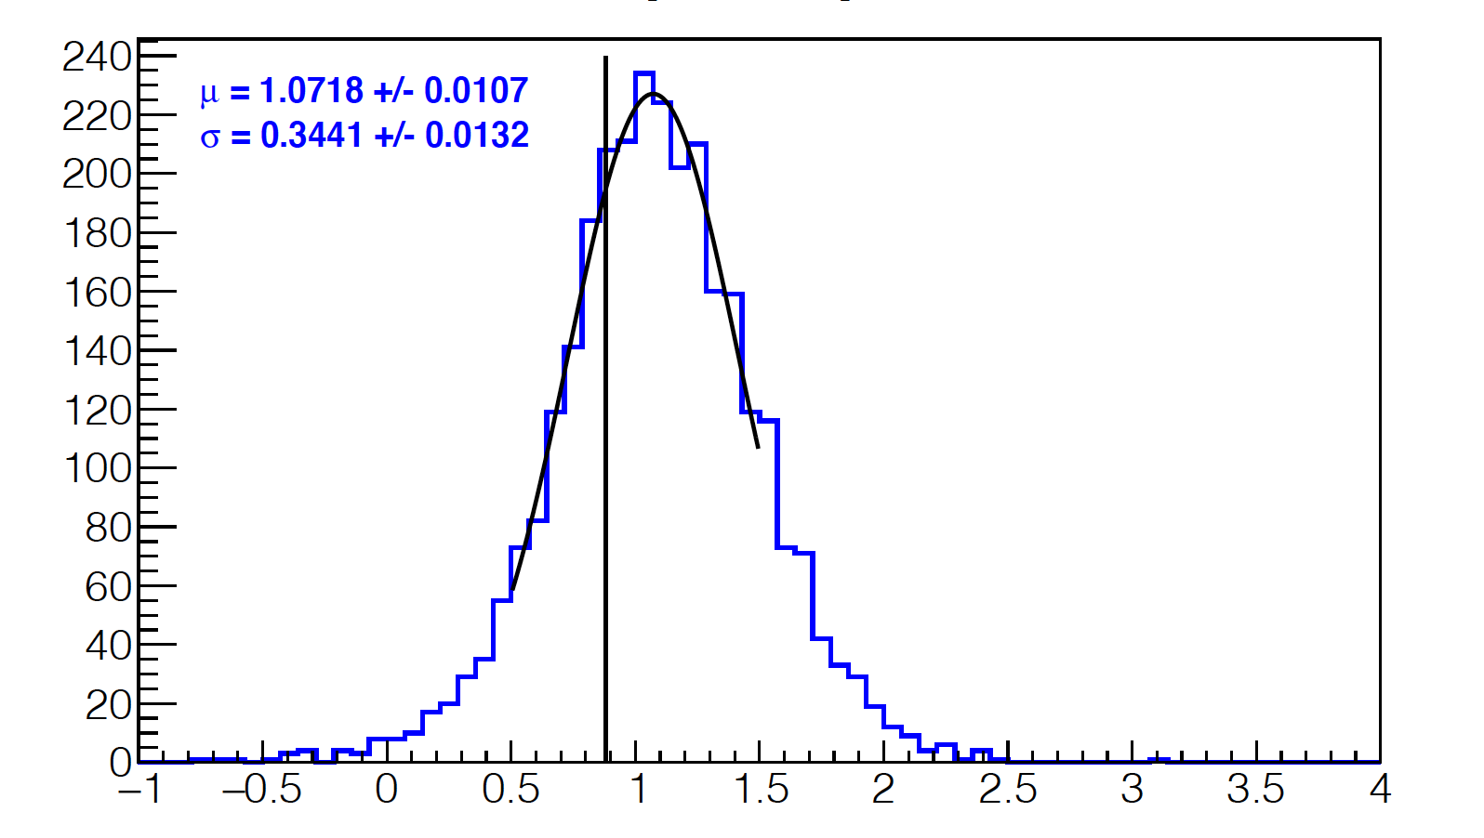


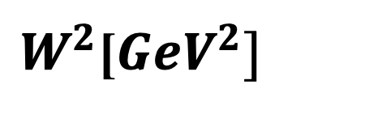
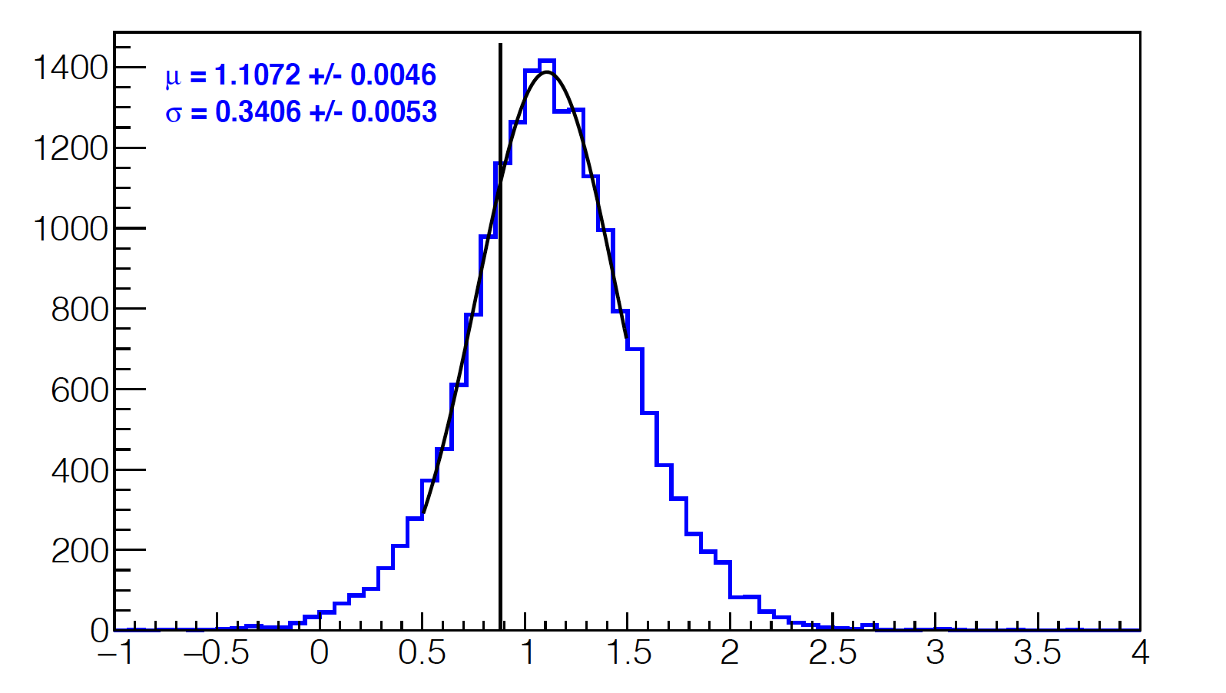
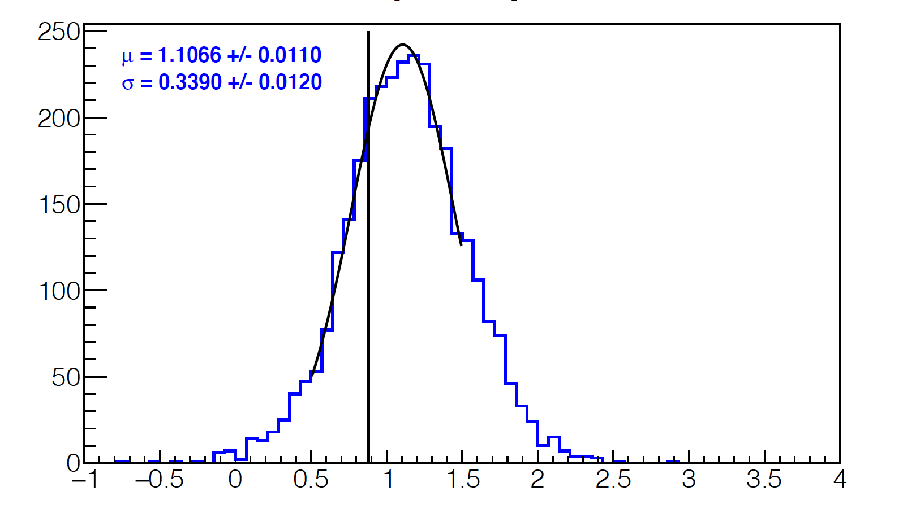
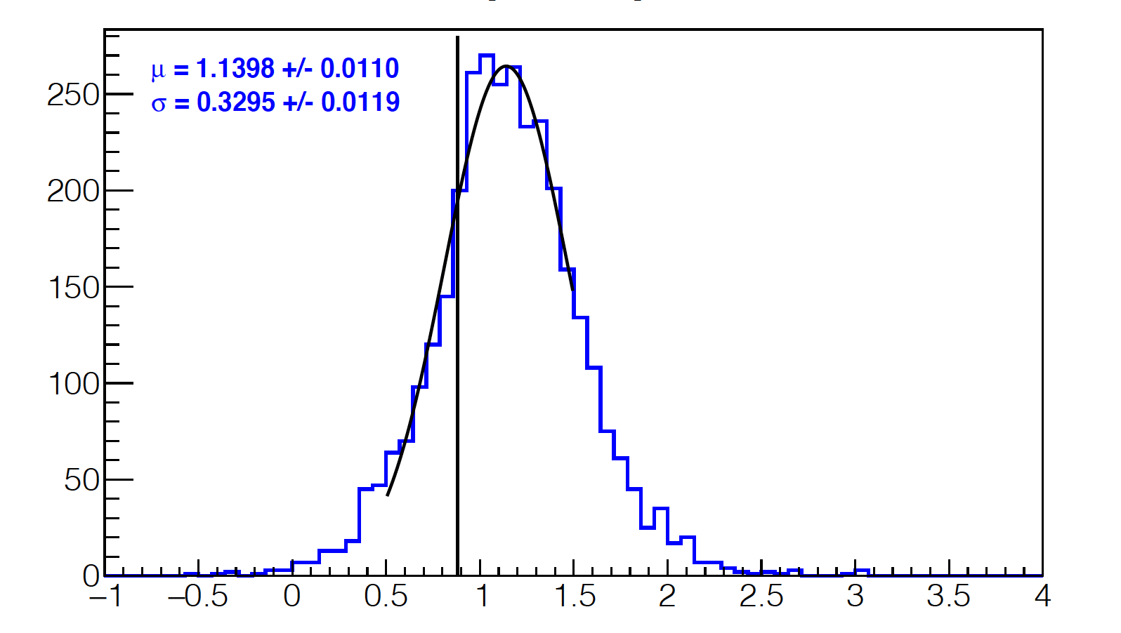


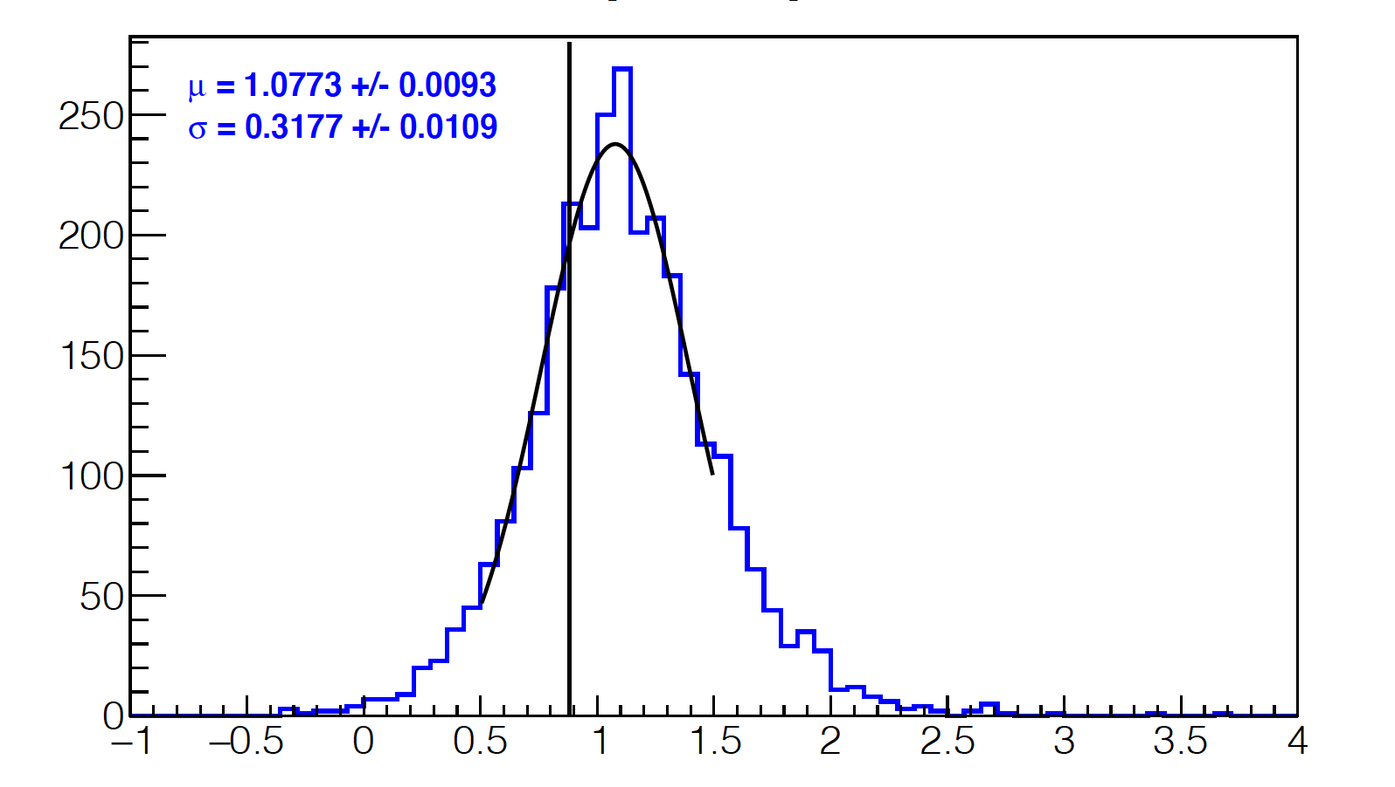
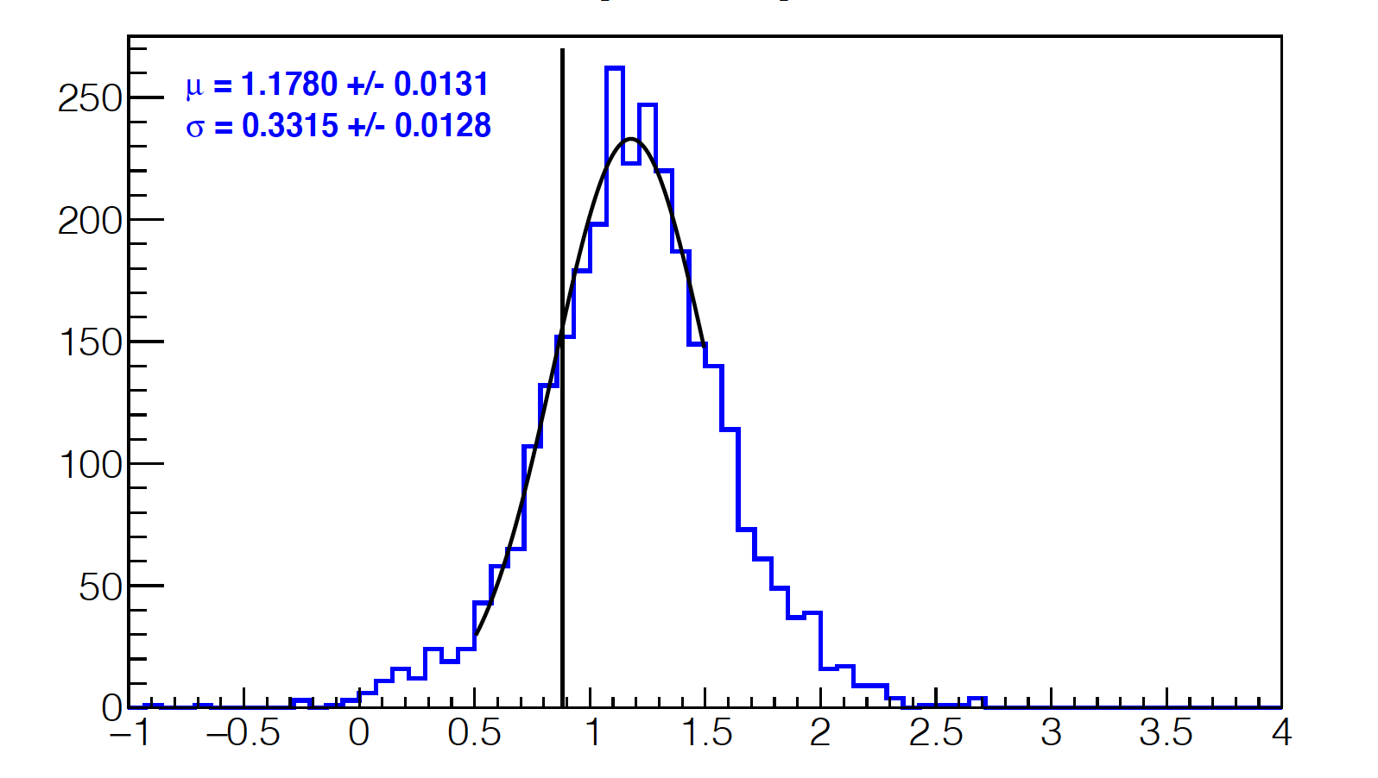


[
[
[
Sector 1
Sector 2
[
[
Sector 3
Sector 4
[
[
Sector 5
Sector 6

Slide 5
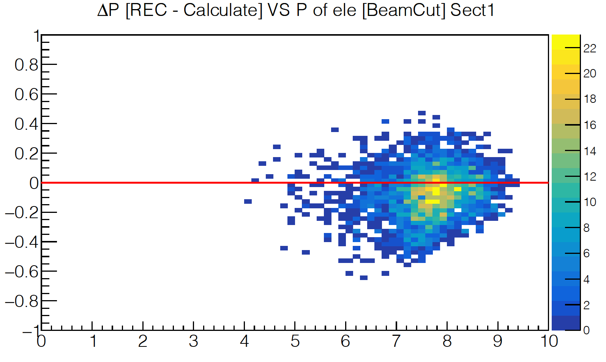
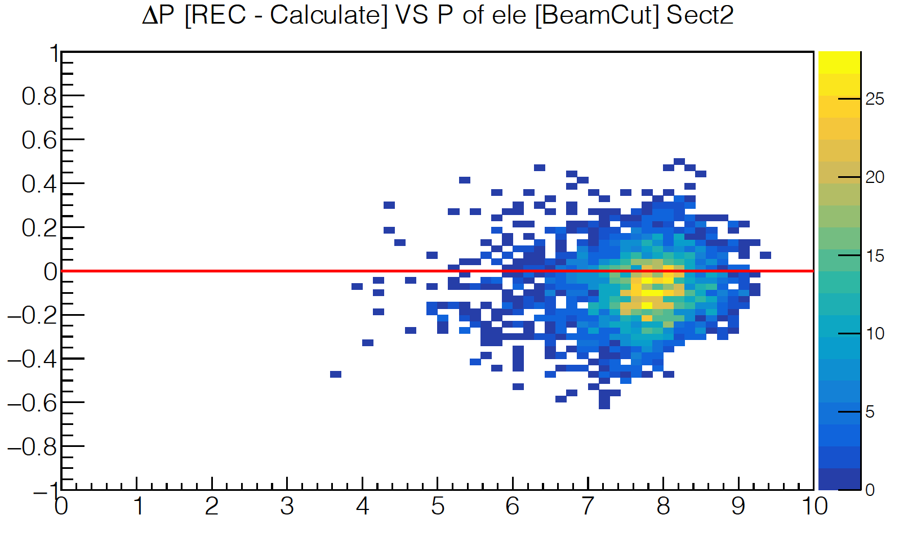


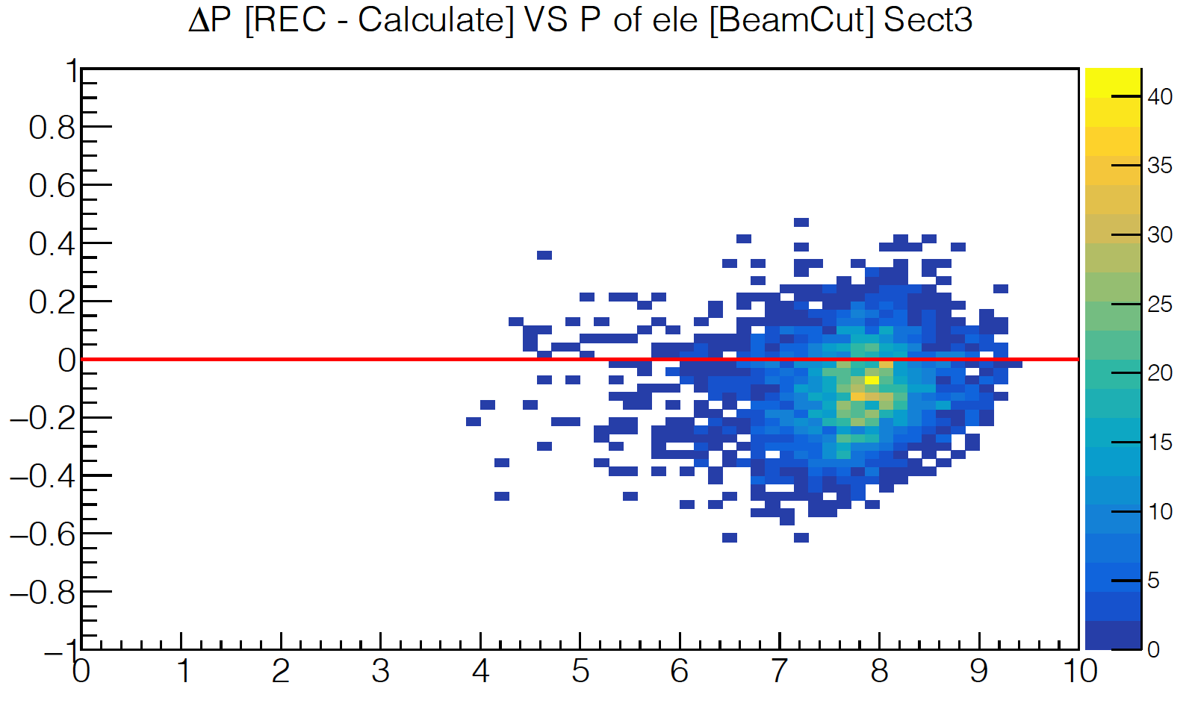
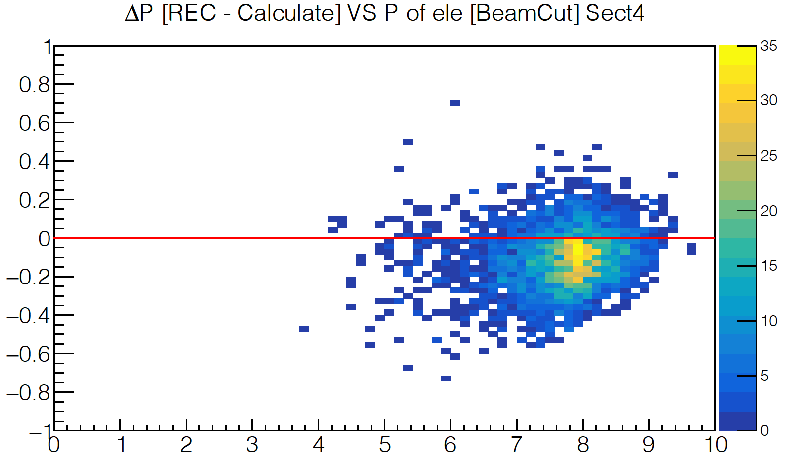
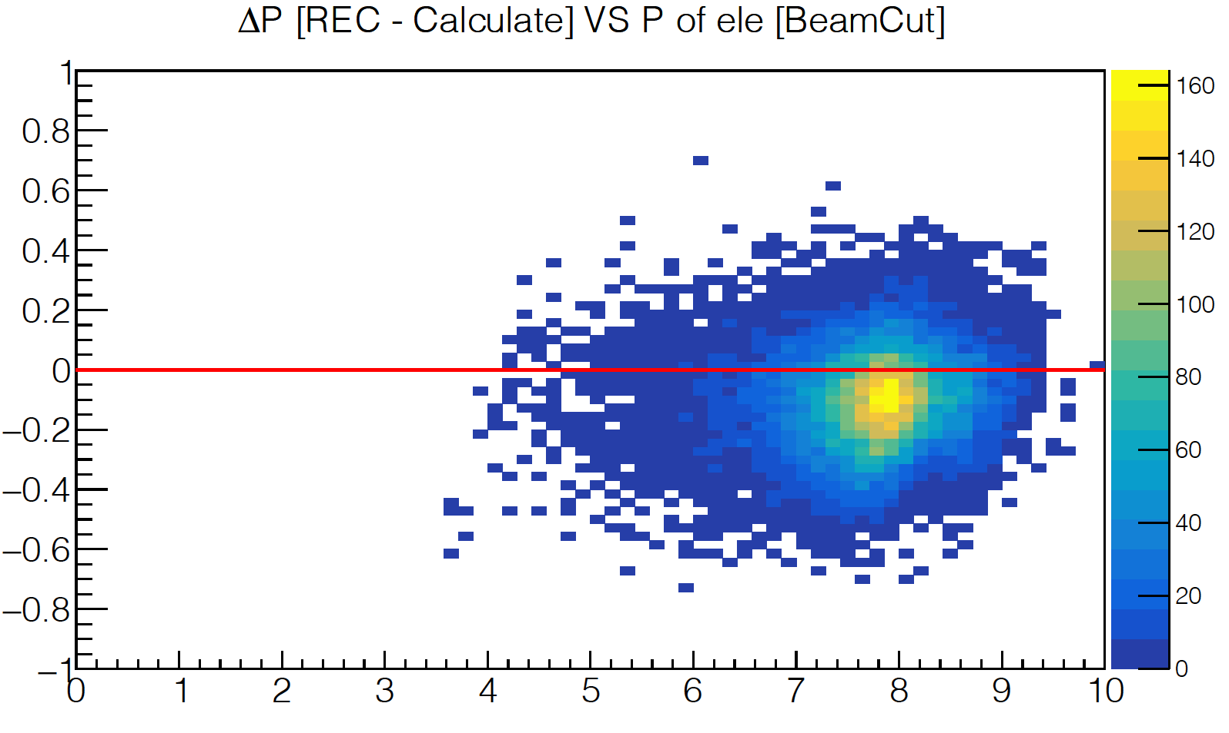

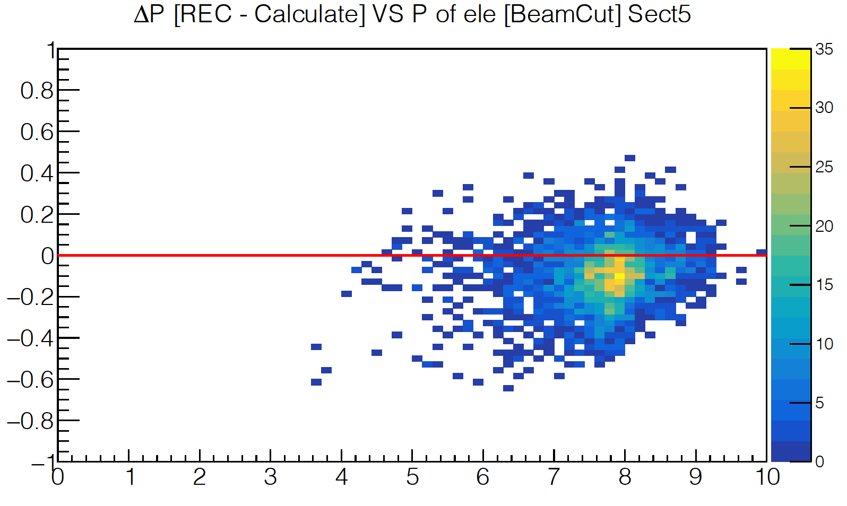
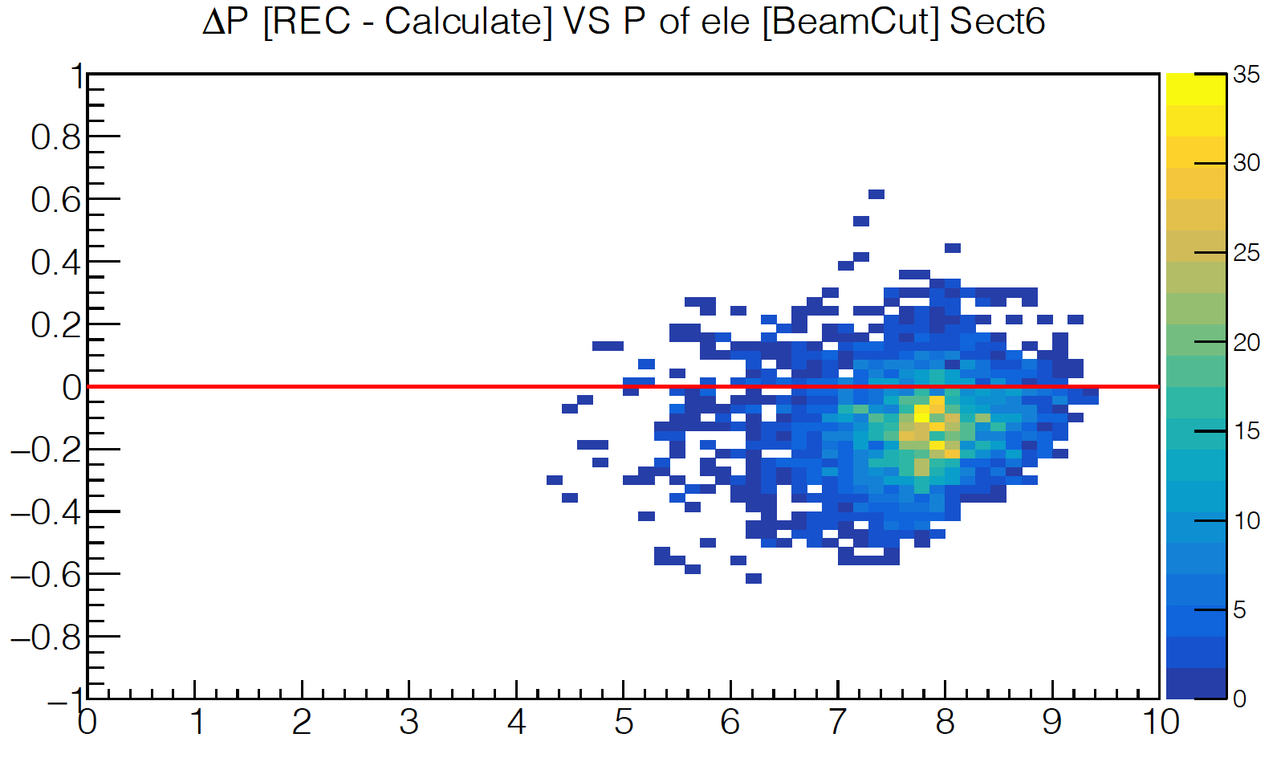

Momentum Corrections
Sector 1
Sector 2
$p_{e}^{calc}=\frac{E_{beam}}{1+2E_{beam}\sin^{2}{\left(\frac{θ_{e′}}{2}\right)}/{M_{p}}}$
${Δp}_{e′}=p_{e}^{REC}−p_{e}^{calc}$
Sector 3
Sector 4
[GeV]
Sector 5
Sector 6
$p_{e^{′}}\left[GeV\right]$

Slide 6
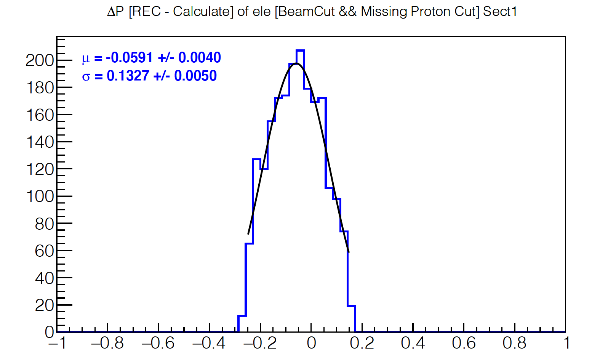
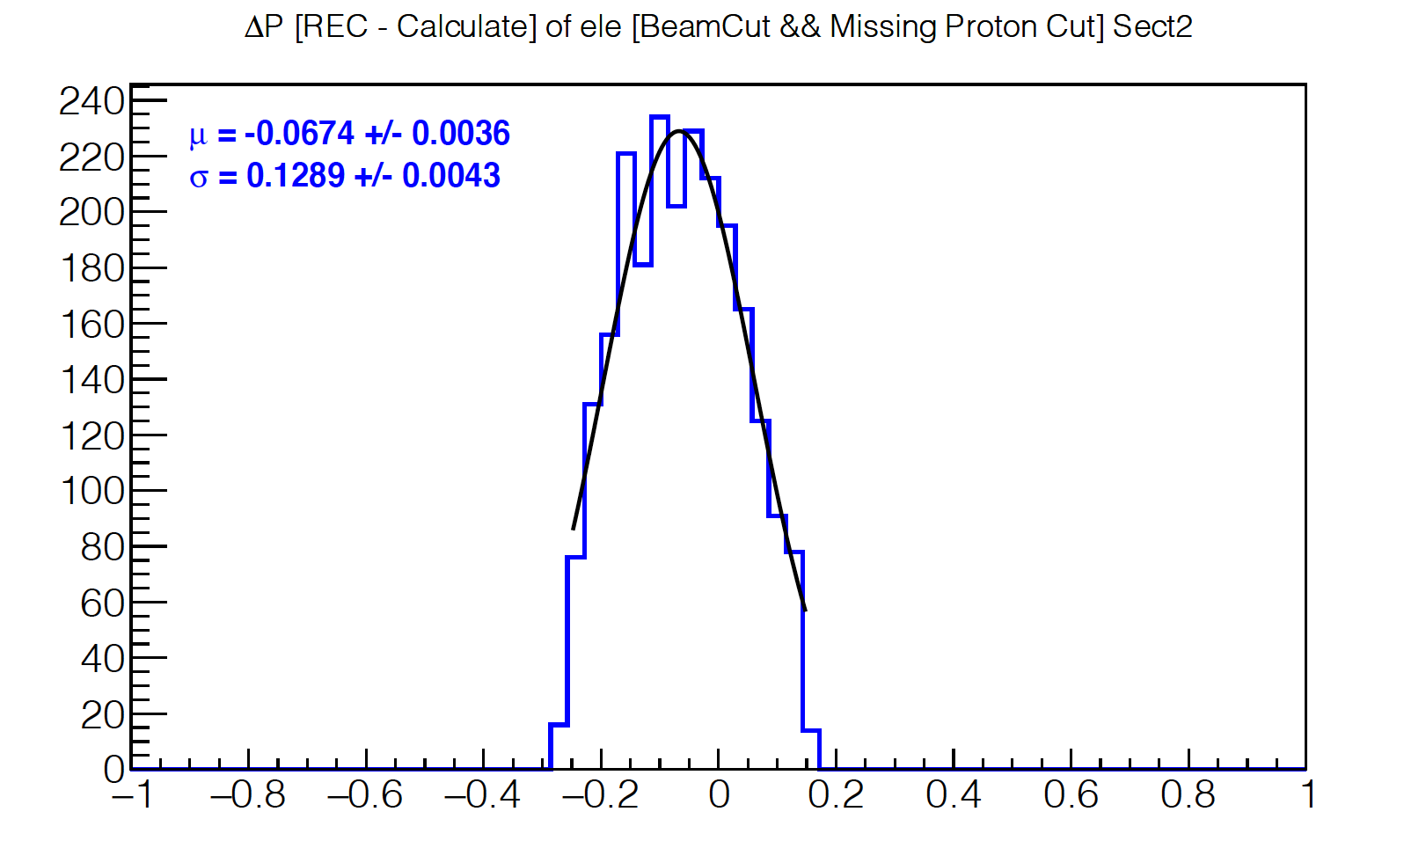
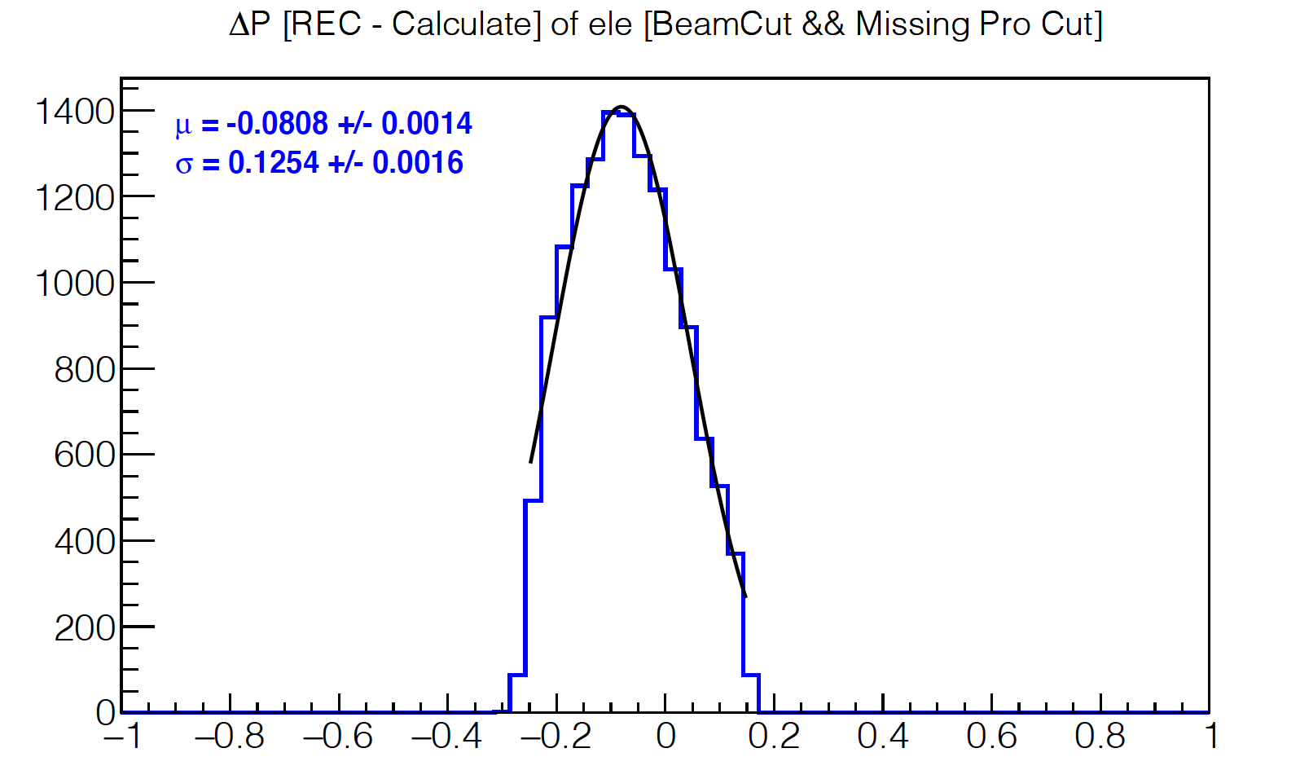


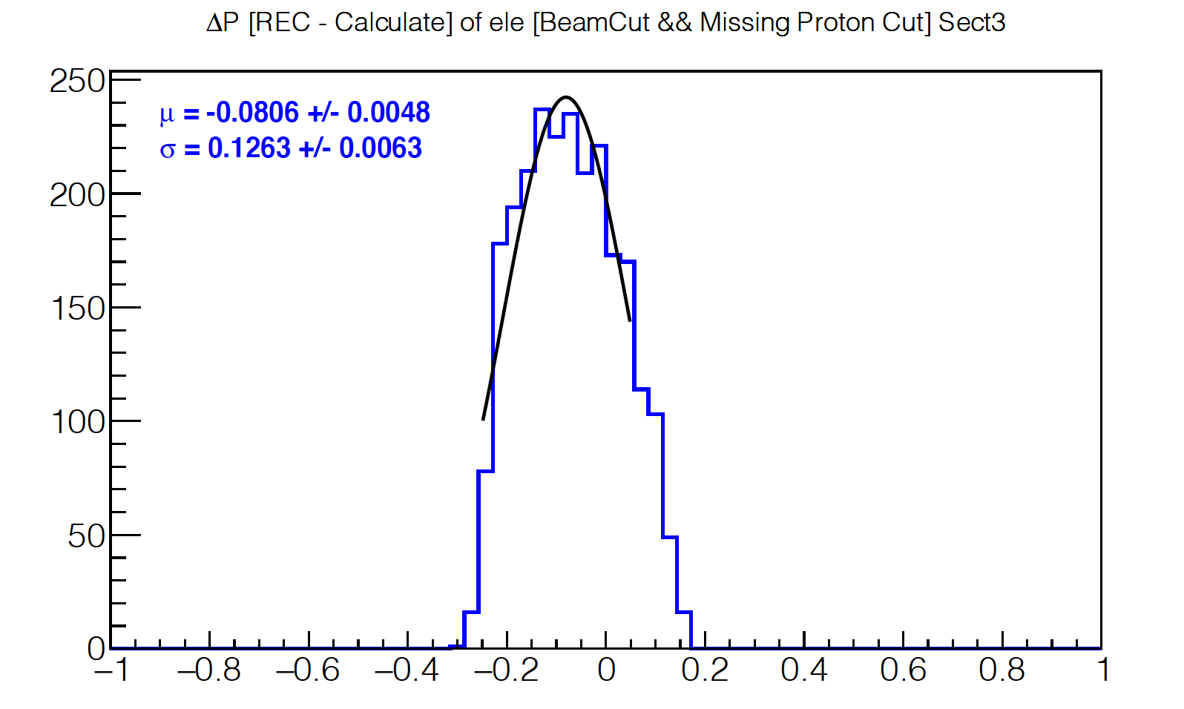
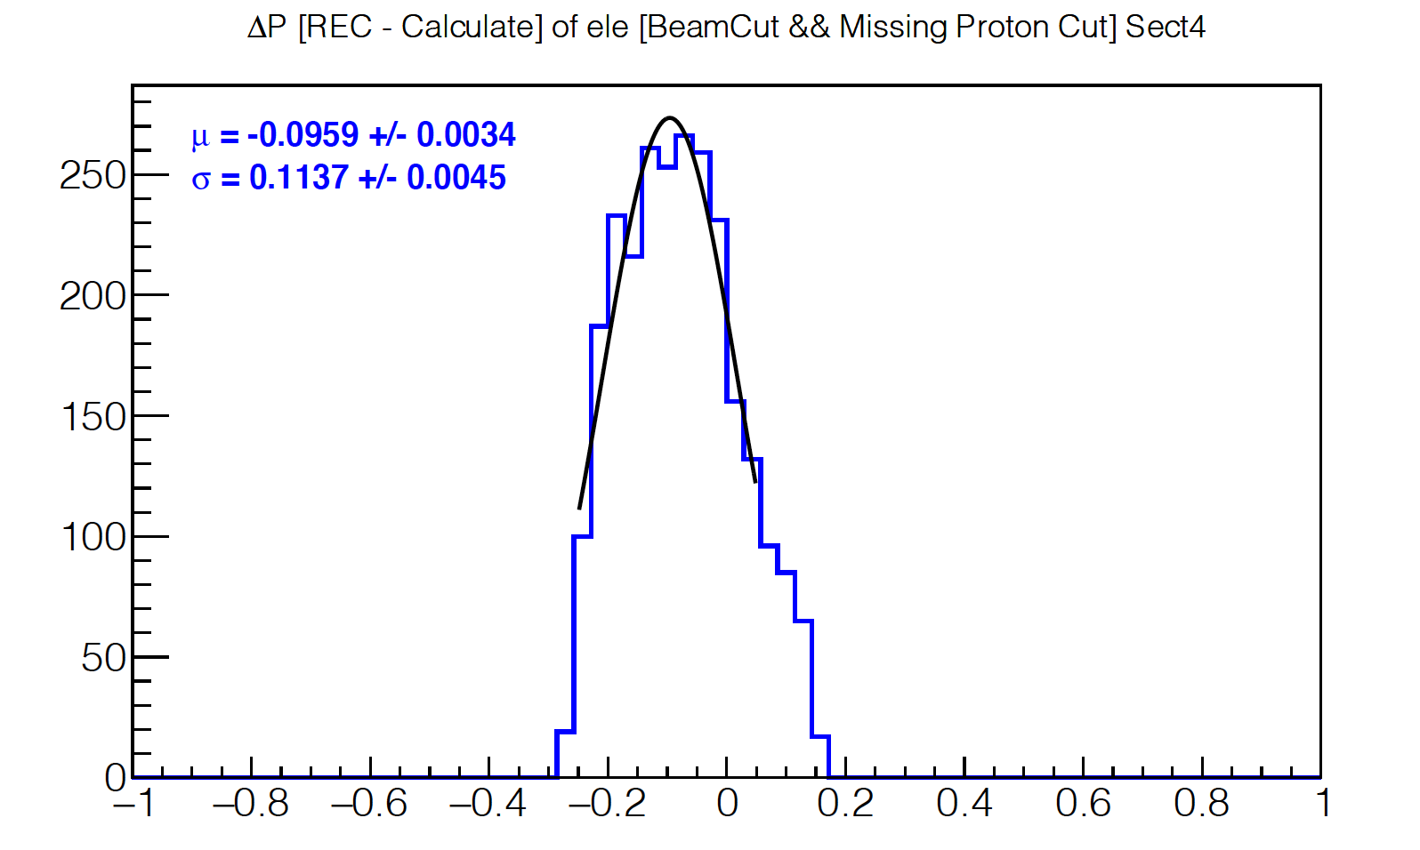

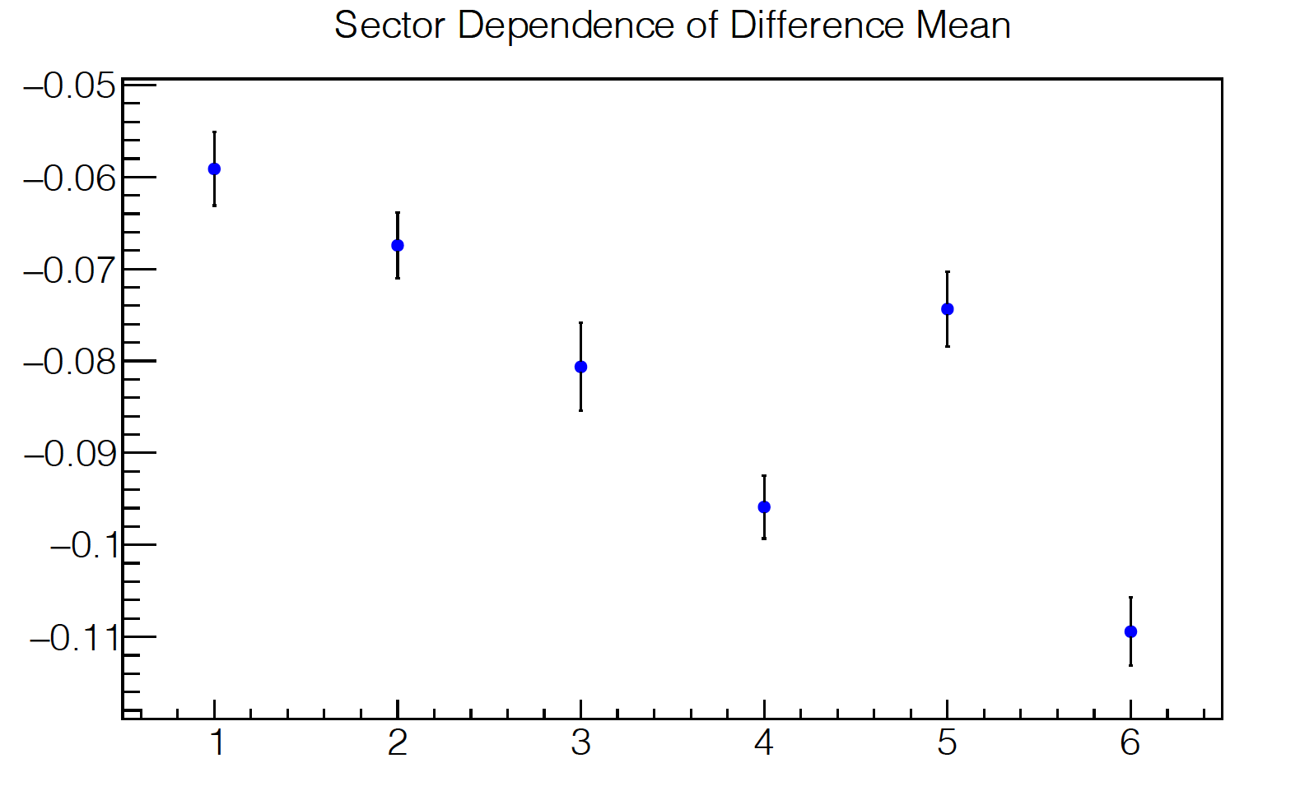


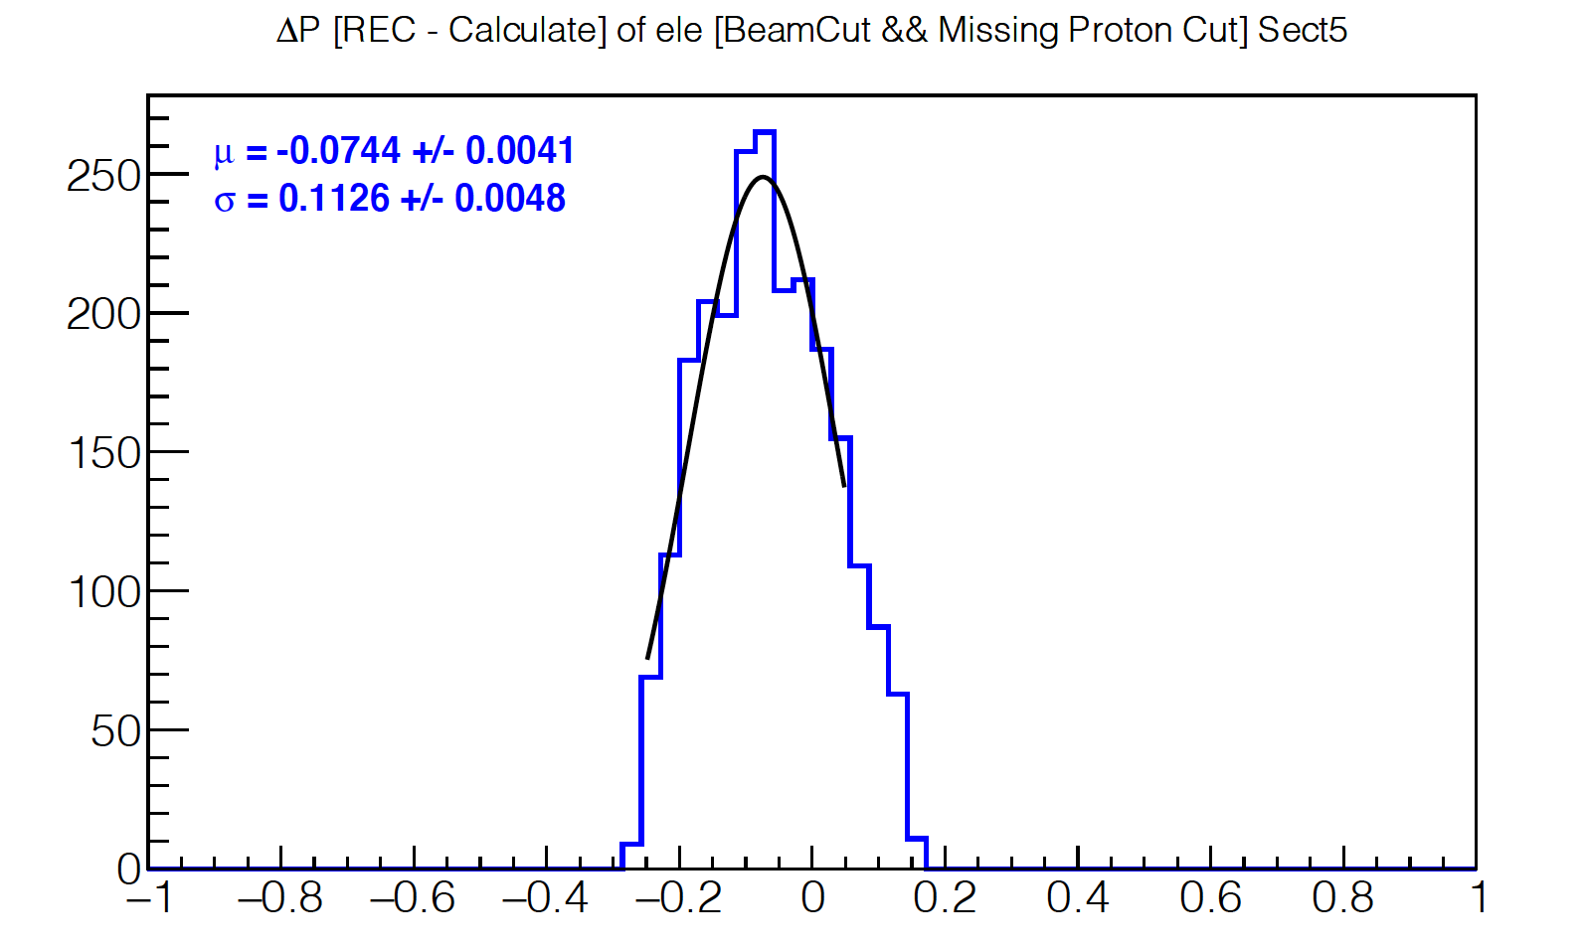
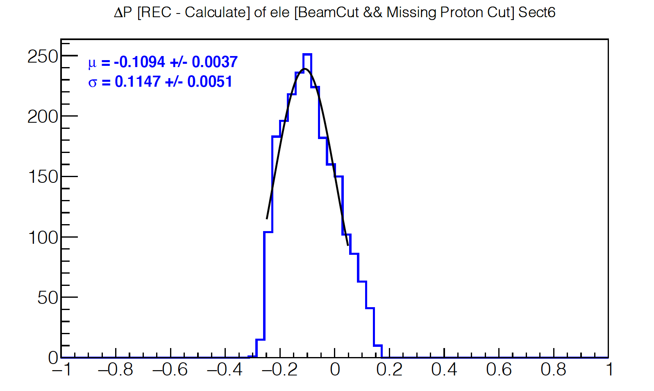


Sector 1
Sector 2
[GeV]
[GeV]
Sector 3
Sector 4
[GeV]
[GeV]
[GeV]
Sector 5
Sector 6
Sector
[GeV]
[GeV]

Slide 7
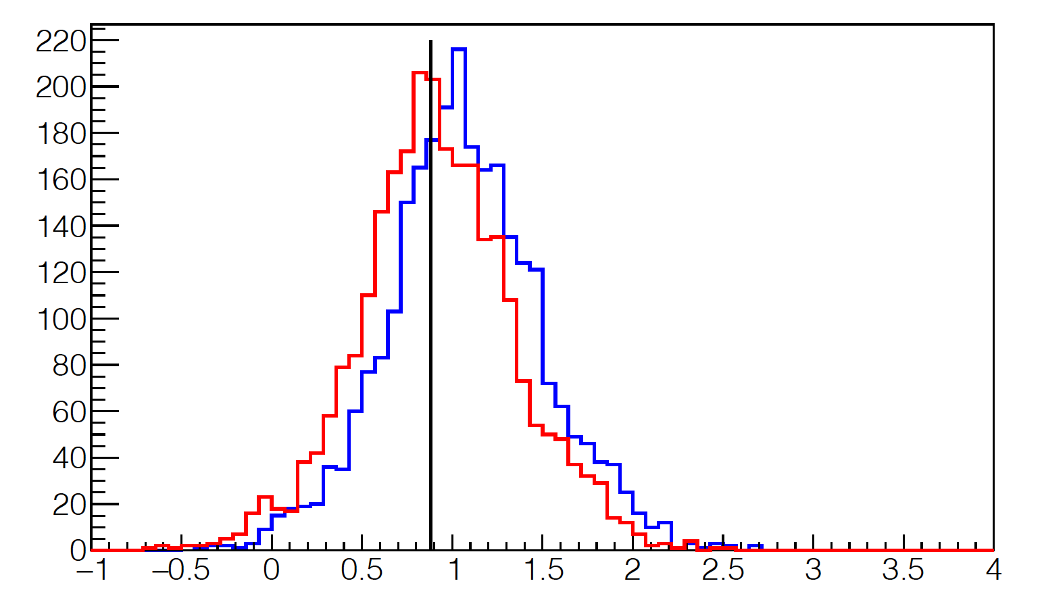
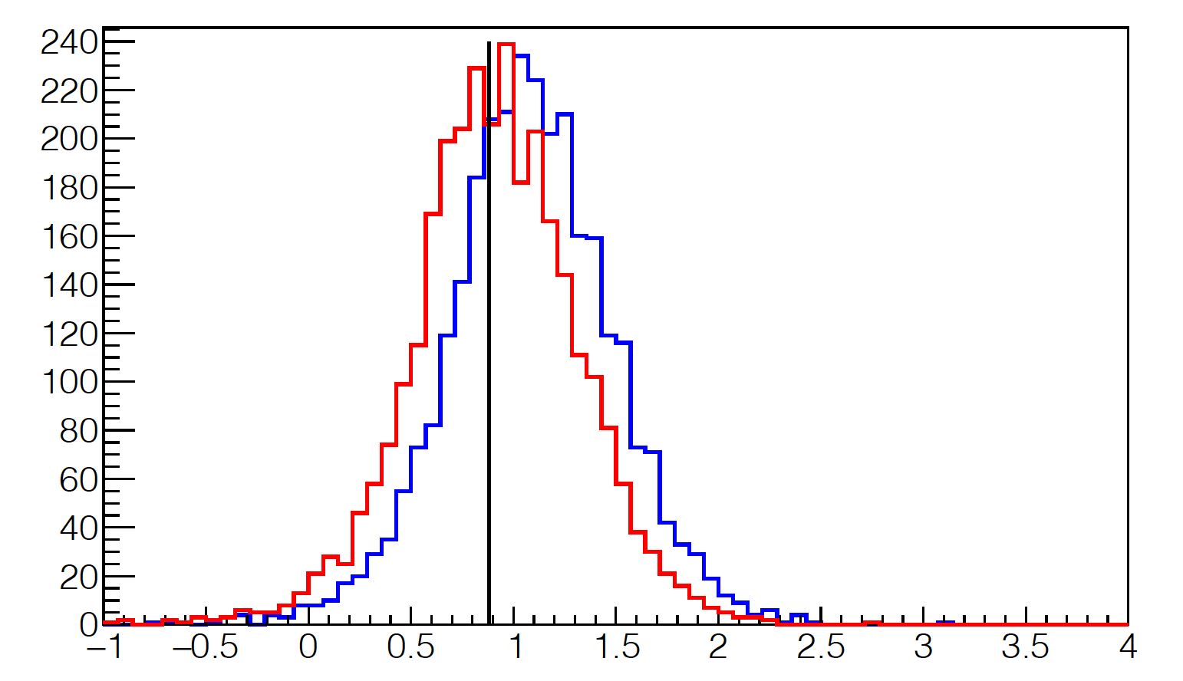
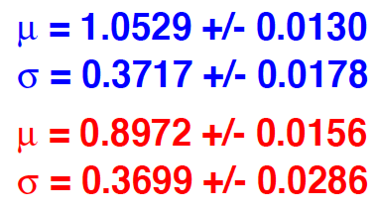
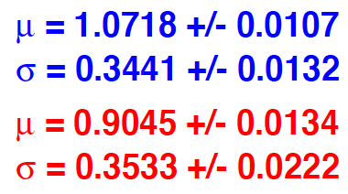
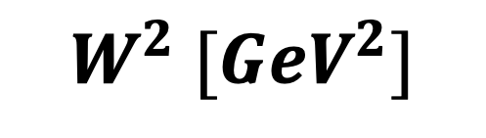
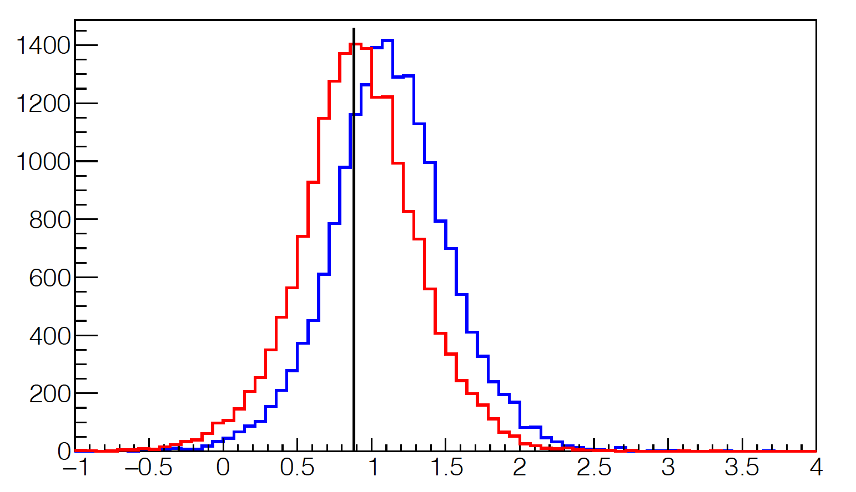
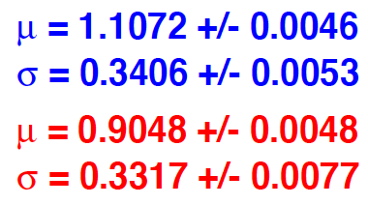
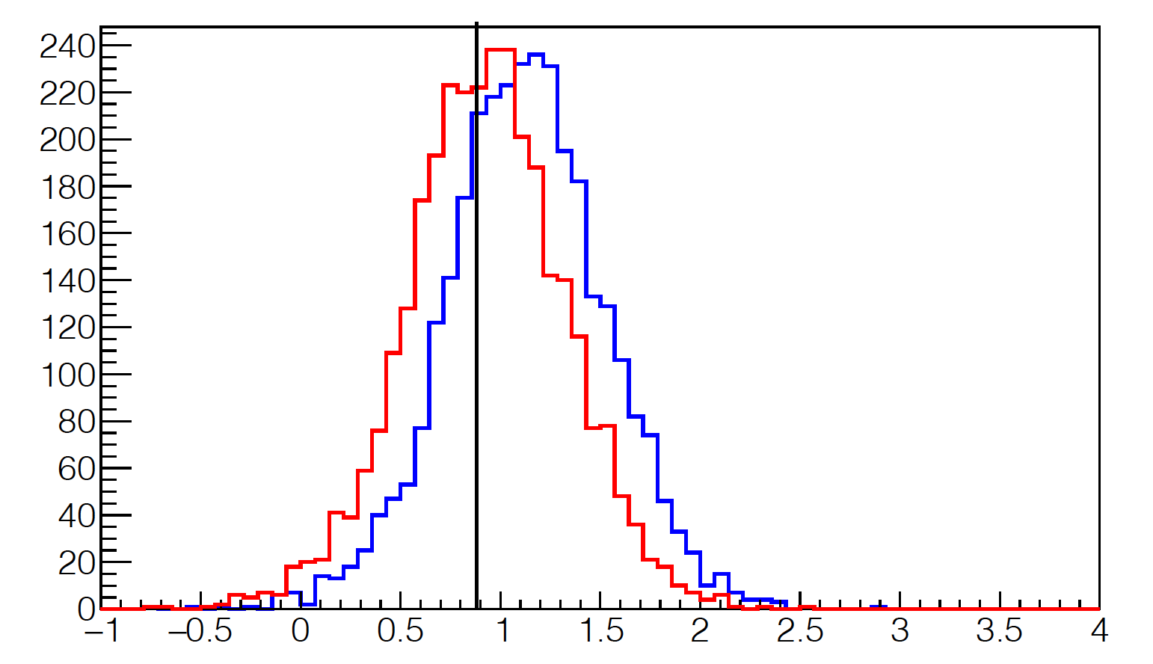
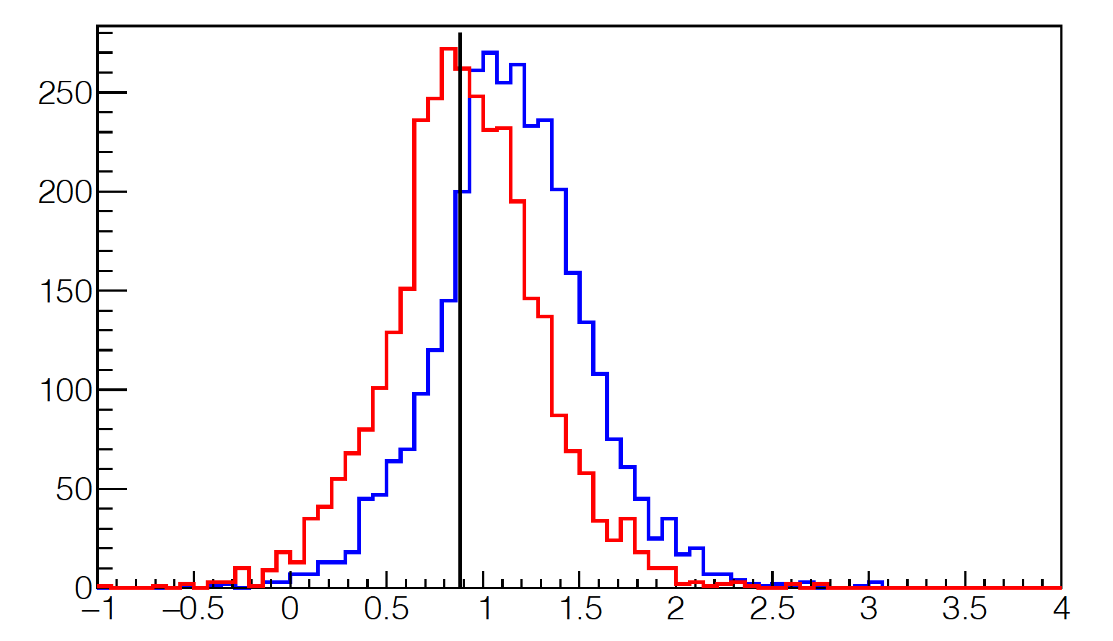
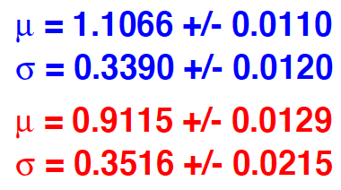
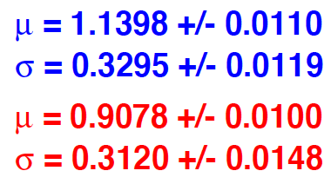
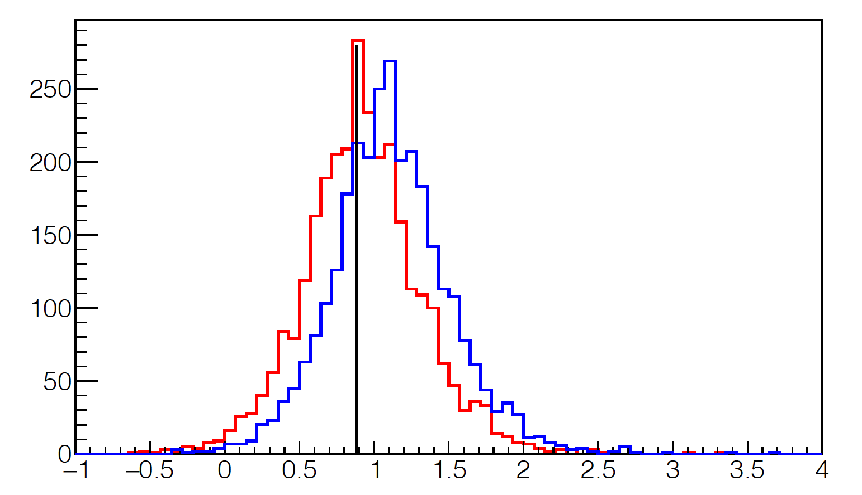
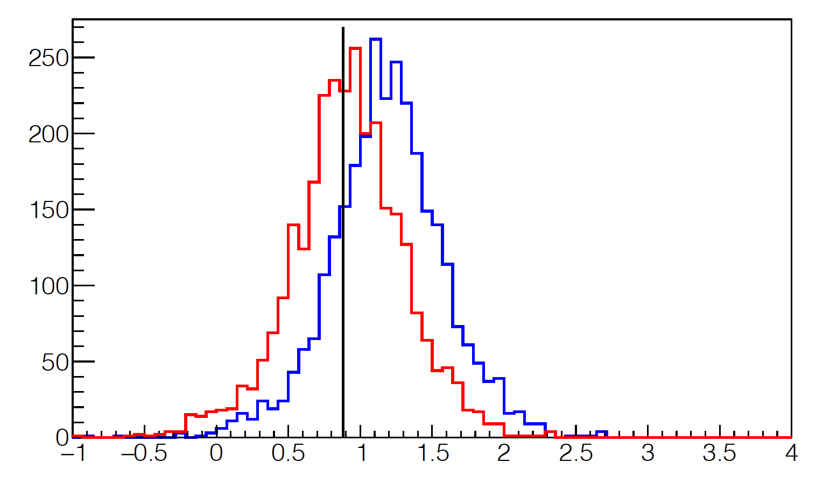
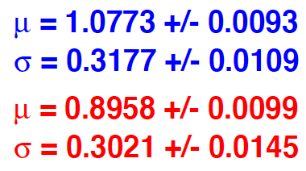
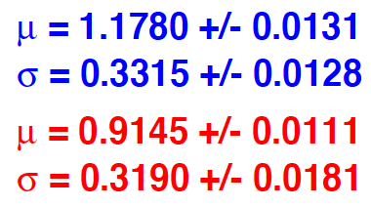
No Correction
Correction
No Correction
Correction
$W^{2}\left[{GeV}^{2}\right]$
Sector 1
Sector 2
No Correction
Correction
No Correction
Correction
No Correction
Correction
Sector 3
Sector 4
No Correction
Correction
No Correction
Correction
Sector 5
Sector 6

Slide 8
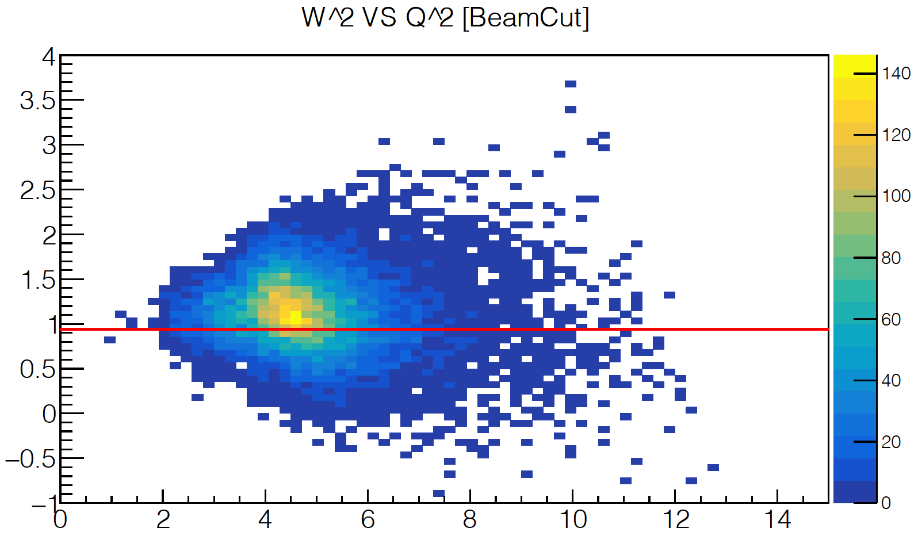
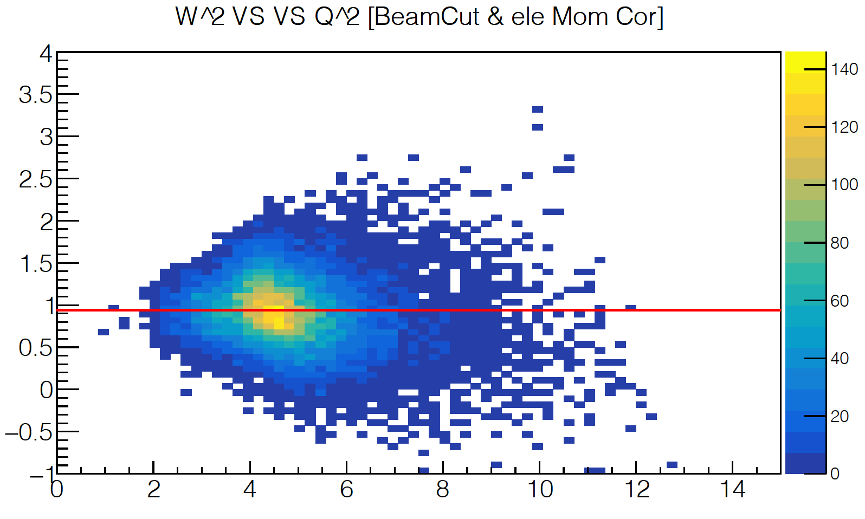
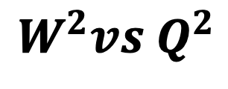
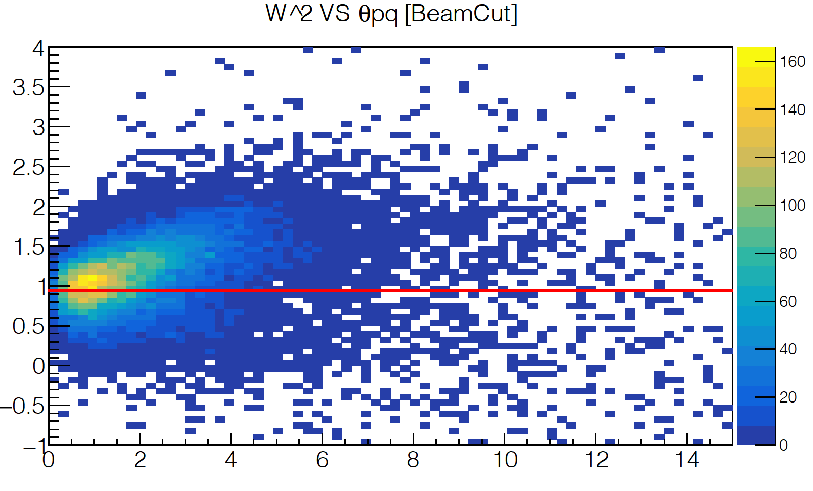
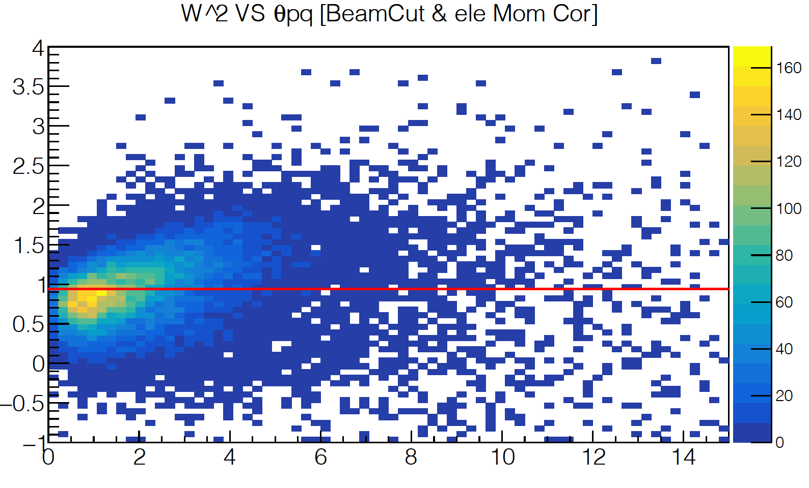
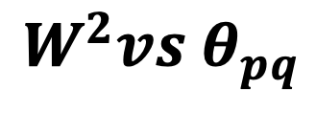
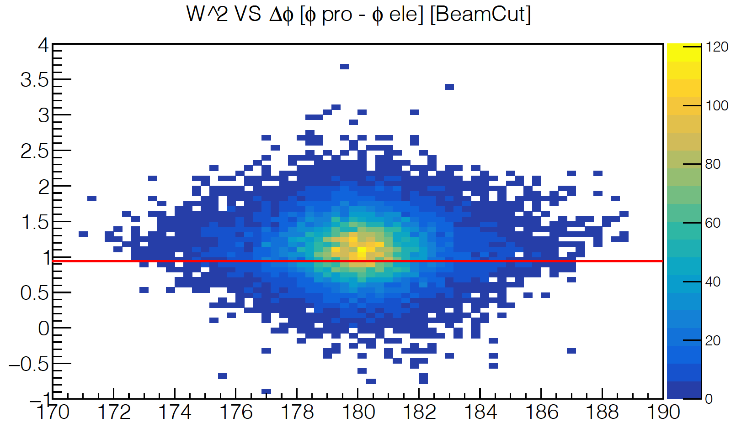
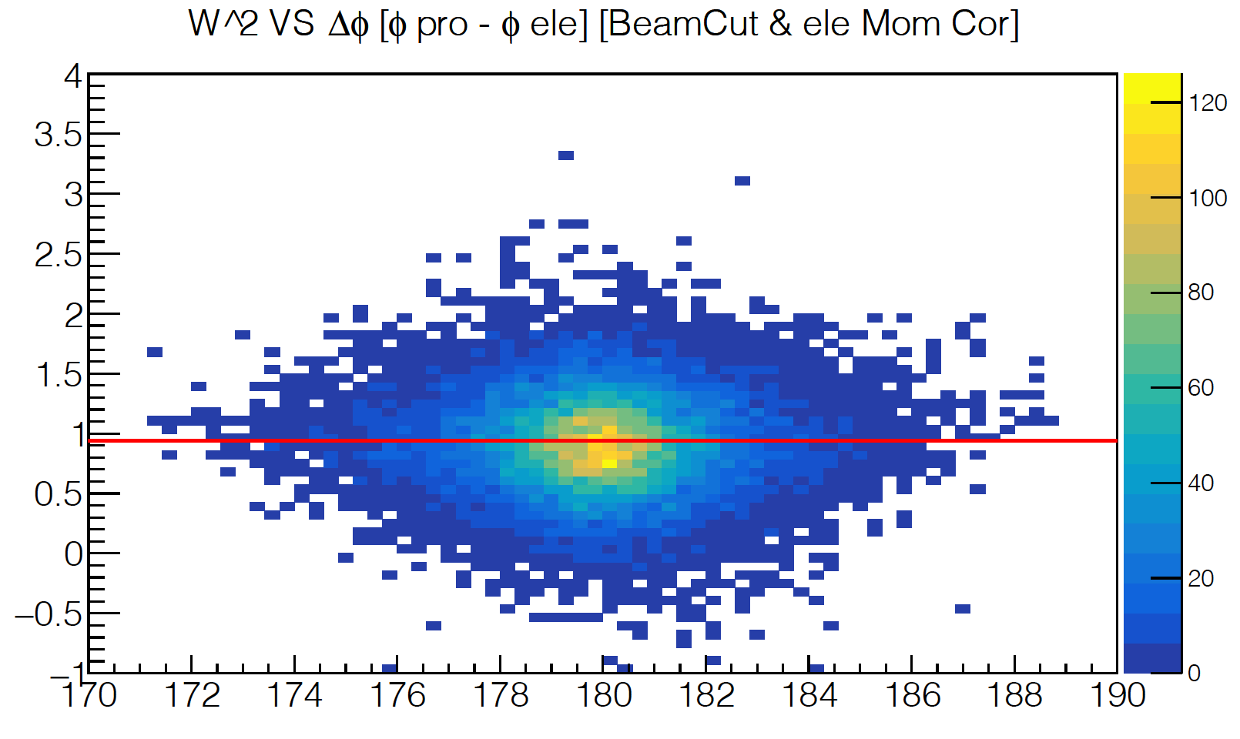

No Correction
Correction
$W^{2}vsQ^{2}$
Correction
No Correction
Correction
$W^{2}vsθ_{pq}$
No Correction
Correction
$W^{2}vs{∆φ}_{p−e^{′}}$

Slide 9









No Correction
Correction
$W^{2}vsp_{e^{′}}$
No Correction
Correction
$W^{2}vsθ_{e^{′}}$
No Correction
Correction
$W^{2}vsφ_{e^{′}}$

Slide 10









No Correction
Correction
No Correction
Correction
$∆p_{e^{′}}vsθ_{e^{′}}$
No Correction
Correction
$∆p_{e^{′}}vsφ_{e^{′}}$

Slide 11









No Correction
Correction
No Correction
Correction
$∆p_{p}vsθ_{p}$
No Correction
Correction
$∆p_{p}vsφ_{p}$

Slide 12









No Correction
Correction
No Correction
Correction
$∆θ_{p}vsθ_{p}$
No Correction
Correction
$∆θ_{p}vsφ_{p}$

Slide 13









No Correction
Correction
No Correction
Correction
$∆φ_{p}vsθ_{p}$
No Correction
Correction
$∆φ_{p}vsφ_{p}$

Slide 14



No Correction
Correction
No Correction
Correction
No Correction
Correction

Slide 15
Future plan
Extract electron corrections for other data set
Apply corrections to e-n channel and test if there is an improvement

Slide 16
Thank you …

Slide 17







No Correction
Correction
No Correction
Correction

Slide 18








No Correction
Correction
No Correction
Correction
No Correction
Correction
No Correction
Correction
No Correction
Correction
No Correction
Correction
No Correction
Correction
at

Slide 19







at
No Correction
Correction
No Correction
Correction
No Correction
Correction
No Correction
Correction
No Correction
Correction
No Correction
Correction

Slide 20









RGA
RGB

