Slide 1
<number>
The Fifth Structure Function
Liam Murray
Research Advisor: Dr. Gerard Gilfoyle
Notes:
<number>

Slide 2
<number>
Overview
Scientific Background
  History of Modern Atomic Physics
  Standard Model
  The Hadronic Model Versus Quantum Chromodynamics
  The Significance of the Fifth Structure Function
  Objective
Experimental Background
  CEBAF
  CEBAF Large Acceptance Spectrometer – CLAS
  Experimental Setup
  Extracting the Longitudinal-Transverse Asymmetry (Summer 2012)
  Kinematics
  Mathematical Approach
  Computational Approach
Simulation of CLAS: Testing the Accuracy of Measurements (Summer 2013)
  Fitting the Asymmetry
  Simulating a Reaction in CLAS
Results
Conclusions
References
Acknowledgements
Notes:
<number>

Slide 3
<number>
Scientific Background
Notes:
<number>

Slide 4
<number>
History
Democritus (400 BC)
  “atomos”
End of the 19th Century → 1930s
  Electrons, nuclei, ions, photons
Modern Era
  1964 – “Quark” or “Ace”
Notes:
According to Democritus, a Greek philosopher, matter is made up of “atomos” or what we call today, atoms.
By the 1930s, science proved that the fundamental building blocks of matter were electrons, nuclei, ions, photons, and their interactions.
Murray Gell-Mann (Caltech) “Quark” and at the same time George Zweig (CERN) “Ace” theorized an identical entity. He called them aces, because he believed there were only four of them.
<number>

Slide 5
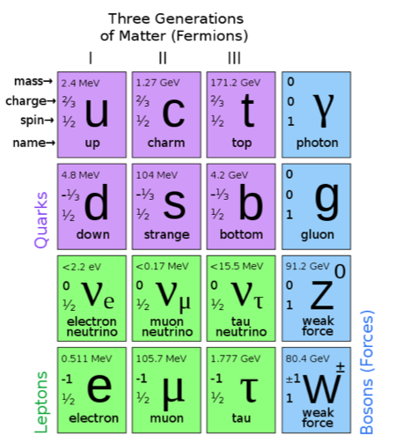
<number>
The Standard Model
Sheldon Glashow
12 Elementary Particles: Spin 1/2
4 Force Mediating Partices: Spin 1
Quark: Non-whole number electron charge
Lepton: Whole number electron charge
Notes:
The Standard Model describes three of the four forces: weak, strong, and electromagnetic, and also the particles associated with these interactions.
The top quark, the tau neutrino, and most recently, the Higgs Boson have been the most recently discovered.
<number>

Slide 6
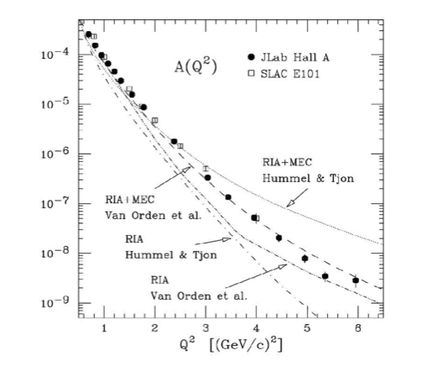
<number>
The Hadronic Model
Interactions between hadrons
Nuclei approximated as collections of protons and neutrons
Low Energy Success
Notes:
The Hadronic Model deals with the interactions between hadrons, baryons (comprised of threee quarks) and mesons(one quark one antiquark) at low energies (less than 1 GeV) in which nuclei can be approximated as collections of protons and neutrons. These hadrons interact with the strong nuclear force.
As stated earlier, the Hadronic Model is a theory which is successful experimentally at low energies (less than 1 GeV). In the figure below, the quantity on the horizontal axis is Q2, the relativistic four momentum transfer. The quantity on the vertical axis is the cross section that describes the probability of interaction in a two-particle initial state. The Hadronic Model as postulated by Van Orden et al. is consistent with the data taken from JLab and the Stanford Linear Accelerator.
<number>

Slide 7
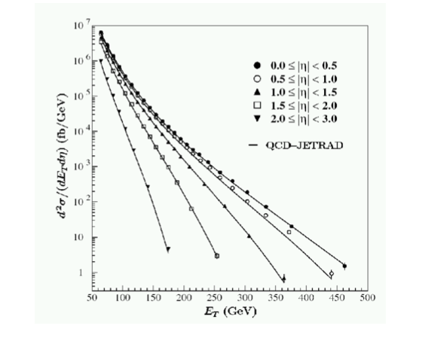
<number>
Quantum Chromodynamics (QCD)
Color force
  Interactions of quarks and gluons making up hadrons
Asymptotic Freedom
Confinement
  ≈ 3 tons of force between
High Energy Success
Difficulty Testing
Notes:
Quantum Chromodynamics or QCD is a theory of the strong or “color” force, describing the interactions of the quarks and gluons making up hadrons. Quantum Chromodynamics predicts asymptotic freedom and confinement.
Asymptotic freedom is when quarks and gluons behave like free non-interactive particles at very high energies and only experience the Coulomb force.
Asymptotic freedom was discovered in the 1970s, physicists received 2004 Nobel Prize in Physics.
Confinement is the theoretical property of quarks that they are never seen outside a macroscopic particle such as a proton or a pion.
Force remains remains constant (around 14 tons).
Quantum Chromodynamics has been a very effective theory at high energies. As you can see in the graph.
Difficult to test.
N = eta is pseudrorapidity, related to the scattering angle
First plot - E_T or transverse energy. These data are from proton-antiproton collisions where both particles are moving in counter-rotating beams. 'Splashes' of particles are produced that are called 'jets'. The total energy of each jet (this is the transverse energy) is obtained by adding up all the energies of the measured particles. High E_T means nearly head-on collisions of the quarks or gluons and more energy released in the collision.
<number>

Slide 8
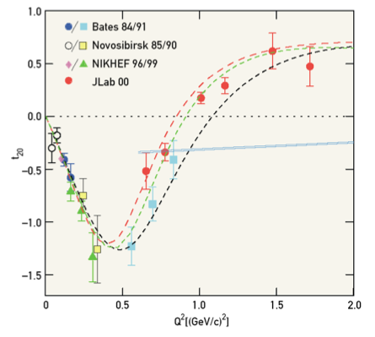
<number>
The Hadronic Model Vs. QCD
Goal: Better understand the behavior of quarks at intermediate energies
Notes:
The major problem with the two theories together is that they do not meet up. In figure 4, we can see that the Hadronic Model works at low energies, but the Quantum Chromodynamics model (the blue) does not fit at all. Therefore, the ultimate goal of nuclear physics is to better understand the behavior of quarks at the intermediate energies.
Deuterium tensor polarization observable vs. Q2
The third T20 is a polarization variable which depends on the difference between cross sections that arise from two different quantum amplitudes. Measuring T20 plus other measurements of the cross sections enable you to separate the contribution from these different amplitudes. The amplitudes are for different angular momenta.
<number>

Slide 9
<number>
Significance of the Fifth Structure Function
Explore the quark-gluon structure of atomic nuclei
  First, we need to understand atomic nuclei as collections of protons and neutrons.
The Structure of the Deuteron
  Important place to start our understanding of atomic nuclei
Helicity Asummetry A’LT→ Fifth Structure Function
  Seldom-measured part of Deuteron W.F. where Proton-Neutron force is expected to dominate
Notes:
One of the goals of Jefferson National Laboratory in Newport News, Virginia is to explore the quark-gluon structure of atomic nuclei. To do that, we first need to understand atomic nuclei as collections of protons and neutrons to see where that picture begins to fail revealing the underlying quark gluon structure. A quantitative understanding of the structure of the deuteron is an important place to start this understanding. A deuteron is the nucleus of deuterium: the stable isotope of hydrogen which contains one proton and one neutron.
Our goal is to measure the helicity asymmetry A’LT. By measuring this asymmetry, we can explore the fifth structure function, a seldom-measured part of the deuteron response where the proton-neutron force is expected to dominate.
The Frontiers of Nuclear Science: A Long Range Plan; US Department of Energy/National Science Foundation, Washington, DC, 2007.
<number>

Slide 10
<number>
Objective
Measure the largely unknown component of the deuteron wave function (the fifth structure)
  2H(e,e’p)n Reaction
  Never completed in this energy range
Test the accuracy of our analysis
  Monte Carlo Simulation
Notes:
a term of the cross section of 2H(e,e’p)n. 2H denotes the deuterium atom, e is the incident electron, e’ is the scattered electron, p is the scattered proton, and n is the residual neutron. No measurement of this term exists in this energy range so this experiment will break through towards the door of strong nuclear force terrain.
To do this, we will take the analysis code that was used on the actual data, and perform the same analysis on a simulation of CLAS. We will then compare the simulated results with a fit to the data. By fitting the measured A’LT from the actual data and then using the fit in a CLAS simulation, we will be able to accurately simulate the experiment. The results should be the same within the uncertainties.
<number>

Slide 11
<number>
Experimental Background
Notes:
<number>

Slide 12
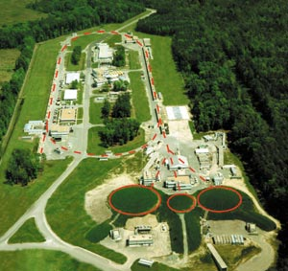
<number>
CEBAF
Continuous Electron Beam Accelerator Facility
  Newport News, Virginia
  ≈ 1 mile long
  Max: 5.7 GeV Beam Energy
Notes:
Jefferson Laboratory initially was constructed to send electron beams up to 5 times around the track at velocities close to the speed of light with a maximum beam energy of 5.7 GeV.
Now, Jlab is upgrading to 12 GeV. They will also be adding a new hall, Hall D.
<number>

Slide 13
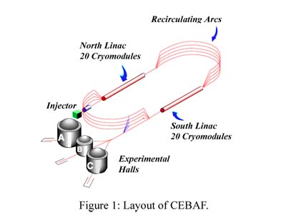
<number>
CEBAF
Injector
North/South Linear Accelerators
  SRF technology
Recirculating Arcs
Experimental Halls
Notes:
CEBAF is based on superconducting radiofrequency (SRF) technology. It produces a stream of charged electrons that scientists use to probe the nucleus of the atom. CEBAF was the first large-scale application of SRF technology in the world, and it is the world's most advanced particle accelerator for investigating the quark structure of the atom's nucleus.
CEBAF greatly increases the velocity of charged electrons by subjecting the charged particles to a series of oscillating electric potentials along a linear beamline
<number>

Slide 14
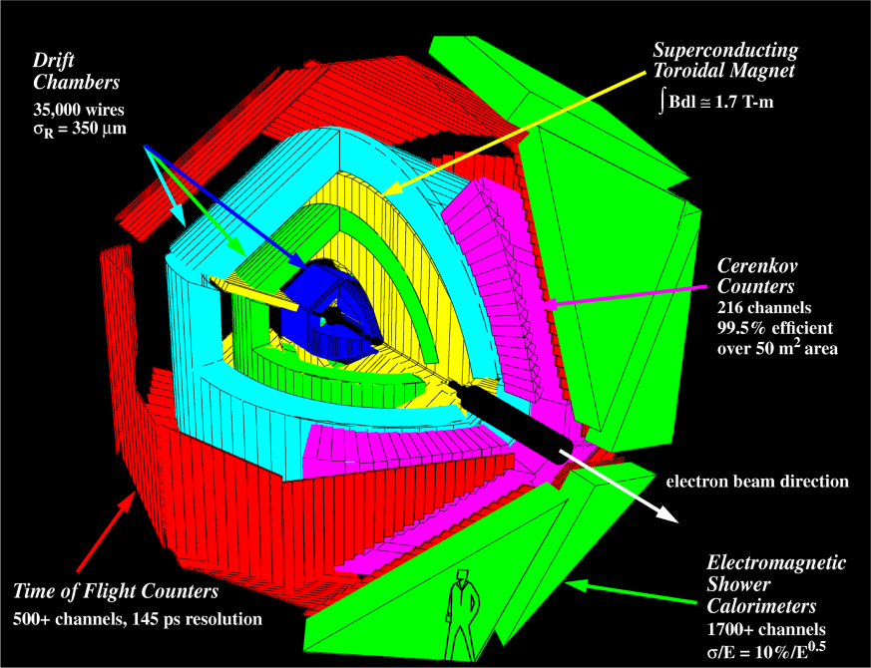
<number>
Hall B: CLAS
CEBAF Large Acceptance Spectrometer
  1995-2012
45-ton, three-story, spectrometer
Six identical Sectors
Nearly 4π Solid Angle
Notes:
<number>

Slide 15
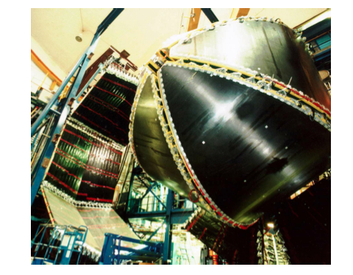
<number>
Hall B: CLAS
Superconducting Toroidal Magnet
Drift Chambers
Cherenkov Counters
Time-of-Flight Scintillators
Electromagnetic Calorimeters
Notes:
<number>

Slide 16
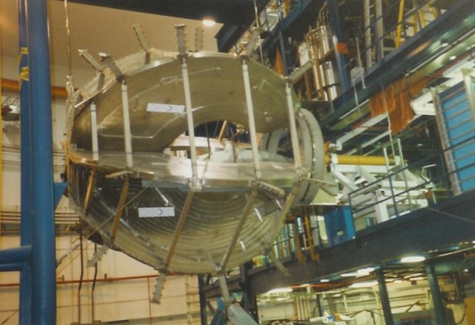
<number>
Hall B: CLAS
Toroidal Magnet
  Provides a magnetic field
  Two magnetic polarity settings (Normal/Reversed)
Notes:
This magnet bends charged particles in opposite directions based on the polarity setting (normal or reversed). This allows us to measure the charged particle momentum.
<number>

Slide 17
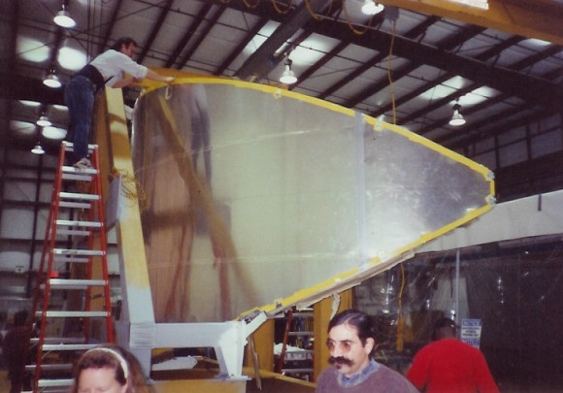
<number>
Hall B: CLAS
Drift Chambers
  Detector for particles with ionizing radiation
  Detects both presence and location of radiation
  Quasi-Geiger counter (I. Lab)
  Three Regions
Notes:
Detector for particles of ionizing radiation. It is an advanced form of the Geiger counter which detects not only the presence of radiation but also its location. Large volume filled with positively charged wires and a chosen gas. As a particle travels through the chamber, the particle ionizes and displaces electrons towards the positively charged wires. This creates an electrical signal.
<number>

Slide 18
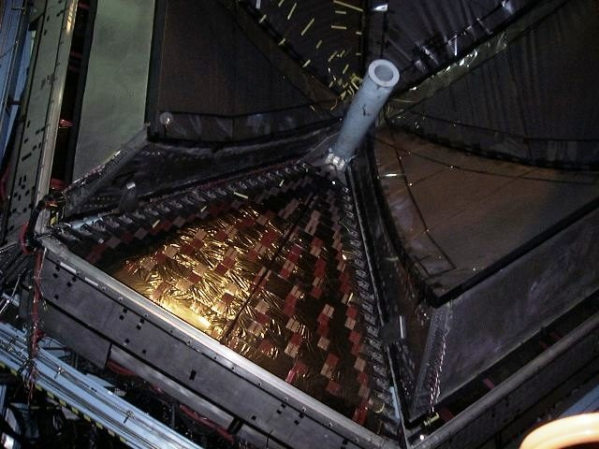
<number>
Hall B: CLAS
Cherenkov Detectors
  Allow us to differentiate between pions and electrons
  Detects electromagnetic radiation emissions
Notes:
Allow us to differentiate between pions and electons.We are able to differentiate between the two based on the fact that a particle moving through the gas filled detector described above at a velocity above the speed of light in the gas emits electromagnetic radiation to reduce its speed in the medium. While electron emits light in the Cerenkov detector, the pion, a heavier particle moving at a speed less than the speed of light in the gas, does not emit Cerenkov radiation.
<number>

Slide 19
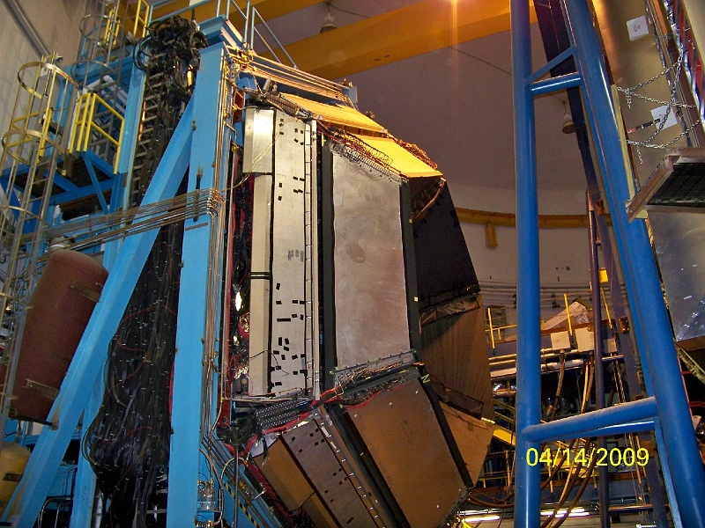
<number>
Hall B: CLAS
Time-of-Flight Scintillators
  Lighter and heavier particle differentiation
  Scintillators: Variety of materials
  Detection possible by photo multiplier tubes
Notes:
Allow us to differentiate between a lighter and a heavier particle with the same momentum using the time from interaction to hitting the scintilator. Scintillators can be made up of a variety of materials both liquid and solid. In the prescense of ultraviolet light, plastic scintillators glow blue. The light can be detected by photo multiplier tubes
<number>

Slide 20
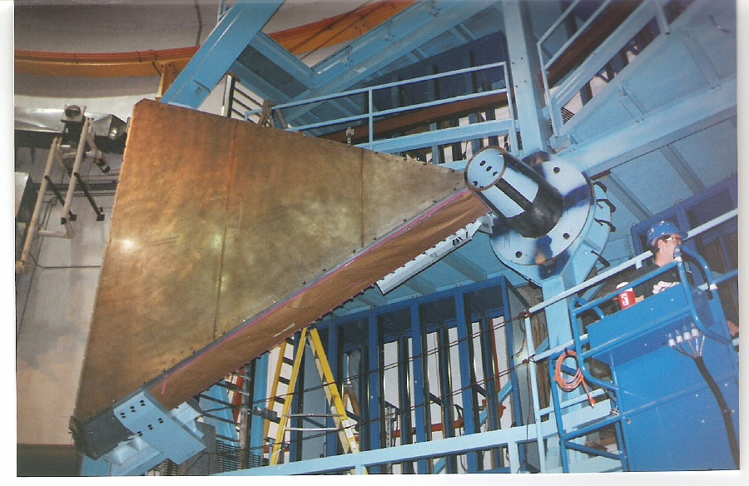
<number>
Hall B: CLAS
Electromagnetic Calorimeters
  Differentiate electrons and neutral particles
  Comprised of alternating layers of lead/scintillator
  Particles interact in the lead creating a shower of photons in the scintillator
Notes:
Allow us to differentiate between a lighter and a heavier particle with the same momentum using the time from interaction to hitting the scintilator. Scintillators can be made up of a variety of materials both liquid and solid. In the prescense of ultraviolet light, plastic scintillators glow blue. The light can be detected by photo multiplier tubes
<number>

Slide 21
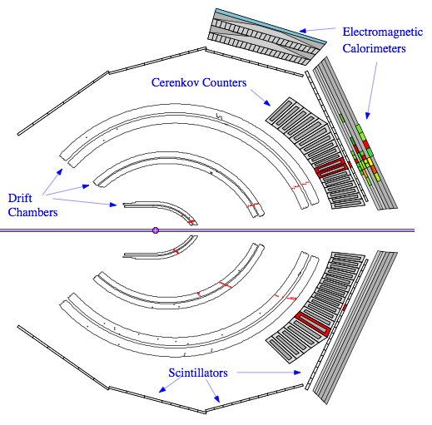
<number>
Hall B: CLAS
Trajectory
Charge
Momentum
Energy
Scattering Angle
Velocity
Notes:
<number>

Slide 22
<number>
Experimental Setup
2.56 GeV beam
Both normal and reversed magnetic torus polarities
Dual, co-linear liquid hydrogen-deuterium cell target
Notes:
5 cm target
<number>

Slide 23
<number>
Extracting the Asymmetry (Summer 2012)
Notes:
<number>

Slide 24
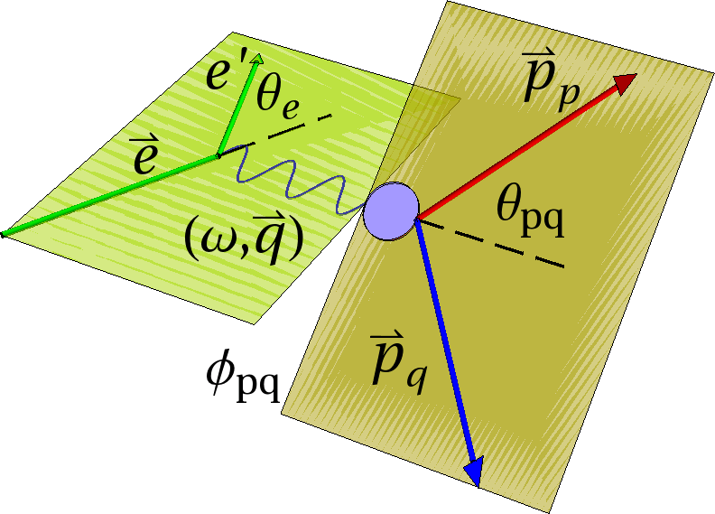
<number>
Extracting the Asymmetry
Kinematics of the 2H(e,e’p)n reaction
  Quasi-elastic collisions
Notes:
As seen in the diagram below, the longitudinal direction points in the direction of the exchanged photon, while the transverse direction is orthogonal to the longitudinal direction. The azimuthal angle Φpq is the angle between the scattering and reaction planes, while the angle θpq is the angle between the longitudinal direction and the direction of the scattered proton. The angle θe is the angle between the incoming electron, e, and the scattered electron e’, and q is the three momentum transfer.
One other important feature of the kinematics of this experiment is the limitation of elastic events in our experimental calculations and simulations. In our investigation, we are interested in quasi-elastic collisions where the conserved kinetic energy is exchanged between the electron and the deuteron nucleus via a virtual photon.
± / h -- beam helicity: Spin of the incoming electron beam. Either aligned or anti-aligned with the momentum of the beam.
Φpq -- shown in Figure 3
Pp -- 3-momentum transfer
q-- ejected proton 3-momentum.
Pm -- missing momentum defined as Pm = q - Pp
σi’s -- partial cross sections for each component.
<number>

Slide 25
<number>
Extracting the Asymmetry
Mathematical Approach
  Differential Cross Section
  Helicity Asymmetry
Notes:
The fivefold differential cross section for the quasielastic 2H(e,e’p)n reaction. Right handside, effective cross section area in longitudinal transverse and their cross terms. On the left hand side of the equations denotes the cross section, dw is the infitesimal elemnt of the enrgy transfer, solid angle, and proton solid angle
± / h -- beam helicity: Spin of the incoming electron beam. Either aligned or anti-aligned with the momentum of the beam.
Φpq -- shown in Figure 3
Pp -- 3-momentum transfer
q-- ejected proton 3-momentum.
Pm -- missing momentum defined as Pm = q - Pp
σi’s -- partial cross sections for each component.
What is a Cross Section: It’s proportional to the probability of particle interaction. It removes all idiosyncrasies of the detector, beam and target.
Last term is what we are looking for. It has rarely been measured. Unknown component of the deuteron wave function. For conventional detectors, scattering plane is at the same angle of the reaction plane. Fifth term is non zero only when angle between the planes is nonzero. Detector must allow for out of plane measurements. The asymmetry allows for some intuition on the fifth structure function.
<number>

Slide 26
<number>
Extracting the Asymmetry
Mathematical Approach
  Differential Cross Section
  Helicity Asymmetry
≈|Ψ|2
Notes:
The fivefold differential cross section for the quasielastic 2H(e,e’p)n reaction. Right handside, effective cross section area in longitudinal transverse and their cross terms. On the left hand side of the equations denotes the cross section, dw is the infitesimal elemnt of the enrgy transfer, solid angle, and proton solid angle
± / h -- beam helicity: Spin of the incoming electron beam. Either aligned or anti-aligned with the momentum of the beam.
Φpq -- shown in Figure 3
Pp -- 3-momentum transfer
q-- ejected proton 3-momentum.
Pm -- missing momentum defined as Pm = q - Pp
σi’s -- partial cross sections for each component.
What is a Cross Section: It’s proportional to the probability of particle interaction. It removes all idiosyncrasies of the detector, beam and target.
Last term is what we are looking for. It has rarely been measured. Unknown component of the deuteron wave function. For conventional detectors, scattering plane is at the same angle of the reaction plane. Fifth term is non zero only when angle between the planes is nonzero. Detector must allow for out of plane measurements. The asymmetry allows for some intuition on the fifth structure function.
<number>

Slide 27
<number>
Extracting the Asymmetry
Mathematical Approach
  Differential Cross Section
  Helicity Asymmetry
pm = pp - q
NOT ZERO FOR OUT-OF-PLANE MEASUREMENTS!
Notes:
The fivefold differential cross section for the quasielastic 2H(e,e’p)n reaction. Right handside, effective cross section area in longitudinal transverse and their cross terms. On the left hand side of the equations denotes the cross section, dw is the infitesimal elemnt of the enrgy transfer, solid angle, and proton solid angle
± / h -- beam helicity: Spin of the incoming electron beam. Either aligned or anti-aligned with the momentum of the beam.
Φpq -- shown in Figure 3
Pp -- 3-momentum transfer
q-- ejected proton 3-momentum.
Pm -- missing momentum defined as Pm = q - Pp
σi’s -- partial cross sections for each component.
What is a Cross Section: It’s proportional to the probability of particle interaction. It removes all idiosyncrasies of the detector, beam and target.
Last term is what we are looking for. It has rarely been measured. Unknown component of the deuteron wave function. For conventional detectors, scattering plane is at the same angle of the reaction plane. Fifth term is non zero only when angle between the planes is nonzero. Detector must allow for out of plane measurements. The asymmetry allows for some intuition on the fifth structure function.
<number>

Slide 28
<number>
Extracting the Asymmetry
Notes:
<number>

Slide 29
<number>
Extracting the Asymmetry
Notes:
<number>

Slide 30
<number>
Extracting the Asymmetry
Notes:
<number>

Slide 31
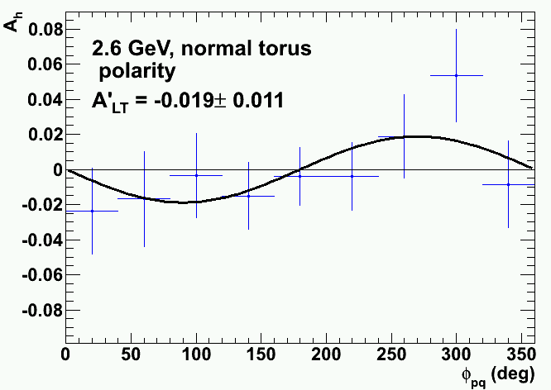
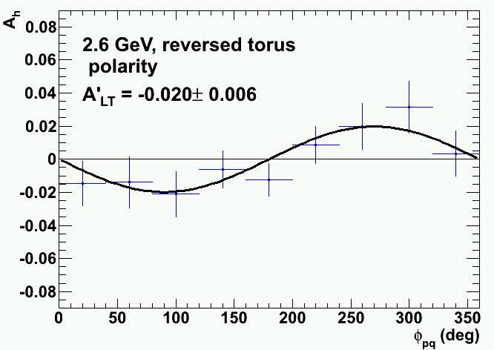
<number>
Extracting the Asymmetry
Computational Approach
  C++ code
  CERN ROOT package
Ah, Normal Polarity, pm=0.30 GeV/c
Ah, Reversed Polarity, pm=0.30 GeV/c
Notes:
We generated ROOT 2D histograms for both beam helicities as a function of the missing momentum pm and the out-of-plane angle Φpq.
We calculated the ratio of the difference of the opposite beam helicity histograms divided by their sum to create a new set of 2D histograms in pm and Φpq bins.
Data for a given pm bin were projected out and the Φpq dependence was fitted to a sinusoidal curve over the range pm=0-0.7 GeV/c in nine bins.
We completed these steps for both the normal and reversed magnetic polarities of the CLAS toroidal magnetic field.
<number>

Slide 32
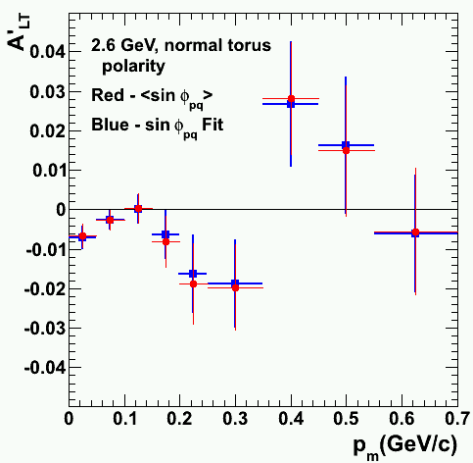
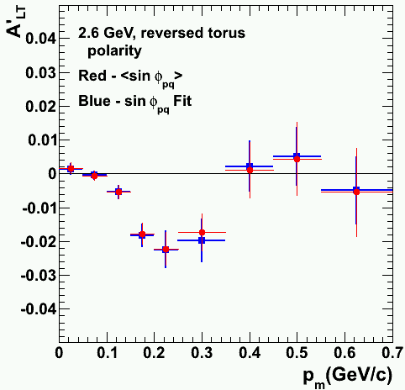
<number>
Results (Summer 2012)
The asymmetry A’LT
  Red: sinΦpq-weighted average
  Blue: fits to Ah from above
Notes:
Both methods of extracting A’LT are consistent. The average difference between the two methods was 0.0004±0.0012 for the normal torus polarity and 0.0001±0.0010 for the reversed torus polarity.
<number>

Slide 33
<number>
Simulation of CLAS (Summer 2013)
Notes:
<number>

Slide 34
<number>
Simulation of CLAS
Simulating a reaction in CLAS
QUEEG
txt2part
QSIM
gppjlab
RECSIS
n10tmaker
h2root
eod5root
Notes:
<number>

Slide 35
<number>
Simulation of CLAS
QUEEG
  Generates quasi-elastic electron events
Notes:
Generates electron and proton 4-vectors
<number>

Slide 36
<number>
Simulation of CLAS
txt2part
  Converts the output files into BOS data files
  BOS: CLAS data format
Notes:
<number>

Slide 37
<number>
Simulation of CLAS
GSIM
  Simulates CLAS
  Based on GEANT3
Notes:
<number>

Slide 38
<number>
Simulation of CLAS
Fitting the Asymmetry (C.A. Copos)
  Incorporated into Monte Carlo simulation to model the Fifth Structure Function
Notes:
To accurately simulate the reaction in CLAS, we use fits of the measured asymmetries to serve as models. Equation 4 was used to fit the data. The equation fits the asymmetry data well and decreases to zero as expected as the missing momentum decreases to zero. See the black curves in Figures 13 and 14. The fit equations were then incorporated into the Monte Carlo simulation GSIM.
<number>

Slide 39
<number>
Simulation of CLAS
gppjlab
  Makes the GSIM output look real
    Knocks out dead scintillators and wires
Notes:
<number>

Slide 40
<number>
Simulation of CLAS
RECSIS
  Standard program for reconstruction of CLAS data
Notes:
<number>

Slide 41
<number>
Simulation of CLAS
n10tmaker
  Converts the output into hbook ntuples
Notes:
<number>

Slide 42
<number>
Simulation of CLAS
h2root
  Convers the ntuples into ROOT ntuples
Notes:
<number>

Slide 43
<number>
Simulation of CLAS
eod5root
  The analysis code in ROOT to extact A’LT
  Code used in Summer 2012
Notes:
<number>

Slide 44
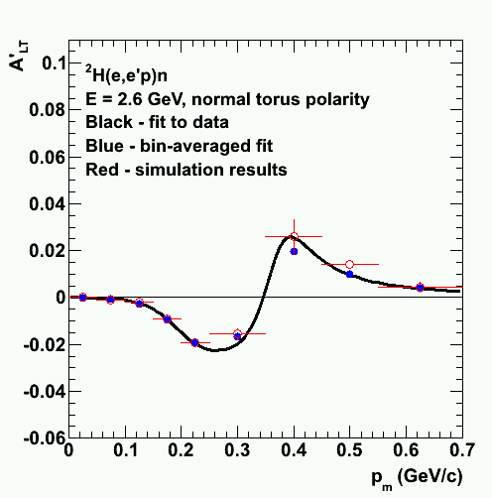
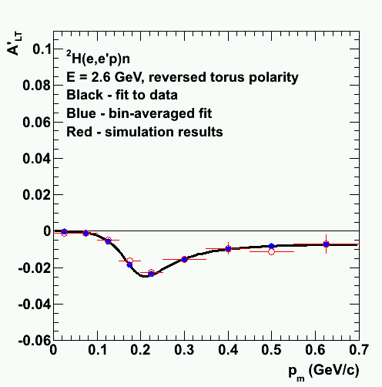
<number>
Results (Summer 2013)
Testing the analysis
  Red: simulated data
  Blue: bin-averaged fit
  Black: Fit to data
Notes:
This shows the results of the analysis algorithms on the simulated data (red points). The bin-averaged fit points (blue points) were found by integrating the fit to the asymmetry and averaging over each bin. The bin-averaged points and the simulation are consistent within uncertainties.
<number>

Slide 45
<number>
Conclusion
Extracted the asymmetry A’LT from fits to the helicity asymmetry
  Normal and reversed polarities
  Comparison to sinΦpq-weighted method
Validated our analysis
  Generated Monte Carlo events modeled after data
  Events passed through simulation and then our analysis code
Notes:
We have developed a method to extract the asymmetry A’LT from fits to the helicity asymmetry. We measured A’LT for both torus polarities using this method and compared our results to the sinΦpq-weighted method. The differences are consistent with zero within uncertainties for both torus polarities. Both methods of extracting A’LT are equivalent.
We have also generated Monte Carlo events with asymmetries modeled after our own data. Those events were passed through the CLAS standard simulation code and A’LT extracted with our analysis codes. Because of the consistency between the inputs and the extracted asymmetry, we have validated our initial analysis codes. We continue to refine our Monte Carlo calculations to improve their precision.
<number>

Slide 46
<number>
Acknowledgements
Dr. Gerard Gilfoyle
Keegan Sherman
University of Richmond Physics Department
Calina Copos (UR ’10)
Kristen Greenholt (UR ‘07)
Notes:
<number>

Slide 47
<number>
References
Copos, C.A. Testing Analysis Algorithms for the 2H(e,e’p)n Reaction. Richmond, VA, 2010. Print.
"Experimental Hall B." Jefferson Lab. N.p., n.d. Web. 24 Feb. 2014.
Gilfoyle, G.P., et. Al. Measurements of the Fifth Structure Function of the Deuteron. Richmond, VA, 2012. Print.
Greenholt, Kristen. Extracting the Fifth Structure Function and Hadronic Fiducial Cuts for the CLAS E5 Data Run at Jefferson Laboratory. Richmond, VA, 2007. Print.
Smith, Timothy Paul. Hidden Worlds: Hunting for Quarks in Ordinary Matter. Princeton, NJ: Princeton UP, 2005. Print.
The Frontiers of Nuclear Science: A Long Range Plan; US Department of Energy/National Science Foundation, Washington, DC, 2007.
Notes:
<number>

