Slide 1



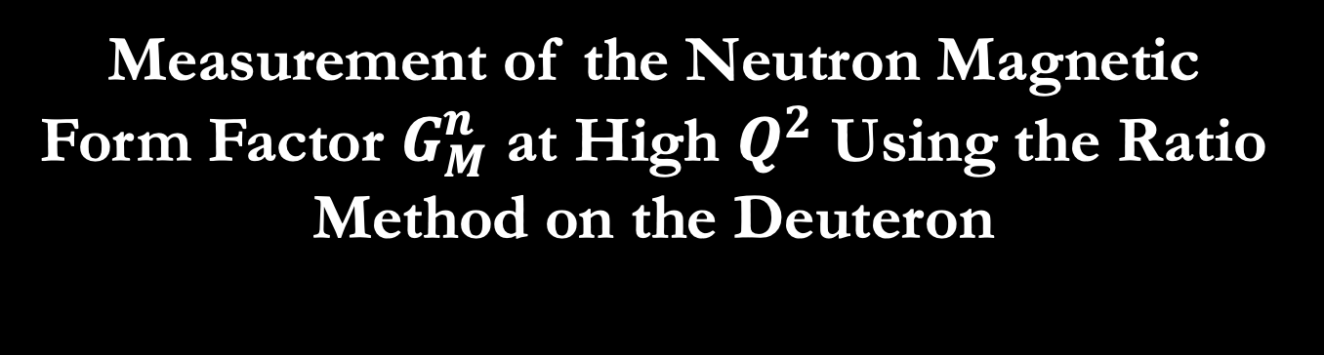
Measurement of the Neutron Magnetic Form Factor $G_{M}^{n}$ at High $Q^{2}$ Using the Ratio Method on the Deuteron
Lamya Baashen
Definition and Meaning of the Elastic Nucleon Form Factor
Scientific Motivation
The Ratio Method
CLAS12 Detector
Analysis tools and Preliminary Neutron detection efficiency (NDE) results
Summary
Brian Raue – FIU
Jerry Gilfoyle – University of Richmond
Cole Smith – University of Virginia

Slide 2
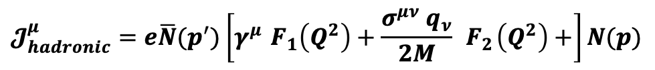
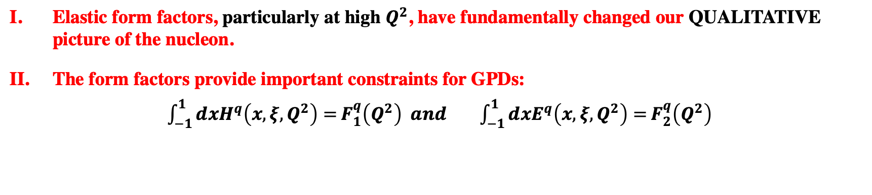
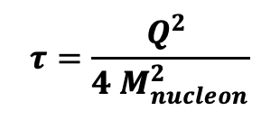
Definition of the Electromagnetic Elastic Nucleon Form Factors (EEFFs)
The hadronic current:
Dirac
Pauli
$$𝓙_{hadronic}^{μ}=e\overline{N}(p^{′})\left[γ^{μ }F_{1}\left(Q^{2}\right)+\frac{σ^{μν} q_{ν}}{2M} { F}_{2}\left(Q^{2}\right)+\right]N(p)$$
The Sachs FFs:
$G_{E}\left(Q^{2}\right)=F_{1}\left(Q^{2}\right)−τF_{2 }\left(Q^{2}\right) and G_{M}\left(Q^{2}\right)= F_{1}\left(Q^{2}\right)+F_{2}\left(Q^{2}\right)$
Where:
$$τ=\frac{Q^{2} }{{4 M}_{nucleon}^{2}}$$
Describes the transverse distribution of charge
Describes the transverse distribution of magnetization
Why we need to measure Form Factors
Elastic form factors, particularly at high $Q^{2}$, have fundamentally changed our QUALITATIVE picture of the nucleon.
The form factors provide important constraints for GPDs:
${\int_{−1}^{1}{ⅆxH^{q}\left(x,ξ,Q^{2}\right)=}F}_{1}^{q}\left(Q^{2}\right) and \int_{−1}^{1}{ⅆxE^{q}\left(x,ξ,Q^{2}\right)=}F_{2}^{q}\left(Q^{2}\right)$
form factors thus play an important role in the entire GPD program
Lamya Baashen $G_{M}^{n}$ 10/30/2020

Slide 3
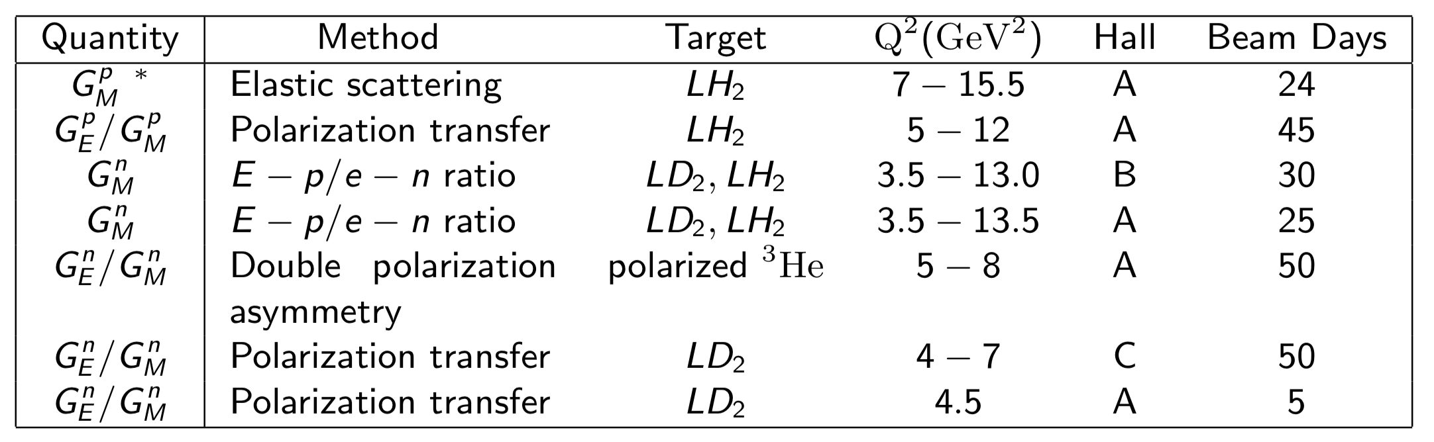
Listing of approved experiments for measuring EEFFs at Jefferson Lab
Lamya Baashen $G_{M}^{n}$ 10/30/2020
3

Slide 4
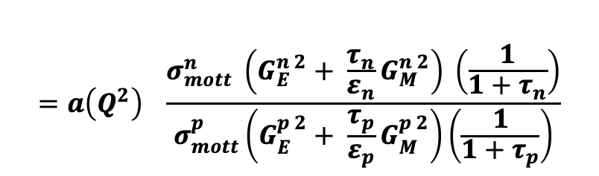
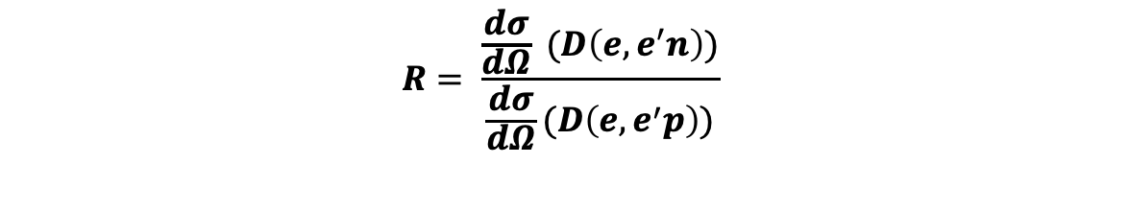
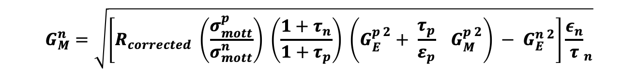
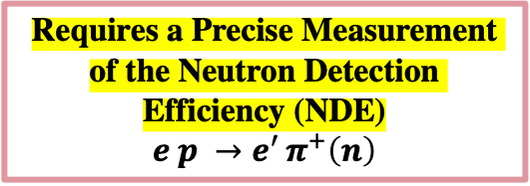
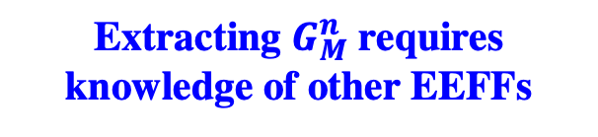
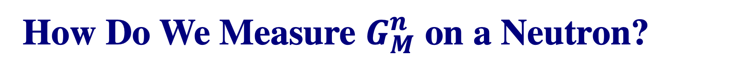
How Do We Measure $G_{M}^{n}$ on a Neutron?
Ratio Method
The ratio of the free nucleon e-n to e-p cross sections in terms of the free nucleon form factors:
Requires a Precise Measurement of the Neutron Detection Efficiency (NDE)
$$e p →e^{′ }π^{+}\left(n\right)$$
$$=a\left(Q^{2}\right) \frac{σ_{mott}^{n} \left(G_{E}^{n 2}+ \frac{τ_{n}}{ε_{n}}G_{M}^{n 2}\right) \left(\frac{1}{1+τ_{n}}\right)}{σ_{mott}^{p}\left(G_{E}^{p 2}+ \frac{τ_{p}}{ε_{p}}G_{M}^{p 2}\right)\left(\frac{1}{1+τ_{p}}\right)}$$
$$R= \frac{\frac{dσ}{dΩ} (D\left(e,e^{′}n\right))}{\frac{dσ}{dΩ}(D\left(e,e^{′}p\right))}$$
corrects for nuclear effects
the denominator is the precisely-known proton cross section.
Where:
$σ_{Mott}=\frac{α^{2}E^{′} \cos^{2}(\frac{θ_{e}}{2})}{{4E^{3}sin}^{4}(\frac{θ_{e}}{2})}$ , $τ=\frac{Q^{2}}{4 M_{p,n}^{2}} , Q^{2}=4{EE}^{′}\sin^{2}\left(\frac{θ_{e}}{2}\right) ,ε={\left[1+2\left(1+τ\right) \tan^{2}(\frac{θ_{e}}{2})\right]}^{−1}$
$$G_{M}^{n }=\sqrt{\left[R_{corrected} \left(\frac{σ_{mott}^{p}}{σ_{mott}^{n}}\right) \left(\frac{1+τ_{n}}{1+τ_{p}}\right) \left(G_{E}^{p 2}+ \frac{τ_{p}}{ε_{p}} G_{M}^{p 2}\right) − G_{E}^{n 2}\right]{\frac{ε_{n}}{τ}}_{n}}$$
Extracting $G_{M}^{n }$ requires knowledge of other EEFFs
Lamya Baashen $G_{M}^{n}$ 10/30/2020
4

Slide 5
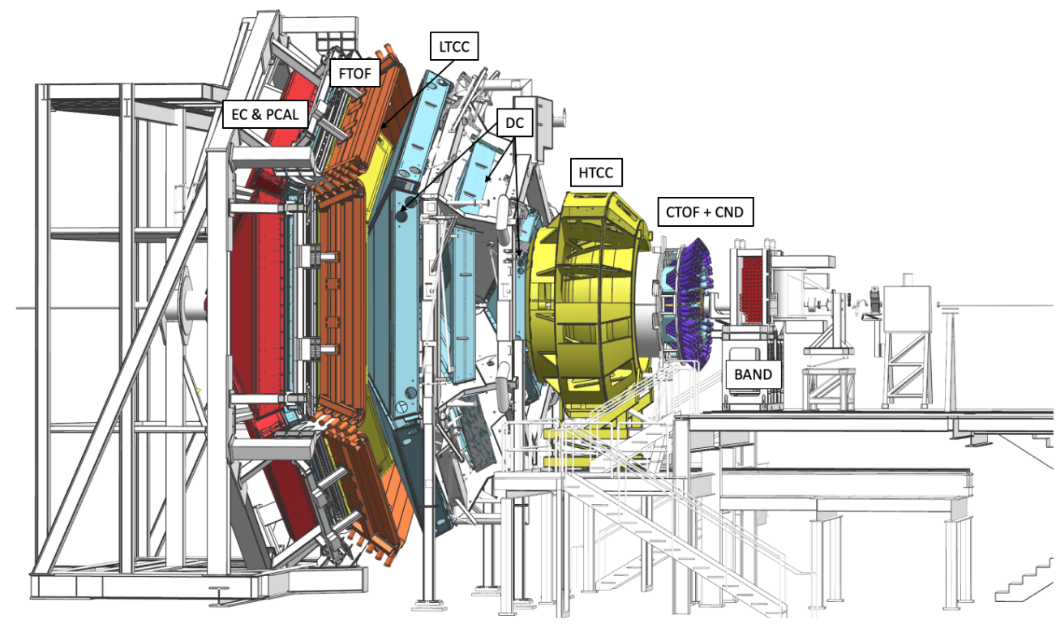
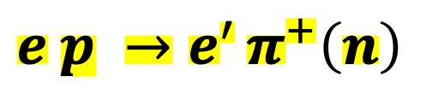
How We Measure Neutron Detection Efficiency(NDE) on CLAS12
$$e p →e^{′ }π^{+}\left(n\right)$$
The CLAS12 Detector located in Hall B at Jefferson Laboratory, Virginia.
Hall B:
Central Detector (CD) and Forward Detector (FD)
Data Set:
First CLAS12 experiment, data were taken in the Spring and Fall 2018.
Beam energy 10.56 GeV / Liquid hydrogen target.
Two magnetic field configurations (Inbending/Outbending electrons)
FD
Burkert et al.,NIM A 959(2020)
Lamya Baashen $G_{M}^{n}$ 10/30/2020
5

Slide 6
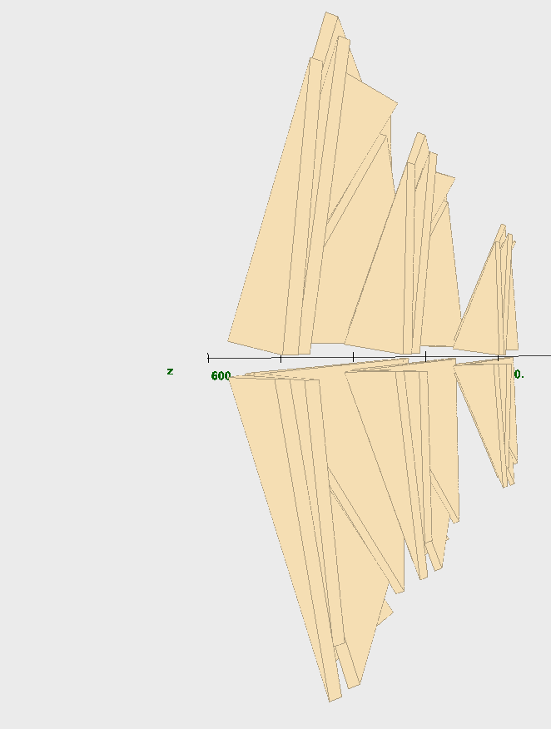
How We Measure Neutron Detection Efficiency(NDE) on CLAS12
$$e p →e^{′ }π^{+}\left(n\right)$$
The CLAS12 Detector located in Hall B at Jefferson Laboratory, Virginia.
Hall B:
Central Detector (CD) and Forward Detector (FD)
Data Set:
First CLAS12 experiment, data were taken in the Spring and Fall 2018.
Beam energy 10.56 GeV / Liquid hydrogen target.
Two magnetic field configurations (Inbending/Outbending electrons)
FD
DC
Burkert et al.,NIM A 959(2020)
Lamya Baashen $G_{M}^{n}$ 10/30/2020

Slide 7
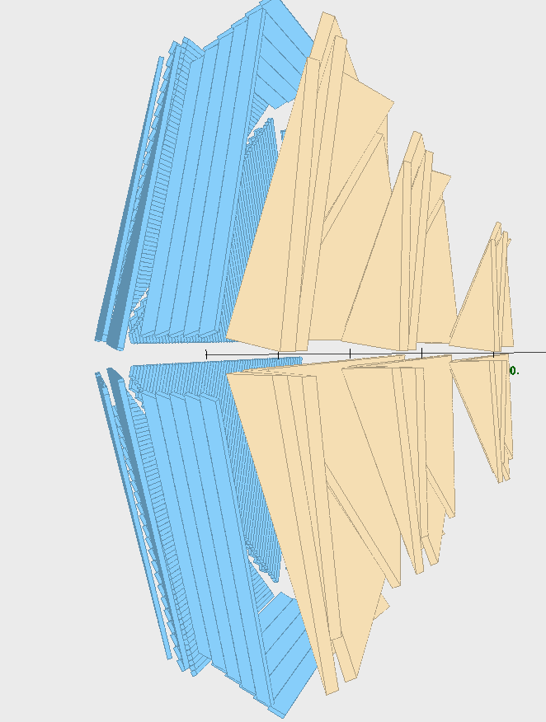
How We Measure Neutron Detection Efficiency(NDE) on CLAS12
$$e p →e^{′ }π^{+}\left(n\right)$$
The CLAS12 Detector located in Hall B at Jefferson Laboratory, Virginia.
Hall B:
Central Detector (CD) and Forward Detector (FD)
Data Set:
First CLAS12 experiment, data were taken in the Spring and Fall 2018.
Beam energy 10.56 GeV / Liquid hydrogen target.
Two magnetic field configurations (Inbending/Outbending electrons)
FTOF
FD
DC
Burkert et al.,NIM A 959(2020)
Lamya Baashen $G_{M}^{n}$ 10/30/2020
7

Slide 8
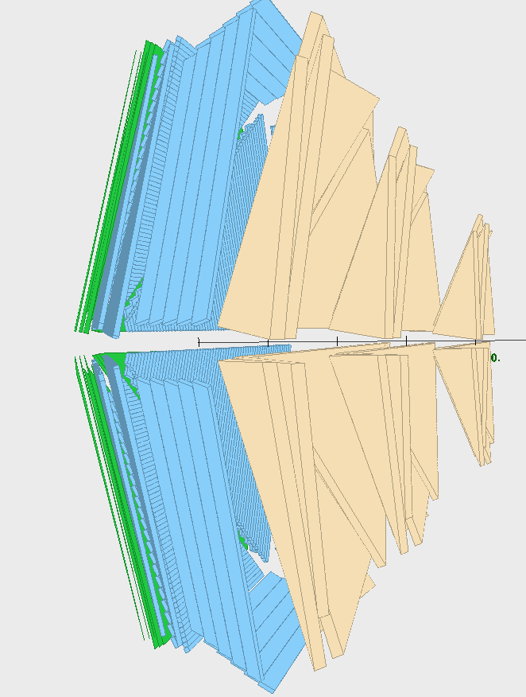
How We Measure Neutron Detection Efficiency(NDE) on CLAS12
$$e p →e^{′ }π^{+}\left(n\right)$$
The CLAS12 Detector located in Hall B at Jefferson Laboratory, Virginia.
Hall B:
Central Detector (CD) and Forward Detector (FD)
Data Set:
First CLAS12 experiment, data were taken in the Spring and Fall 2018.
Beam energy 10.56 GeV / Liquid hydrogen target.
Two magnetic field configurations (Inbending/Outbending electrons)
FTOF
FD
PCAL
DC
Burkert et al.,NIM A 959(2020)
Lamya Baashen $G_{M}^{n}$ 10/30/2020
8

Slide 9
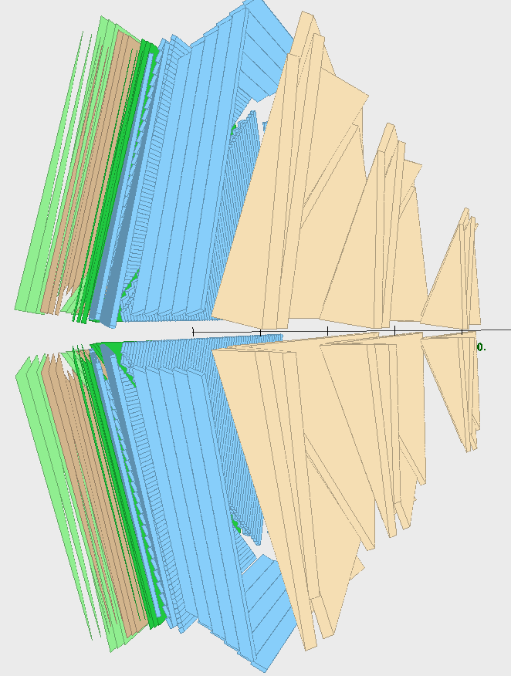
How We Measure Neutron Detection Efficiency(NDE) on CLAS12
$$e p →e^{′ }π^{+}\left(n\right)$$
The CLAS12 Detector located in Hall B at Jefferson Laboratory, Virginia.
Hall B:
Central Detector (CD) and Forward Detector (FD)
Data Set:
First CLAS12 experiment, data were taken in the Spring and Fall 2018.
Beam energy 10.56 GeV / Liquid hydrogen target.
Two magnetic field configurations (Inbending/Outbending electrons)
FTOF
PCAL
FD
ECAL
DC
Burkert et al.,NIM A 959(2020)
Lamya Baashen $G_{M}^{n}$ 10/30/2020
9

Slide 10
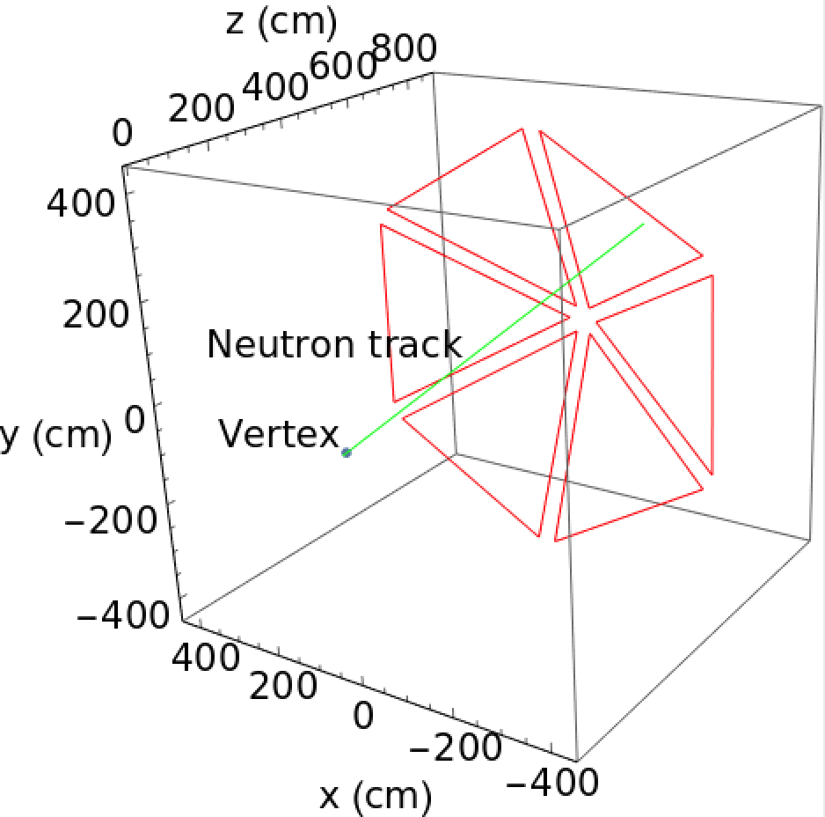

Extracting Neutron Detection Efficiency
Determine the neutron detection efficiency (NDE) by using:
$e p →e^{′ }π^{+}\left(n\right)$
1. Select $e^{′ }π^{+}$final state with no other charged particles ${p(e,e}^{′ }π^{+})X_{n}$.
2. Assume the missing particle is a neutron, calculate the missing momentum of the neutron and its trajectory through CLAS12 from the $e^{′ }π^{+}$ vertex
3. Check if the neutron’s path intersects with the front face of PCAL/ECAL.
Yes count as expected neutron
NO skip the event
Lachniet et al., PRL 102, 192001(2009)
Lamya Baashen $G_{M}^{n}$ 10/30/2020
10

Slide 11
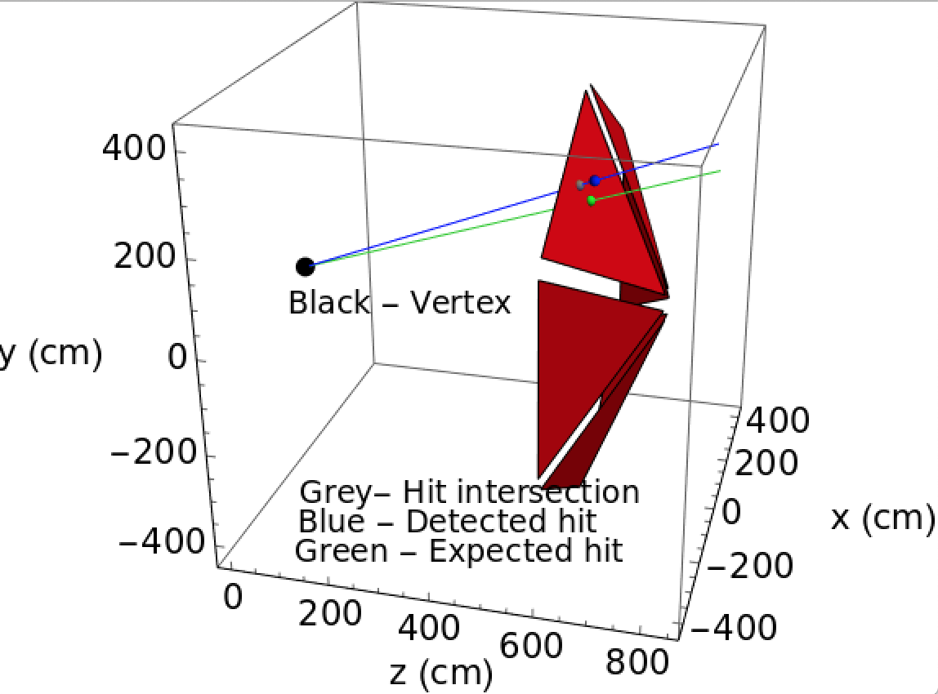
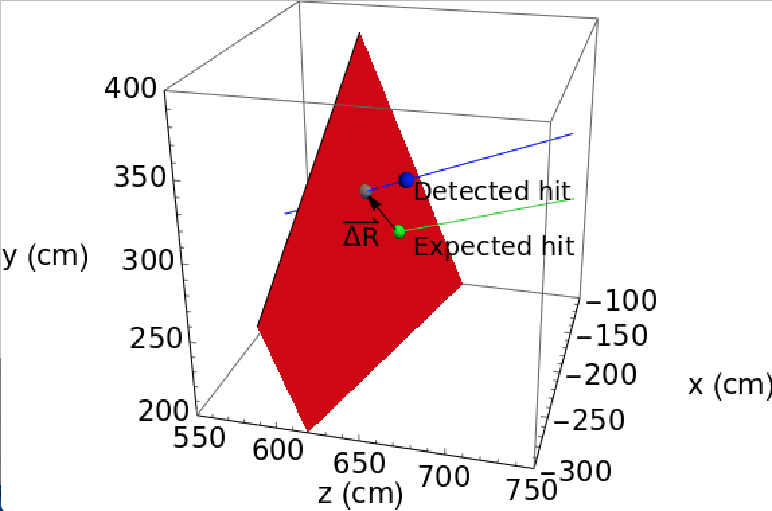

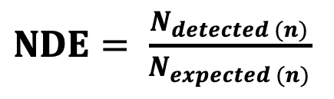
Extracting Neutron Detection Efficiency
4. Loop over neutral PCAL/ECAL hits:
  Get intersection of ray with the PCAL/ECAL face by drawing a line
  from the $e^{′ }$ $π^{+}$vertex to the actual neutral PCAL/ECAL hit.
  Calculate ∆R for each actual neutral PCAL/ECAL hits, which is the distance between the intersection of the PCAL/ECAL hit and the intersection of the expected neutron trajectory.
  Select hit with the smallest ∆R.
5. Applied some kinematics cuts to identify neutrons.
$NDE= \frac{N_{detected (n)}}{N_{expected (n)}}$
Lamya Baashen $G_{M}^{n}$ 10/30/2020
11

Slide 12
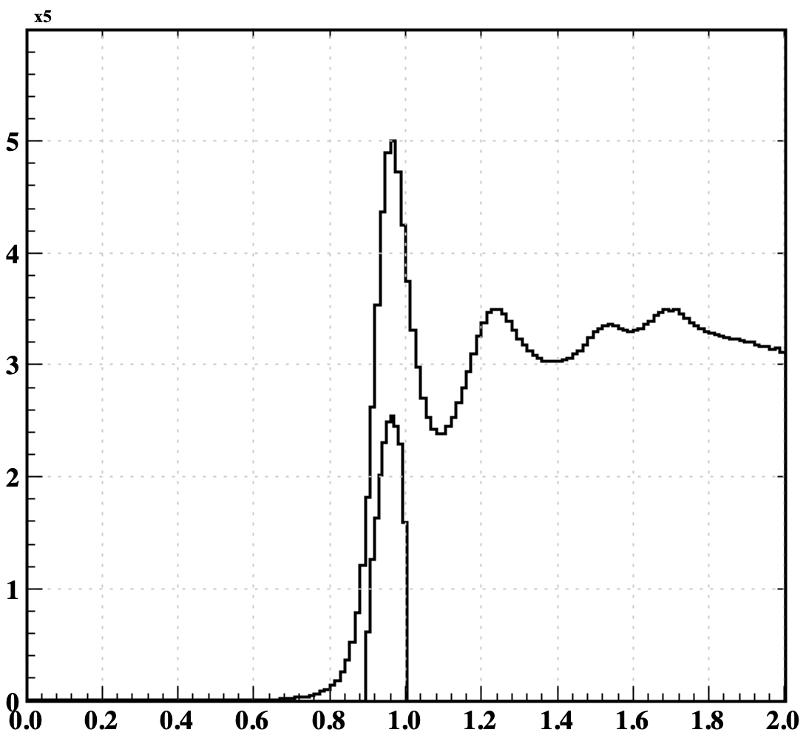
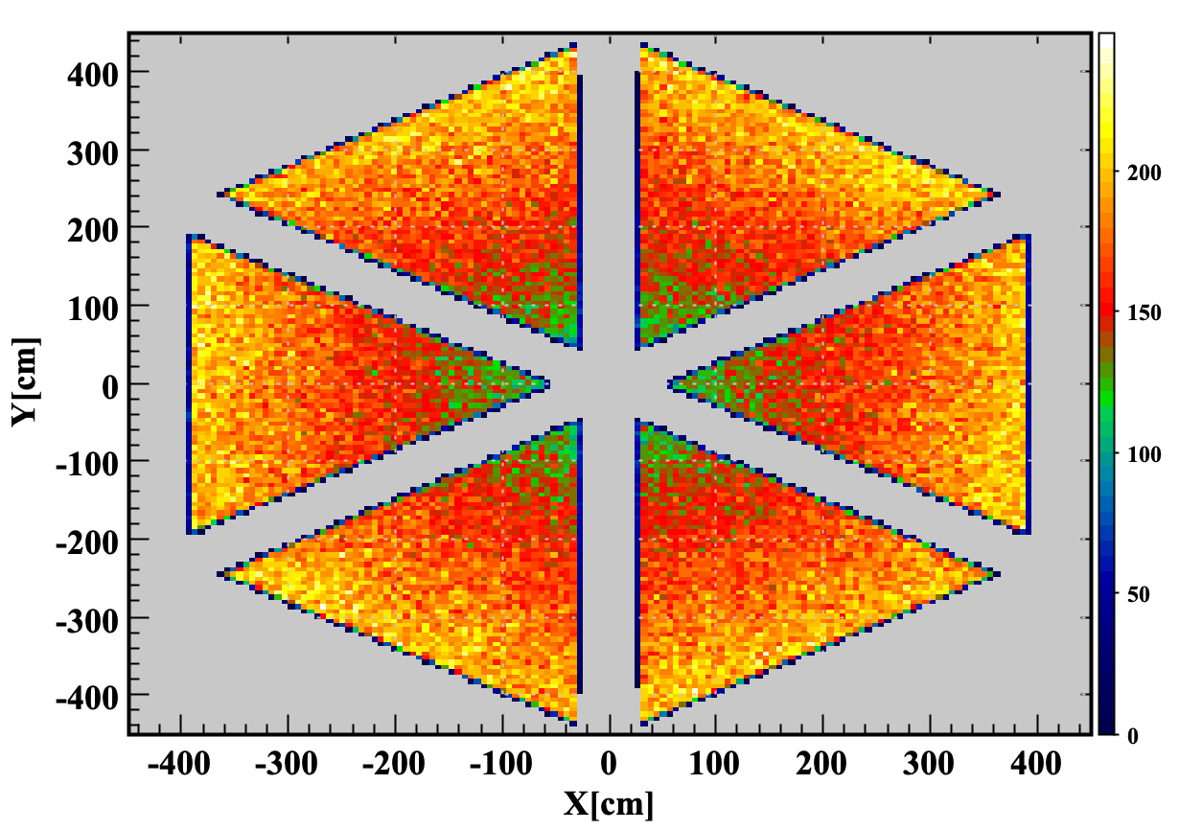

Missing Mass of Expected Neutron PCAL/ECAL
Intersection point of expected neutron with front face of PCAL/ECAL
Missing Mass of an expected neutron hit PCAL/ECAL
0.9 < MM <1
MM from $e^{′ }π^{+}$[GeV]
Lamya Baashen $G_{M}^{n}$ 10/30/2020
12

Slide 13
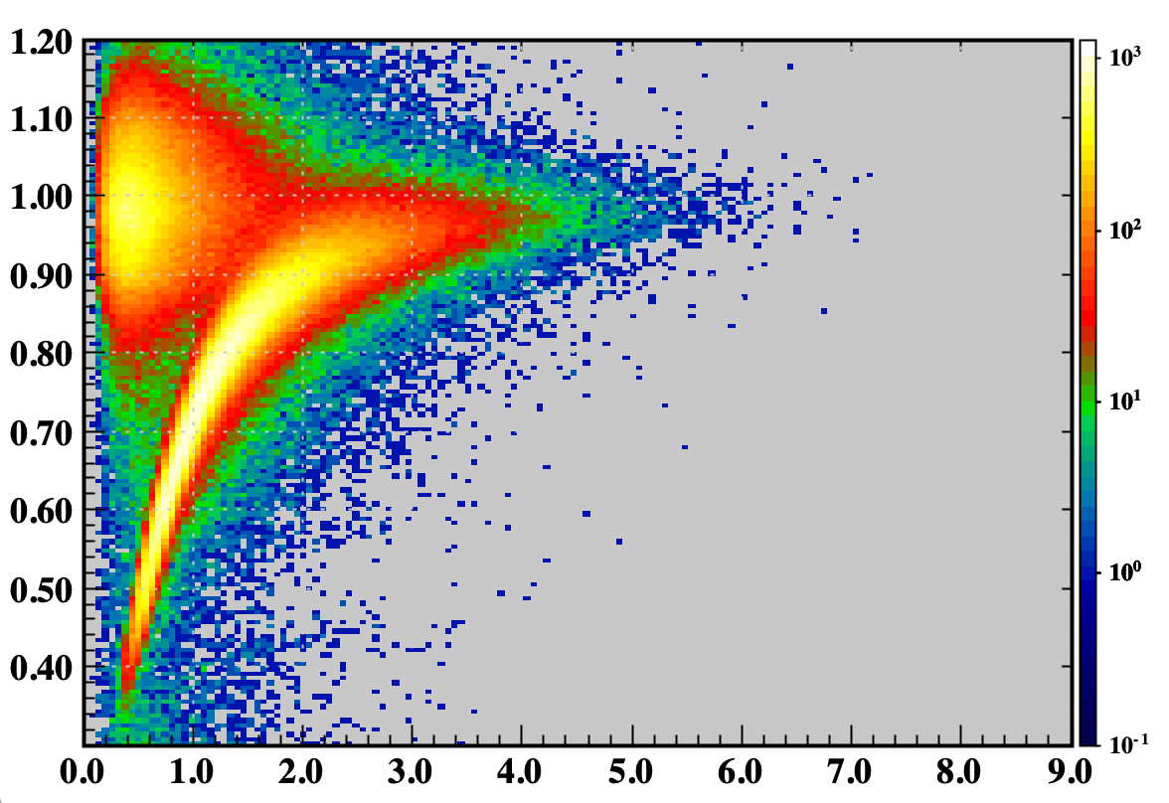
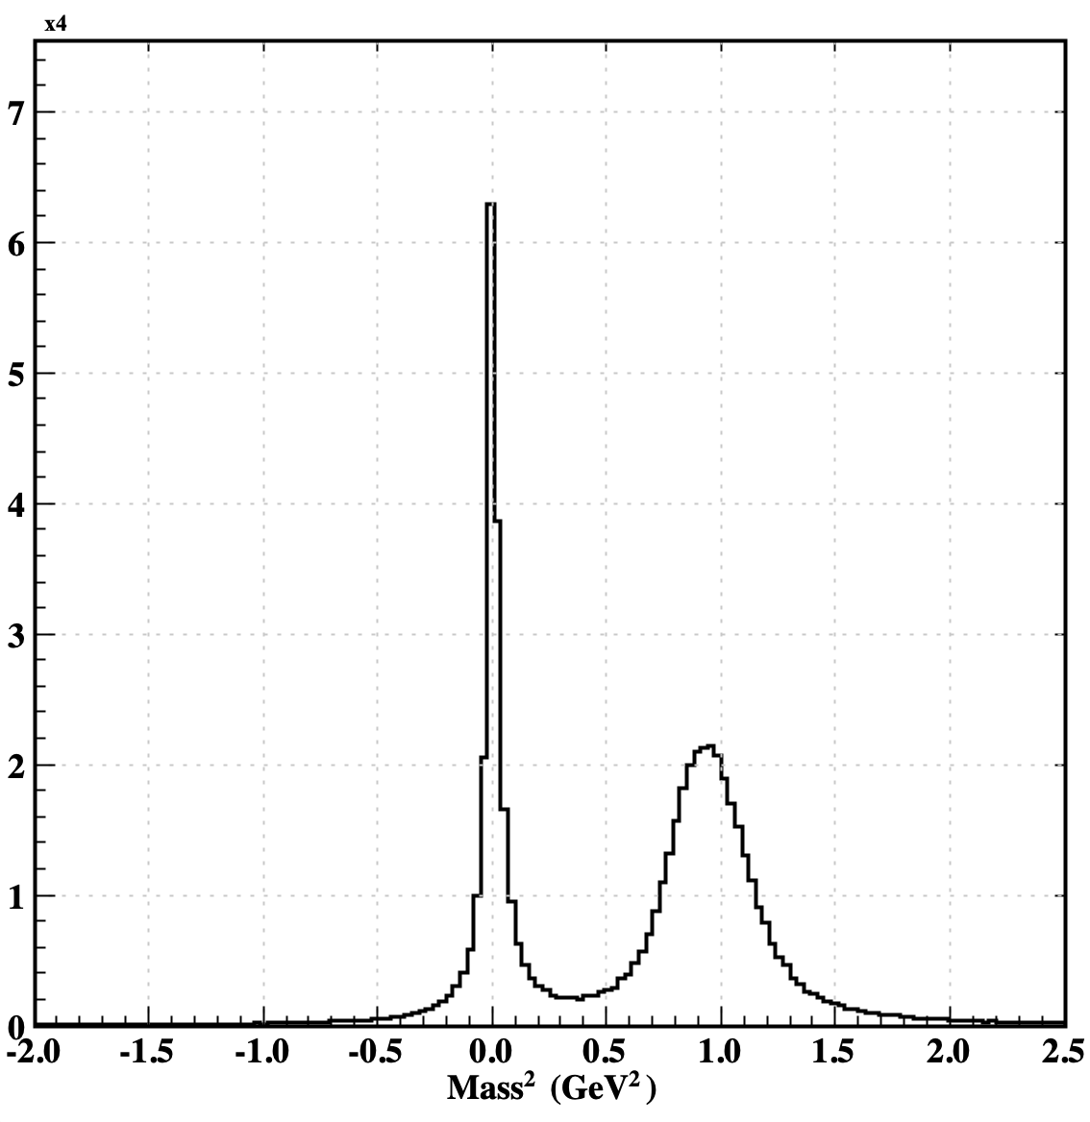
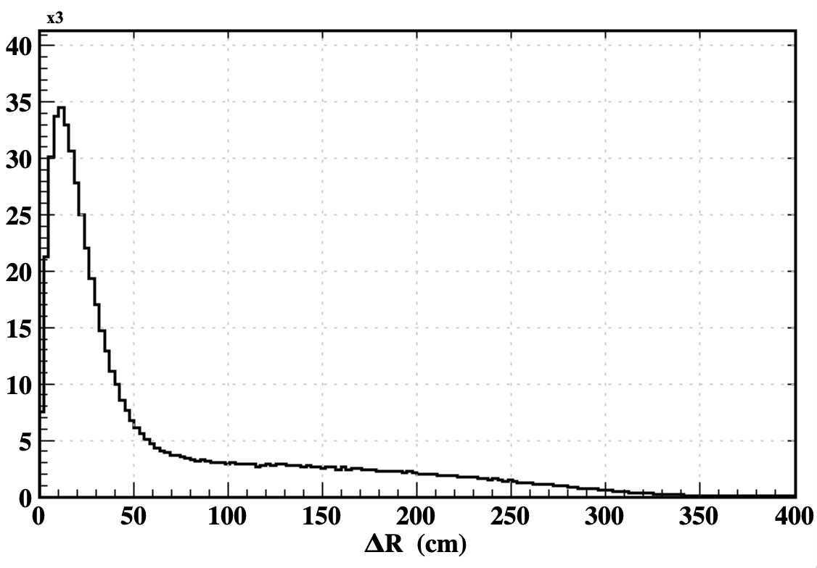




Neutral Particles Measured in PCAL/ECAL
mass² distribution of the neutral particles measured in PCAL/ECAL
β_{neutral} vs p_{mm}
ΔR[cm]
$γ$
$γ$
$n$
β_{neutral}
$n$
ΔR is the distance between the intersection point of expected neutron and the intersection of detected neutral particles with the front face of PCAL/ ECAL
p_{mm} [GeV]
mass² distribution of the neutral particles calculated from the measured β neutral and missing momentum
β_{neutral} calculated from the path/time in PCAL/ECAL vs p_{mm}
Lamya Baashen $G_{M}^{n}$ 10/30/2020
13

Slide 14
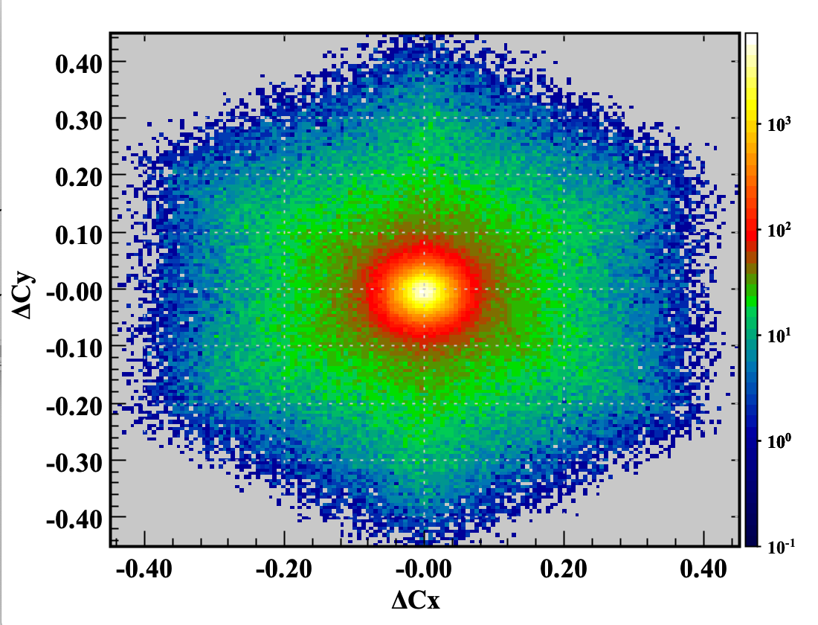
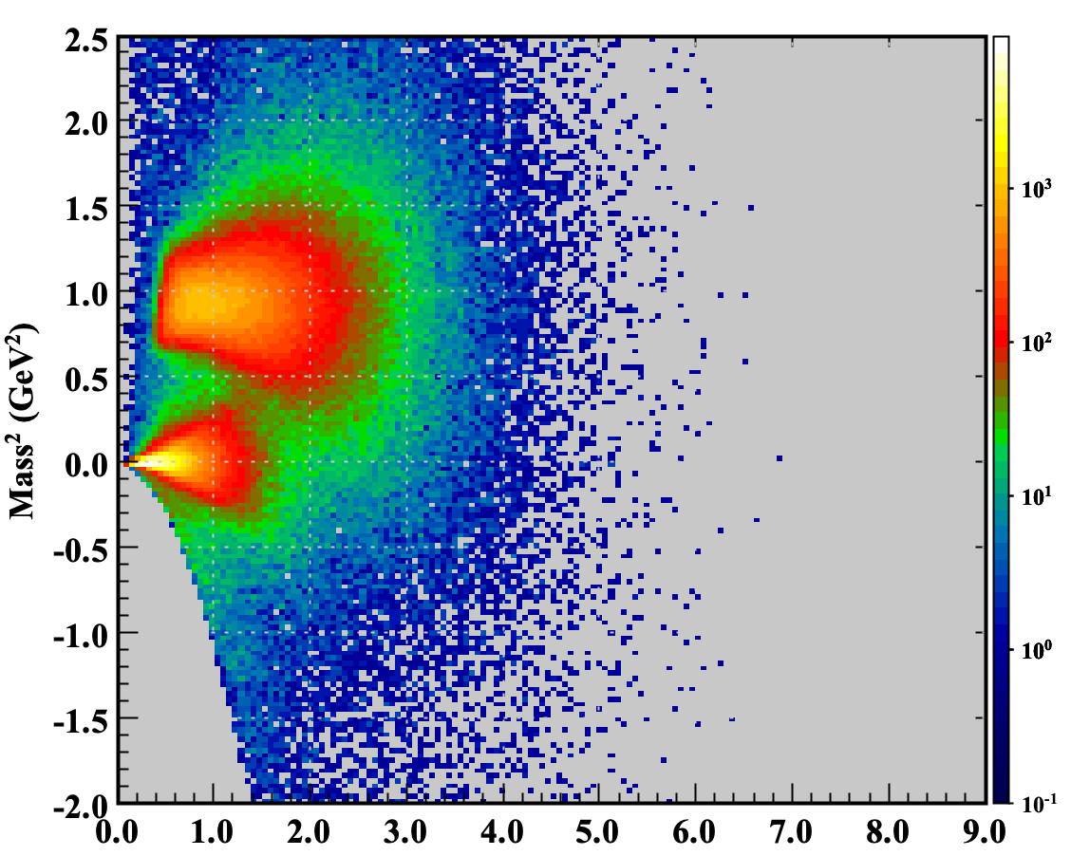



Identifying Neutron in PCAL/ECAL
To identify neutron hits:
Required the direction cosine of the expected neutron C_{exp} to coincide with the direction of the measured neutral particles C_{meas}
ΔC = C_{exp} - C_{meas}
mass² distribution of the neutral particles vs missing momentum
-0.1 < $∆$Cx < 0.1 && -0.1 < $∆$Cy < 0.1
mass² > 0.45 If p_{mm} <1.2
$n$
$γ$
G.Asryan et al., MIN A959(2020) 163425
p_{mm} [GeV]
Lamya Baashen $G_{M}^{n}$ 10/30/2020
14

Slide 15
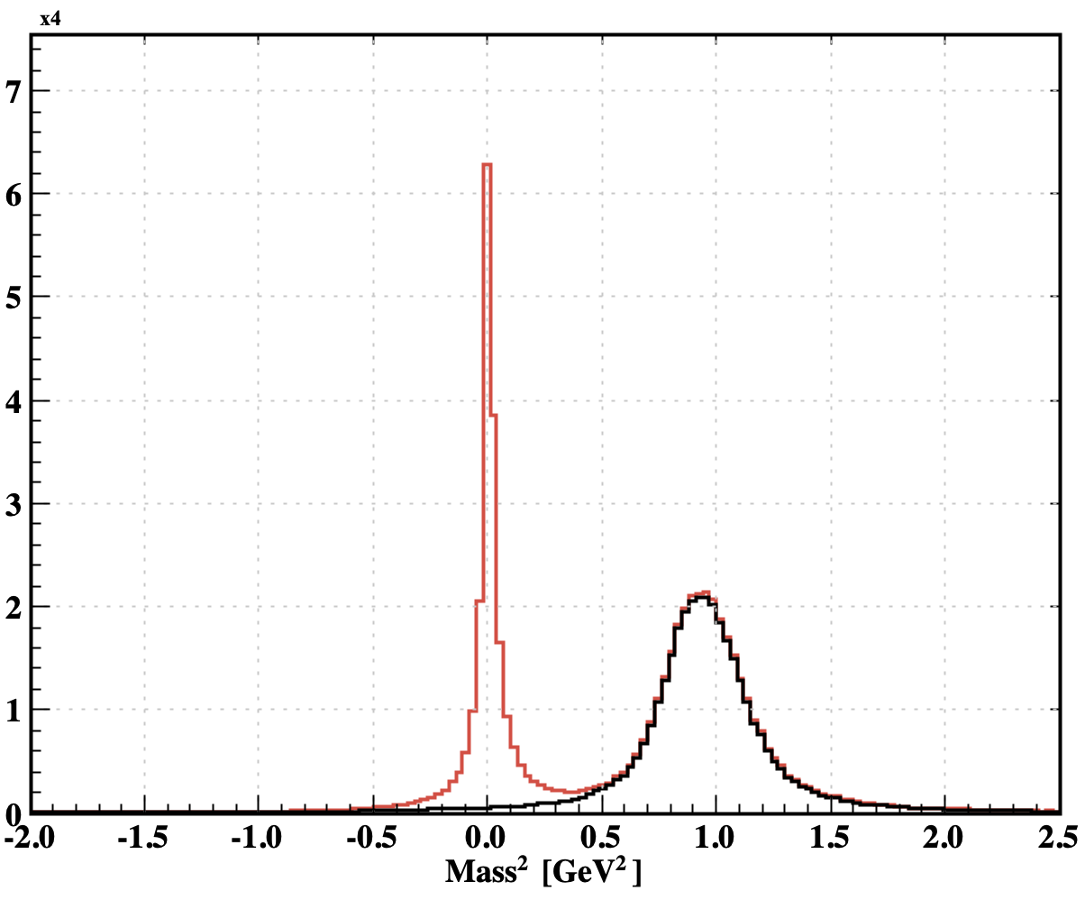
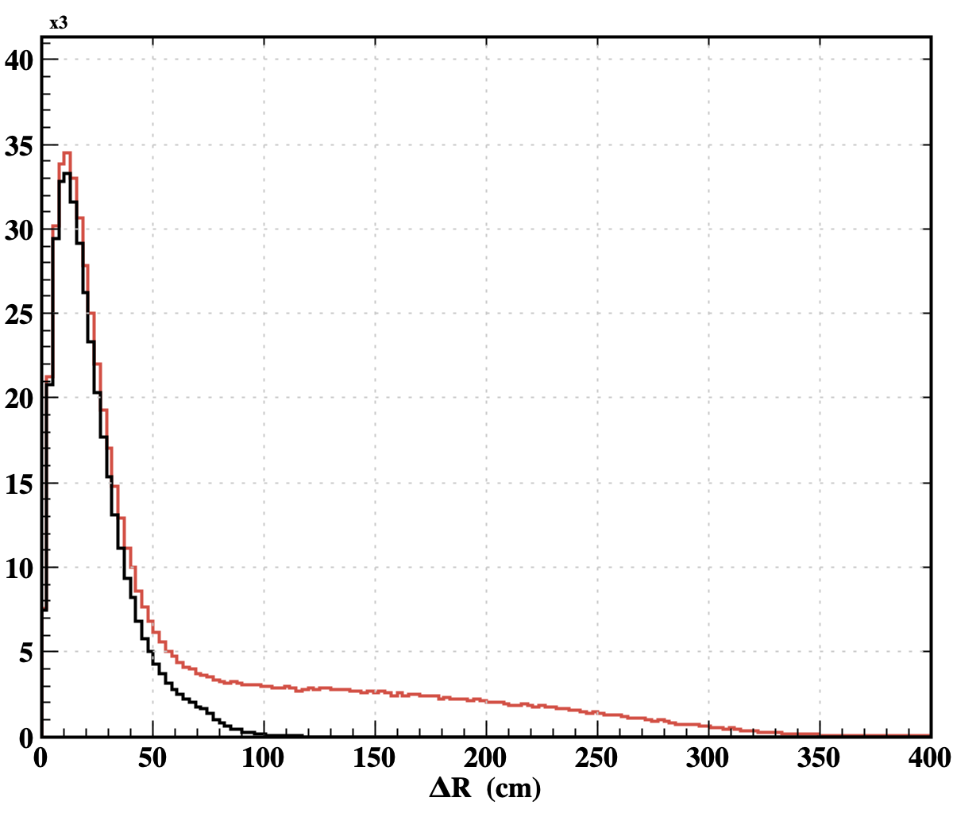
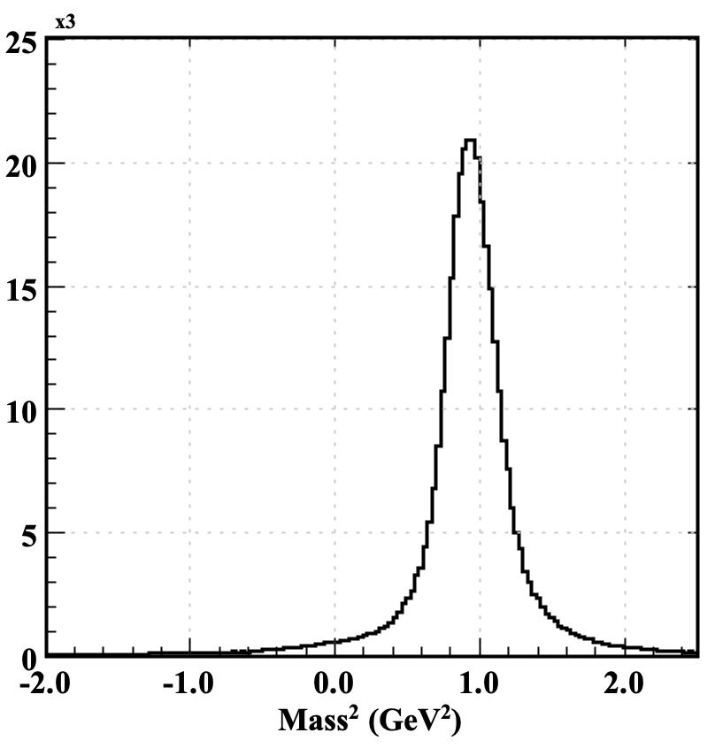
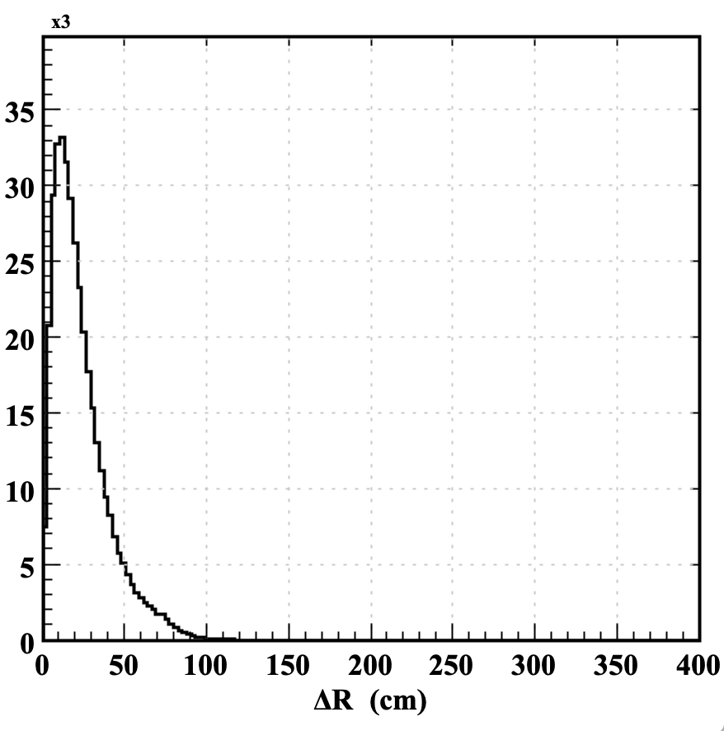
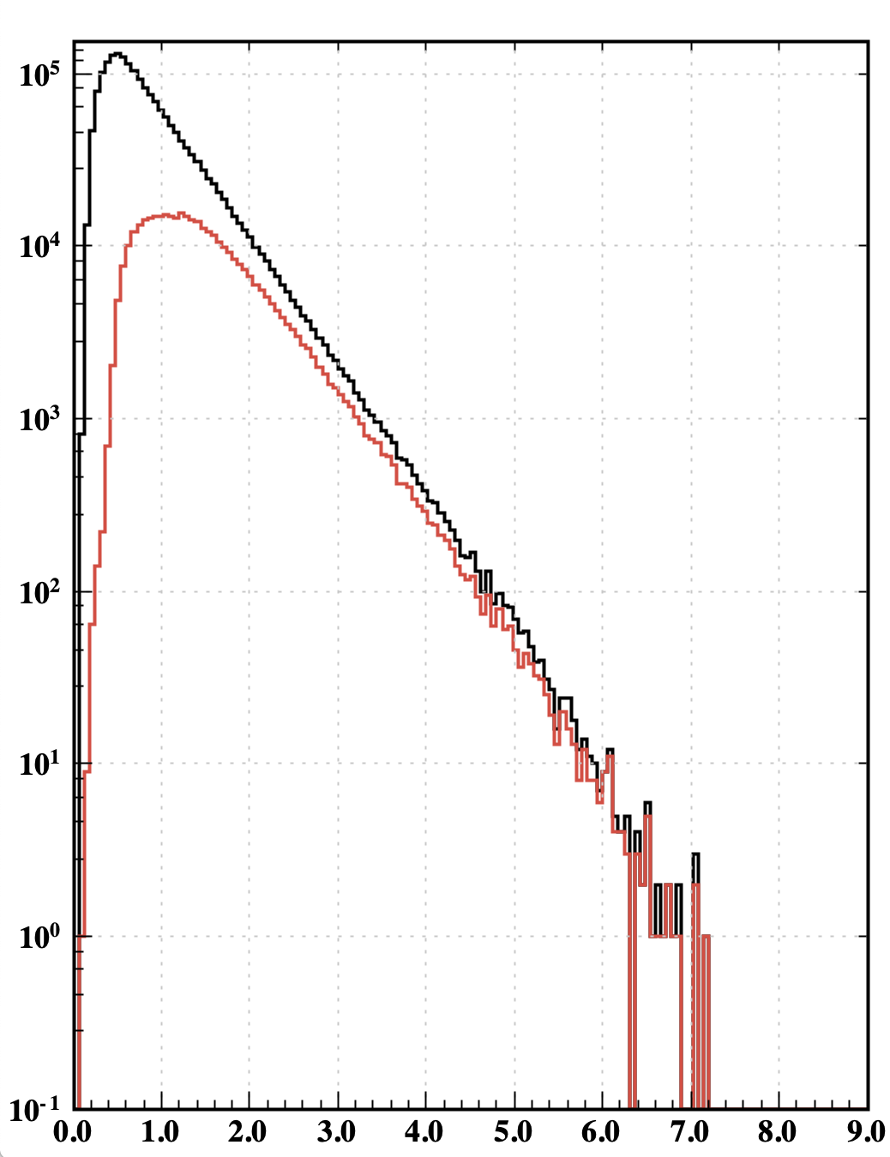
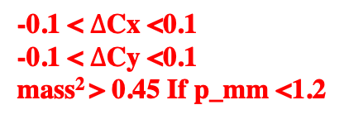




Neutral Particles Measured in PCAL/ECAL
Cuts Applied:
-0.1 < $∆$Cx <0.1
-0.1 < $∆$Cy <0.1
mass² > 0.45 If p_mm <1.2
mass² distribution of the neutral particles
ΔR[cm]
Applied Cuts
NO CUT
Missing Momentum of Expected neutron
Missing Momentum of Detected neutron
$γ$
$γ$
$n$
$n$
mass² distribution of the neutron measured in PCAL/ECAL
ΔR is the distance between the Intersection point of expected neutron and the intersection of detected neutral particles with the front face of PCAL/ ECAL
mass² distribution of the neutral particles calculated from the measured β neutral and missing momentum
p_{mm} [GeV]
Lamya Baashen $G_{M}^{n}$ 10/30/2020
15

Slide 16
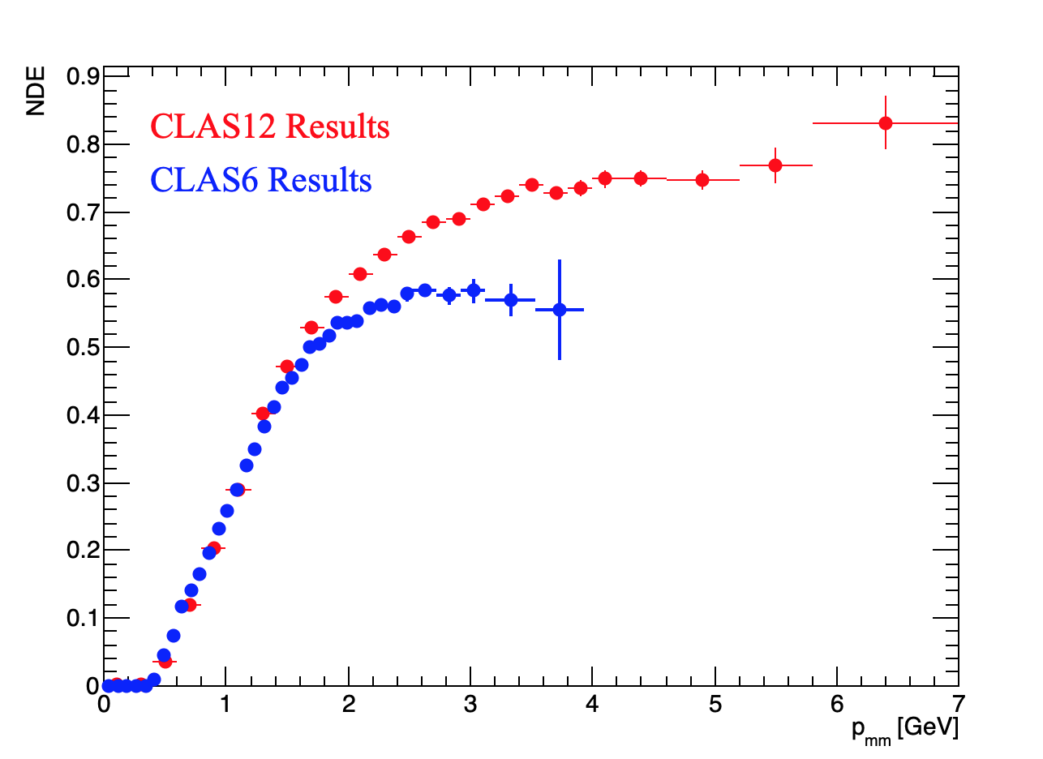
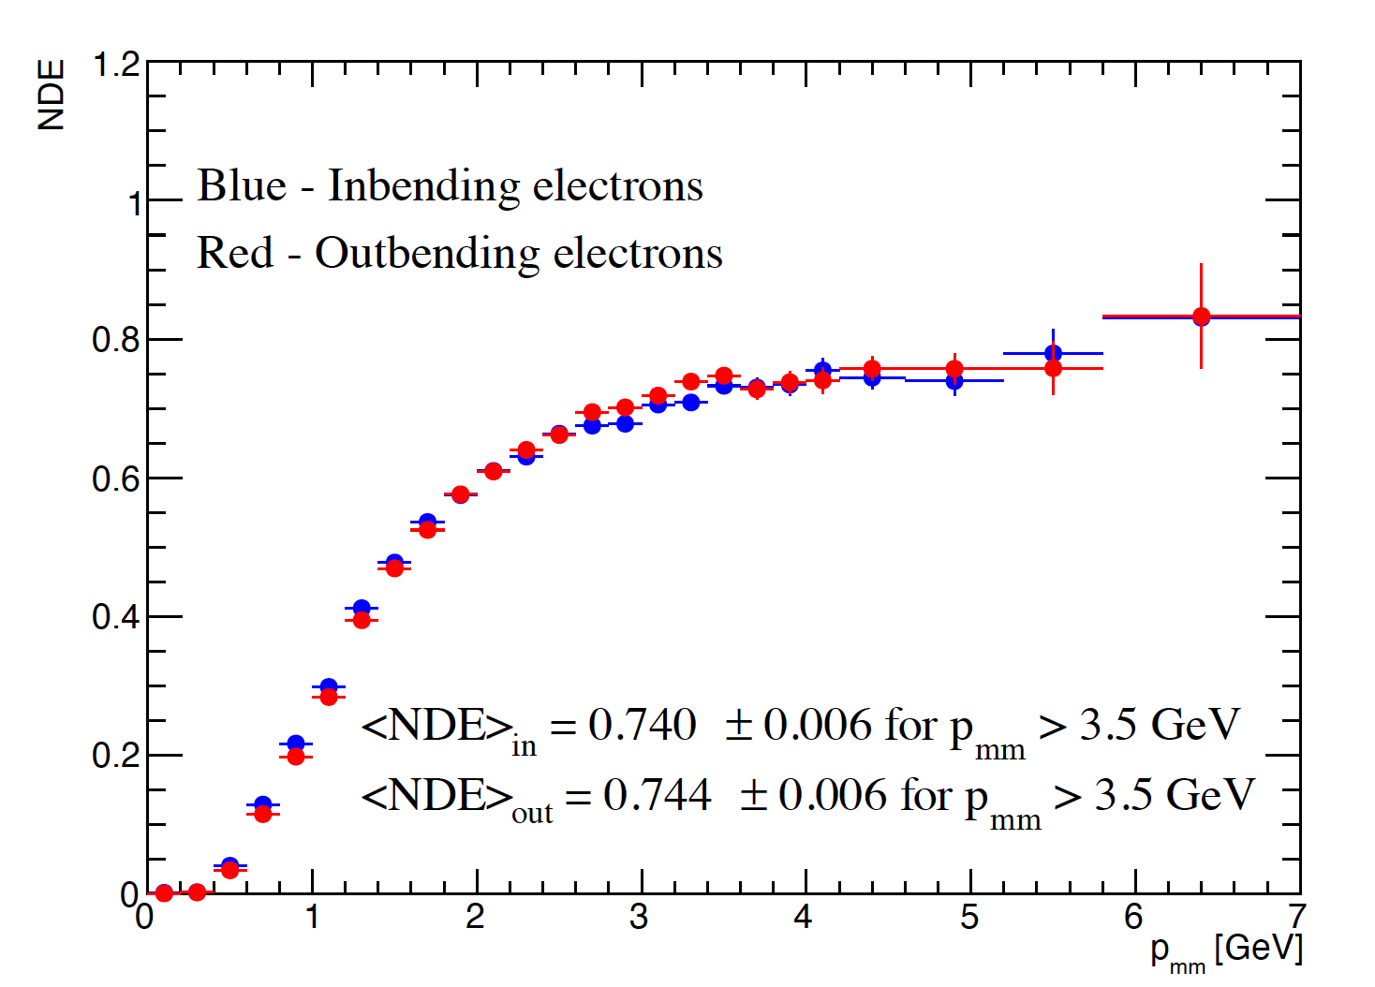
Preliminary Results of NDE
Preliminary
Preliminary
Plateau at $NDE=0.74 ±0.01 for p_{mm}>3.5 GeV$
Lamya Baashen $G_{M}^{n}$ 10/30/2020
16

Slide 17
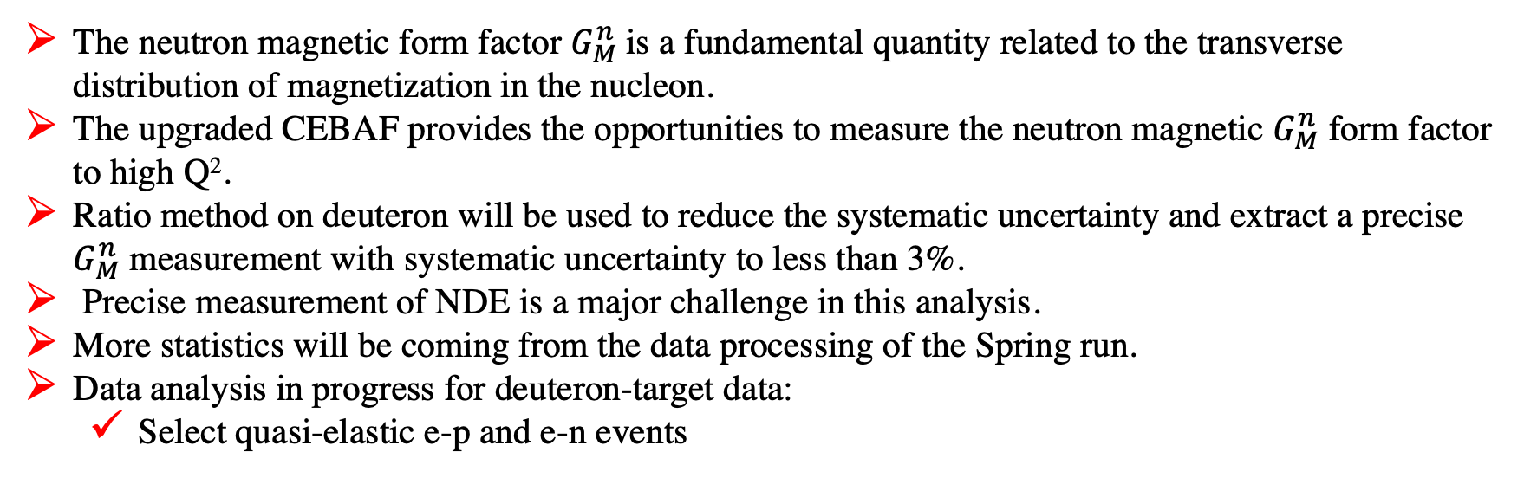
Summary
The neutron magnetic form factor $G_{M}^{n}$is a fundamental quantity related to the transverse distribution of magnetization in the nucleon.
The upgraded CEBAF provides the opportunities to measure the neutron magnetic $G_{M}^{n}$ form factor to high Q².
Ratio method on deuteron will be used to reduce the systematic uncertainty and extract a precise $G_{M}^{n}$ measurement with systematic uncertainty to less than 3%.
Precise measurement of NDE is a major challenge in this analysis.
More statistics will be coming from the data processing of the Spring run.
Data analysis in progress for deuteron-target data:
  Select quasi-elastic e-p and e-n events
Lamya Baashen $G_{M}^{n}$ 10/30/2020
17

Slide 18
Thank you for attention..

Slide 19
Listing of approved experiments for measuring EEFFs at Jefferson Lab
1. GMp - E12-07-108 Hall A (done)
2. GEp/GMp - E12-07-109 Hall A
3. GMn - E12-07-104 Hall B
4. GMn - E12-09-109 Hall A
5. GEn/GMn - E12-09-016 Hall A
6. GEn/GMn - E12-11-009 Hall C
7. GEn/GMn - E12-17-004 Hall A

