Slide 1
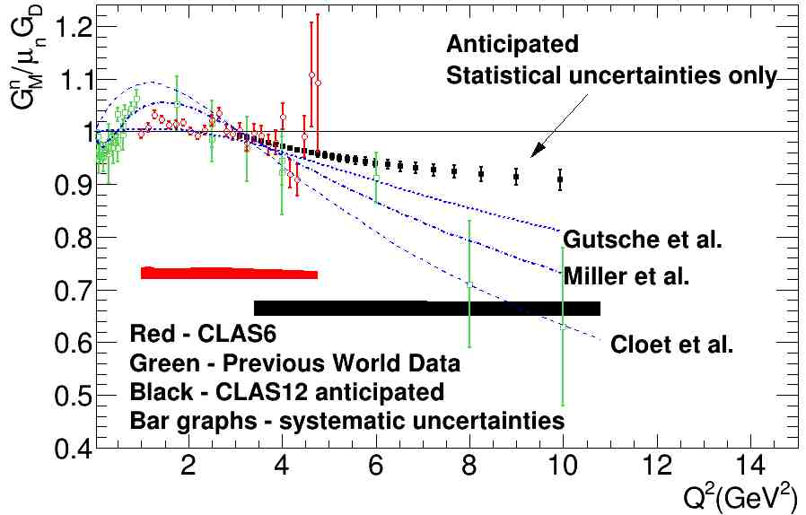
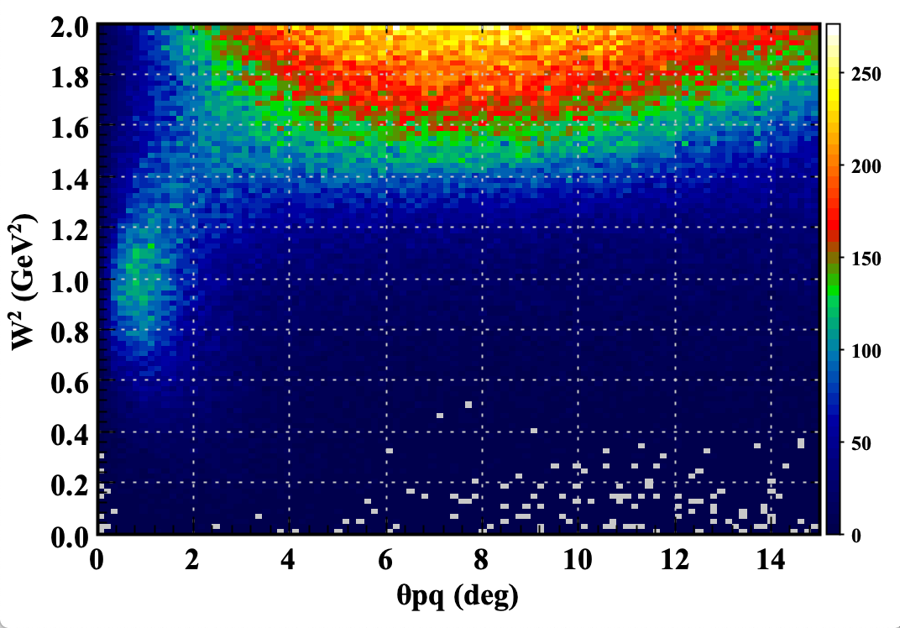
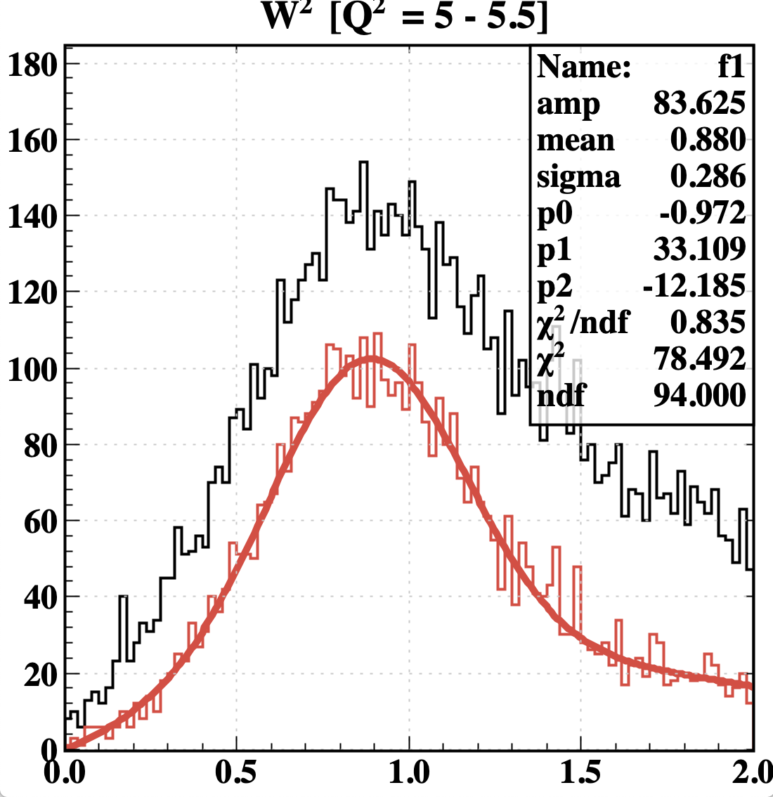



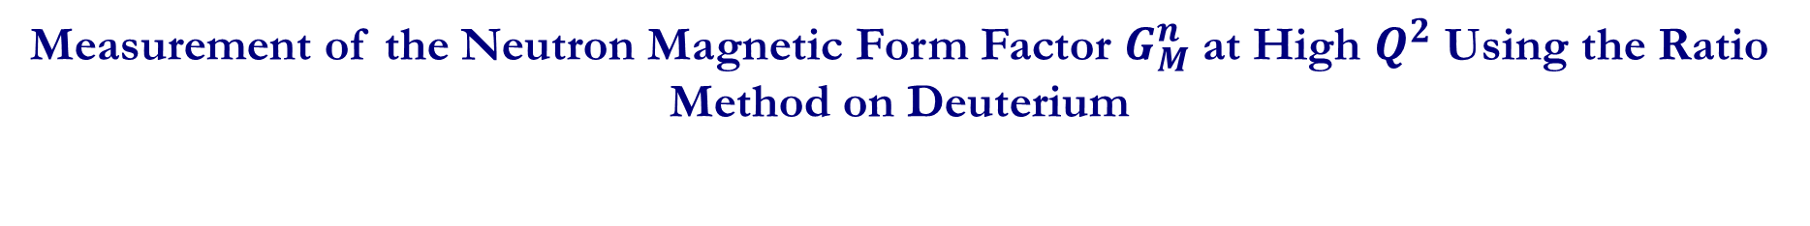

Measurement of the Neutron Magnetic Form Factor $G_{M}^{n}$ at High $Q^{2}$ Using the Ratio Method on Deuterium
Work by L.Baashen (FIU), B.A. Raue (FIU), G. Gilfoyle (Richmond), L.C. Smith (UVA)
Goal: Extract $G_{M}^{n}$ at high Q² using the ratio of quasi-elastic e-n and quasi-elastic e-p on deuteron: $R=\frac{d\left(e,e^{′}n\right)p}{d\left(e,e^{′}p\right)n}$
1. The neutron magnetic form factor is a fundamental observable related to the distribution of magnetization in the nucleon.
2. Figure to the left shows world’s data for GMn including anticipated results.
3. Curves show recent theoretical calculations from Gutsche et al. (PRD 97, 054011, 2018))and Miller et al. (arXiv 1912.07797 [nucl-th], 2020).
4. Continued strong theory reported by JLab TAC.
5. Additional RGB run time will extend the reach in Q² and improve the statistical precision at high Q².
Quasi-elastic ep event at Q² = 5.25 GeV²
$${W^{2} VS θ}_{pq}$$
Analysis status for quasi-elastic e-p :
1. Using RG-B data from spring 2019 (pass 1 cooking) ~ 223 production runs.
2. Select tracks with one electron and one proton in Forward Detector.
Quasi-elastic event selection:
1. Apply cut on W² < 2.0.
2. Apply cut on θ_{pq} (angle between the virtual photon and scattered nucleon 3-momenta) to reduce inelastic background.
$$θ_{pq}<3$$
$$θ_{pq}<1.5$$
$$e p→e^{′}p$$
Quasi-elastic ep events

Slide 2
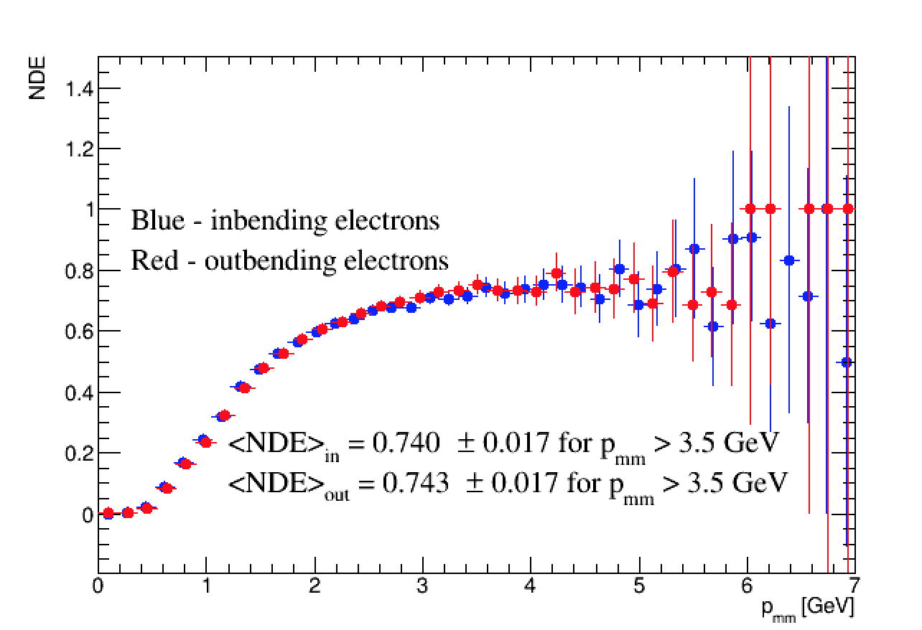
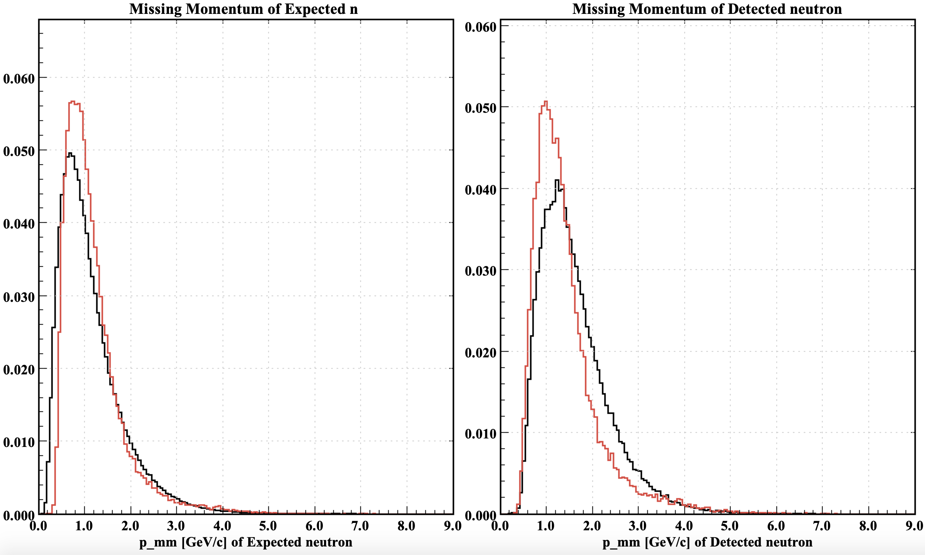
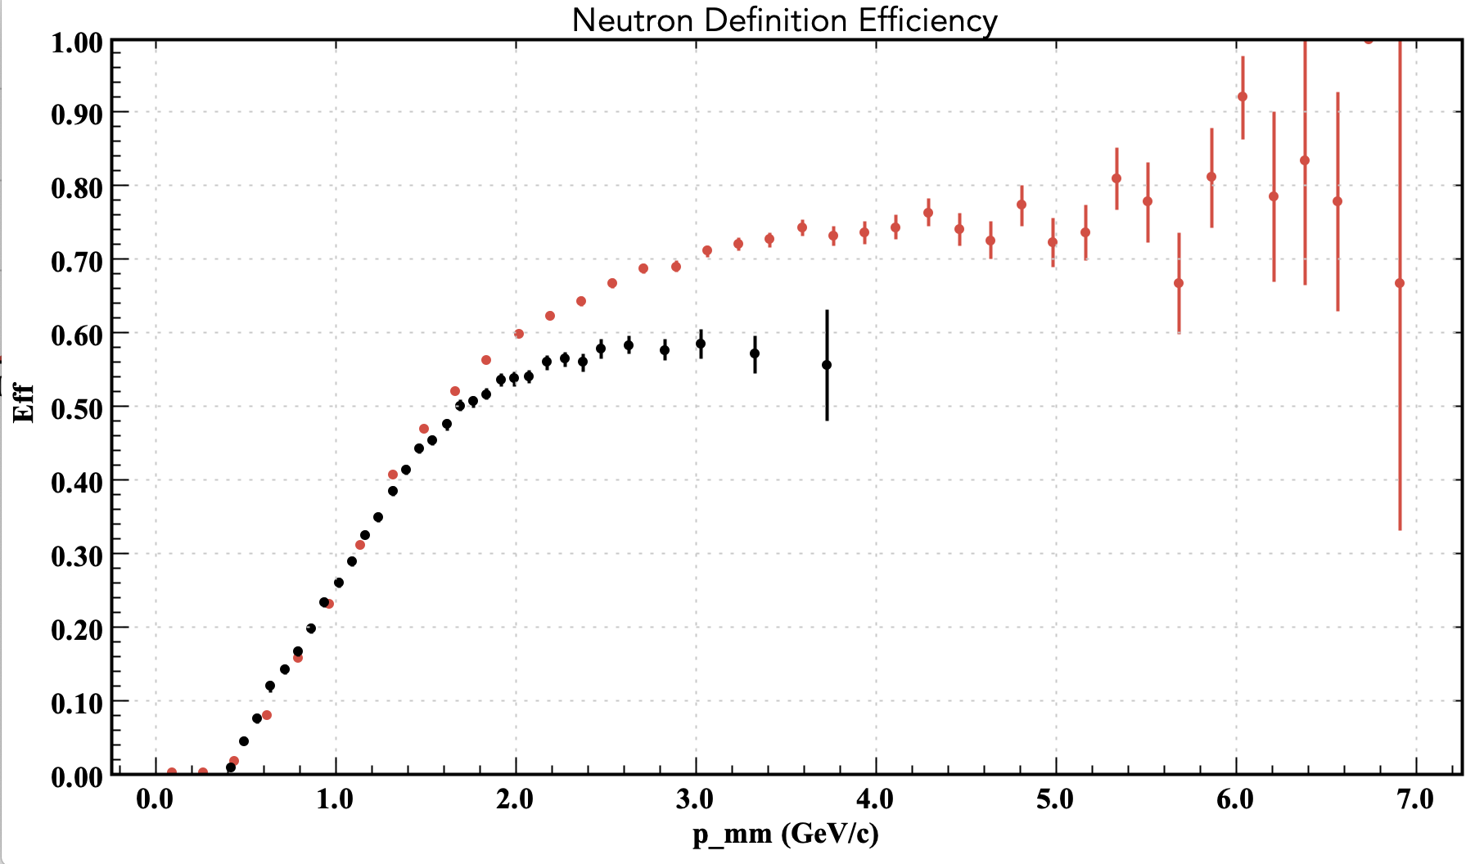
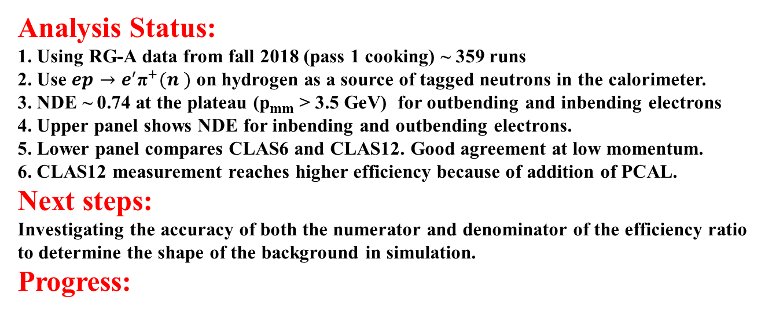
Measuring the neutron detection efficiency (NDE) needed for quasi-elastic e-n$e D→e^{′} n (p)$
Analysis Status:
1. Using RG-A data from fall 2018 (pass 1 cooking) ~ 359 runs
2. Use $ep→e^{′}{\text{π}}^{+}(n )$ on hydrogen as a source of tagged neutrons in the calorimeter.
3. NDE ~ 0.74 at the plateau (p_{mm} > 3.5 GeV) for outbending and inbending electrons
4. Upper panel shows NDE for inbending and outbending electrons.
5. Lower panel compares CLAS6 and CLAS12. Good agreement at low momentum.
6. CLAS12 measurement reaches higher efficiency because of addition of PCAL.
Next steps:
Investigating the accuracy of both the numerator and denominator of the efficiency ratio to determine the shape of the background in simulation.
Progress:
CLAS12 (PCAL/ECAL)
CLAS
Simulate events using SIDIS (from Giovanni Angelini) and A0/MAID2000 (UConn group) event generators. Preliminary comparison with data from the SIDIS simulation is shown here.
inbending SIDIS simulation
inbending Real data
inbending SIDIS simulation
inbending Real data
Plateau at $NDE=0.740 ±0.01 for p_{mm}>3.5 GeV$

