Slide 1
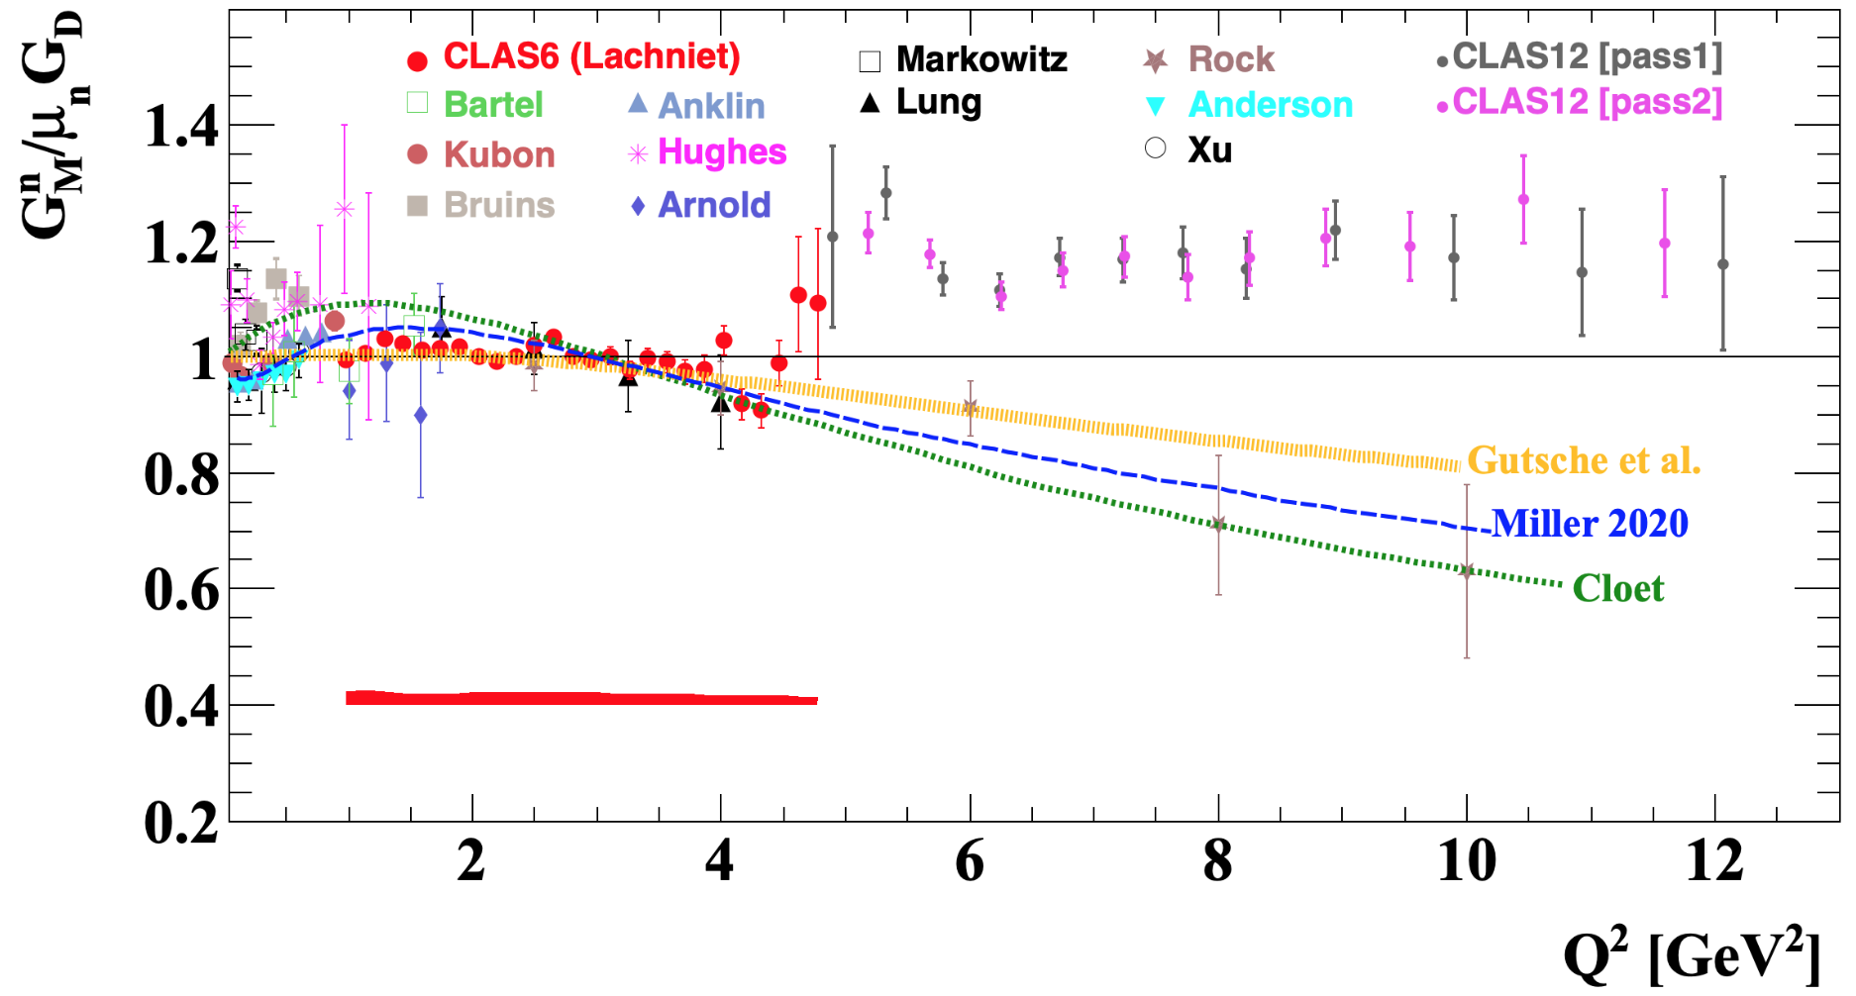
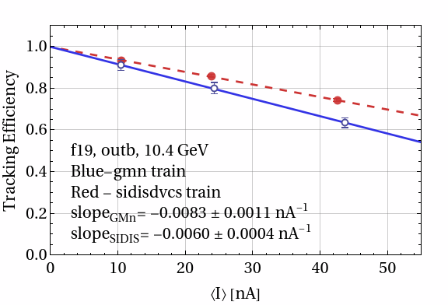
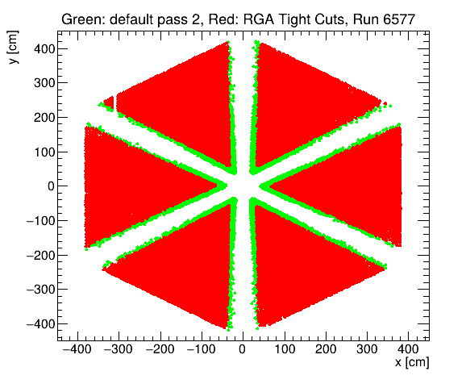
Measurement of the Neutron Magnetic Form Factor GM^{n} at
High Q² Using the Ratio Method on Deuterium
L.Baashen (KSU), B.A.Raue (FIU), J.Carvajal (FIU), G.P.Gilfoyle (Richmond)
Goal: Extract GM^{n} at high Q² using the ratio of quasi-elastic e-n and quasi-elastic e-p events on deuterium.
Introduction
1. The neutron magnetic form factor is a fundamental observable related to the distribution of magnetization in the neutron.
2. The form factor is extracted from the e-n/e-p ratio.
3. Figure to the left shows world’s data for GM^{n} including preliminary CLAS12 results that still require corrections.
4. Pass 1 extraction of ratio is done – Lamya Baashen’s FIU thesis.
5. Transition to Pass 2 has begun. We observed improvements in the statistics and resolution in preliminary studies.
Preliminary
Gutsche et al. (PRD 97, 054011, 2018)
Miller et al. (arXiv 1912.07797 [nucl-th], 2020)
Cloet et al. (Few-Body Syst, 46(1):1-36)
Luminosity Correction
1. The ratio of the number of ep to electron events, Nep/Ne, is normalized to unity at zero current to form the tracking efficiency. See CLAS-NOTE-2020-005 for more details.
2. Average current is extracted from the event data.
3. This correction has a large effect (0.008 nA⁻¹). See plot below.
4. Comparison using the same Pass 1 analysis code on SIDIS train data gave a slope consistent with that group’s results.
Another Luminosity Test and the Transition to Pass 2
1. To further test the luminosity correction, low-current data (5 nA) are merged with background data generated at the appropriate current and then analyzed.
2. Updated analysis chain to Pass 2 - rebuilt data dictionaries, increased memory allocations, … etc.
3. Next step - started update the GM^{n} analysis code to Pass 2.
4. We are using RGA results.* Effect of PCAL fiducial cuts are shown. RGB survival rates (below) are higher than RGA.
*RGA Analysis Note draft.
Run Period Survival Rates
Period | Polarity | Ebeam | Rate
S19 | inb | 10.6 | 0.75
S19 | inb | 10.2 | 0.84
F19 | outb | 10.4 | 0.70
S20 | inb | 10.4 | 0.88

