Slide 1

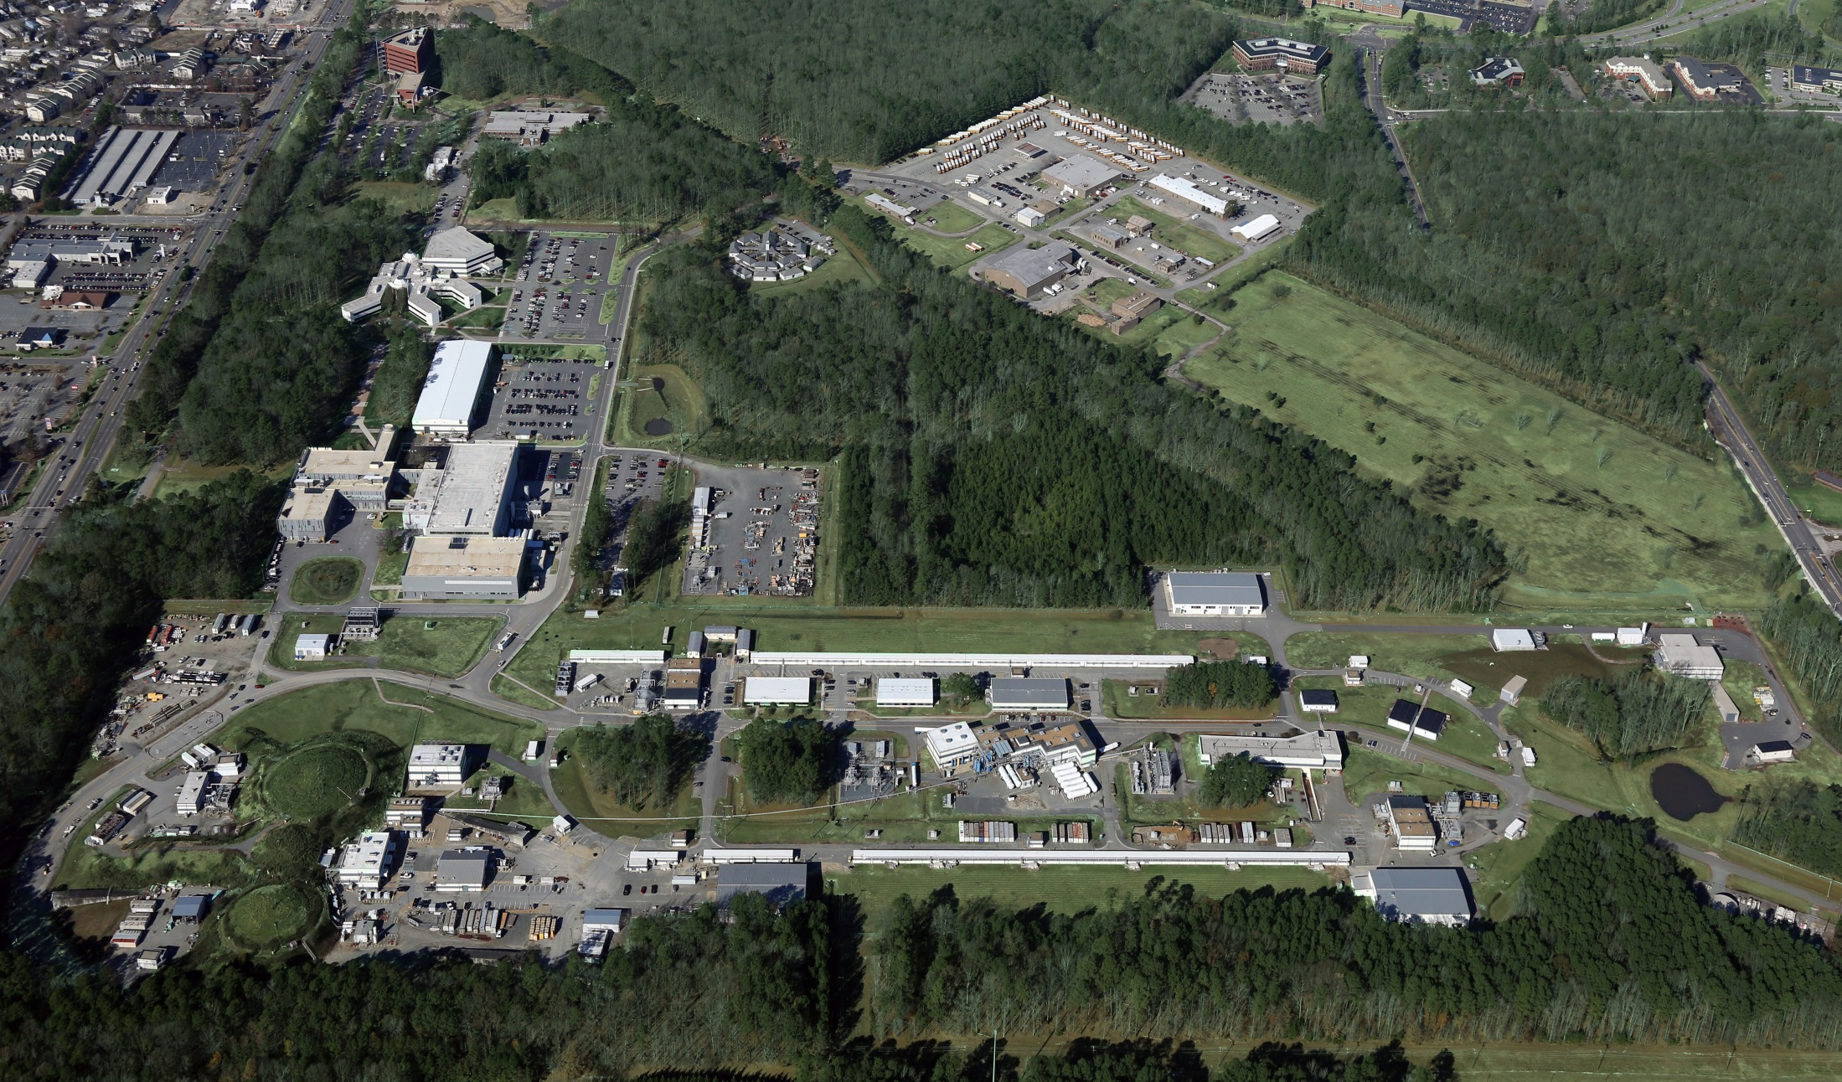
CLAS12 Analysis and First Experiment Organization
Notes:
1

Slide 2
CLAS12 Analysis and First Experiment Organization
Latifa & Jerry
January 13, 2017

Slide 3
Recommendations of Common Tools Committee
Complete COATJAVA reconstruction and calibration tools.
Extend COATJAVA to include event selection.
Create this group
  Guide development of analysis algorithms
  PID, momentum corrections, background subtraction, fiducial cuts
  Higher level analysis – kinematic fitting, PWA
  Standardize the algorithms and software.
Create first experiment analysis review committee before the fall run to begin assessing the techniques used in the previous bullet.
Get ready for the fall run: develop and run simulations for the experiments in Run Group A, define optimal running conditions, complete development of necessary tools, and define infrastructure to manage the work.
Documentation and dissemination.

Slide 4
CLAS12 Data Analysis Scheme
CCDB
RAW DATA
Simulation
Calibration
RECONSTRUCTED DATA
MC DATA
Reconstruction
DSTs
Event selection
DSTs
COATJAVA/CLARA
Physics analysis
PHYSICS OBSERVABLE
Notes:
CHECK COLORS
4

Slide 5
CLAS12 First Experiment Organization
CLAS Coordinating Committee
Physics Working Groups
Collaboration Governance
Expert Analysis Review Committee
First Experiment Coordinator & Contact Person
Calibration & Commissioning Group
Analysis Coordinator
Calibration Team
Software & Reconstruction
Group
Analysis Team
Experts
First Experiment
Notes:
5

Slide 6
Expert Analysis Group Membership
Ken Hicks
Dave Ireland
Sebastian Kuhn
Silvia Niccolai
Eugene Pasyuk
Larry Weinstein

Slide 7
To-Do List for Today (The Agenda)
Organizational items.
  Select a chair.
  Find a day to have regular meetings
  Report to Collaboration Chair every couple of months.
What to do first
  Make a plan
  Read/assess recent reviews (SR, ERR, CT)
What to do next
  Divide workload by software/hardware subsystems.
  Assess software preparations for calibration and analysis for CLAS12.
  Results from KPP
  Advice on setting up first experiment analysis review.
  Interaction with first experiment analysis review.

