Slide 1
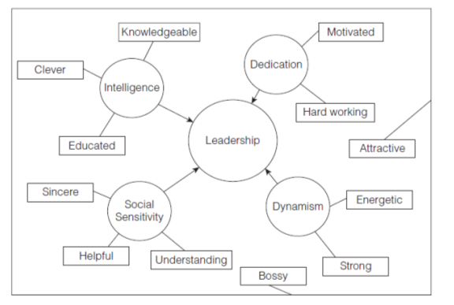
9 Leadership
Groups generally require guidance as they strive to reach their goals, and the individual who coordinates and motivates the group can fundamentally shape the group’s future. If asked, “What one thing would you change to turn an inept group into a productive one?” most people would answer, “The leader.”
What is leadership
Who will lead?
Who do some leaders succeed and others fail?

Slide 2
Preview
Leadership
Nature of Leadership
Emergence
Effectiveness
Contiingency
Myths
Definition
Traits and more
Appearances
Theories
Style
LMX
Shared
Transformational

Slide 3


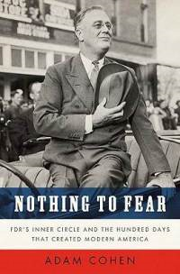


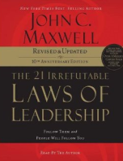
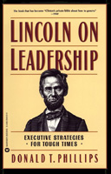
Many have examined leadership carefully, and have offered many insights ….

Slide 4
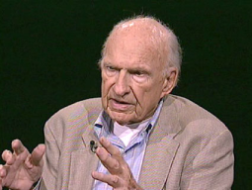

Yet, as James MacGregor Burns writes:
Leadership is “one of the most observed and least understood phenomena on earth”

Slide 5
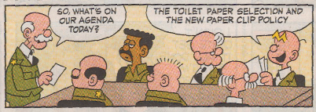
Leadership Matters….
Intellectually
Politically
Practically
Personally
Scientifically
(empirically,
conceptually)

Slide 6
What Is Leadership?
Leadership myths
Leadership is power (with people rather than over people)
Leaders are born (but leaders are also “made”)
All groups have leaders (shared influence and group size)
People resist their leaders (most groups accept the need for a leader)

Slide 7
Leadership myths (cont.)
Leaders make or break their groups (leaders influence their groups in significant ways)
Leaders make ALL the difference (The “romance of leadership” exaggerates the impact of a leader

Slide 8
What is leadership?
Leadership defined: guidance of others in their pursuits, often by organizing, directing, coordinating, supporting, and motivating their efforts.
Reciprocal (followership)
Transactional
Transformational
Cooperative
Adaptive, goal seeking
Kelley’s theory of followers

Slide 9
Kelley’s theory of followers
First Key Dimension: Energy
Is it positive, neutral, or negative?
I am highly committed to and energized by my work and organization, giving them the best ideas and performance.
I take the initiative to identify the organizational activities that are critical for achieving the company's goals.
I take the initiative to seek out and successfully complete assignments that go above and beyond my job.
When I am not the leader of a group project, I still contribute at a high level, often doing more than my share.
I actively develop a distinctive competence in those critical areas so that I am more valuable to the leader and organization.
I understand the leader's needs, goals, and constraints, and try to help address them.
Sum of 1-6 (Negative-Positive Energy, 6-30)

Slide 10
Kelley’s theory of followers
Second Key Dimension: Independence
Critical eye, neutral, or “yes-man”?
I act on my own ethical standards rather than the leader's or group's standards.
When the leader asks me to do something that runs contrary to my professional or personal preferences, I say "no" rather than "yes."
I internally question the logic of the leader's decision rather than just doing what I am told.
I assert my views on important issues, even though it might mean conflict with the group or reprisals from the leader.
I do not always agree with suggestions my leader makes.
I make a habit of challenging the wisdom of the leader's decisions.
Sum of 7-12 (Independent/Critical Thinking: 6-30)

Slide 11
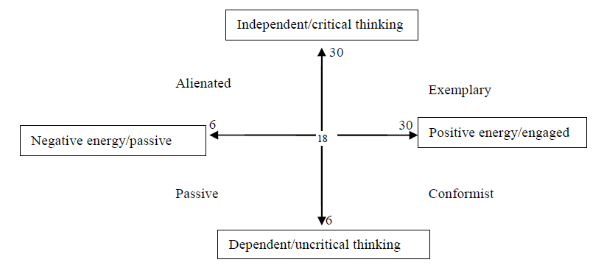
Kelley’s theory of followers

Slide 12


What do leaders do? The T-R Model
Task Leadership
Relationship Leadership
Task-oriented, agentic, goal-oriented, work facilitative, production- centered, administratively
Relationship oriented, communal, socio-emotional, supportive, employee centered,
skilled, goal achieve-ment oriented
relations skilled, group main-tenance, best liked

Slide 13
What do leaders do? The T-R Model
Task Leadership
Relationship Leadership
Assigns tasks to members
Makes attitudes clear to the group
Critical of poor work
Sees to it that the group is working to capacity
Coordinates activity
Listens to group members
Easy to understand
Friendly and approachable
Treats group members as equals
Willing to make changes

Slide 14
Issues…. Leadership Substitutes Theory
Group Member Characteristics
Task Characteristics
Characteristics of the Organization
Has ability, experience, training, knowledge
Has a need for independence
Has “profes-sional orientation”
Is indifferent to group rewards
Is unambiguous and routine
Is methodological-ly invariant
Provides it own feedback concerning accomplishment
Is intrin-sically satis-fying
Formalized (explicit plans, goals, and areas of responsibility)
Inflexible (rigid, unbending rules and procedures)
Highly specified with active advisory and staff functions
Closely knit, cohesive workgroups
Organizational rewards not within the leader’s control
Spatial distance between superior and subordinate
Will Neutralize Task Leadership
Will Neutralize Relationship Leadership

Slide 15


Issues…. Men, Women, and Leadership
Task Leadership
Relationship Leadership
Assigns tasks to members
Makes attitudes clear to the group
Critical of poor work
Sees to it that the group is working to capacity
Coordinates activity
Listens to group members
Easy to understand
Friendly and approachable
Treats group members as equals
Willing to make changes

Slide 16
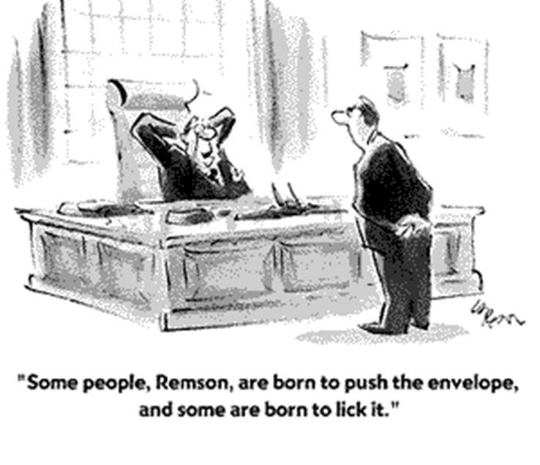
Leadership Emergence: Who Will Lead?

Slide 17
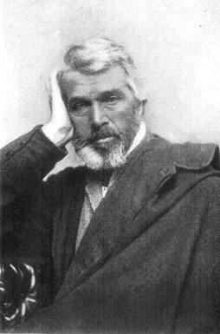
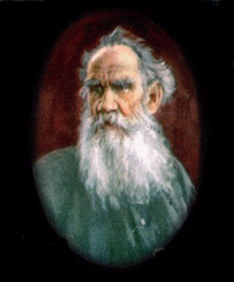
Leadership Emergence: Who Will Lead?
Perspectives on leadership emergence
The history of the world is but the biography of great men.
Leo
Tolstoy
Thomas Carlyle’s Great Man Theory
From War and Peace:
The people of the west moved eastwards to slay their fellow men, and by the law of coincidence thousands of minute causes fitted in and coordinated to produce that movement and war: …A king is history's slave.
Note: Except for Abraham Lincoln, who Tolstoy believed was a great man: “The greatness of Napoleon, Caesar or Washington is only moonlight by the sun of Lincoln.
Zeitgeist Theory

Slide 18
Interactional Model: Traits + Situations = Leadership
New Evidence Yields Clearer Evidence
Better Theory
+
Better Measures
Emerging consensus leaders do possess certain qualities that set them apart from other people.
+
Better Methods
+
Better Statistics
Example: Big Five Theory

Slide 19
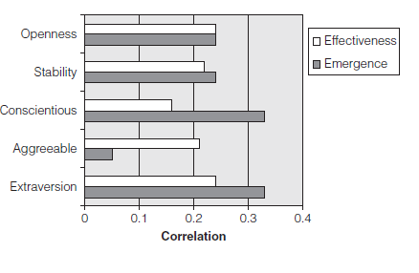
Big Five Factors and Leadership

Slide 20
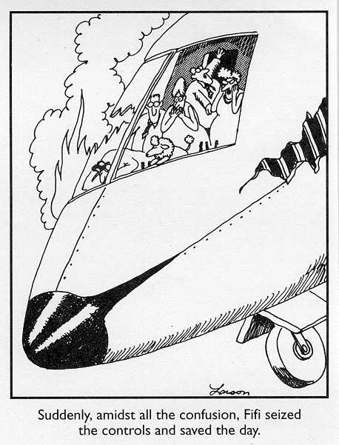
Other Predictors of Leadership Emergence
Physical qualities: height, weight, age
Intelligence and emotional intelligence (degree of social skill).
Sex
Ethnicity
Expertise, skill, and experience.
Level of participation in discussion: the “babble effect.”

Slide 21
Theoretical explanations of leadership emergence
Knowledgeable
Motivated
Dedication
Clever
Intelligence
Leadership
Leadership
Hard working
Implicit Leadership Theory
Social Identity Theory
Social Role Theory
Terror Management Theory
Evolutionary Theory
Educated
Attractive
Dynamism
Sincere
Social
Sensitivity
Dynamism
Energetic
Helpful
Understanding
Strong
Bossy
Individuals have intuitive “theories” about what leadership is and who is good at it

Slide 22
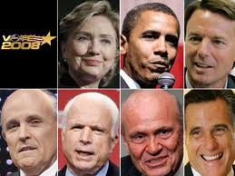
ILTs and Prototype matching
Who will lead? The person who best fits my “profile” of an able leader….
The Prototype Matching Hypothesis

Slide 23
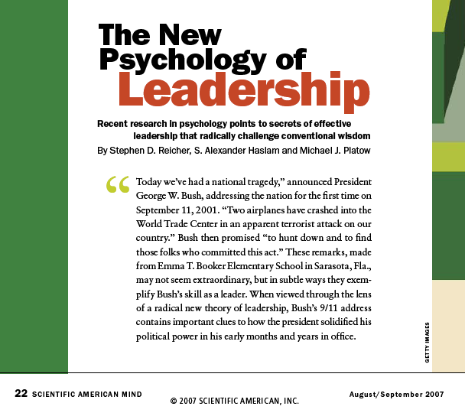
Theoretical explanations of leadership emergences
Weber: leaders must be charismatic
Fiedler: leaders must “match” the situation
Burns: leaders must be “transformational”
Reicher et al:
Implicit Leadership Theory
Social Identity Theory
Social Role Theory
Terror Management Theory
Evolutionary Theory
Followers identify with their groups, and if their leader is a symbol of the group, they will follow him or her.
Example: President Bush on 911

Slide 24

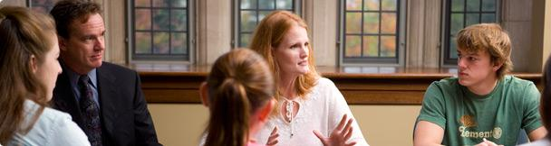
Theoretical explanations of leadership emergences
Who is leading this group?
Implicit Leadership Theory
Social Identity Theory
Social Role Theory
Terror Management Theory
Evolutionary Theory
Agency (and autonomy)
Forceful
Task-focused
Makes Decisions Easily
Dominant
Individualistic
Ambitious
Communal
Cheerful
Supportive
Sympathetic
Tender
Sensitive to others needs
Understanding
As Eagly and others note, these two sides of leadership correspond to sex role expectances

Slide 25

Theoretical explanations of leadership emergences
Mortality salience triggers a need for charismatic leaders
“Please briefly describe the emotions that the thought of your own death arouses in you”
“Jot down, as specifically as you can, what you think will happen to you as you physically die and once you are physically dead”
Awareness of Morality
Humans are aware of their mortality
Morality Salience (MS)
MS leads to
Self-esteem bolstering
Protection of worldview
Existential Anxiety
Need for a group-centered leader
Implicit Leadership Theory
Social Identity Theory
Social Role Theory
Terror Management Theory
Evolutionary Theory

Slide 26
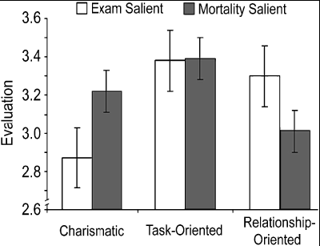
Cohen, Solomon, Maxfield, Pyszczynski, & Greenberg 2004
Hypothesis: People will favor charismatic leaders when primed with death-related thoughts

Slide 27
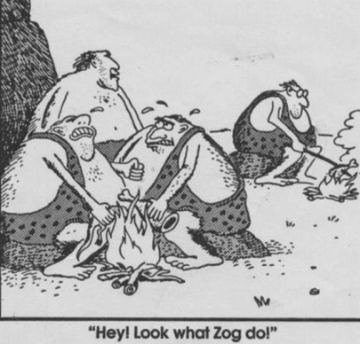
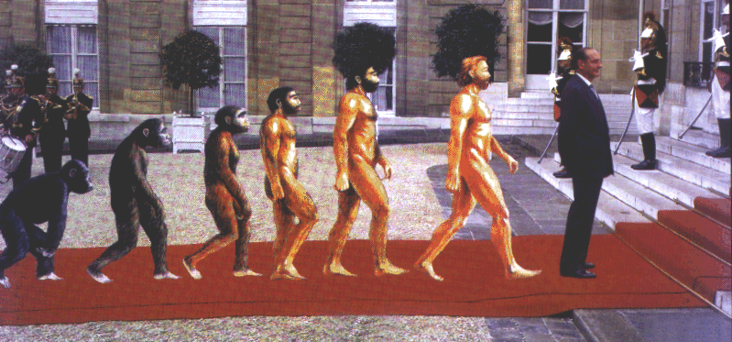
Theoretical explanations of leadership emergences
Basics
Survival of the fittest
Sexual selection
Leaders are useful in social species
Leaders help followers survive, thrive
Tribes with leaders are more “fit”
Results
People readily recognize leaders
Leadership is a resilient cultural feature
Leadership has rewards to offset costs
Implicit Leadership Theory
Social Identity Theory
Social Role Theory
Terror Management Theory
Evolutionary Theory

Slide 28
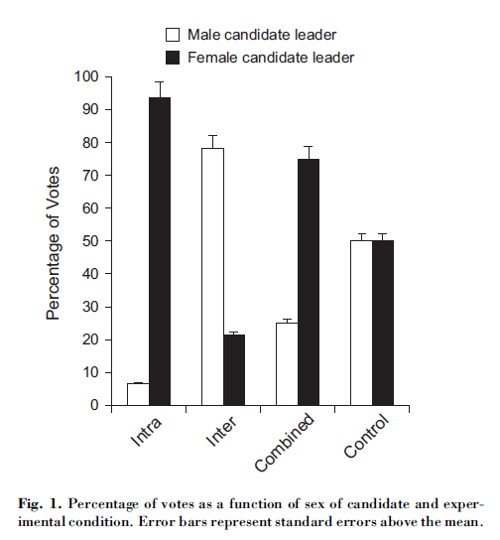
Van Vugt & Spisak, 2008, suggest that the “instinct” to seek a male leader is tuned to the situation
If women are thought to be superior to men at maintaining group harmony
If men are thought to be better during conflict with other groups
Then
Women will be preferred as leaders during times of intragroup competition (and conflict)
Men will be preferred if there is trouble with another group (intergroup)

Slide 29
Final Section
Leadership
Nature of Leadership
Emergence
Effectiveness
Contiingency
Myths
Definition
Traits and more
Appearances
Theories
Style
LMX
Shared
Transfomational

Slide 30
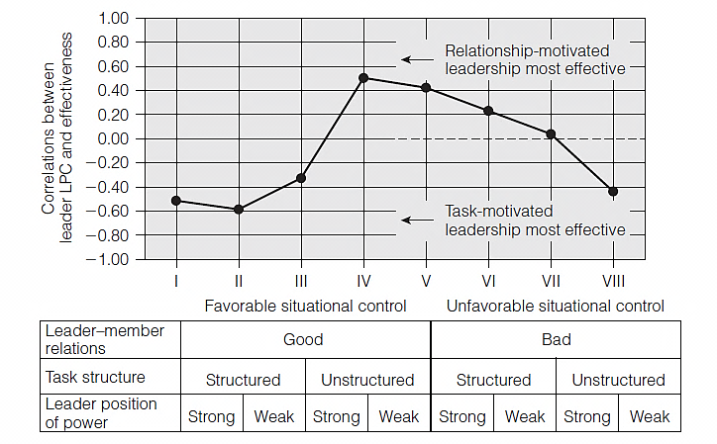
Contingency Theories
Leadership effectiveness depends on (is “contingent on”) both the person and the situation
Fred Fiedler’s contingency theory includes 1 “person” variable (leadership motivation, which is task vs. relational) and 3 situational variables (that combine to determine situational favorability)
For more details see supplement slides

Slide 31
Fiedler’s Contingency Theory
High LPC leaders most effective in “moderately” favorable situations
Low LPC leaders most effective in very favorable or very unfavorable situations
In moderate situations, the correlation between LPC and Effectiveness is POSITIVE
In highly favorable or highly unfavorable situations, the correlation between LPC and Effectiveness is NEGATIVE

Slide 32
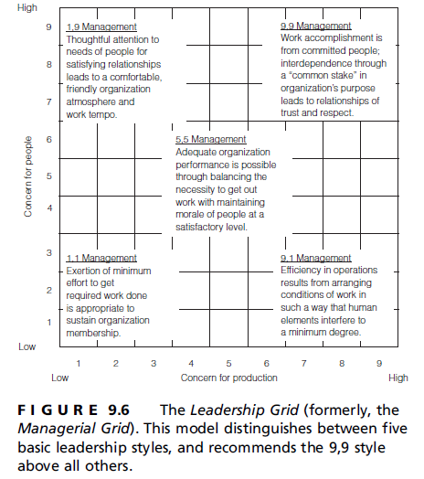
Style Theories
Leadership effectiveness depends on the leader’s “style”—some styles are more effective than others—and the match of style to situation is also important
Blake and Mouton’s “leadership grid” theory

Slide 33
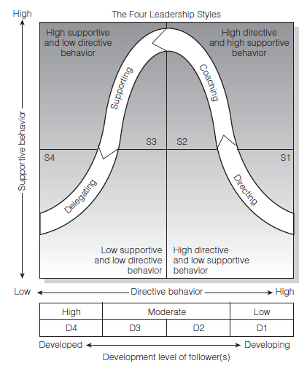

Style Theories
Hersey & Blanchard’s Situational Leadership Theory

Slide 34
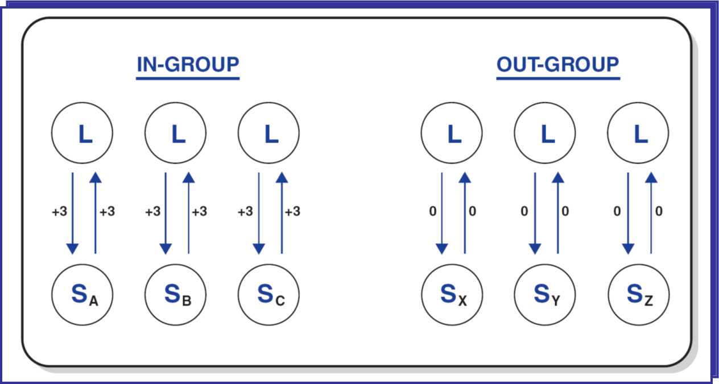
LMX Theory
Earlier work based on vertical dyad linkage theory; later work shifted to a more group-level view
Leader-Member Exchange Theory

Slide 35
LMX Theory
S
Subordinate
S
S
In-Group
more information, influence, confidence & concern from Leader
more dependable, highly involved & communicative than out-group
Out-Group
In-Group
Leader
S
S
S
S
S
S
S
S
S
S
Out-Group
less compatible with Leader
usually just come to work, do their job & go home

Slide 36
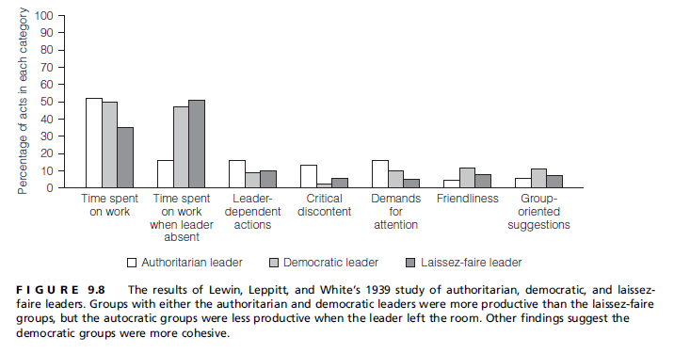
Participation Theories
Example: Lewin, Lippitt, and White
Leadership is shared with all group members

Slide 37
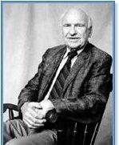
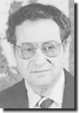
Transformational Theories
The “new face” of charismatic leadership theory
James MacGregor Burns
Bernard Bass

Slide 38
There is a mutually beneficial exchange between leaders and followers in which both have something to offer the other. The nature of the exchange defines the type of leader.
Follower
Leader

Slide 39
Bass’s transactional-transformational distinction
Transactional Leadership
Leaders treat their relationships with followers as a transaction: define expectations and offer rewards, some sort of exchange
Contingent rewards: if a follower produces the desired behavior, she will receive the contracted award (positive and negative)
Transformational Leadership
Idealized influence
Inspirational motivation
Intellectual stimulation
Individualized consideration

Slide 40

GLOBE study of leadership
In Sum: Cross-cultural analyses of leadership
Administratively Competent
Orderly Administrative Skilled
Organized
Good Administrator
Decisive *
Willful
Decisive
Logical
Intuitive
Team I: Collaborative Team *
Group-oriented
Collaborative
Loyal
Consultative
Team II: Team Integrator *
Communicative
Team Builder
Informed
Integrator
Charismatic I:
Visionary*
Foresight
Prepared
Anticipatory
Plans Ahead *
Charismatic II:
Inspirational*
Enthusiastic
Positive
Morale Booster
Motive Arouser
Dynamic
Diplomatic
Diplomatic
Worldly
Win-win Problem solver
Effective Bargainer
Humane *Orientation
Generous
Compassionate
Integrity *
Honest
Sincere
Just
Trustworthy
Performance Oriented *
Improvement-oriented
Performance-oriented
Procedural
Ritualistic
Formal
Habitual
Procedural

Slide 41
Review
Leadership
Nature of Leadership
Emergence
Effectiveness
Contiingency
Myths
Definition
Traits and more
Appearances
Theories
Style
LMX
Shared
Transformational

Slide 42
Details on Fiedler’s Contingency Theory
"The realization that leadership effectiveness depends on the interaction of qualities of the leader with demands of the situation in which the leader functions, made the simplistic "one best way" approach of earlier eras obsolete.“
From Martin M. Chemers and Roya Ayman, 1993
Background
empirically based (studied many kinds of leaders and groups)
many measures but required a clear indicator of group performance
exploratory (funded by ONR)

Slide 43
Model
Leadership
effectiveness is
contingent
on
Situation
Variable:
Leader
Situational
Control
Person
Variable:
Motivational
Structure

Slide 44
Person Side
Motivational
Structure or
Leadership
Style
“In oversimplified terms, … the leader manages the group in either of two ways. He can:
Tell people what to do and how to do it.
Or share his leadership responsibilities with his group members and involve them in the planning and execution of the task.”
Fiedler, Harvard Business Review, p. 116

Slide 45
Fiedler measured these two tendencies with the LPC Scale
Think of a person with whom you can work least well. He or she may be someone you work with now or someone you knew in the past. This coworker does not have to be the person you like least but should be the person with whom you had the most difficulty in getting a job done.

Slide 46
LPC
Pleasant :.8..7..6..5..4..3..2..1.: Unpleasant
Friendly :.8..7..6..5..4..3..2..1.: Unfriendly
. . .
Insincere :.1..2..3..4..5..6..7..8.: Sincere
Kind :.8..7..6..5..4..3..2..1.: Unkind
.
Low score = Task Motivated (57)
High score = Relationship Motivated (63)
(If 58-62, “socioindependent”): ambivalent, mixed motivations, socially independent, not clear

Slide 47
Situation
Variable:
Leader
Situational
Control

Slide 48
Situation Side
Leadership
effectiveness is
contingent
on
Situation
Variable:
Leader
Situational
Control
Person
Variable:
Motivational
Structure
Situational Control
(or favorability)
Leader-member relations
Task structure
Position power

Slide 49
Leader-member relations
Good
Bad
The people I supervise have trouble getting along with each other.
My subordinates always cooperate with me in getting the job done.
I have good relations with the people I lead.

Slide 50
Task structure
Structured
Unstructured
Is the goal clearly stated or known?
Is there only one way to accomplish the task?
Is there only one correct answer or solution?
Is it easy to check whether the job was done right?

Slide 51
Position power
Strong
Weak
Can the leader directly or by recommendation administer rewards and punishments to his subordinates?
Is it the leader’s job to evaluate the performance of his subordinates?

Slide 52
Combining the 3 situational factors
Combining
the three variables
Situation
Variable:
Leader
Situational
Control
Situational Control =
4 (Leader-member relations)
2 (Task structure)
Position power

Slide 53
Combining the 3 situational factors
Most favorable: Good LMR, Structured Task, Strong PP
8 types of situations that vary in controllability, or favorability
High Controllability |  |  |  |  |  |  |  |  | Low Controllability
Least favorable: Poor LMR, Unstructured Task, Weak PP

Slide 54
Predictions
What type of leadership is most effective in each of the 8 situation?
High
LPC
Low
LPC
?
High Controllability |  |  |  |  |  |  |  |  | Low Controllability

Slide 55
High LPC leaders most effective in “moderately” favorable situations
Low LPC leaders most effective in very favorable or very unfavorable situations
In moderate situations, the correlation between LPC and Effectiveness is POSITIVE
High Controllability |  |  |  |  |  |  | Low Controllability
In highly favorable or highly unfavorable situations, the correlation between LPC and Effectiveness is NEGATIVE
High Controllability |  |  |  |  |  |  | Low Controllability

Slide 56
Correlation between LPC and Performance
In these situations, the Higher your LPC the more effective your group
In these situations, the lower your LPC, the more effective your group
Leader-member Relations | Good |  |  |  | Bad
Task Structure | Structured |  | Unstructured |  | Structured |  | Unstructured
Position Power | S | W | S | W | S | W | S | W
S = Strong
W = Weak

Slide 57
Fiedler conducted other “validation” studies
Correlation between LPC and Performance
Leader-member Relations | Good |  |  |  | Bad
Task Structure | Structured |  | Un-structured |  | Structured |  | Un-structured
Position Power | S | W | S | W | S | W | S | W
S = Strong
W = Weak

Slide 58
Fiedler reports that Low LPC leaders become MORE effective over time, High LPCs become less so
Fiedler et al., 1975, combat groups

Slide 59
Conclusions
Leadership Implications
What do members expect from the leader in a favorable situation? Directiveness?
The low power leader working on an ambiguous task: if relations good must be high LPC (e.g., nonprofit, volunteer coordinator)
When a situation is very unfavorable, don’t bother to focus on relationships
Since most heterogeneous groups are unfavorable, low LPCs are more effective
Train leaders to manipulate situations, not selves: LEADER MATCH concept

