Slide 1
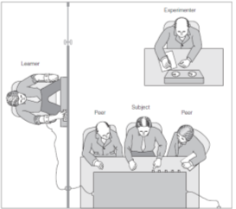

8 Power
Power is a group-level process, for it involves some members of a group doing what others require in situations that range from the purely cooperative and collaborative to those rife with conflict, tension, and animosity. Power can be used for the group and against it, for authorities sometimes demand actions that members would otherwise never consider. We would not be social beings if we were immune to the impact of power, but power can corrupt.
What are the limits of an authority’s power over group members?
What are the sources of power and status in groups?
How do people react when they use their power to influence others?
How do those without power react when power is used to influence them?

Slide 2
Power
Obedience to Authority
Power
Processes
Bases of Power
Power Tactics
Metamorphic Effects
Changes in the Powerholder
Reactions to the Use of Power
Compliance Tactics
Milgram’s Findings
Social Status
Claiming Status
Achieving Status
Status Hierarchies
Milgram Study

Slide 3

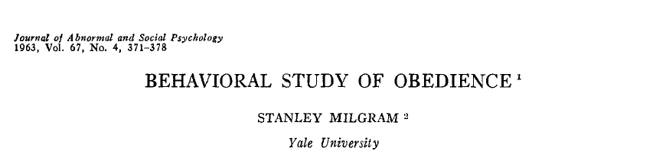
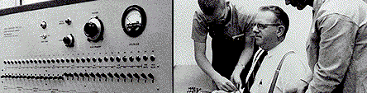
Milgram Study
Rigged drawing (teacher, learner)
Shock machine
Basic condition: series of errors, pounding on the wall at 300 volts, refused to answer at 315 volts
Prods: "The experiment requires that you continue"

Slide 4
Pounding sound
“Ugh!”
“Let me out of here.”
“I absolutely refuse to answer any more. You can’t hold me here.”
Percent Obedient
Maximum obedience
(450 v)
450
Shock Level
Notes:
Figure 8.1. Adapted.

Slide 5
Milgram’s Findings
Variations on the theme

Slide 6
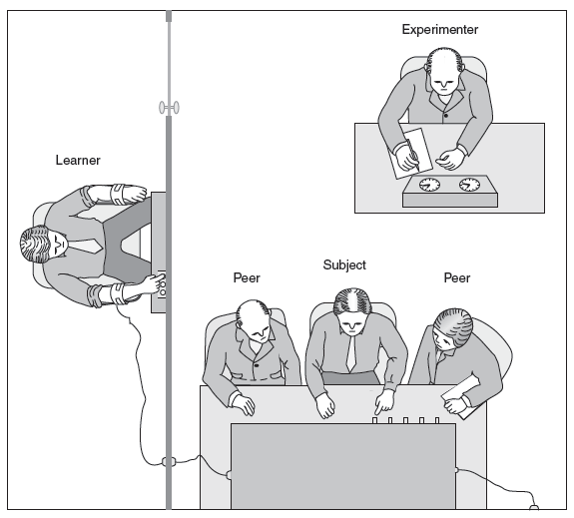
Milgram’s Findings
Group Effects
Only 1 of the 3 group members was an actual subject.
If 2 others gave shocks, 92% obedience.
If 2 others refused to give shocks, 90% DISobedience.

Slide 7

Replications and Controversies
Milgram’s Findings
Methodological Challenges
Ethical Challenges
Applications
Cross-cultural replications
Jerry Burger (2009), by modifying aspects of the Milgram situation that caused the greatest stress for participants, was able to test 70 men and women in 2006.

Slide 8

Obedience to Authority
Power
Processes
Social Status
Metamorphic Effects
French and Raven’s Bases of Power
Milgram Study
Bases of Power
Reward:
Coercive:
Legitimate:
Referent:
Expert:
Informational:
rewards given or offered
threaten or punish
sanctioned right to influence
identification, respect, and attraction
skills and abilities
access to and control of information
Milgram’s Findings
Power Tactics
Compliance Tactics

Slide 9
How do people “get their way?”
Power Tactics
Soft/hard
Collaboration, socializing, ingratiation
Bully, threaten, economic rewards
Rational/
nonrational
Reasoning, logic, persuastion
Evasion, ingratiation
Unilateral/
bilateral
Fait accompli, demands, disengagement
Discussion, negotiation

Slide 10
Subtle, indirect, and difficult to detect techniques used to extract compliance
Compliance Tactics
Foot-in-the-Door Technique
Small request followed by a much larger one
Door-in-the-Face Technique
Large request followed by a much smaller one
Behavioral commitment
Ask for commitment before revealing costs
Brainwashing
Combining a series of compliance tactics with physical threats

Slide 11
Obedience to Authority
Power
Processes
Social Status
Metamorphic Effects
Claiming Status
Power (status) is relational; It requires people, interacting with people
Power tends to be unevenly distributed
Power is dynamic; ebbs and flows, negotiated through interpersonal maneuverings (politics)
Achieving Status
Status Hierarchies

Slide 12

Claiming Status
People claim status through both verbal behaviors (speech) and nonverbal displays
Powerful speech
Direct
Frequent
Loud
Disclosure
Questioning
Advisement
Interpretation
Disclosure: I’m in charge. | Question (query): What do you think you are doing?
Edification: I finished the report. | Acknowledgment: I heard you.
Advisement: You need to complete that report by tomorrow. | Interpretation: I think you are making an error.
Confirmation: I informed them that we are will be arriving on time. | Reflection (suggestion): I think we should adopt plan B.

Slide 13
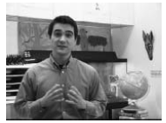

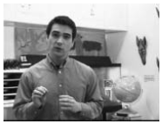
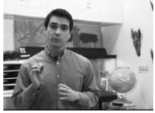
Claiming Status
People claim status through both verbal behaviors (speech) and nonverbal displays
Powerful nonverbal displays
Eager Display
Posture
Facial expressions
Gestures
Kinesics
Vocalics
Vigilant Display
Source: Cesario & Higgins, Making Message Recipients “feel right”, 2008

Slide 14


Claiming Status
Who seeks Power?
Need for Power
Men, women, and power
Social Dominance Orientation (Sidanius & Pratto, 1999)
Physiology of power (testosterone)
Bullies and bullying

Slide 15
X displays specific and diffuse status character-istics
Other members form positive expectations about Person X
Members permit X to influence them.
Expectation States Theory
Achieving Status
Person X gains status
Specific status cues: qualities that are relevant to the group’s situations (e.g., competencies)
Diffuse status cues: general qualities people use (often mistakenly) when allocating status (e.g., age, race)

Slide 16
Achieving Status
Status Generalization:
Group members unfairly allow irrelevant characteristics, such as race, age, or ethnicity, to influence the allocation of prestige.
Individuals in privileged categories (e.g., males, professionals, etc.) achieve status in groups more easily
In some online groups, the effects of status on participation are muted, resulting in a participation equalization effect
Status allocations are particularly unfair when individuals who are members of stereotyped minority societal groups are solos (or underrepresented)

Slide 17
Status differentiation in group may be an evolved adaptation in human groups
Status Hierarchies
Even in “leaderless” groups (ones with no designated leader or no explicit requirement to distinguish between people on the basis of status) status differences emerge quickly as the group organizes hierarchically
Michel’s Iron Law of Oligarchy: in any group, power is concentrated in the hands of the few
Interpersonal complementarity: Dominant actions tend to “trigger” submissive actions from others
Conflict is lower and cooperation tends to be higher in groups with stable hierarchies

Slide 18
Status Hierarchies
Interpersonal complementarity: Dominant actions tend to “trigger” submissive actions from others
Dominant
Confident
Lead
Assertive
Guide
Aggressive
Help
Criticize
Support
Hostile
Friendly
Rebellious
Cooperate
Wary
Act Friendly
Withdraw
Seek Help
Obey
Respect
Submissive

Slide 19
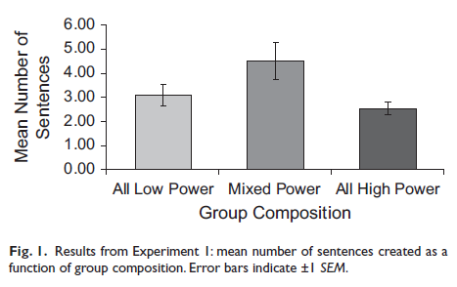
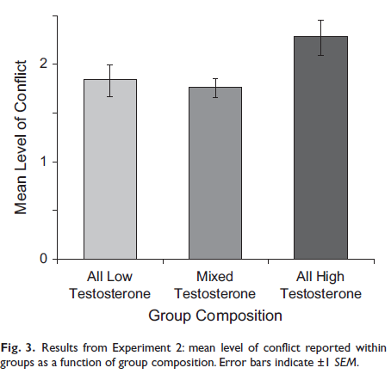

Status Hierarchies
Researchers found that groups where members had high levels of testosterone (and were likely to compete for status) were less productive but high in level of conflict

Slide 20
Obedience to Authority
Power
Processes
Social Status
Metamorphic Effects
Changes in the Powerholder
Is Lord Acton’s Law of Power, “Power tends to corrupt, and absolute power corrupts absolutely,” accurate?
Reactions to the Use of Power
Researchers, by experimentally manipulating people’s feeling of power (priming power), find that power and powerlessness are two very different psychological states.
Remember a time . .
You are the leader…
Please sit here…

Slide 21
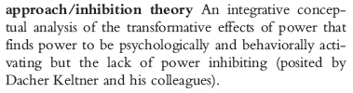
Keltner’s Approach-inhibition model of power
Power leads to approach behavior (positive affect, automatic processing, action)
Powerlessness leads to inhibition (negative affect, controlled processing, inaction)

Slide 22
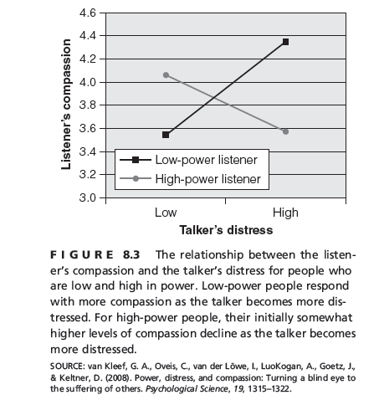
Changes in the Powerholder
Positive Effects of Power
Proactive, engaged
Insulates from influence
Negative Effects of Power
Risky
Positive, strong emotions
Goal focused
Positive Emotions
Enhanced cognitive functioning
Negatively affect others emotional experiences
Loss of empathy, social attentiveness
Less ethical (the Bathsheba syndrome)
Self-satisfied
Coercive : use power to influence others

Slide 23
Reactions to the Use of Power
Resistance to influence
Revolutionary coalitions
Reactance
Conflict and rebellion authority (the ripple effect)
Kelman’s three-stage model of conversion
Compliance
Identification
Internalization
Destructive obedience
Milgram’s agentic state
The Zimbardo Prison Study
What causes obedience?

Slide 24


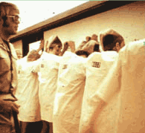

Haney, Banks, & Zimbardo, 1973
Zimbardo's Stanford Prison Study
Results: study was aborted because situation overpowered the subjects

Slide 25
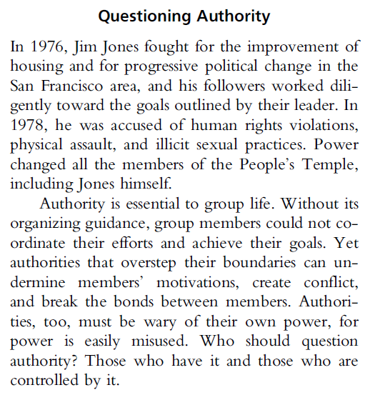

Slide 26
Power
Review
Obedience to Authority
Power
Processes
Bases of Power
Power Tactics
Metamorphic Effects
Changes in the Powerholder
Reactions to the Use of Power
Compliance Tactics
Milgram’s Findings
Social Status
Claiming Status
Achieving Status
Status Hierarchies
Milgram Study

