Slide 1
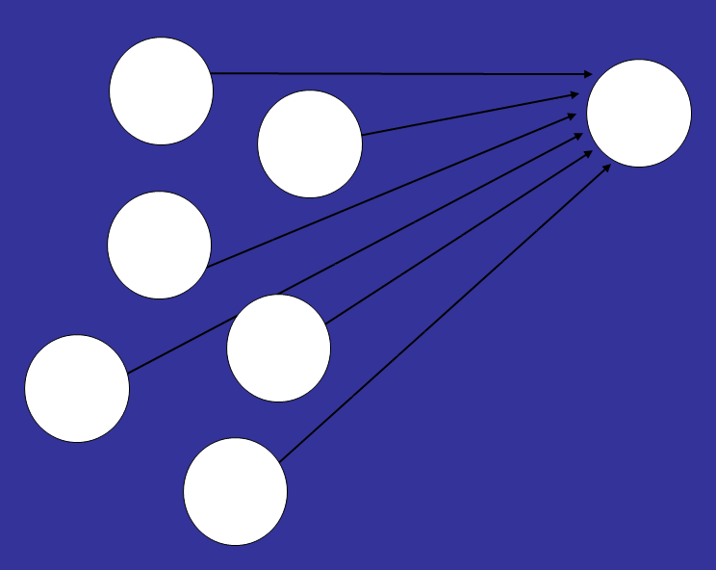
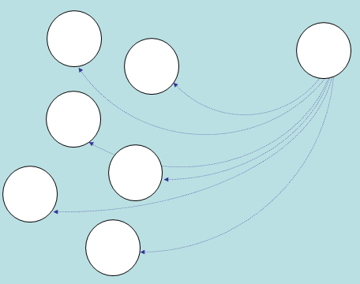
Chapter 7 Influence
An interpersonal undercurrent flows beneath the surface of most groups that pushes group members together, toward greater consensus, uniformity, homogeneity, or conformity. But other forces push members in divergent directions, promoting dissension, uniqueness, heterogeneity, and independence. Groups require both conformity and rebellion if they are to endure.
When do people conform in groups?
When do people resist the group’s influence and, instead, change the group?
Why do people conform?
Do social influence processes shape jury verdicts?

Slide 2
Juries

Slide 3
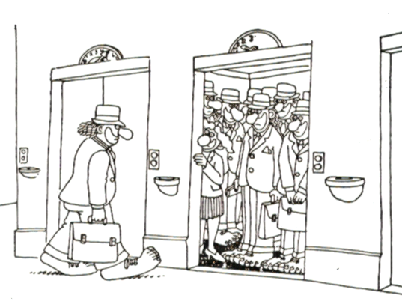
Influence
We are discreet sheep; we wait to see how the drove is going, and then go with the drove.
--Mark Twain
In America …. there is freedom of choice, but nothing to choose from.
--Peter Ustinov
The idea that men are created free and equal is both true and misleading: men are created different; they lose their social freedom and their individual autonomy in seeking to become like each other.
--David Riesman

Slide 4
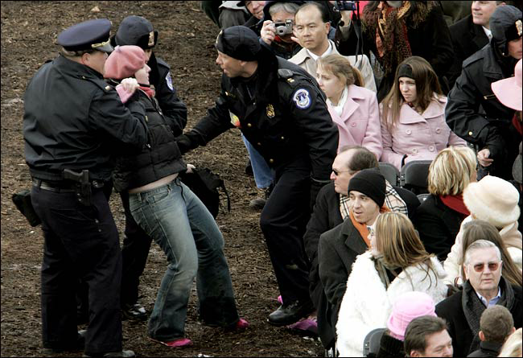
Issues
How many of your choices do you make willfully, and how often do you just conform?
Does a cooperative, civil society require its members conform?
Do we each have the right to refuse to conform, to engage in civil disobedience if need be?
Do you personally accept and admire those who don’t conform?
Is it better to conform or to dissent?

Slide 5

Influence comes from the word “influentia”: an ethereal fluid that flowed down from the planets and the stars to affect human actions.
Unseen and unnoticed, influentia was thought to subtly push humans in one direction or another without completely controlling them.

Slide 6
Pressure of Many against
One: Majority Influence
But influence comes not from planets, but from people
Minority Influence: Pressure of
One against Many

Slide 7
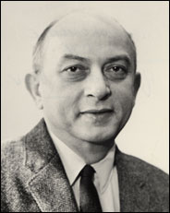
Asch’s study of conformity
Ralph Waldo Emerson:
"I must be myself. I will not hide any taste or aversions." (1926, p. 53)
Conformity: Changing one’s thoughts, feelings, and behavior to match the thoughts, feelings, and behavior of other people
When will a person bend to the pressure of the group?

Slide 8
Example of the “stimulus lines”
1 2 3
Standard Line
Comparison Lines
Trial 1

Slide 9
1 2 3
Standard Line
Comparison Lines
Trial 2

Slide 10
Results: people conform even on this easy task
76.4
36.8%
5%

Slide 11
Evidence of conversion, compliance, and some independence (nonconformity)
Social
Influence
Compliance
Conversion (private
acceptance)
The
Individual
Independence
Anticonformity
Congruence—agree, but did so before influence

Slide 12
Conformity reached peak at group size of 4 (3 stooges + 1 subject)
Conformity low
with 1 or 2 sources
Adding more sources does not appreciably increase conformity
Increased conformity
if 3 sources
Number of Sources of Influence
Conformity less if
Unanimity was lost
Coalitions formed

Slide 13
Latané, B. (1981). The psychology of social impact. American Psychologist, 36, 343-356.
Social Impact Theory: Impact is a function of the Strength of the source(s), their Immediacy, and Number

Slide 14
What is the shape of influence?

Slide 15
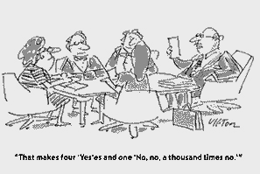
Other studies find variations in rates across people and situations
Individual differences in conformity
Conformists, counter-conformists, independents
Situational factors and conformity
Accuracy needs
Cultural effects
Cohorts
Sex difference
Anonymity (Crutchfield)
Cohesion
Task difficulty
Status of other members

Slide 16
Juries
Diffusion of
Responsibility

Slide 17
When Do People Resist the Group's Influence and Instead Change the Group?
Moscovici’s studies of minority influence: Pressure of
One against Many

Slide 18
Reversing Asch: Moscovici’s study of a consistent minority
Behaviorally consistent minorities sometimes change the majority
Expanding minorities are more influential
Minority influence is more indirect than majority influence, and so is associated with conversion and innovation rather than compliance

Slide 19
Theories of Minority Influence
Moscovici’s conversion theory
Hollander’s idiosyncrasy credits
High status minorities are more influential (idiosyncrasy credits protect them from sanctions)
Latané's dynamic social impact theory
consolidation, clustering, correlation, and continuing diversity

Slide 20
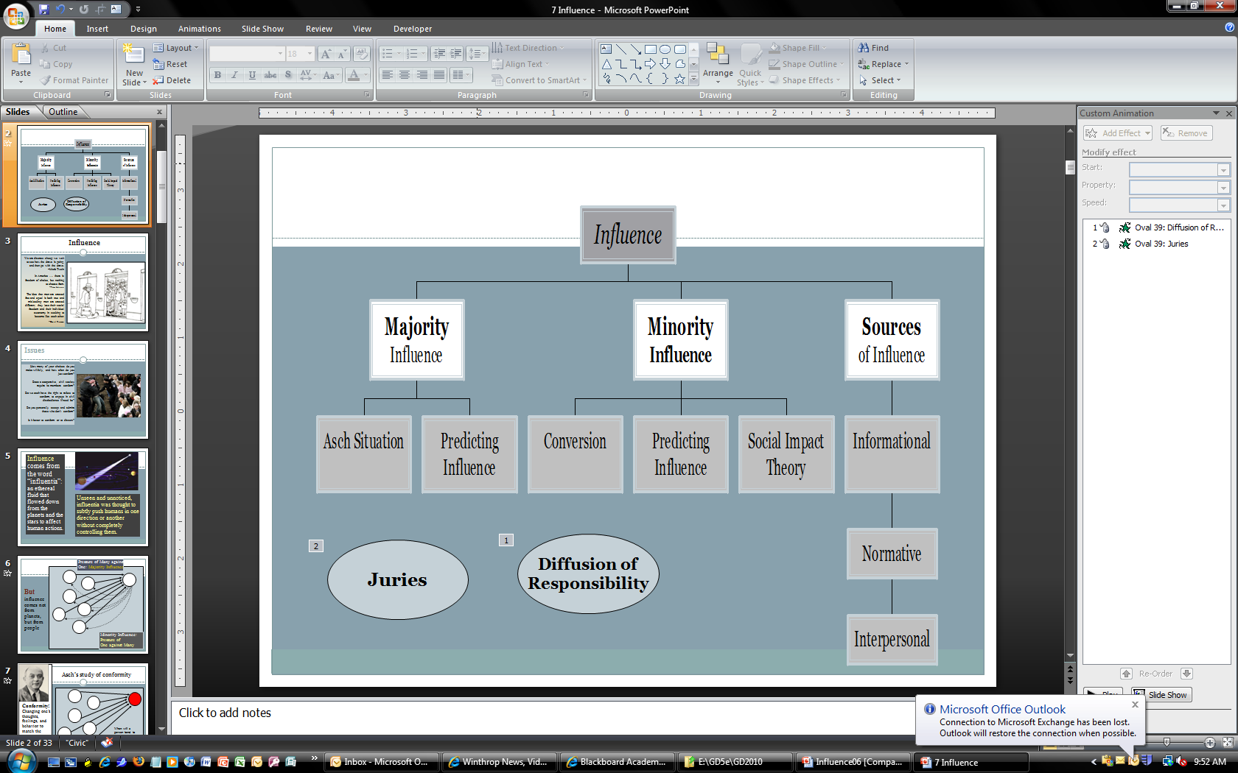
How Does Influence Work?

Slide 21
Three basic forms of influence: informational, normative, and interpersonal
Three basic forms of influence: informational, normative, and interpersonal
Informational influence: group members look to others for information
Social comparison processes
Dual process theories of influence
Thoughtful analysis
Mindlessness

Slide 22
Langer's study of mindlessness
If 20 copies little compliance.

Slide 23
Normative influence: acting, feeling, and thinking in ways that are consistent with group standards
Remember Sherif?
Norms are not just obeyed, but internalized
Examples of normative influence
Milgram’s study of norm violations on a subway

Slide 24
Interpersonal influence: verbal and nonverbal tactics designed to induce change
Schachter’s study of reactions to group deviance
Methods: deviant, mode, slider
Communication with a disliked deviant diminishes in some cases

Slide 25
Communication rate
To most deviates
To excluded deviants*
To the mode
To the slider
Time
* very rare: cohesive, task relevant groups only that disliked deviant

Slide 26
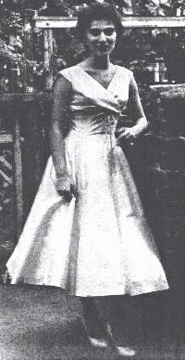
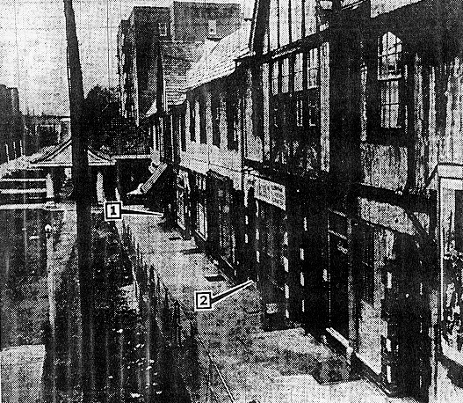
Reactions to Emergencies
Social influence causes people to fail to respond in emergency situations
The “Kitty Genovese” incident
Rachel Manning, Mark Levine, and Alan Collins (2007) point out that the Kitty Genovese is something of a parable.

Slide 27
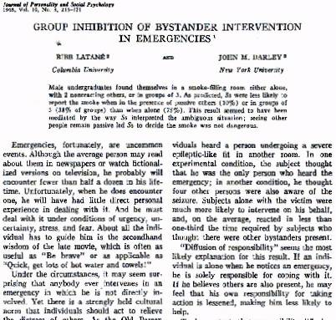
Darley and Latane analysis of reactions to emergencies (1968)
“Diffusion of responsibility” seems the most likely explanation for this result. If an individual is alone when he notices an emergency, he is solely responsible for coping with it. If he believes others are also present, he may feel that his own responsibility for taking action is lessened, making him less likely to help.

Slide 28
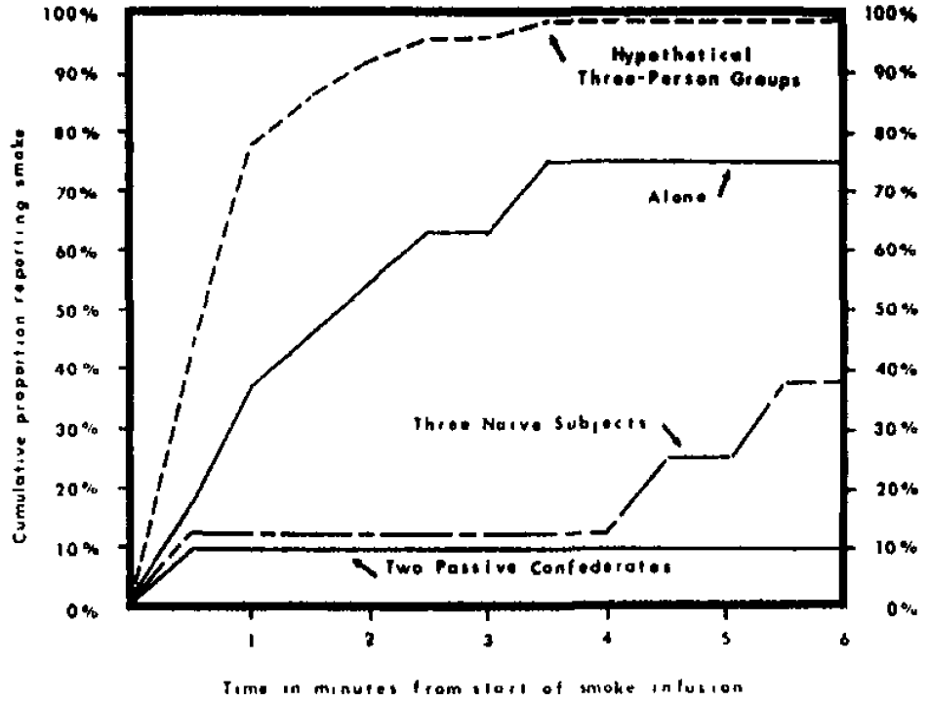
Darley and Latane analysis of reactions to emergencies (1968)

Slide 29
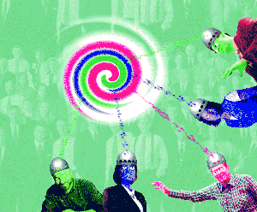
YES: Behold the The Power of Groups
Is influence in groups really so powerful, so inexorable, so ubiquitous?
Why do we do what we do? Because others influence us.

Slide 30
Do Social Influence Processes Shape Juries' Verdicts?
Social influence occurs as jurors deliberate and make a decision
Verdict-driven or evidence-driven deliberation strategies
Jury usually picks the verdict favored by the majority of the members prior to deliberation
Higher status jurors are more influential

Slide 31
Evaluations and innovations
Juries tend to make their decisions carefully
Size and decision rules (anonymity requirement) influence jury dynamics
Note taking during trials
Voir dire procedures and systematic jury selection

Slide 32
Review
Juries

