Slide 1
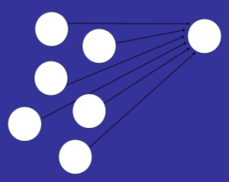
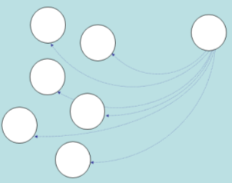
7
Influence
An interpersonal undercurrent flows beneath the surface of most groups that pushes group members together toward greater consensus, uniformity, homogeneity, and conformity. But other forces push members in divergent directions, promoting dissension, uniqueness, heterogeneity, and independence. Groups require both conformity and rebellion if they are to endure.
When do people conform in groups?
When do people resist the group’s influence and, instead, change the group?
What are the sources of social influence?
Do social influence processes shape jury verdicts?

Slide 2
Majority Influence
Minority Influence
Conformity & Independence
Who Will
Conform?
Conversion Theory
Dynamic Social Impact Theory
Conformity across Contexts
Predicting Minority Influence
Sources of
Influence
Implicit Influence
Application:
Juries
Informational Influence
Normative Influence
Interpersonal Influence
When Influence Inhibits: The Bystander Effect
Jury
Dynamics
How Effective are Juries?
Improving Juries

Slide 3
12 Angry Men!
Lone Holdout
Old Man
Bigot
Thick Accent
Ad Man
Baseball Fan
Foreman
Broker
Angry
Father
Juror 1
Regular “Joe” (#6)
Man from Ghetto

Slide 4
Broker
Lone Holdout
Angry
Father
Old Man
Baseball Fan
Foreman
Bigot
Man from Ghetto
Regular “Joe” (#6)
Juror 1
Ad Man
Thick Accent

Slide 5
We are discreet sheep; we wait to see how the drove is going, and then go with the drove.
--Mark Twain
Majority Influence
Influence comes from the word influentia: an ethereal fluid that flowed down from the planets and the stars to affect human actions.
Unseen and unnoticed, influentia was thought to subtly push humans in one direction or another without completely controlling them.
But influence comes not from planets, but from people.
Social influence
Majority influence
Minority influence

Slide 6
Pressure of Many against
One: Majority Influence
Minority Influence: Pressure of
One against Many

Slide 7

Asch’s studies of conformity
Ralph Waldo Emerson:
"I must be myself. I will not hide any taste or aversions." (1926, p. 53)
Conformity: Changing one’s thoughts, feelings, and behavior to match the thoughts, feelings, and behavior of other people
When will a person bend to the pressure of the group?

Slide 8
Example of the “stimulus lines”
Conformity & Independence
1 2 3
Standard Line
Comparison Lines
Trial 1

Slide 9
Trial 2
1 2 3
Standard Line
Comparison Lines

Slide 10
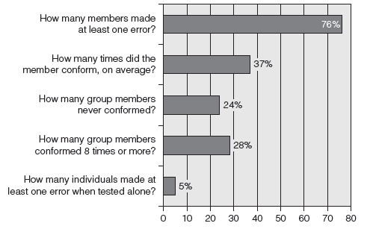
Results: people conform even on this easy task

Slide 11
Conformity & Independence
Evidence of conversion, compliance, and independence (nonconformity)
Social
Influence
Compliance
Conversion (private
acceptance)
The
Individual
Independence
Anticonformity
Congruence—agree, but did so before influence

Slide 12
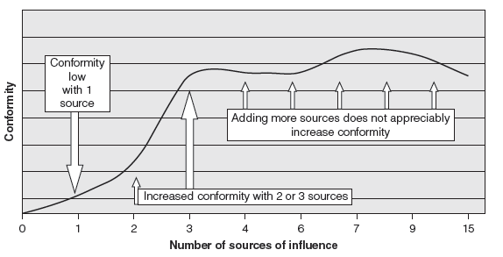
Conformity across Contexts
Factors that influence levels of conformity:
Unanimity of majority
Another dissenter (even if incorrect)
Strong vs. weak situations (e.g., face-to-face, remote)
Size of the group

Slide 13
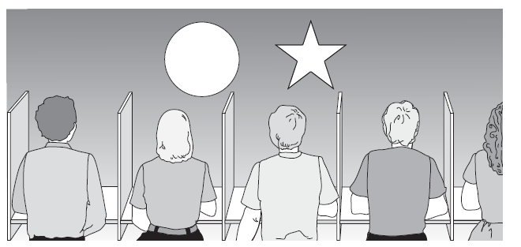
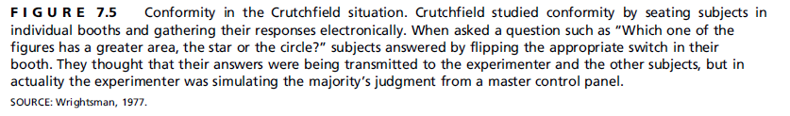
Conformity across Contexts
Factors that influence levels of conformity:
Unanimity of majority
Another dissenter (even if incorrect)
Strong vs. weak situations (e.g., face-to-face, remote)
Size of the group

Slide 14
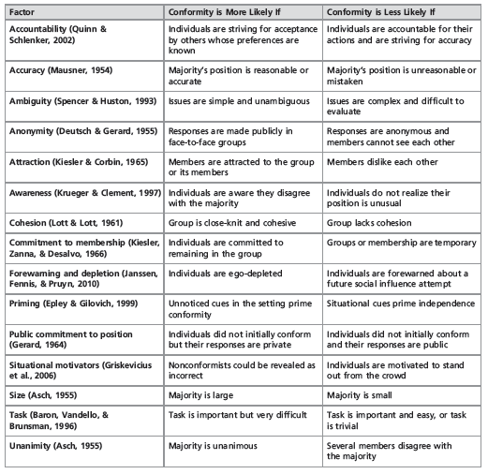
Conformity across Contexts
Other studies find variations in rates across situations
Status of other members
Task difficulty
Cohesion
Accuracy needs
Situational factors and conformity
Social impact theory stresses 3 key factors: strength, immediacy, and number (Latané, 1981)
Individuals interacting online also conform, even though anonymous and remotely located
Social Identity Model of Deindividuation Effects (SIDE)
Conformity and viral online processes

Slide 15
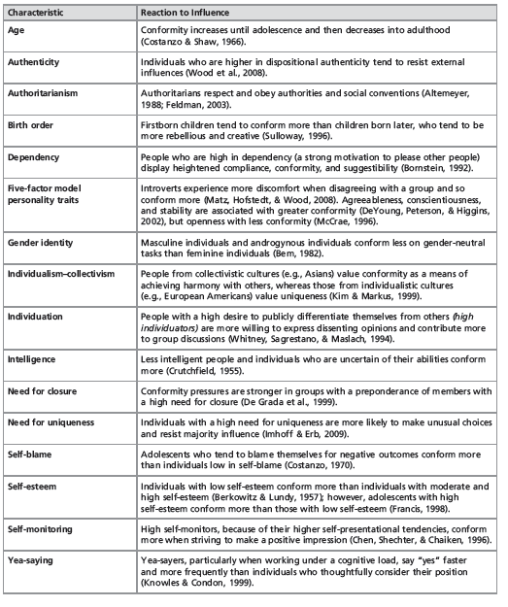
Who Will
Conform?
Other studies find variations in rates across people
Individual differences in conformity
Conformists, counter-conformists, independents
Cultural effects
Cohorts
Sex differences

Slide 16

When Do People Resist the Group's Influence and Instead Change the Group?
Moscovici’s studies of minority influence: Pressure of
One against Many

Slide 17
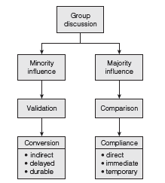
Reversing Asch: Moscovici’s study of a consistent minority
Conversion Theory
Minority Influence
Behaviorally consistent minorities sometimes change the majority
Expanding minorities are more influential
Minority influence is more indirect than majority influence, so generates conversion and innovation rather than compliance

Slide 18
Predicting Minority Influence
Consistency: Moscovici suggests a behaviorally consistent minority is most effective
Status: Hollander argues minorities that are accorded high status in the group are most effective, for their idiosyncrasy credits protect them from sanctions
Effort: Minorities exert more effort in their attempts to influence than do majorities
Decision rules: A majority-rules decision rules favors majority influence, a unanimity rule minorities

Slide 19
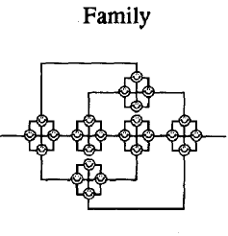
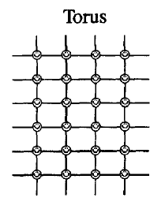

Dynamic Social Impact Theory
Latané’s dynamic social impact theory identifies four additional processes:
Consolidation
Clustering
Correlation
Continuing diversity
Source: Latane & L’Herrou, Spatial Clustering, JPSP, 1996

Slide 20
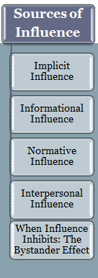
Implicit Influence
Implicit influence is produced by cognitive, emotional, and behavioral processes that are neither consciously controlled nor frequently noticed.
Group members tend to mimic each other, without realizing they are doing so.
Langer suggests that mindlessness can cause individuals to conform automatically.

Slide 21
Langer's photocopy study of mindlessness: Results
If 20 copies little compliance

Slide 22
Informational Influence
When members use others’ responses as reference points and informational resources.
Social comparison theory: basing conclusions on others’ responses
False consensus: misjudging the extent to which others agree
Dual process theories : members base choices on available information (direct process) or nonrational processes, such as heuristics and emotional responses (indirect process).

Slide 23
Normative Influence
Members feel, think, and act in ways that are consistent with their group’s social standards
Disagreeing with others can trigger cognitive dissonance, an unpleasant and neurologically detectable psychological state that individuals are motivated to reduce.
Cialdini’s focus theory of normative influence: norms are a more potent and longer-lasting form of influence than informational influence.

Slide 24
Interpersonal Influence
Verbal and nonverbal tactics (pressure) designed to induce change.
Schachter’s analysis of group rejection indicates that a nonconformist is generally less liked by others in the group.
Communication with a disliked deviant eventually diminishes, at least when cohesive groups are working on relevant tasks.
Any dissent from the group mode will reduce likeability.

Slide 25
  Schachter’s study of reactions to group deviance
Communication rate
To most deviates
To excluded deviants*
To the mode
To the slider
Time
* very rare: cohesive, task relevant groups only that disliked deviant

Slide 26
Interpersonal Influence
Subjective group dynamics: Intuitive beliefs about group processes; members who violate norms can trigger the black-sheep effect—they will be evaluated more negatively than an individual who is not a group member who performs the same type of action.
Normative conflict model: strongly identified members are more willing to bear social costs associated with dissent in order to improve group outcomes.

Slide 27
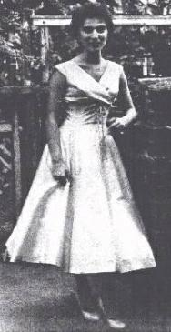
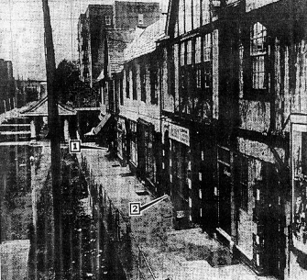
When Influence Inhibits: The Bystander Effect
People help less when in groups rather than alone
  The “Kitty Genovese” incident
Rachel Manning, Mark Levine, and Alan Collins (2007) point out that the Kitty Genovese is something of a parable.

Slide 28
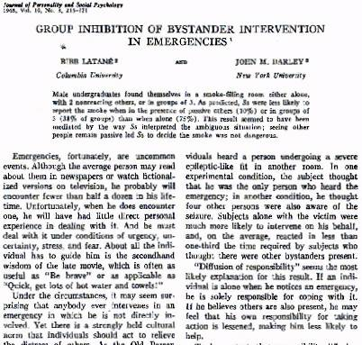
What causes the bystander effect?
Multiple causes
Informational influence
Diffusion of responsibility
Normative influence (helping is “normal” in sympatico cultures)
“Diffusion of responsibility” seems the most likely explanation for this result. If an individual is alone when he notices an emergency, he is solely responsible for coping with it. If he believes others are also present, he may feel that his own responsibility for taking action is lessened, making him less likely to help.

Slide 29
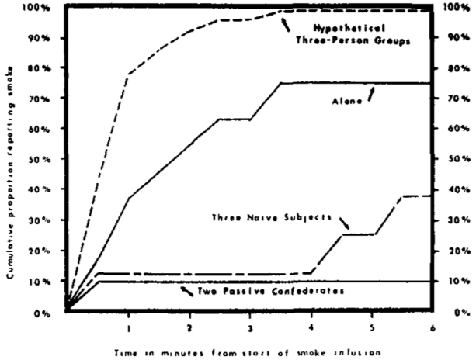
Darley and Latane analysis of reactions to emergencies (1968)

Slide 30
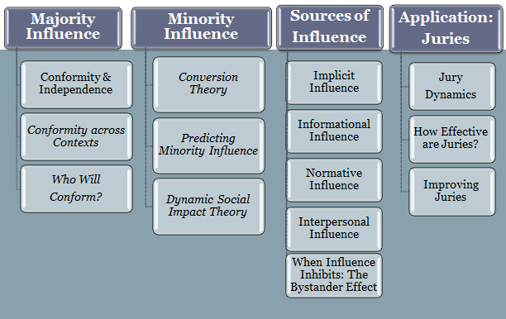
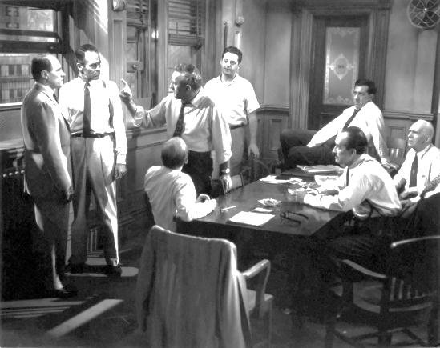

Slide 31
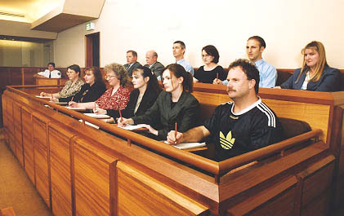
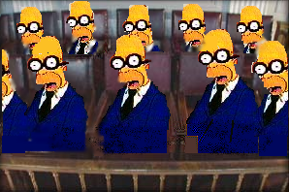
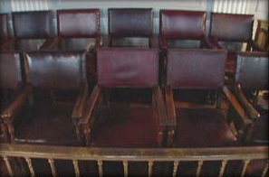
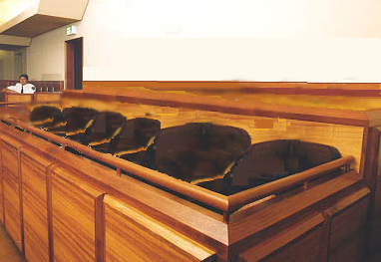
The jury, by tradition, is the finder of fact, commissioned to make the decision of guilt
impartial
representative of the community
Juries Make People Nervous
The jury, passing on the prisoner's life, may have in the sworn twelve a thief or two guiltier than him they try.
Shakespeare
Measure for Measure
We hope that juries will be filled with fair and civic-minded citizens who will keep an open mind, weigh the evidence, deliberate carefully, and reach a just decision
But like many lawyers interviewed by Seymour Wishman in his book Anatomy of Jury,we fear our jury will be “twelve prejudiced, gullible dolts incapable of understanding the evidence or law involved in a case.”
“What is a jury? The stupidity of one brain multiplied by twelve.”
Elbert Hubbard
Our civilization has decided that determining the guilt or innocence of men is a thing too important to be trusted to trained men.
Gilbert K. Chesterton
Notes:
Longstanding tradition of the jury, whose history we need not review: finder of fact, commissioned to make the decision of guilt; impartial and also representative of the community.
Seventh Amendment: …the right of trial by jury shall be preserved, and no fact tried by a jury, shall be otherwise re-examined in any Court of the United States
Juries, like all groups, make people nervous. Feel that they will fail to honor their charge of making a just decision, where just is based on distributive justice and on procedural justice.
This fear, or distrust, of juries lies at the heart of common complaints about juries.

Slide 32

This distrust of juries is the theme of the book and movie, Runaway Jury

Slide 33
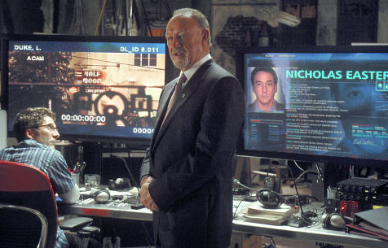
The villain is Rankin Fitch, who will stack the jury through systematic jury selection and much, much more.
John Grisham touches a nerve in his analysis of juries and justice, suggesting that juries can run out of control as their dynamics can lead them astray. They can be controlled through careful, and systematic, jury selection processes.

Slide 34

The villain is Rankin Fitch, who will stack the jury through systematic jury selection and much, much more.
“Trials are too important to be left up to juries”
Rankin Fitch, Jury Consultant (Gene Hackman) `

Slide 35
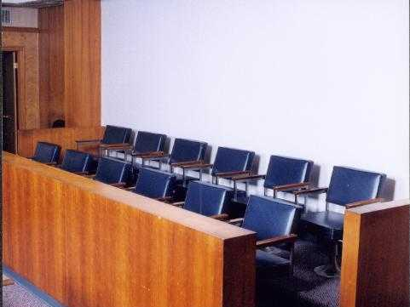
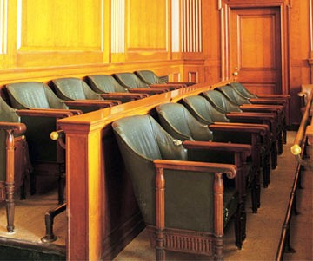
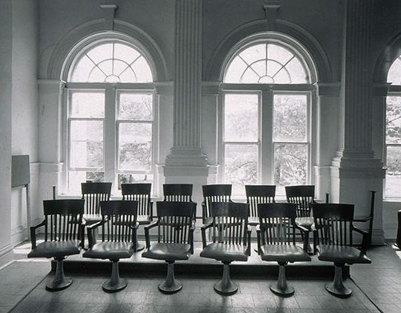
The jury system, despite constant review (and criticism),
Provides a counterbalance to potential judicial abuse
Is the legitimate voice of the community, allowing a public affirmation of its values
Provides a limit on specialization and the complexity of the legal system
Offers a means for dispute resolution that is recognized as fair by the public
Juries, as groups, are effective makers of decisions
The jury system, despite constant review (and criticism),
Provides a counterbalance to potential judicial abuse
Is the legitimate voice of the community, allowing a public affirmation of its values
Provides a limit on specialization and the complexity of the legal system
Offers a means for dispute resolution that is recognized as fair by the public
Juries, as groups, are effective makers of decisions

Slide 36
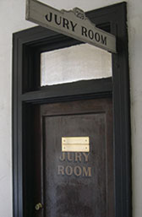
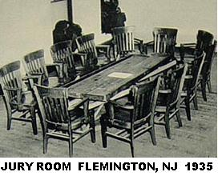
Social science studies of juries
Kalven and Zeisel’s The American Jury
Hastie et al., Inside the Jury
Chicago Jury Project from the 1950s
Accumulating experimental research
What Does Research Tell Us?
Myth One: Jurors do not take their task seriously, and resent or shirk their obligation

Slide 37
Jury duty is an important civic duty I should meet even if inconvenient.
Jurors DO take their task seriously; they do not shirk their obligation (Harris poll, 2004)

Slide 38
Jury duty is a burden to be avoided.
Jurors DO take their task seriously; they do not shirk their obligation (Harris poll, 2004)

Slide 39
“If I were a participant in a trial I would want a jury to decide my case, rather than a judge”
Citizens report a strong preference for a jury trial

Slide 40
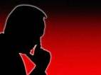
Myth Two: Jurors are overwhelmed by the cognitive demands of jury service.
Jurors take a systematic, rational approach to their task. They cope with the demands of the situation in different ways, however.
Evidence‑driven jurors resist making a decision until they have reviewed the available evidence; then they generate a "story" that organizes the evidence
Verdict-driven jurors reach a decision about the verdict before deliberation and cognitively organize the evidence.

Slide 41
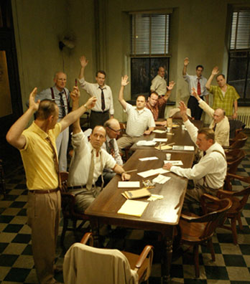
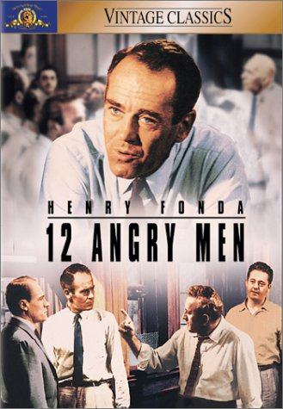
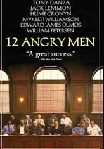
Myth Three: The Jury in “12 Angry Men” is a typical jury in terms of its process and dynamics

Slide 42
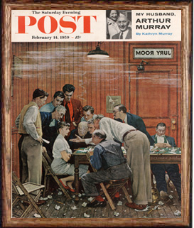
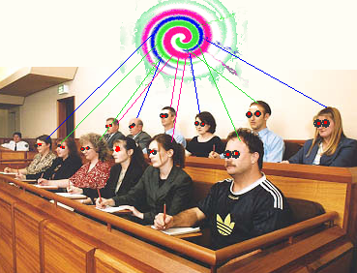
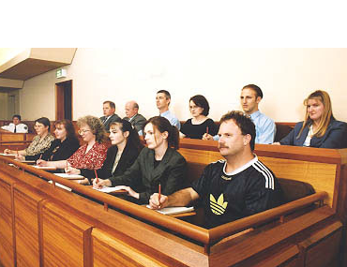
Myth Four: Juries, like all groups, can become so strong that they overwhelm the individual members
Pressures are applied to dissenters
Decision leaders emerge
Some jurors are more influential than others
Some jurors are completely silent
Norman Rockwell
But pressures are held in check by the group’s design
Notes:
Norman Rockwell

Slide 43
The effectiveness/accuracy of juries is difficult to calibrate
Myth Five: Juries never (or always) make mistakes.
Pro-juries
Evidence of “good” process, deliberation
80% agreement between judges and juries in most cases
Design of the jury process has been shown to minimize bias, increase accuracy
Studies of biases and variation show relatively little impact on judgments
Anti-juries
High profile juries raise questions
Evidence of gross misunderstanding of evidence and law
Lack of representativeness of juries in U.S.
Studies of group decision making, in general, points to weaknesses in groups’ capactity to process information

Slide 44
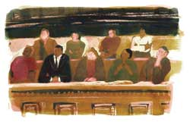
The Myths
Myth One: Jurors do not take their task seriously, and resent or shirk their obligation
Myth Two: Jurors are overwhelmed by the cognitive demands of jury service.
Myth Three: The Jury in “12 Angry Men” is a typical jury in terms of its process and dynamics
Myth Four: Juries, like all groups, can become so strong that they overwhelm the individual members
Myth Five: Juries never (or always) make mistakes.
Last Myth . . . . . . . . . . . . . . . . . . . . .
“Trials are too important to be left up to anyone BUT juries”
Trials are too important to be left up to juries.

Slide 45

  Verdict-driven or evidence-driven
  deliberation strategies
Jury
Dynamics
Evidence‑driven jurors resist making a decision until they have reviewed the available evidence; then they generate a "story" that organizes the evidence
Verdict-driven jurors reach a decision about the verdict before deliberation and cognitively organize the evidence.
  Juries usually picks the verdict favored by the majority of the members prior to deliberation
  Higher status jurors are more influential

Slide 46
How Effective are Juries?
Pro-juries
Evidence of “good” process, deliberation
80% agreement between judges and juries in most cases
Design of the jury process has been shown to minimize bias, increase accuracy
Studies of biases and variation show relatively little impact on judgments
Anti-juries
High profile juries raise questions
Evidence of gross misunderstanding of evidence and law
Lack of representativeness of juries in U.S.
Studies of group decision making, in general, points to weaknesses in groups’ capacity to process information

Slide 47
Percentage of all verdicts

Slide 48
Improving Juries
Despite size-related changes in group dynamics, small and large juries do not appear to differ significantly in the types of verdicts reached.
Juries that do not have to reach a unanimous decision render their judgments twice as quickly and are far less likely to be hung juries.
Several alterations of procedure have been developed to help jurors remember and process trial information, but their impact is not yet known.
Voir dire procedures are often used to select jury members, but this process can undermine the representativeness of the jury.

Slide 49
Majority Influence
Minority Influence
Conformity & Independence
Who Will
Conform?
Conversion Theory
Dynamic Social Impact Theory
Conformity across Contexts
Predicting Minority Influence
Sources of
Influence
Implicit Influence
Application:
Juries
Informational Influence
Normative Influence
Interpersonal Influence
When Influence Inhibits: The Bystander Effect
Jury
Dynamics
How Effective are Juries?
Improving Juries

