Slide 1
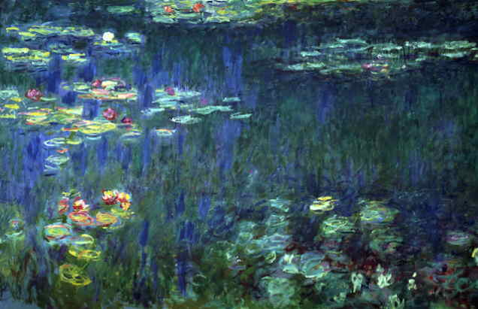
Chapter 3
Inclusion and Identity
Chapter 4
Formation
Groups form through a combination of personal, situational, and interpersonal processes. Formation depends on the members ; some are more likely than others to join together, and when they do a group is born. Groups come into existence when environmental circumstances push people together rather than keeping them apart. They also spring up, often unexpectedly, when people discover that they like one another, and this attraction provides the foundation for the development of interpersonal bonds.
Who joins groups?
When do people seek out others?
What processes generate bonds of interpersonal attraction between members of groups?

Slide 2
Preview

Slide 3
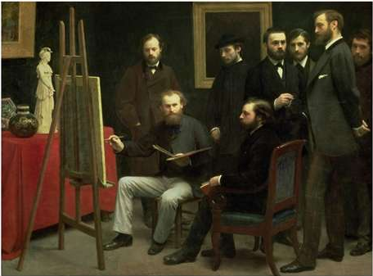
Case: The Impressionists
Henri Fantin-Latour’s A Studio at Batignolles featuring Manet (seated), Renoir (framed), Zola, Bazille, and Monet (hidden in the back).

Slide 4
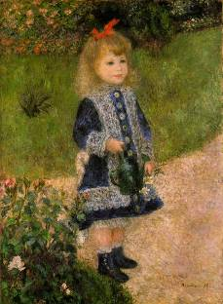
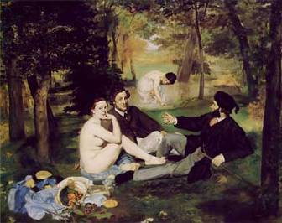
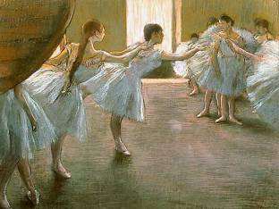

Frédéric Bazille
Mary Cassatt
Gustave Caillebotte
Paul Cezanne
Edgar Degas
Armand Guillaumin
Édouard Manet
Claude Monet
Berthe Morisot
Camille Pissarro
Pierre-Auguste Renoir
Theodore Robinson
Alfred Sisley
Vincent Van Gogh
Renoir
Manet
Degas
Caillebotte

Slide 5
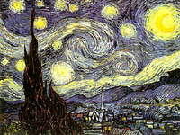
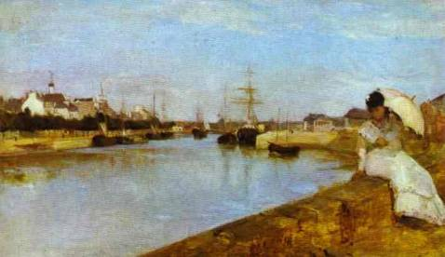
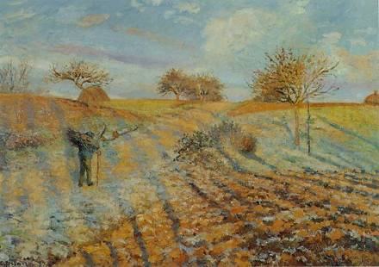
Morisot
Van Gogh
Pissarro

Slide 6
Monet

Slide 7
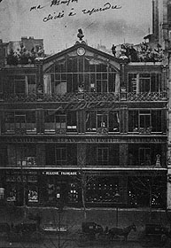
Impressionists
Frédéric Bazille
Mary Cassatt
Gustave Caillebotte
Paul Cezanne
Edgar Degas
Armand Guillaumin
Édouard Manet
Claude Monet
Berthe Morisot
William McGregor Paxton
Camille Pissarro
Pierre-Auguste Renoir
Theodore Robinson
Alfred Sisley
Nadar¹s Studio at 35 Boulevard des Capucines, site
of the first exhibition

Slide 8
What Factors Determine When Groups Form?
Group
Formation
Who Joins Groups?
When Do People Seek Membership
Group Attraction
Who? Depends on individuals' personal qualities (traits, social motives, sex, etc.)
When? Depends on the situation (e.g., ambiguous, tasks)
Relationships? Depends on attraction between people, for groups form when individuals find they like one another.

Slide 9
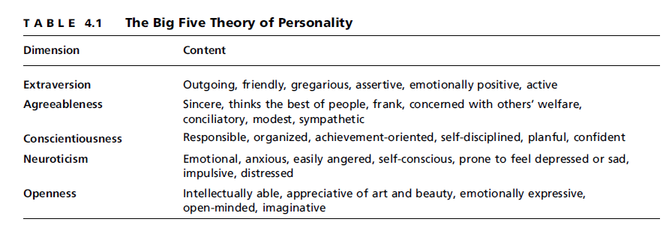
Who Joins Groups and Who Remains Apart?
Personality: Some are more affiliative than others

Slide 10
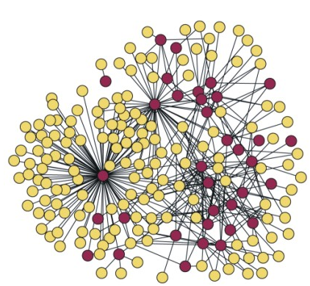
Who Joins Groups?
  Relationality: some individuals adopt values, attitudes, and outlooks that emphasize and facilitate connections with others seek out group memberships
Gladwell’s Connectors
  Sex differences?

Slide 11
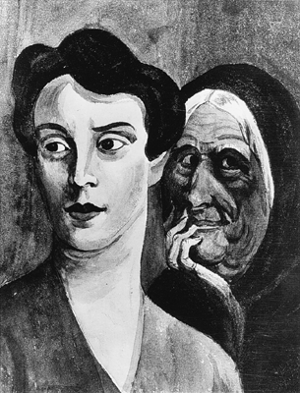
Who Joins Groups?
Social motivation
  Need for affiliation
  Need for intimacy
  Need for power
  Fundamental Interpersonal Relations Orientation (FIRO) theory: Individuals’ need to receive and express inclusion, control, and affection influences group-seeking tendencies

Slide 12
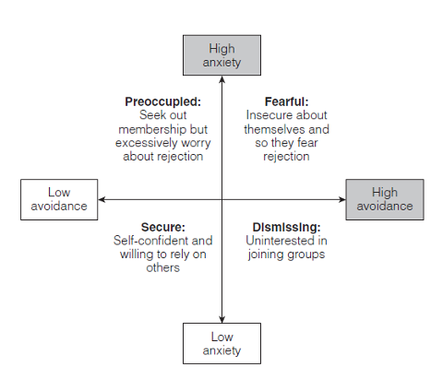
Who Joins Groups?
Prior experiences in groups
Attachment style
  Secure
  Avoidant
  Anxious

Slide 13
When Do People Seek Out Others?
Affiliation and social comparison
Group
Formation
Who Joins Groups?
When Do People Seek Membership
Group Attraction
Social comparison: gaining information from other people’s reactions
(Festinger, 1954)
Cognitive Clarity
Psychological reaction
  Negative emotions
  Uncertainty
  Need for information
Ambiguous, confusing circumstances
Affiliation and social comparison with others

Slide 14

Schachter’s studies of affiliation
How do people react in an ambiguous, frightening situation?
  Misery loves company: People affiliate with others
  Misery loves miserable company: Schachter found people prefer to wait with others facing a similar experience.

Slide 15
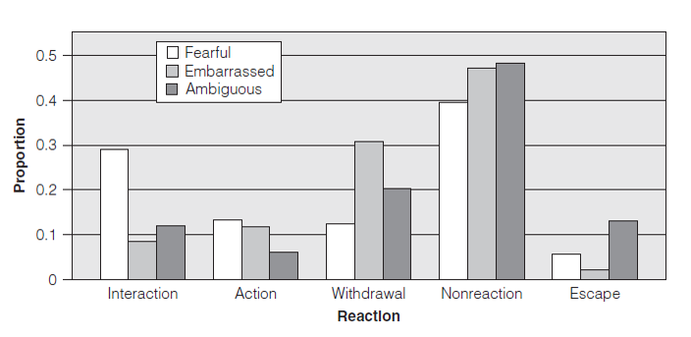
Other Motives May Reduce Affiliation
Morris and his colleagues studied what people actually do when they affiliate in 3 types of situations

Slide 16
Directional Comparison
  downward social comparison: bolsters sense of competence
  upward social comparison: hope and motivation
  The self-evaluation maintenance (SEM) model: people affiliate with individuals who do not outperform them in areas that are very relevant to their self-esteem.

Slide 17
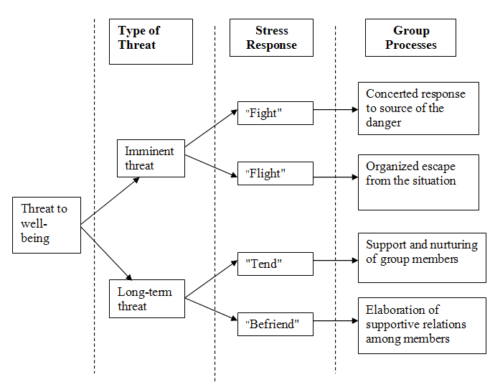
Social Support

Slide 18
Types of Social Support
Belonging
Emotional support
Informational support
Instrumental support
Spiritual support

Slide 19
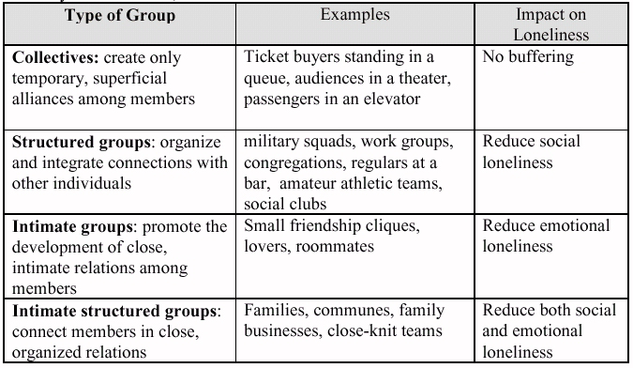
  Emotional and social loneliness

Slide 20

When Do Processes of Interpersonal Attraction Between Individuals Contribute to Group Formation?

Slide 21
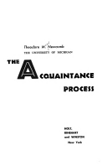
When Do Processes of Interpersonal Attraction Between Individuals Contribute to Group Formation?
Group
Formation
Who Joins Groups?
When Do People Seek Membership
Group Attraction
Newcomb: Study of group formation in a dorm
  Social Exchange Theory of Attraction: Relationships are like economic exchanges, bargains where maximum outcomes sought with minimum investment
Rewards
Costs
Commitment

Slide 22
Principles of Attraction
proximity principle: People tend to like those who are situated near by.
elaboration principle: Groups often emerge when groups, as complex system, grow as additional elements (people) become linked to original members.
similarity principle: People like those who are similar to them in some way.
  homophily: similarity in attitudes, values, appearance, etc.

Slide 23
Principles
  complementarity principle: People like others whose qualities complement their own qualities.
  reciprocity principle: Liking tends to be mutual
  minimax principle: Individuals are attracted to groups that offer them maximum rewards and minimal costs.

Slide 24
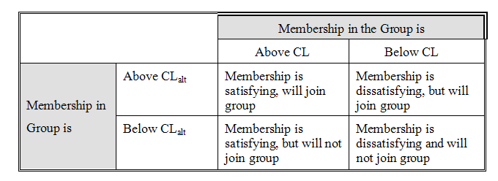
Joining and Leaving Groups
  Satisfaction is determined by comparison level (CL)
  Value of other groups determines comparison level for alternatives (CL_{alt})

Slide 25
Review

