Slide 1

Chapter 3 Inclusion and Identity
The ancient taoist taijitu symbolizes the synthesis of the individual and the collective.
Most people prefer group membership to isolation, but once they join with others they find they must sometimes do what is best for the group rather than what benefits them personally. Groups blur the boundary between the self and the others, for members retain their personal qualities—their motives, emotions, and outlooks—but add to them a sense of self that incorporates their collective rather than their individual characteristics. Groups transform the me into the we.
Do humans, by nature, seek solitude or inclusion in groups?
When do people embrace collectivism by putting the group’s needs before their own?
What processes transform an individual’s sense of self into a collective, social identity?

Slide 2
Preview

Slide 3
Questions to Consider
How social an animal is mankind?
Is homo sapiens communal or individualistic?
Is the self a private, personal quality?
In his
essay on
Self-reliance
Ralph Waldo
Emerson wrote:
do not tell me . . .of my obligation to put all poor men in good situations. Are they my poor?

Slide 4
Do Humans Prefer Solitude or Membership
in Groups?
Daniel Defoe’s Robinson Crusoe
I am cast upon a horrible, desolate island; void of all hope of recovery. I am singled out and separated, as it were, from all the world, to be miserable. I am divided from mankind, a solitary; one banished from human society. I have no soul to speak to or to relieve me.
The Need to Belong:
All human beings, “have a pervasive drive to form and maintain at least a minimum quantity of lasting, positive, and impactful interpersonal relationships.”
Roy Baumeister & Mark Leary (1995, p. 497).

Slide 5
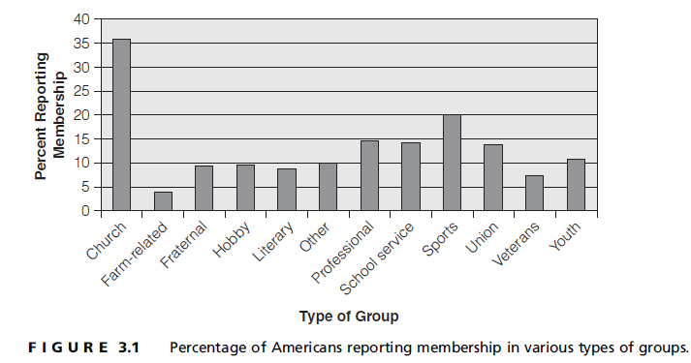
Evidence of Human Sociality
People affiliate at high rates

Slide 6
People respond negatively to isolation
Rubin Hurricane Carter:
I had nothing, absolutely nothing. I was trapped at the bottom, the lowest point at which a human being can exist without being dead: solitary confinement. I had nothing to hold on to, no family, nobody to do anything for me.
Solitary confinement
Solitary adventurers
Studies of people who agree to isolation
“Life alone” studies
increased aggression
take risks
reduced cognitive capacity

Slide 7
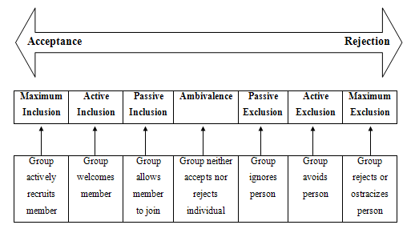
Exclusion is aversive and avoided

Slide 8

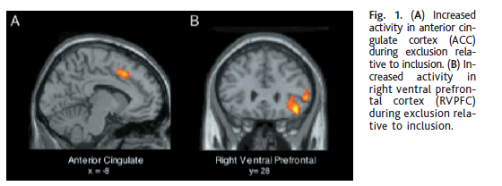
Deliberate isolation – ostracism – is particularly noxious
Williams finds ostracism triggers “pain” areas of the brain
Fight-flight
Tend-befriend
Can trigger

Slide 9

Leary’s sociometer theory: self-esteem warns of possible exclusion
Self-esteem is not the evaluation of your worth—it is an indicator of how well you are accepted into social groups
Mark Leary:
We need to think about ourselves occasionally, but none of us needs to think about ourselves as much as we do.

Slide 10
Evolutionary psychology suggests this instinct resulted from natural selection

Slide 11
The Individual – Group Connection
Living
in groups
requires
“pragmatic
compromise”:
One must some-
times give
priority to the
needs and concerns
of the group and
put one’s own
interests on hold
(Hewitt, 1989)
When alone, you are free to act any way that you like
But join a group, and you must tailor your actions to the demands of the group situation

Slide 12
The balance between the individual’s rights and the group’s rights
Can the group insist on compliance? Force the member to obey rules?
Can members insist that the group satisfy their needs? Put them first?
How involved are you in the community?
volunteering
political action
social change
nationalism
See Putnam’s Bowling Alone
Also, footage of U.S. in 1918
Also, footage of U.S. in 1918

Slide 13
Individualism
Collectivism
The group is primary, first. Its rights must be recognized and
put above the right of the individual. The individual belongs to the group.
The individual is primary, first. His
or her rights must be recognized and
put above the right of the group as a
whole. If the group’s goals aren’t
compatible with the individual’s goals,
then the individual is free to go his
or her own way.

Slide 14
Contrasts and Comparisons
Individualism
Collectivism
Exchange Relations
Reciprocity
Equity
Self-serving
Personal identity
Communal relations
Generalized reciprocity
Equality or need
Group-serving
Social identity

Slide 15
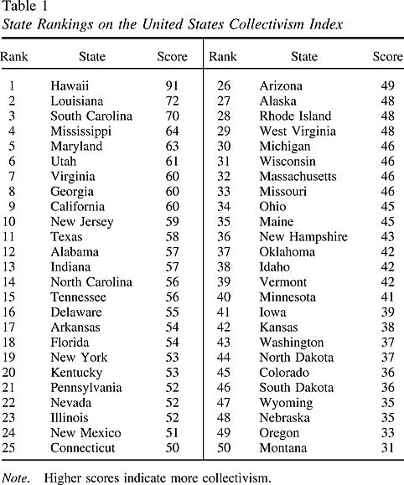
Cultures, groups, and individuals vary in
individualism and
collectivism
Cultures: East vs. West
Subcultures: Some ethnic groups, such as Asian Americans and Latinos, are more collectivistic than individualistic
Regions of the U.S.
Individual differences
Sex differences

Slide 16
Does Membership in a Group Change a Person's Self-Concept and Social Identity?
Social identity theory: the self-concept is determined by group memberships
Social categorization: Individuals automatically classify people, including themselves, into groups.
Social identification: accepting as self-descriptive (self-stereotyping) the qualities attributed to one’s group (depersonalization)

Slide 17

Self-related processes
Self-esteem depends on an individual’s personal qualities and the value of the groups to which they belong.
Ingroup-outgroup bias: by rating one’s own group positively self-esteem is enhanced
If a member of a prestigious collective self-esteem will increase
Basking in Reflected Glory (BIRG): stressing association with successful groups.
Yale prank image

Slide 18
Self-protective strategies
Members of stigmatized group may nonetheless take pride in their groups and reject nonmembers evaluations of their groups (social creativity)
Stereotype threat: negative impact of situations when one feels he or she is viewed in a stereotypic way
Denying connections to groups that are performing poorly (CORF, or cutting off reflected failure)
Leaving the group (individual mobility).

Slide 19
Social Identity Theory
Need for self-esteem
Personal Identity
Inclusion
Achievements
Social Identity
Group achievements
Group favoritism
Increased self-esteem
Outgroup rejection
Not clear if outgroup rejection raises self-esteem

Slide 20
Who are you? A complex, hard-to-answer, question.
Review

