Slide 1

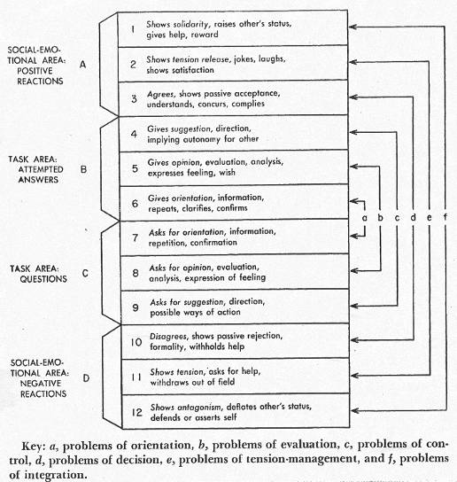
Chapter 3 Inclusion and Identity
2 Studying
Groups
How can we learn more about groups and their complex processes? Just as scientists use exacting procedures to study aspects of the physical and natural environment, so do group researchers use scientific methods to further their understanding of groups. Through research, theorists and researchers separate fact from fiction and truth from myth.
What are the three critical requirements of a scientific approach to the study of groups?
How do researchers measure individual and group processes?
What are the key characteristics of and differences between case, experimental, and correlational studies of group processes?
What are strengths and weaknesses of case, experimental, and correlational methods?
What theoretical perspectives guide researchers’ studies of groups?

Slide 2
Preview
Studying Groups
Measurement
Research Design
Theory
Motivational
Observation
Self-report
Case
Correlational
Experimental
Behavioral
Systems
Cognitive
Biological

Slide 3
What Are the Three Critical Requirements of a Scientific Study of Groups?
Reliable and valid measurement
Research procedures to test hypotheses about groups
Theories that organize knowledge of groups

Slide 4

Measurement: Observational Methods
Observing and recording events
Types:
Overt
Covert
Participant
Qualitative and quantitative (structured) measures
Hawthorne effect: changes in behavior when observed
IRB: review panel

Slide 5
Bales Interaction Process Analysis
Bales's Interaction Process Analysis (IPA) classifies behaviors into two categories: task and relationship behaviors

Slide 6
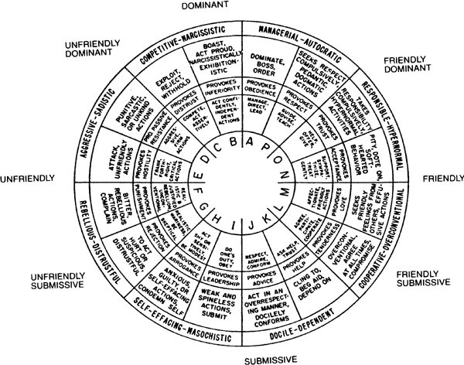
Second Example: A Circumplex Model of Communication

Slide 7
Self-Report Methods
Self-report measures: group members describe their perceptions and experiences
Example: Moreno's sociometry method
A Sociogram
Out
In

Slide 8
Research Methods
Case study
Example: Groupthink groups (Janis)
Bona fide groups
Experiments
Key features
manipulate independent variable
measure dependent variable
control other variables

Slide 9
Research Methods
Experiments
Example: Lewin, Lippitt, and White’s study of leadership
Strength: Test cause-effect relationships
Correlational Studies
Measure only, no manipulation
Example: Newcomb’s Bennington Study

Slide 10
What Are the Key Characteristics of, and Differences Between Case, Experimental, and Correlational Studies of Group Processes?
Case studies: atypical of most groups, subjective, stimulate theory
Experiments: too artificial, not “real” groups, but clearest test of cause and effect.
Correlational studies: limited information about causality but precise estimates of the strength of relationships, less artificial, fewer ethical concerns
Multilevel approaches are uniquely informative

Slide 11
What Theoretical Perspectives Guide Researchers’ Studies of Groups?
Motivational models: Group affective tone (George, 1995)
Behavioral approaches: Thibaut and Kelley's social exchange theory
Systems theory: Input-process-output models of performance
Cognitive theories: Berger's expectation-states theory
Biological perspectives: Evolutionary psychology (or sociobiology)

Slide 12
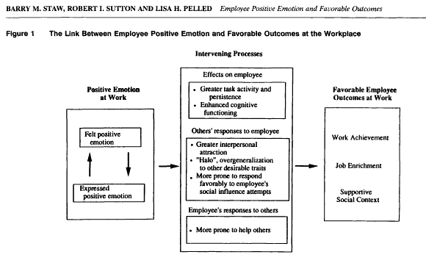
Motivational Models: Affect and Performance

Slide 13
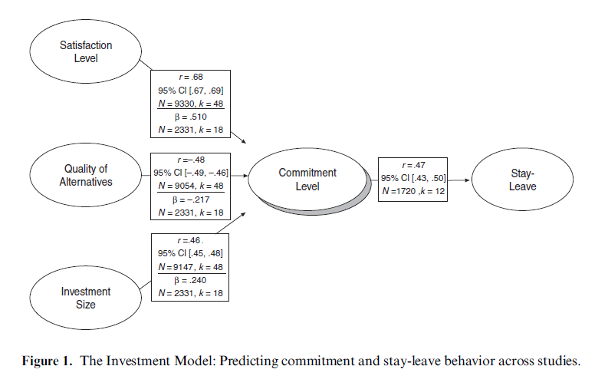
Behavioral models: Social exchange and group commitment
Source: Le & Agnew, 2003

Slide 14
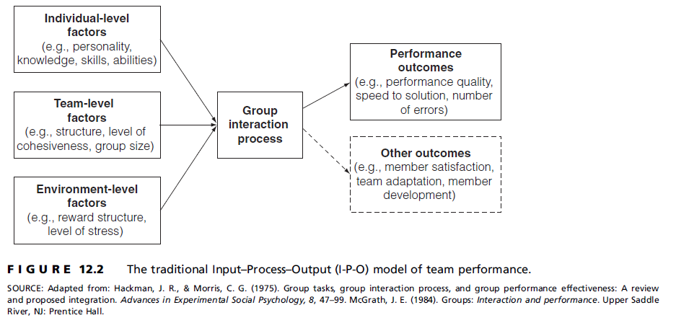
Systems Models: Input-Process-Output Models of Performance

Slide 15

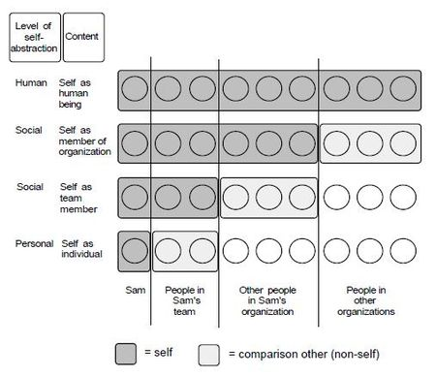
Cognitive Models: Turner’s Self-categorization theory
Source: Haslam, A. S. (2001). Psychology in Organizations. London, SAGE Publications.

Slide 16
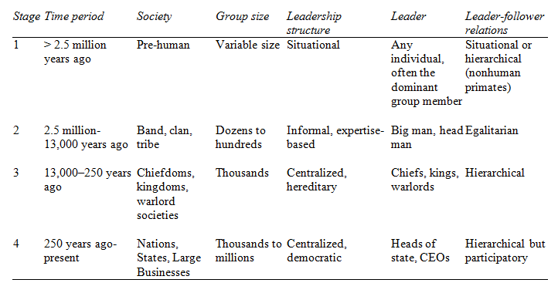

Biological Models: Evolutionary theory
A Natural History of Leadership (Source: Van Vugt et al., 2008)

Slide 17
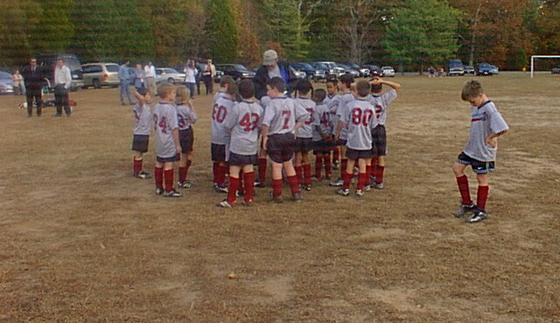
In Review
Studying Groups
Measurement
Research Design
Theory
Motivational
Observation
Self-report
Case
Correlational
Experimental
Behavioral
Systems
Cognitive
Biological

