Slide 1


16 Groups and Change
The usefulness of groups is nowhere more apparent than when groups are used to help their members change. Groups, by their very nature, provide their members with information, support, and guidance, and so many personal
and interpersonal problems can
be resolved more readily when confronted in a group rather than alone.
What are some of the ways that groups are used to help members change?
How do groups promote change?
How effective are groups in bringing about change?

Slide 2
Preview
Groups and Change
Types
Curative Factors in groups
Effectiveness
Perceptions vs. behavior
Group psychotherapy
Interpersonal learning groups
Universality & Hope
Social learning
Cohesion
Negative effects
Types and Outcomes
Overall value
Support groups
Disclosure & catharsis
Altruism
Insight

Slide 3
Lewin’s Law of Change
Basic “types” of therapeutic groups
Psychotherapy groups
Interpersonal learning groups
Support (self-help) groups
“It is usually easier to change individuals formed into a group than to change any of them separately.”

Slide 4
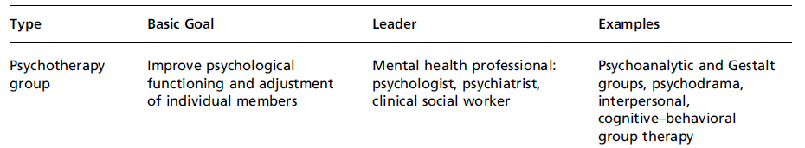
Group Psychotherapy
Group Psychoanalysis
Gestalt Groups
Psychodrama
Interpersonal Group Psychotherapy
Cognitive-behavioral therapy groups
Types

Slide 5
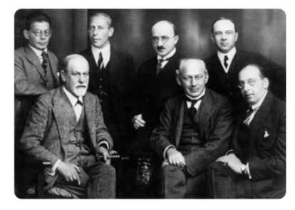
Group Psychoanalysis
Freud’s discussed group processes in his book Group Psychology and the Analysis of Ego
Freud did not conduct therapy in groups, but other analysis did
gaining insight into problems
interpretations and working through sibling and parental transference
The First Committee Of The Vienna Psychoanalytical Society
[Source: Berlin, 1922 Becker Maas, Library of Congress (124),(LC-USZ62-119779)]
From Left to Right: Otto Rank, Sigmund Freud, Karl Abraham, Max Eitingon, Sàndor Ferenczi, Ernest Jones, Hans Sachs

Slide 6
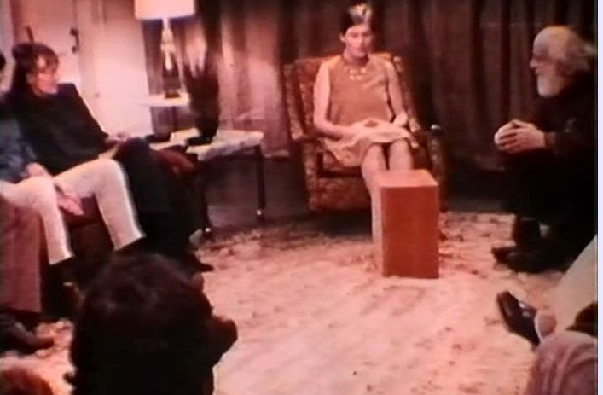
Gestalt Group Psychotherapy
This approach is based on the work of Fritz Perls, who maintained people tend to fail to accept and integrate their experiences, thoughts, and emotions
Goal was to achieve phenomenological unity (a gestalt)
When conducted in groups, stressed emotional growth using experiments and role‑playing methods (e.g., the hot seat, empty seat, etc.).

Slide 7
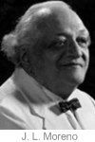
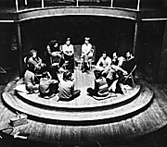
Psychodrama
Jacob Moreno, who coined the word sociometry and developed the method, also made use of groups in treatment
Psychodrama involves acting out experiences in the group, role-playing, and imitation

Slide 8

Interpersonal Group Psychotherapy
Therapeutic methods that use the group itself as a “social microcosm” where members, during the course of their interactions with one another, gain insights and develop interpersonal skills
Irvin Yalom’s interactive process groups, for example, emphasize analysis of ongoing interactions in the group (a “here and now” orientation) by all members

Slide 9
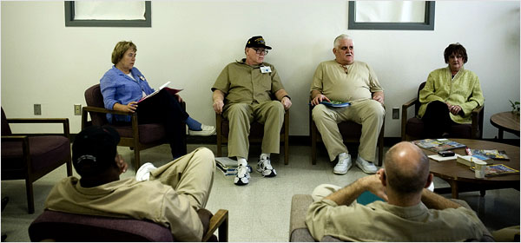
Cognitive‑behavioral therapy groups
Make use of methods developed in cognitive-behavioral therapies, but do so in a group setting
Behavioral contracts, modeling, behavior rehearsal, feedback
Often used for more specific issues, such as phobias, depression, drug addiction, sexual offenses, and so on.
http://www.nytimes.com/2007/03/06/us/06civil.html

Slide 10
Interpersonal Learning Groups
Older Forms
Training groups, or T‑groups
Growth groups (sensitivity‑training groups or encounter groups)
Contemporary Forms
Structured learning groups (workshops) such as Lifespring, actualization training, Pathworks, life dynamics, etc.

Slide 11
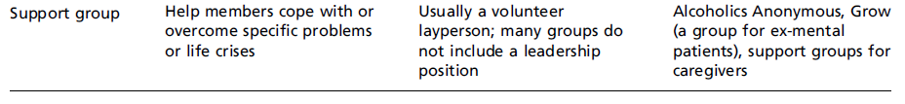
Self-help Groups
Problem-specific: deal with a specific problem or concern, such as alcohol, physical illness
Interpersonal: members establish strong ties to each other
Communal: group stresses community and sharing
Autonomous: little or no fee is charged for membership, and leaders are volunteers rather than professionals
Perspective-based: Often adopt a particular “perspective” on the issue and its causes (e.g., AA)

Slide 12
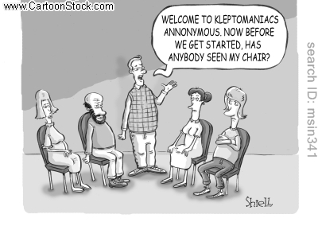
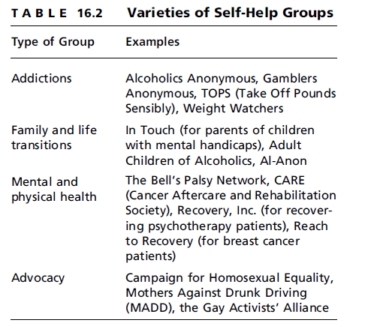
Examples of Support Groups

Slide 13
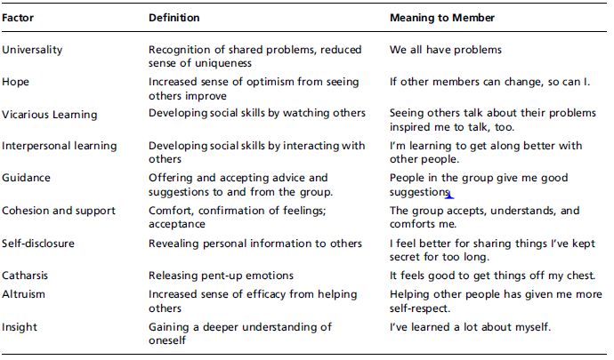
Sources of Change in Groups

Slide 14
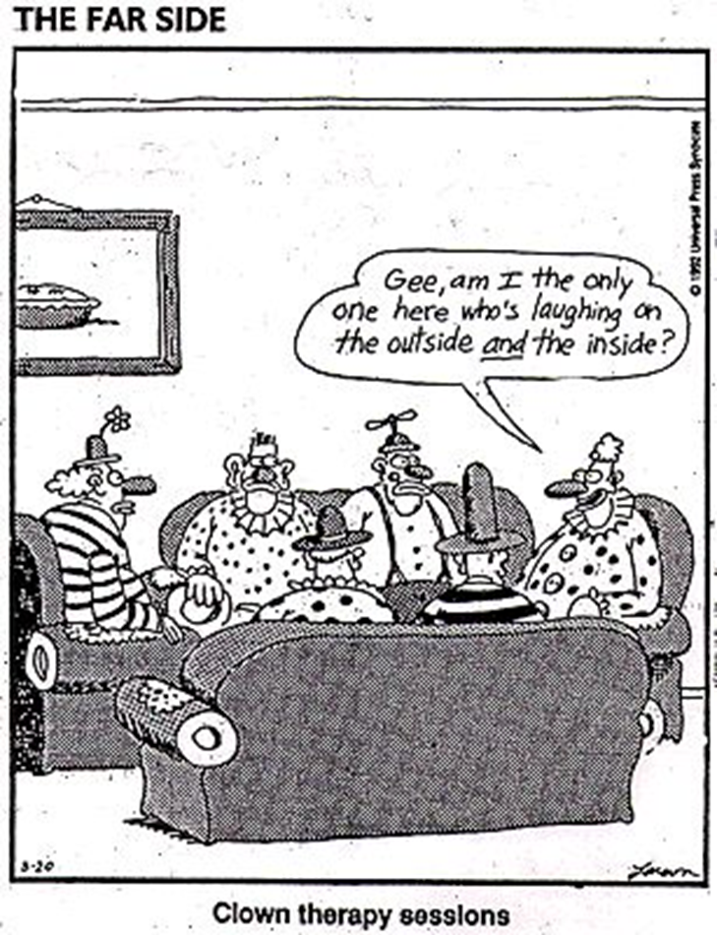
Sources of Change in Groups
Curative factors (therapeutic factors) in groups
Universality: We all have problems
Hope: If others can change, so can I
Upward social comparison
Hope: sense of efficacy and multiple pathways
Vicarious learning: I learn by watching others.
Social learning theory

Slide 15
Sources of Change in Groups
Interpersonal learning: I’m learning to get along better with people.
Guidance: Members give me good suggestions.
Leadership and co-leadership
Cohesion and support: The group takes me in and sustains me.
Group development and therapeutic interventions
Self-disclosure: It feels better to share these secrets.
Catharsis: I’ve gotten some anger off my chest.
Altruism: Helping others makes me feel more confident in myself.
Insight: I’ve learned a lot about myself.

Slide 16
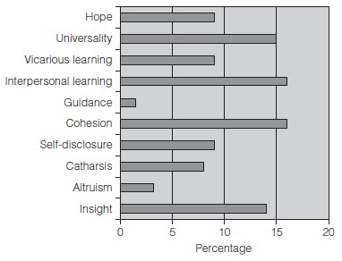
Sources of Change in Groups
Members most value universality, interpersonal learning, cohesion/support, and insight
Application to traumatic events
Victims of negative events, such as floods, terrorism
Interventions involve the curative factors, particularly hope, guidance, cohesion, opportunities for self-disclosure, and altruism.

Slide 17
How Effective are Groups?
Group approaches are as effective as individual methods
Limitations
Changes are often more perceptual than behavioral
Premature termination
Psychological casualty
Group methods, despite their diversity, tend to be equally effective.

Slide 18
Preview
Groups and Change
Types
Curative Factors in groups
Effectiveness
Perceptions vs. behavior
Group psychotherapy
Interpersonal learning groups
Universality & Hope
Social learning
Cohesion
Negative effects
Types and Outcomes
Overall value
Support groups
Disclosure & catharsis
Altruism
Insight

