Slide 1
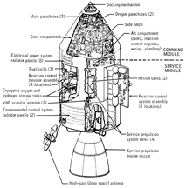
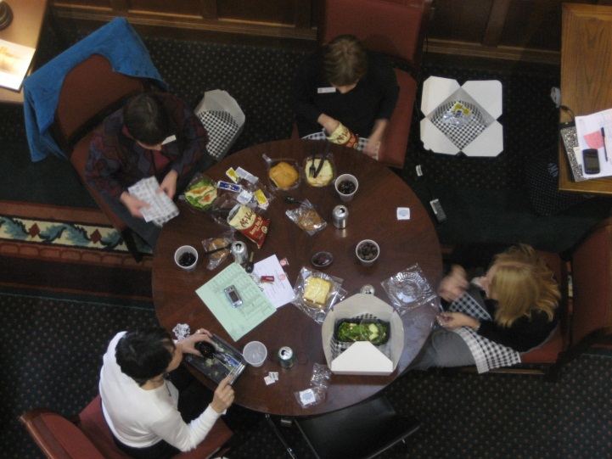
15
Groups in Context
How does the social and physical environment influence groups and their dynamics?
What is the ecology of a group?
What are the causes and consequences of a group’s tendency to establish territories?
Just as individuals are embedded in
groups, so groups are embedded in
physical and social environments.
Groups alter their environments substantially, but in many cases, it’s the place that shapes the group. As Kurt Lewin’s (1951) formula, B = f (P, E), states, group behavior (B) is a function of the persons (P) who are in the group and the environment (E)

Slide 2
Preview
Groups in Context
Places
Spaces
Locations
Group territoriality
Comfortable Spaces
Stressful Spaces
Personal space
Crowding
Seating
Members’ territories
Groups in context
Behavior settings

Slide 3

All groups exist somewhere
All Humanity
Society
Community
Lewin’s field theory: B = f (P, E)
  “E” includes the physical, behavioral, and interpersonal environment
  Examples of groups in specific environmental contexts
    …work teams, gangs, Impressionists, fraternities, classes, airline pilots, astronauts
Organization
Group
Person
Setting
Locality
Region
Global

Slide 4
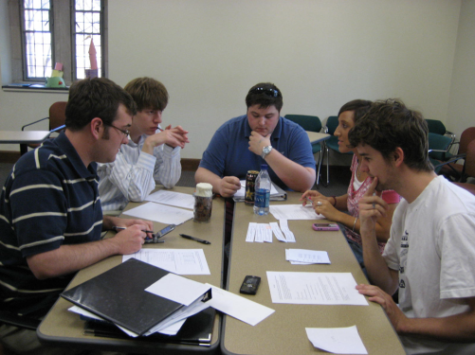
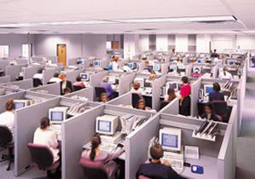
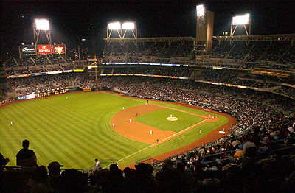
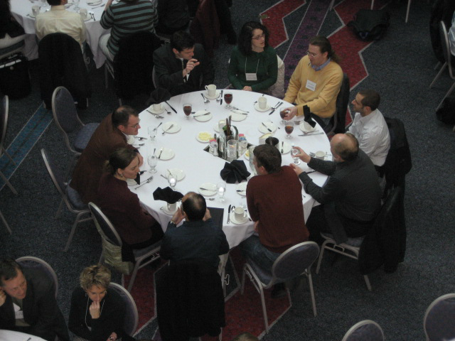
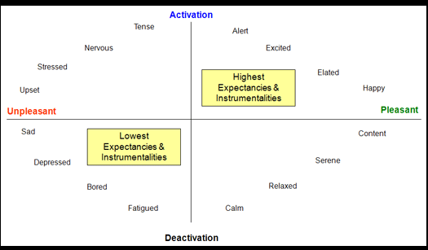
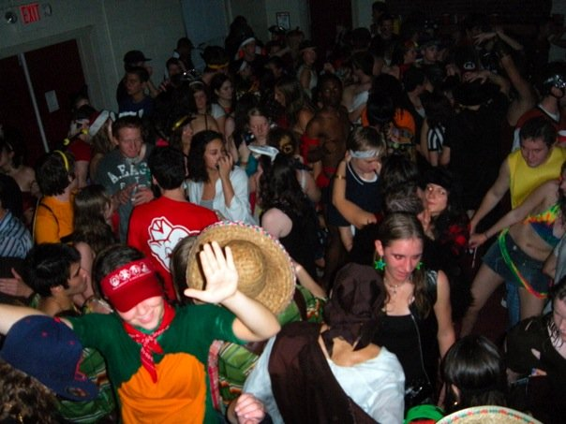

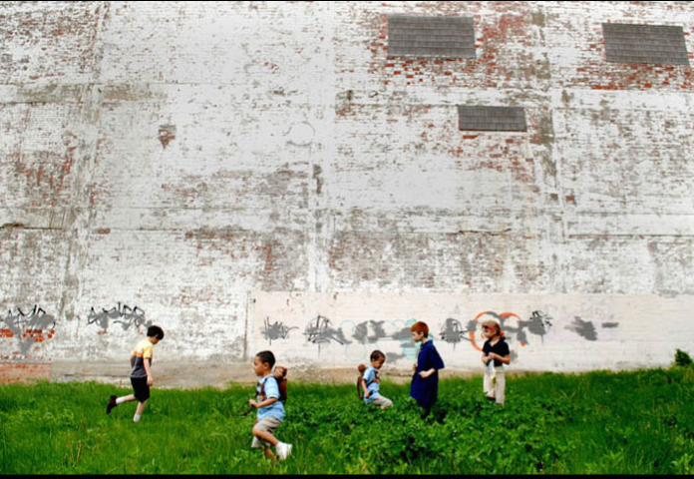
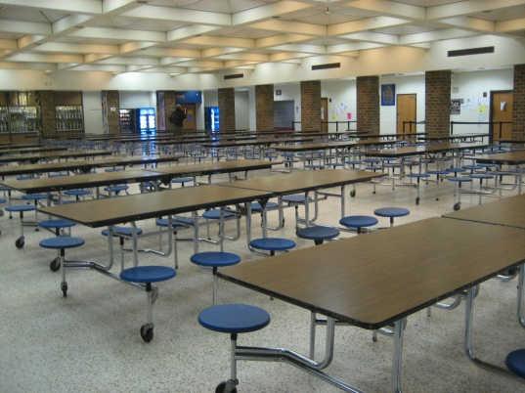
Comfort in Contexts: Groups exist in many different places, which vary in their physical and psychological properties

Slide 5
Comforting and stressful settings
Ambiance: psychological reaction to place
Stress: negative reaction to a place
We have strong feelings in and about places. Some places make us feel good: glad to be there, relaxed, excited, warm all over…Other places make us feel bad: uncomfortable, insignificant, unhappy, out of place.
We avoid these places and suffer if we have to be in them.
Farbstein & Kantrowitz, 1978
Overload: cognitively, perceptually, emotionally taxing
Unpleasant temperature
Noise
Danger

Slide 6
Barker’s Theory of Behavior Settings
  Ecological psychology developed by Roger Barker
  Behavior setting: physically and temporally bounded social situations
    examples: checkout-line, classroom, elevator, conference room
  Elements
    geographically fixed
    boundaries
    components
    program: determine behavior in the place

Slide 7
Staffing Theory
  Synomophy: fit between people and the place
  Staffing theory: fit between number of people, tasks, and setting
    understaffing: heavy workload, involving, commitment
    overstaffing: low moral, too little work to do

Slide 8
Reaction | Understaffed groups | Overstaffed groups
Task performance | Members engage in diligent, consistent, goal-related actions | Members are perfunctory, inconsistent, and sloppy
Performance monitoring | Members provide one another with corrective, critical feedback as needed | Members exhibit little concern for the quality of the group’s performance
Perceptions | Members are viewed in terms of the jobs they do rather than individual qualities | Members focus on the personalities and uniqueness of members rather than group
Self-perceptions | Members feel important, responsible, and capable | Members feel lowered self-esteem with little sense of competence
Attitude toward the group | Members express concerned over the continuation of the group | Members are cynical about the group and its functions
Supportiveness | Members are reluctant to reject those who are performing poorly | Members are less willing to help other members of the group

Slide 9
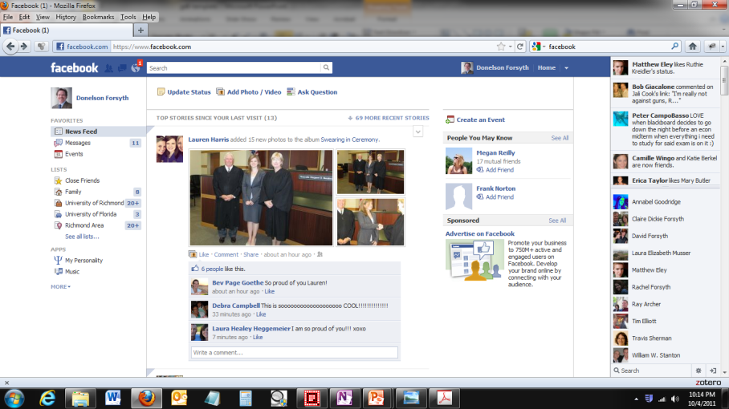
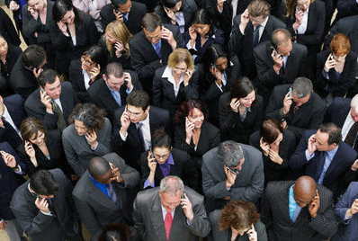

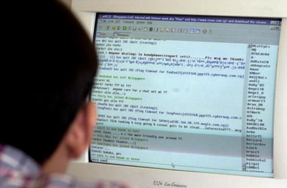
The Remote Zone: E-groups
Online vs. Offline groups
Social presence can be very high in online groups

Slide 10
Designing Effective Group Spaces
Duffy’s analysis of workspaces: hives, cells, dens, clubs
  Hives: Members who function as “worker bees” by performing divisible, highly structured tasks require little interaction with other group members.
  Cells: Members working on complex, long-term, relatively individualized projects need private spaces to carry out their work.
  Dens: When members who are similar in terms of skills and responsibilities work together on collective tasks and projects they need an open space that all members share.
  Clubs: Members who are talented, well-trained, or possess very specialized skills often work on diverse tasks and projects that vary greatly in their collaborative demands.

Slide 11
Group spaces: The Ecology of a Group
  Group ecology includes spatial and seating dynamics
  Personal space: Maintaining distance between oneself and others
  Crowding: Reaction to spatial invasion
  Seating (and standing) arrangement: how the group is arranged in the physical place
Just as frogs issue their croaks from their favorite places in the stream, and birds neatly space themselves along a telephone wire, so humans display
consistent patterns of spacing and seating when immersed in a group habitat.

Slide 12
Personal Space
  Hall’s concept of interpersonal zones
Zone | Characteristics | Typical Activities
Intimate (touching to 18 inches) | Sensory information concerning the other is detailed and diverse; stimulus person dominates perceptual field | Sex, hugging, massage, comforting, jostling, handshakes, slow dancing
Personal (18 inches to 4 feet) | Other person can be touched if desired; gaze can be directed away from the other person with ease | Conversations, discussion, car travel, viewing performances, watching television
Social (4 feet to 12 feet) | Visual inputs begin to dominate other senses; voice levels are normal; appropriate distance for many informal social gatherings | Dining, meeting with business colleagues, interacting with a receptionist
Public (12 feet or more) | All sensory inputs beginning to become less effective; voices may require amplification; facial expressions unclear | Lectures, addresses, plays, dance recitals
Remote (different locations) | Primarily verbal inputs; facial and other behavioral nonverbal cues unavailable | Electronic discussions, conference calls, telephone voice mail, e-mail

Slide 13
Personal Space
Equilibrium model of communication
Sex differences in space needs
Status and space
Cross-cultural variations in spatial dynamics

Slide 14
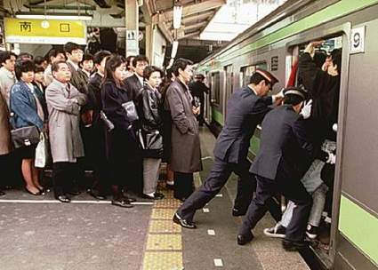
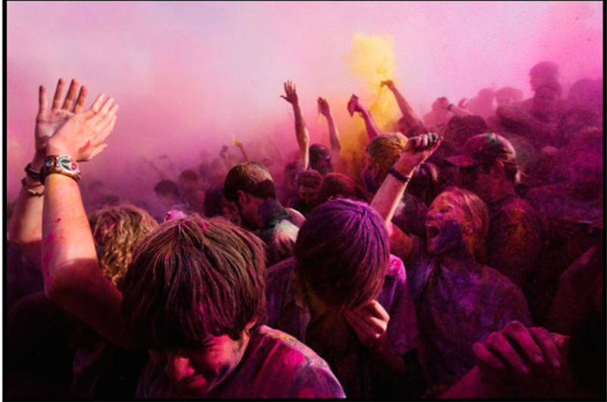
Crowding: Reactions to Spatial Invasion
  Density vs. crowding
  Cognitive model of reactions to arousal induced by crowded circumstances
  Freedman’s density-intensity hypothesis
  Controllability, interference, and crowding

Slide 15
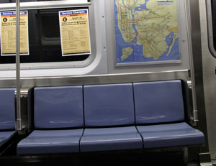
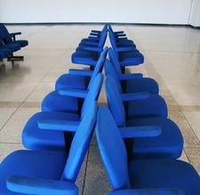
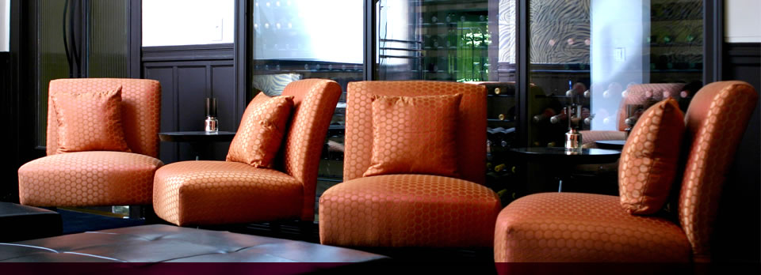
Seating
  sociofugal seating arrangements discourage interaction
  sociopetal seating promotes interaction

Slide 16
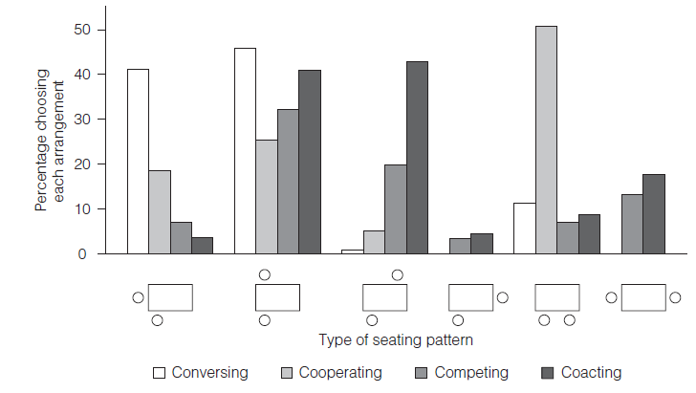
  Sommer’s studies of seating preferences
  Also:
  Sex differences in preferences
  Communication: Steinzor and head-of-the-table effects

Slide 17
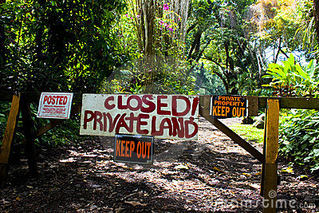

Locations: Group Territoriality
Territories: geographical locations that an individual or group defends against intrusion by others
Altman’s typology of territories
  Primary territories
  Secondary territories
  Public territories

Slide 18
Types of Territories
Type | Degree of Control | Duration of Claim | Examples
Primary | High: Occupants control access and are very likely to actively defend this space. | Long-term: Individuals maintain control over the space on a relatively permanent basis; ownership is often involved. | A family’s house, a bedroom, a clubhouse, a dorm room, a study
Secondary | Moderate: Individuals who habitually use a space come to consider it to be “theirs.” Reaction to intrusions is milder. | Temporary but recurrent: Others may use the space, but must vacate area if usual occupant requests. | A table in a bar, seat in a classroom, a regularly used parking space, the sidewalk in front of your home
Public | Low: Although occupant may prevent intrusion while present, no expectation of future use exists. | None: The individual or group uses the space on only the most temporary basis and leaves behind no markers. | Elevator, beach, public telephone, playground, park, bathroom stall, restaurant counter

Slide 19
Group Territories
  Examples: Gangs, “turf wars,” tags, and graffiti
  Group space: temporary territories
  Consequences of territoriality
          adjustment and stress
          intergroup conflict
          home advantage
We didn’t rally them there. We never went looking for trouble. We only rallied on our own street, but we always won there.
-- Doc, leader of the Nortons

Slide 20

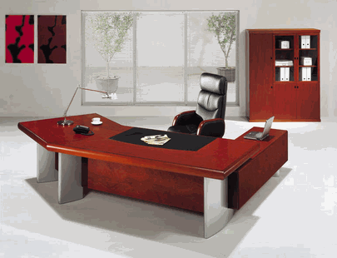
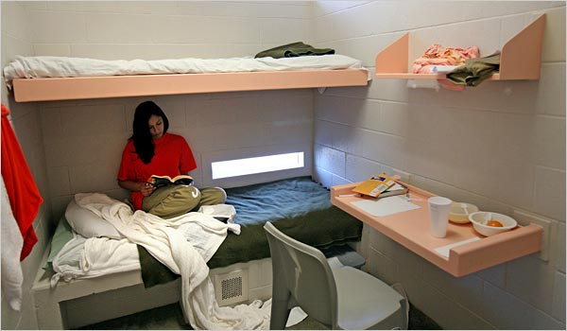
Member Territoriality
  Functions: establishing privacy, regularizing (organizing), and securing identity
  Status: those with authority control larger and more desirable territories

Slide 21
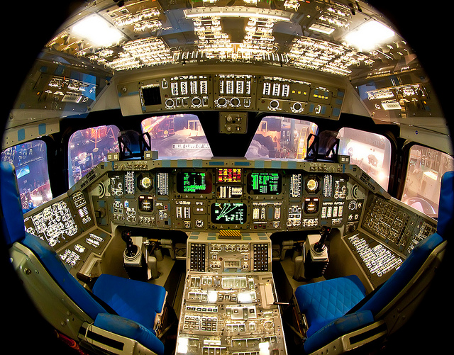
Territoriality in a EUE (Extreme and Unusual Environment)
  Examples: space crews, Antarctic crews, Sealab
  Adjustment determined by adaptive use of territories

Slide 22
Review
Groups in Context
Places
Spaces
Locations
Group territoriality
Comfortable Spaces
Stressful Spaces
Personal space
Crowding
Seating
Members’ territories
Groups in context
Behavior settings

