Slide 1
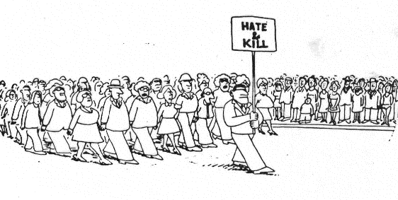
14 Intergroup Relations
As a social species, humans strive to establish close ties with one another. Yet the same species that seeks out connections with others also metes out enmity when it confronts members of another group. Intergroup relations are more often contentious than harmonious.
What interpersonal factors disrupt relations between groups?
What are the psychological foundations of conflict between groups?
How can intergroup relations be improved?

Slide 2
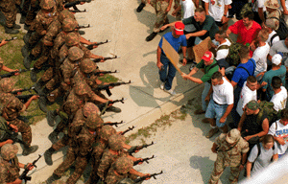
I am, in plainer words, a bundle of prejudices—made up of likings and dislikings—the veriest thrall of sympathies, apathies, and antipathies."
- Nineteenth century English author Charles Lamb
I have no race prejudices, and I think I have no color prejudices nor creed prejudices. Indeed, I know it. I can stand any society.”
-- Mark Twain
Intergroup Relations
Does membership in one group require rejection of other groups?
Who does more harm? Groups or individuals?
Is it hopeless? Can conflict only be reduced if all groups are blended together?

Slide 3
Intergroup Relations
Causes
Intergroup Bias
Contact
Cognitive cures
Conflict Management
Competition
Power
Norms
Anger
Evolution
Categorization
Ingroup-outgroup bias
Cognitive biases
Intergroup emotions
Identity
Resolution

Slide 4
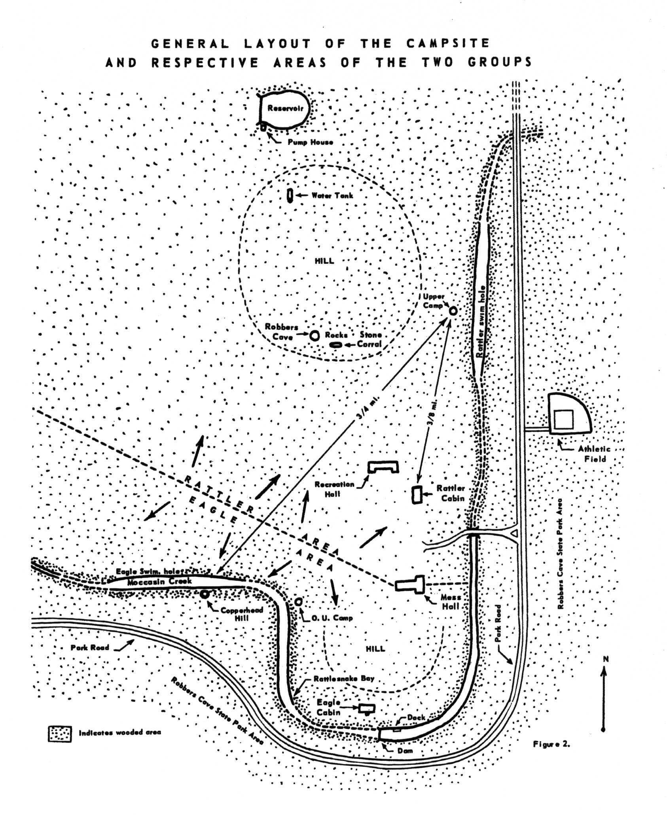
What Interpersonal Factors Disrupt Relations Between Groups?
The Robbers Cave Experiment
Conducted by Muzafer and Carolyn Sherif and colleagues in 1950s
Two groups of young boys: The Rattlers and the Eagles

Slide 5
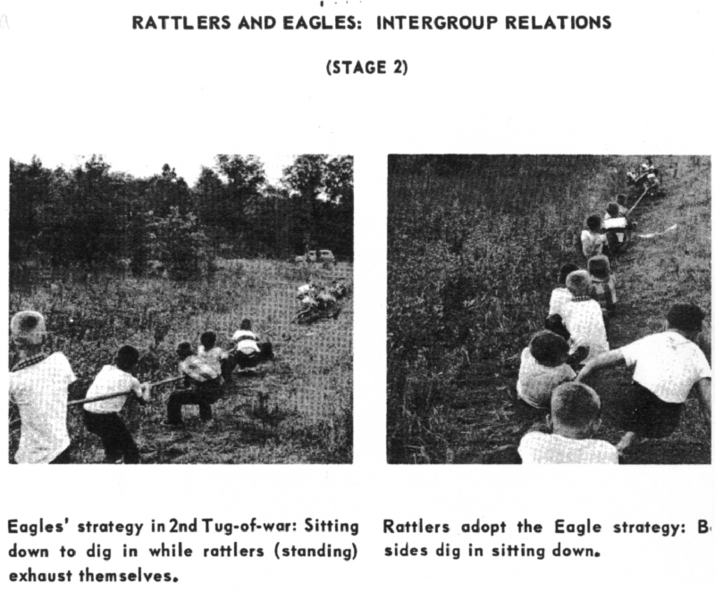
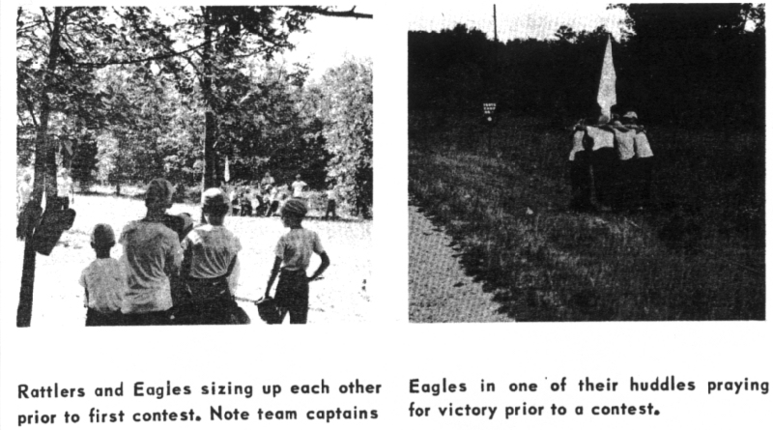
Scenes from the Robbers Cave

Slide 7
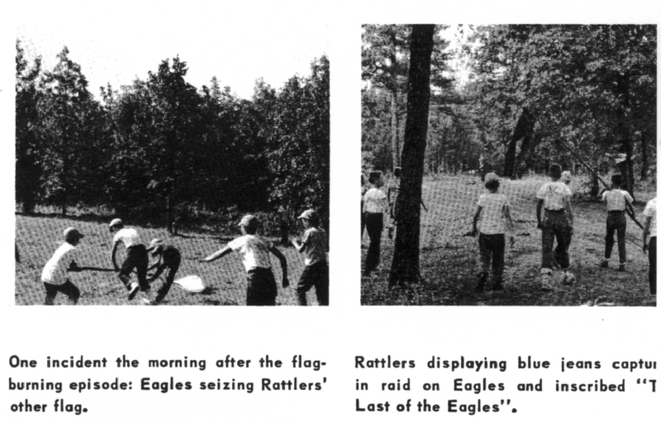

Slide 8
The Rattlers vs. the Eagle: Conflict!
Result: Reactions to conflict escalated from exclusion to verbal abuse to discrimination to violence
What caused the conflict between these two groups?
Causes
Competition
Power
Norms
Anger
Instincts

Slide 9
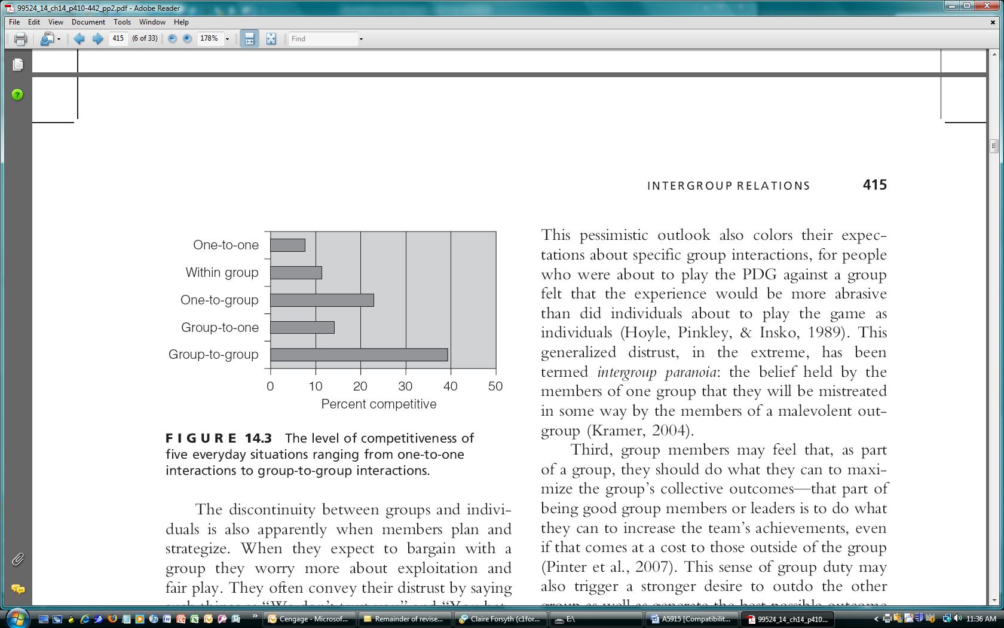
Competition for Scarce Resources
Realistic Group Conflict Theory
Insufficient Resources
Competition for Resources
Conflict
Discontinuity effect: Insko et al. find groups are more competitive than individuals
Greed
Identifiability
Fear
Diffusion of Responsibility

Slide 10
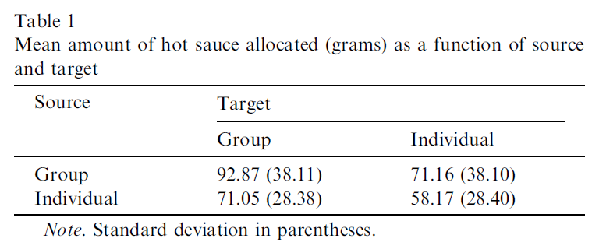
Maier & Hinsz (2004) “Hot Sauce” Study
In a purported taste test study participants (alone or in a group) were told another person or a group had sent them a cup of very, very spicy sauce to consume (48.1 grams). They then were asked to measure out a portion to send to that other individual or group.

Slide 11

Power: Group vs. Group
Economic versus militaristic (coercive) exploitation
Insko’s study of laboratory microsocieties
If certain groups of people stayed in their place, we would have fewer problems.
Sometimes other groups must be kept in their place
We should do what we can to equalize conditions for groups.
We should increase social equality.
Social Dominance Theory (Sidanius & Pratto)

Slide 12
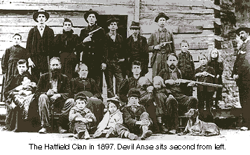
Norms and Conflict
Norm of reciprocity and conflict spirals
Cultural norms
Chagnon’s studies of the Yanomanö
Collectivistic and individualistic societies
Group norms (gangs, “culture of honor, etc.)

Slide 13
Yanomano Politics: Alliance vs. Warfare
Conflict De-escalation Conflict Escalation
Nomohoni
Generalized Reciprocal
Reciprocity Woman Exchange Raids
Spear Fights
Balanced Mutual Feasting
Reciprocity Ax Fights
Club Fights
Side-Slapping Duels
Sporadic and Chest-Pounding Duels
Reciprocity Reciprocal
Trading

Slide 14
Emotions and Instincts
Anger
Frustration-aggression and conflict
Scapegoating and intergroup conflict
Evolution
Group-level aggression/territoriality
Outgroup violence solidified the ingroup

Slide 15
Intergroup Bias: The Cognitive Causes of the Intergroup Conflict
Causes
Intergroup Bias
Categorization
Ingroup-outgroup bias
Cognitive biases
Intergroup emotions
Identity
Tajfel and Turner’s “minimal intergroup situation”
Groups were nominal, based on some trivial factor (such as art preferences)
When asked to distribute resources to others, favored the members of one’s own group
They concluded (1986, p. 13): the “mere perception of belonging to two distinct groups—that is, social categorization per se—is sufficient to trigger intergroup discrimination favoring the ingroup”

Slide 16
The Ingroup-Outgroup Bias
Favoring the ingroup over the outgroup: Ethnocentrism
Ingroup positivity tends to be stronger than outgroup negativity
Implicit intergroup biases (IAT findings)
Double-standard thinking

Slide 17
Cognitive Biases
Outgroup Homogeneity Bias
Group Attribution Error
Ultimate Attribution Error
Stereotypes

Slide 18
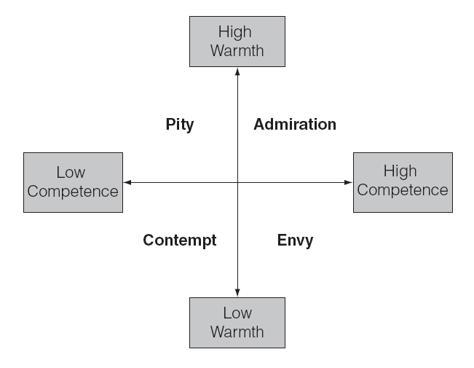
Intergroup Emotions
Stereotype content model: outgroup viewed in terms of warmth and competence
Emotions: Pity, contempt, envy, admiration
Group Hate: Usually associated with physical violence
Moral exclusion
Dehumanization
Cuddy, Fiske, & Glick, 2007

Slide 19
Social Identity Theory of Intergroup Conflict
Need for self-esteem
Personal Identity
Inclusion
Achievements
Social Identity
Group achievements
Group favoritism
Increased self-esteem
Outgroup rejection
Not clear if outgroup rejection raises self-esteem

Slide 20
Intergroup Relations
Causes
Intergroup Bias
Contact
Cognitive cures
Conflict Management
Resolution
Identity
Intergroup emotions
Cognitive biases
Ingroup-outgroup bias
Categorization
Evolution
Anger
Norms
Power
Competition

Slide 21
Intergroup Contact: The Contact Hypothesis
Contact between the groups at the Robbers Cave did not reduce hostilities
Contact hypothesis: Contact is more effective when
it creates cooperation between the groups
participants are equal in status
interaction is intimate (stimulated friendships across groups)
norms encourage cooperation

Slide 22
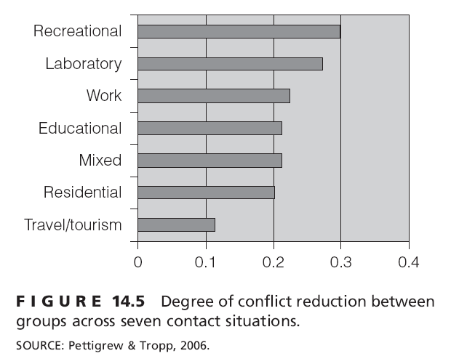
Pettigrew and Tropp's review
High quality contact is best, but any contact better than nothing
Contact is more effective in recreational, laboratory, work and educational settings than in residential and tourist settings.
Robbers Cave contact
Contact worked when groups worked toward superordinate goals

Slide 23
Managing Intergroup Conflict
Cognitive approaches to conflict reduction
Decategorization
Recategorization: common ingroup identity model
Cross-categorization
Controlling stereotyped thinking
Conflict management: interpersonal skill training procedures
Jigsaw learning groups
Constructive controversy procedures: Learning to Cooperate

Slide 24
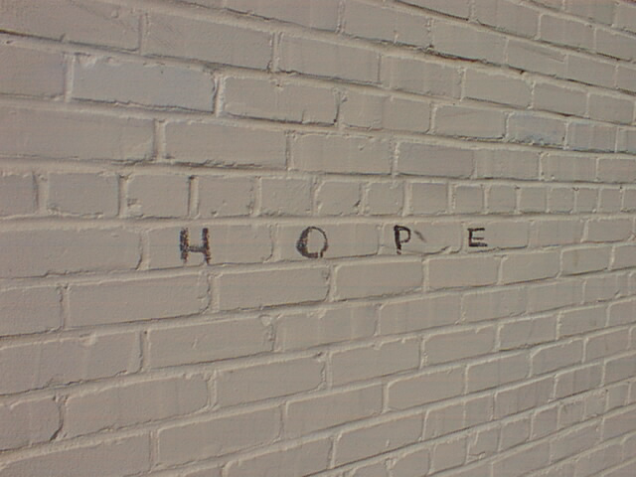
Darkness cannot drive out darkness; only light can do that. Hate cannot drive out hate; only love can do that. Hate multiplies hate, violence multiplies violence, and toughness multiplies toughness in a descending spiral of destruction....The chain reaction of evil--hate begetting hate, wars producing more wars--must be broken, or we shall be plunged into the dark abyss of annihilation.
Martin Luther King, Jr.

Slide 25
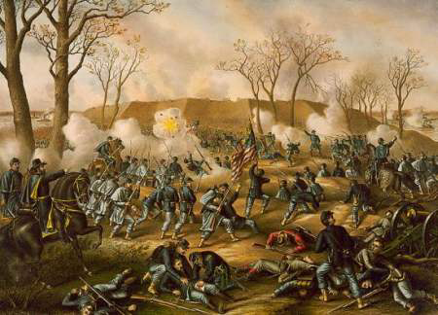
Battle of Fort Donelson
The Battle of Fort Donelson was fought from February 11 to February 16, 1862, in the Western Theater of the American Civil War. The capture of the fort by Union forces opened the Cumberland River as an avenue for the invasion of the South. The success elevated Brig. Gen. Ulysses S. Grant from an obscure and largely unproven leader to the rank of major general, earning him the nickname "Unconditional Surrender" Grant in the process (utilizing his first two initials, "U.S.").

