Slide 1
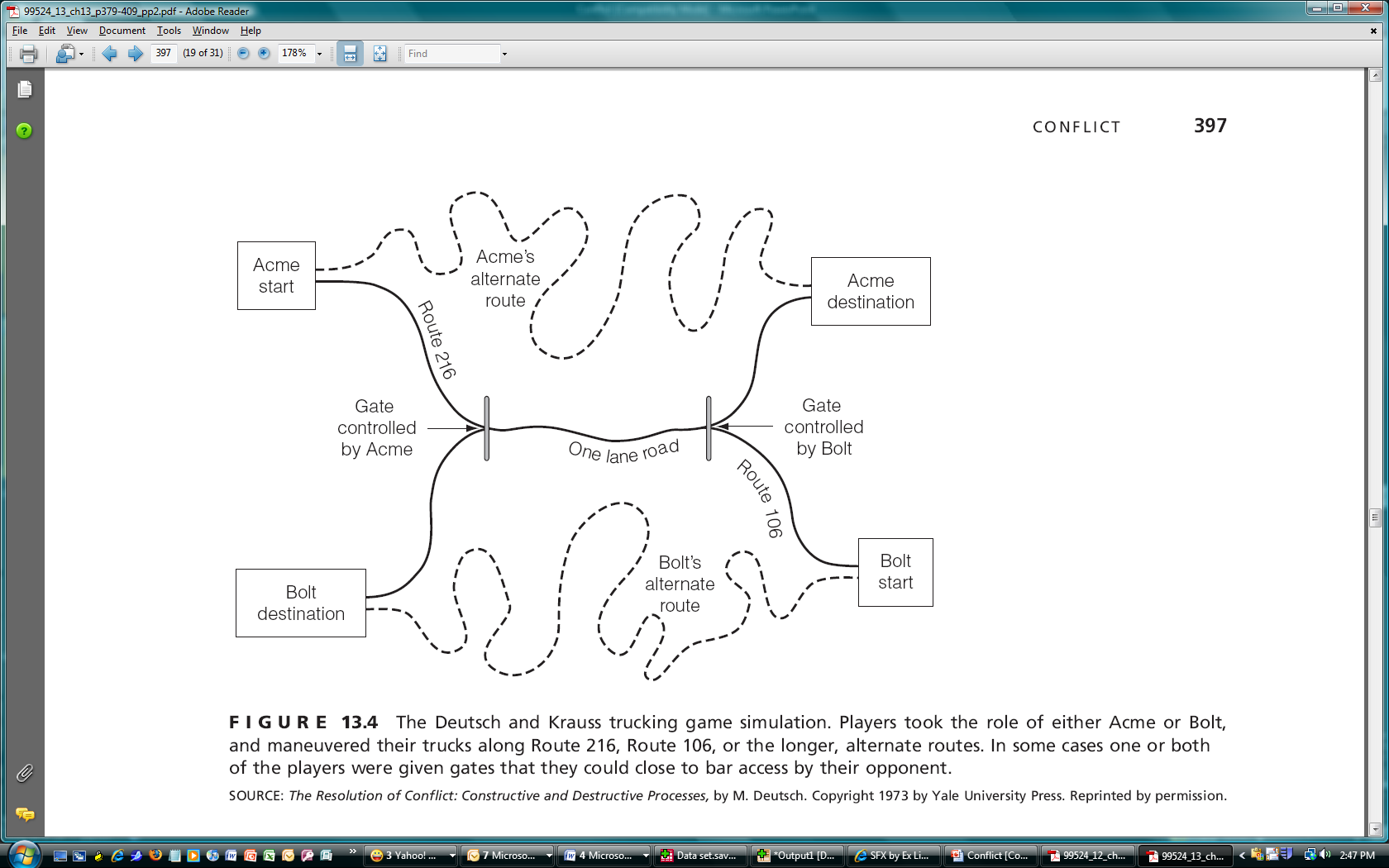
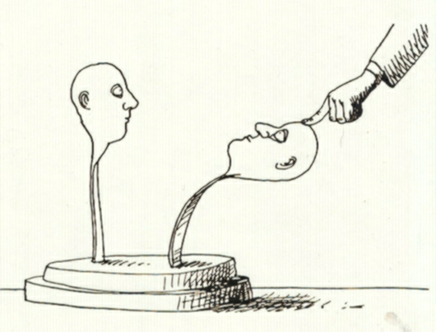
13 Conflict
Group members do not always get along well with one another. Even in the most serene group the group’s atmosphere may shift rapidly, so that once close collaborators become hostile adversaries. Because conflict is a ubiquitous aspect of group life, it must be managed to minimize its negative implications.
What is conflict?
What are the sources of conflict in groups?
Why does conflict escalate?
How can group members manage their conflict?
Is conflict an unavoidable evil or a necessary good?

Slide 2
That man is an aggressive creature will hardly be disputed. With the exception of certain rodents, no other vertebrate habitually distroys members of his own species.
A. Storr
If you have learned how to disagree without being disagreeable, then you have discovered the secret of getting along -- whether it be business, family relations, or life itself.
Bernard Meltzer
Conflict
Some people are always itching for a fight.
Groups must experience conflict to develop fully.
The human species is, by nature, aggressive.
An all-male group will have higher levels of conflict than will an all-female group.
The best way to deal with conflict is to talk things over.

Slide 3
Conflict in Groups
Causes
Escalation
Management
Negotiation
Understanding
Cooperative tactics
Winning
Sharing
Controlling
Working
Liking
Uncertainty
Perception
Soft tactics
Reciprocity
Few
Irritation
Downward Spiral
Few
Composure
Commitment
Misperception
Hard tactics
Upward Spiral
Many
Anger

Slide 4
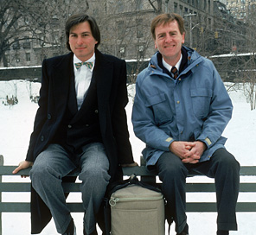

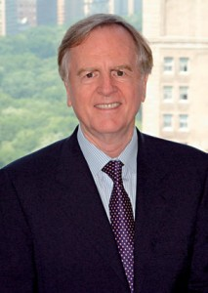
What is Conflict?
Examples of conflict situations
Definition: Disagreement, discord and friction that occur when the actions or beliefs of one or more members of the group are unacceptable to and are resisted by one or more of the other group members
Steve Jobs
John Sculley
Photo: Diana Walker/Contour by Getty Images

Slide 5
The course of conflict in groups
Conflict
Escalation
Conflict
Conflict Management/Resolution
Intragroup conflict
Intergroup conflict
Routine Group Interaction
Routine Group Interaction

Slide 6
Roots of Conflict: Basic questions
Who has won (competition)?
Who gets what (resource distribution)?
Who is in charge (power struggles)?
Who decides (decisional conflict)?
Who do I like (personal conflict)?

Slide 7
Winning: Conflict and competition
Deutsch: Cooperation vs. competition
Mixed-motive conflict and the prisoner’s dilemma game (PDG)
John’s Choice
C
D
John
Wins
25¢
John
Wins
50¢
Steve’s Choice
C
Steve
Wins
25¢
Steve
Loses
25¢
John
Loses
25¢
John
Loses
10¢
D
Steve
Wins
50¢
Steve
Loses
10¢

Slide 8
Prisoner’s Dilemma Game
John’s Choice
C
D
If John picks C, and Steve picks C
John
Wins
25¢
John
Wins
50¢
Steve’s Choice
C
Steve
Wins
25¢
Steve
Loses
25¢
If John picks D, and Steve picks C
If John picks C, and Steve picks D
John
Loses
25¢
John
Loses
10¢
D
Steve
Wins
50¢
Steve
Loses
10¢
If John picks D, and Steve picks D

Slide 9
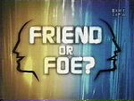

Choices in the PDG
Matrix of rewards vs. costs
“Wall Street Game” vs. Community Game
Opponent vs. Partner
Iterated → cooperation
Reciprocity over iterations
Amount of money
Sex
Game shows using the PDG

Slide 10
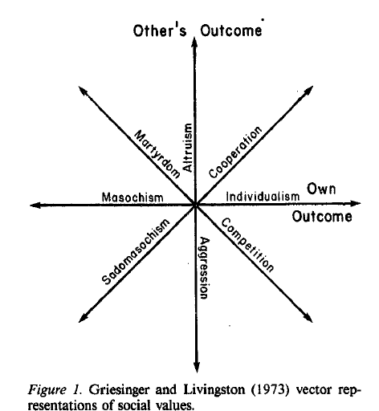
SVO: Social Values Orientation
Cooperative
Competitive
Altruistic
Individualistic
Maki, J. E., & McClintock, C. G. (1983). The accuracy of social value prediction: Actor and observer influences. Journal of Personality and Social Psychology, 45, 829-838.

Slide 11
Sharing: Social Dilemmas
Groups, because they ask individuals to work, live, and play with others, can set the stage of conflict over resources, and how they will be shared
Common Dilemma (social traps): exploiting shared resources
Public goods dilemmas: contributions to public goods (free-riding)
Fairness dilemmas: distributive vs. procedural justice, distribution norms
Responsibility dilemmas: egocentrism vs. sociocentrism

Slide 12
Other Sources of Conflict
Controlling: Power struggles
Deciding: Substantive vs. procedural conflicts
Liking and disliking: Personal conflicts
Attraction decreases conflict but disaffection (repulsion) increases conflict
Conflict and diversity in groups
Balance theory: members respond negatively when they disagree with those they like

Slide 13

Other Sources of Conflict in Groups
Controlling: Conflict & Power
Power Conflicts
Working & Disagreements
Substantive (task) conflict
Procedural (process) conflict
Likes & Dislikes
Personal conflict and disaffection
Disliking + Disagreeing = Hostility

Slide 14
Why does conflict escalate?
Causes
Escalation
Management
Negotiation
Understanding
Cooperative tactics
Winning
Sharing
Controlling
Working
Liking
Uncertainty
Perception
Soft tactics
Reciprocity
Few
Irritation
Downward Spiral
Few
Composure
Certainty
Misperception
Hard tactics
Upward Spiral
Many
Anger

Slide 15
Factors that increase conflict
Escalation
Uncertainty
Perception
Soft tactics
Reciprocity
Few
Irritation
Misattribution and FAE
Misunderstanding
motivations
Commitment
Misperception
Hard tactics
Upward Spiral
Many
Anger

Slide 16
The Deutsch/Krause Trucking Experiment
Escalation
Uncertainty
Perception
Soft tactics
Reciprocity
Few
Irritation
Hard tactics

Slide 17
Factors that increase conflict
Escalation
Uncertainty
Perception
Soft tactics
Reciprocity
Few
Irritation
Reciprocity → Upward Conflict Spiral
Norm of reciprocity
Rough (overmatching) and light reciprocity (undermatching)
Few → Many (coalition formation)
Irritation → Anger (contagion)
Commitment
Misperception
Hard tactics
Upward Spiral
Many
Anger

Slide 18
Factors that decrease conflict
Escalation
Uncertainty
Perception
Soft tactics
Reciprocity
Few
Irritation
Conflict Management
Commitment
Negotiation
Misperception
Understanding
Hard tactics
Cooperative tactics
Upward Spiral
Downward Spiral
Many
Few
Anger
Composure

Slide 19
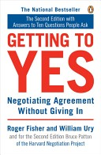
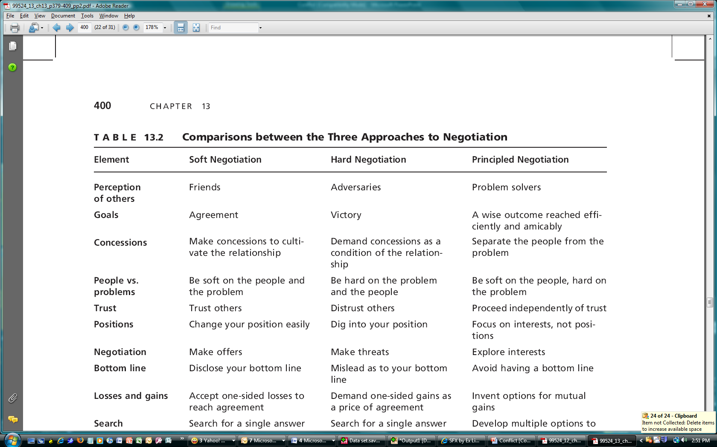
Controlling Conflict
Commitment → Negotiation (Getting to Yes)
Types: soft, hard, and principled negotiators

Slide 20
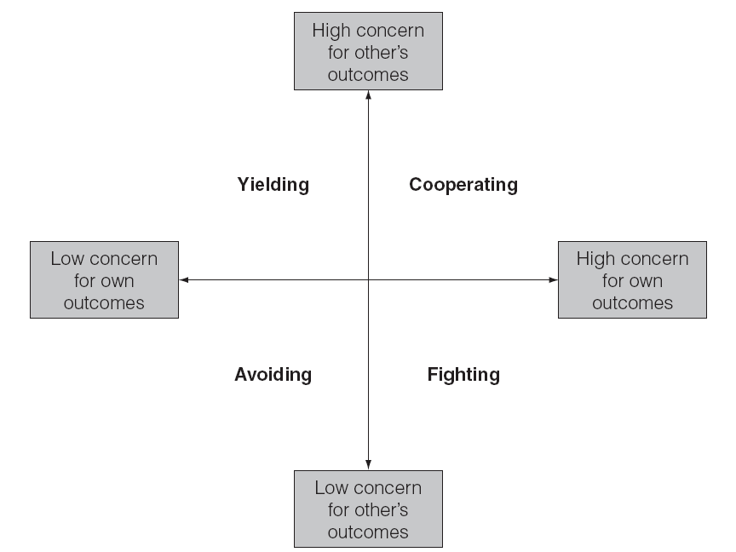
Controlling Conflict
Misperception → Understanding
Strong Tactics → Cooperative Tactics
Types of tactics: Avoiding, yielding, fighting, and cooperating
Dimensions: proself and prosocial

Slide 21
Other Ways to Manage Conflict
Downward Conflict Spirals
Tit-for-Tat is nice, provocable, clear, forgiving (and reciprocal)
Mediation (3rd party)
inquisitorial, arbitration, moot
Composure
Count to ten
Rethink that email

Slide 22
Does Conflict, When Resolved, Lead to Improved Group Functioning?
Conflict is a natural consequence of joining a group
Cooperation may promote group unity but more likely: conflict undermines the group
Resolving non-personal conflicts may promote group functioning, but unclear
De Dreu & Weingart find that any type of conflict (both task and relational) undermines group functioning

