Slide 1
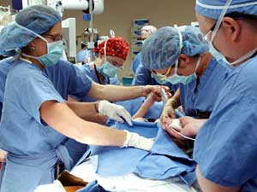
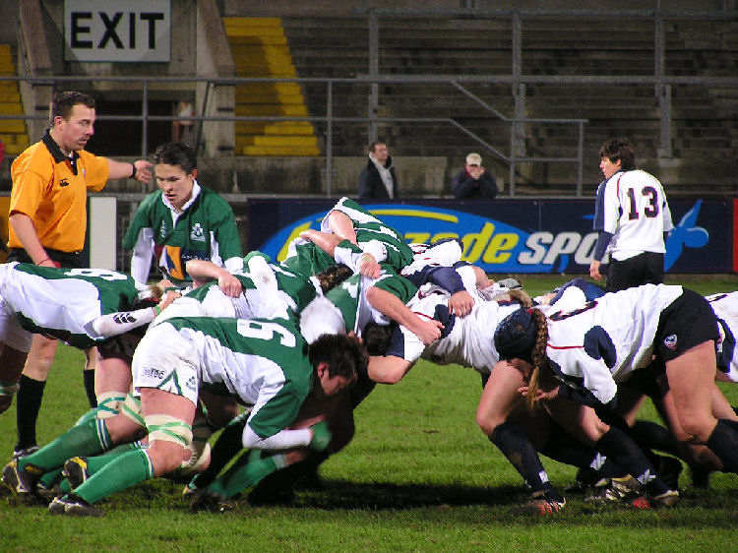
12 Teams
When the goals people want to
accomplish are so complex that they would overwhelm any individual’s capabilities—such as building a bridge, flying a spacecraft to the moon, or
performing Bach’s Brandenburg concerto—people turn to teams. Teams, when successful, transform groups into complex, adaptive, dynamic task-performing systems. Teams are groups, but not all groups are teams.
What are teams and when should they be used?
How does the team’s composition influence effectiveness?
What group processes mediate the input-output relationship?
How effective are teams, and how can they be improved?

Slide 2
Preview
Teams
Working in Teams
Team
Composition
Team
Processes
Teamwork
Definition
Types
Personality
KSAs
Diversity
Team Cognition
Cohesion
Team
Effectiveness
When to use
IPO Model
Men & Women
Evaluation
Team Design

Slide 3
What is a Team?
Interaction
concentrated
continuous
Goals
collective goals rather than only individualistic ones
Inter-dependence
tightly coupled dependencies
member’s have interlocking abilities, skills…
performance/outcome focused
Structure
clearly defined roles and norms
explicit lines of authority communication are
Unity
cohesive
collective efficacy
Teams are “extreme” groups, for each of the qualities of a typical group are exhibited, to an extreme degree, in a team

Slide 4
Types of Teams (and related groups)
Management
Executive
Negotiation
Commission
Design
Service
Command
Project
Advisory
Work
Production
Action
Medical
Response
Military
Transportation
Sports
Expeditions
Mobile, exploration focused
Crews
Make use of tools, equipment
Task Forces
Specific project, time limited

Slide 5
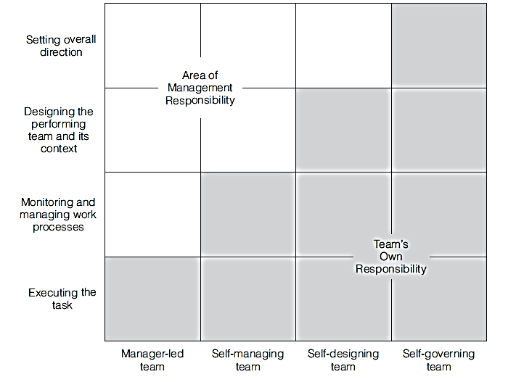
Types of Teams
Hackman identifies four types of teams based on responsibility for setting procedures and goals
Manager-led
Self-managing
Self-designing
Self-governing

Slide 6
When to use a team?
Task Demands
Psychological & Interpersonal Demands
How difficult is the task?
How complex is the task?
How important is the task?
How monotonous/dull is the task?
Desire for company (work partners)
Diffusion of responsibility
Social loafing
“Romance of Teams”

Slide 7
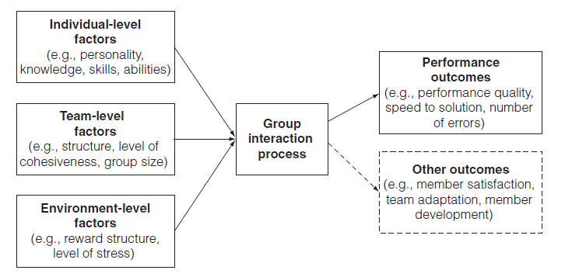
The I-P-O Model of Teams

Slide 8
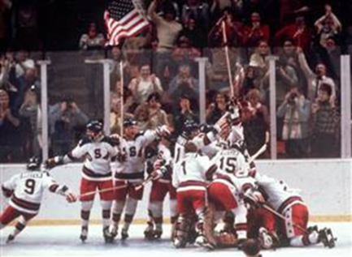
Composition: Building the Team
Strong composition effects (fit of members)
Presence of “team players”
Individual level of skill and experience
Low diversity and high cohesion
Outstanding leadership
Why was the 1980 US Hockey Team successful?
Rights: Associated Press

Slide 9
Working in Teams and Personality
.05
.12
.16
.25
.24
Emotional
Stability
(neuroticism)
Extraversion
Openness
Agreeable-ness
Conscien-tiousness
Adjustment
Dominance
Flexibility
Trust
Dependability
Self-esteem
Affiliation
Cooperation
Dutifulness
Social perceptiveness
Achievement
Efficacy
Expressivity
Five Factor Personality Inventory (OCEAN)

Slide 10

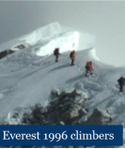
In general, great teams require great group members
Additive effects
Synergy effect
Weakest link effect
Bad apple effect

Slide 11
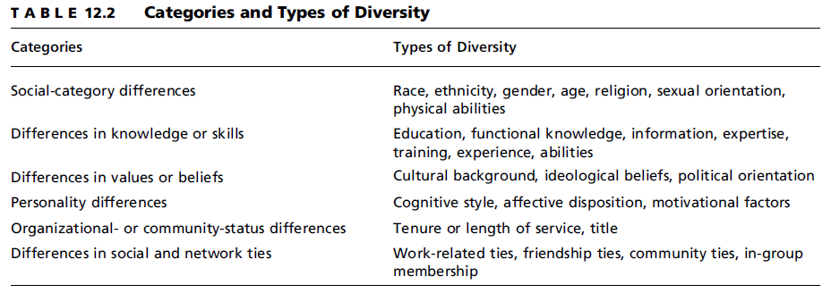
Team Diversity

Slide 12
Broader range of KSAs
Increased creativity, less traditional solutions and outlooks
Advantages of Heterogeneous Teams
Advantages of Homogenous Teams
Stronger social identity, fewer schisms, subgroups
More cohesive
Reduced conflict, misunderstanding

Slide 13
Dealing with Team Diversity
Surface diversity easy to deal with, deep diversity more difficult
Organizational support
Reduce tendency to subgroup
Mixing Men and Women in Teams: bonding effects, sexism, tradition, “civilizing” effects, tokenism, etc.

Slide 14
Teamwork
Transition Processes
Mission analysis
Action Process
Monitoring progress
Monitor int/ext resources/ demands
Interpersonal Process
Conflict management
Motivation
Goal specification
Monitor/tweak “teamwork”
Affect /cohesion management
Social support
Strategy formulation
Coordination

Slide 15
Team cognition and learning
High performing teams
Capitalize on transactive memory processes: different members are trusted to know specific areas of information
Train as a team, rather than individually
Review their work regularly and identify methods to improve
Transactive memory: a process by which information to be remembered is distributed to various members of the group who can ten be relied upon to provide that information when it is needed

Slide 16
Are Teams Effective?
“The emphasis on groups and teams has gone far beyond any rational assessment of their practical usefulness. We are in the age of groupomania.” Edwin Locke, 2001
Is he right?

Slide 17
Empirical evidence is mixed
Case studies and field studies generally support the effectiveness of teams
Experimental studies identify a number of limitations for working in teams
Surveys of workers find widespread dissatisfaction with teams (and leaders)
Suggestions:
Make certain that so-called teams actually are teams
Train individuals to work in teams and to lead teams
Provide organizational (and financial) support to teams (Remember the quality circle!)
Hackman maintains that teams should:
Meet standards of quantity, quality, and timeliness
The team should improve over time.
The team should contribute in positive ways to members’ well-being and learning

Slide 18
Review
Teams
Working in Teams
Team
Composition
Team
Processes
Teamwork
Definition
Types
Personality
KSAs
Diversity
Team Cognition
Cohesion
Team
Effectiveness
When to use
IPO Model
Men & Women
Evaluation
Team Design

