Slide 1
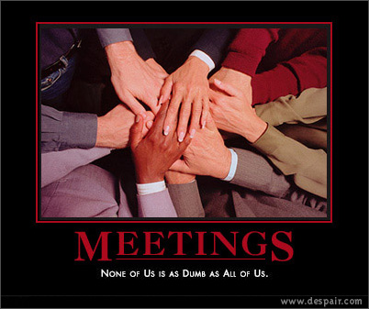
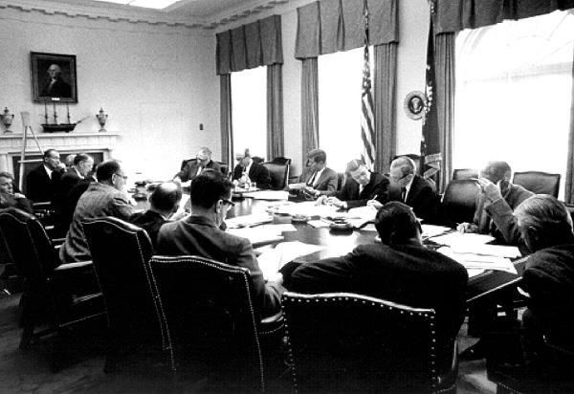
11 Decision Making
People turn to groups when they must solve problems and make decisions. Groups often make better decisions than individuals, for groups can process more information more thoroughly. But groups, like individuals, sometimes make mistakes. When a group sacrifices rationality in its pursuit of unity, the decisions it makes can yield calamitous consequences.
Why make decisions in groups?
What problems undermine the effectiveness of decision making in groups?
Why do groups make riskier decisions than individuals?
What is groupthink, and how can it be prevented?

Slide 2
Decision Making
Functional Model
Biases & Pitfalls
Shared information bias
Cognitive biases and errors
Groupthink
Polarization
Causes
Symptoms
Cures

Slide 3
The mob has
no judgment,
no discretion,
no direction,
no discrimination, no consistency.
Cicero
madness is the exception in individuals but the rule in groups. Nietzsche
When "a 100 clever heads join a group, one big nincompoop is the result.”
Carl Jung
Decision Making in Groups

Slide 4
Why Work in Groups?
more people = more information
more people to do more work
more people means people can do what they are best at
groups can discuss, process information (check for errors, etc.)
groups have standards for deciding (e.g., majority rules)
people are more likely to follow through if part of a group that decided

Slide 5
Why Not?
sometimes the group doesn't recognize the correct problem, even if proposed
groups oversample shared information
sometimes work done by just a few
discussion can be manipulated
groups sometimes make riskier decisions
groups sometimes make horrible decisions when very cohesive (groupthink)

Slide 6
Functional Model of Decision Making
Orientation
Orientation
Defining the
Problem
Planning the Process
Discussion
Decision
No Decision
Reached
Orientation
Development of shared mental model
Tendency to skip this step
Decision
Reached
Implementation

Slide 7
Remembering Information
Discussion
Exchanging
Information
Processing Information
Remembering information
collective memory
weakness in group memory
Exchanging information: Acquiring and sharing data
cross-cueing
transactive memory
Processing information: Collective review of information

Slide 8
Decision: Social decision schemes
Decision
Ways to Make the Decision
Delegation
Statistical aggregation
Voting
Consensus (discussion to unanimity)
Random choice

Slide 9
Implementation
Decision
Reached
Implementation
Evaluating the decision
Adhering to the decision: Coch and French (1948)
Vroom’s normative model of decision making
Evaluating the Decision
Adhering to the Decision

Slide 10
Vroom’s normative model of decision making
Decide: Leader makes decision
Consult (Individual): Leader discusses with individual members, then makes decision him or herself
Delegate: Leader turns problem over to the group
Facilitate: Leader coordinates problem solving session
Consult (Group): Leader discusses with group, but makes decision him or herself

Slide 11

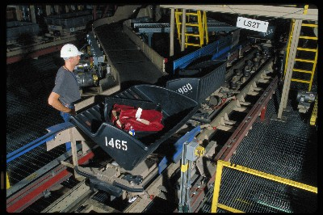


Enron
Denver Airport
Abilene paradox
1.7 billion – 300 million
Which is not to say that groups always make good decisions
Notes:
The Abilene Paradox and Other Meditations on Management by jerry Harvey
On March 27, Quaker Oats Co. announced that it would sell the Snapple drink business to Triarc Cos. for $300 million, for which it paid $1.7 billion in 1994
Investors responded positively. Quaker stocks closed at $37.75, up 25 cents. Triarc's shares advanced $1.625, to $17.375.

Slide 12
What Problems Undermine the Effectiveness of Decision-Making Groups?
Functional Model
Biases & Pitfalls
Shared information bias
Cognitive biases and errors
Groupthink
Polarization
Causes
Symptoms
Cures

Slide 13
Discussion is Difficult
Group discussion pitfalls
Information processing limitations: leveling, assimilation, sharpening
Poor communication skills
Decisional avoidance (procrastination, bolstering, satisficing)

Slide 14
Shared Information Bias
Oversampling shared information leads to poorer decisions when a hidden profile would be revealed by considering the unshared information more closely
Causes
Informational influence
Normative influence
Emphasis on consensus vs. correctness
Initial preferences
Impression management goals

Slide 15
Reducing the Shared Information Bias
The SIB can be reduced by improving information exchange by:
Good leadership
Increasing diversity
Using a GDSS
(group decision support system)
Discussion

Slide 16
Judgmental Errors of Omission, Commission, and Imprecision
“Sin” | Examples
of Commission | Belief perseverance: reliance on information that has already been reviewed and found to be inaccurate Sunk cost bias: reluctance to abandon a course of action once an investment has been made in that action Extra-evidentiary bias: use of information that one has been told explicitly to ignore Hindsight bias: tendency to overestimate the accuracy of prior knowledge of an outcome
of Omission | Base rate bias: failure to pay attention to information about general tendencies Fundamental attribution error: stressing dispositional causes when making attributions about the cause of people’s behaviors
of Imprecision | Availability heuristic: basing decisions on information that is readily available Conjunctive bias: failing to recognize that the probability of two events occurring together will always be less than the probability of just one of the events occurring Representativeness heuristic: excessive reliance on salient but misleading aspects of a problem

Slide 17
Polarization and Risk
Group polarization: A shift in the direction of greater extremity in individuals' responses

Slide 18
Why Do Groups Make Riskier Decisions than Individuals?
Social comparison theory
Persuasive-arguments theory
“Risk-supported wins” social decision scheme

Slide 19
Janis’s Theory of Groupthink
Functional Model
Biases & Pitfalls
Shared information bias
Cognitive biases and errors
Groupthink
Polarization
Causes
Symptoms
Cures
Kennedy’s advisory group planning the Bay of Pigs “covert op”

Slide 20
Causes

Slide 21
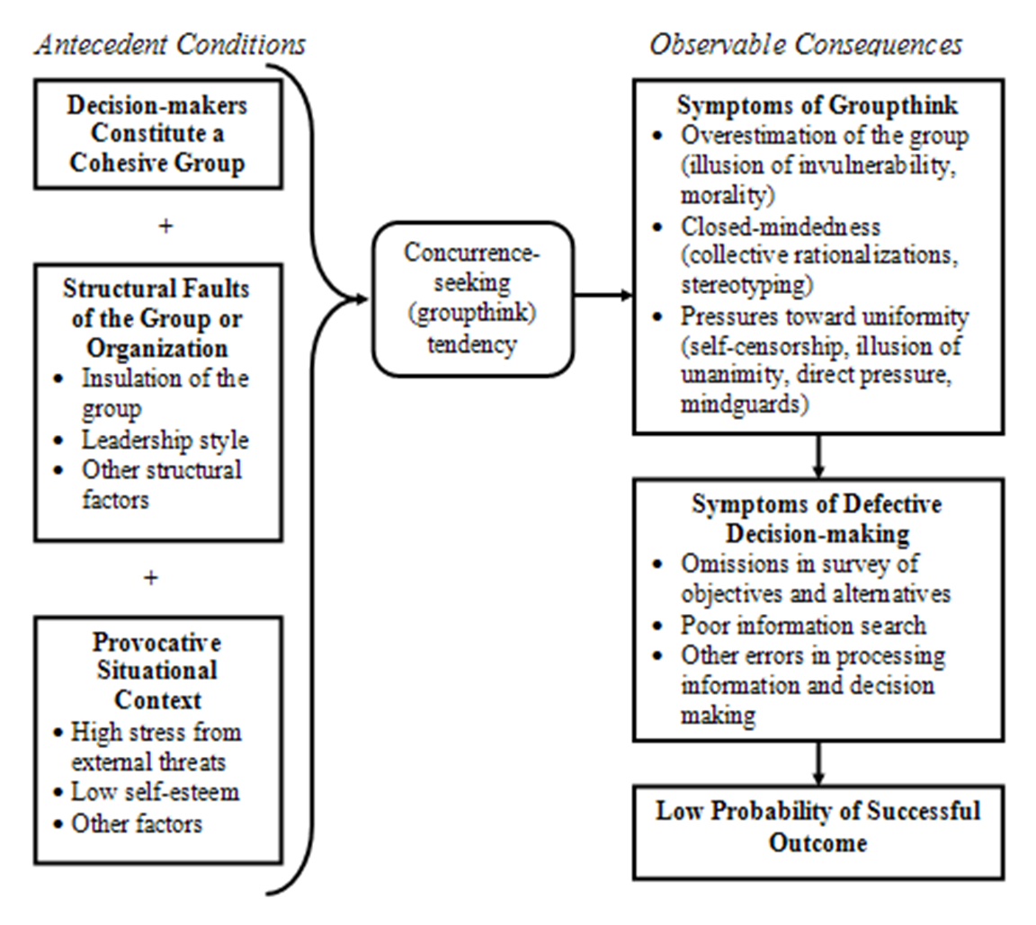
Groupthink: Causes
Cohesion
StructuralFaults
Provocative Situational Context

Slide 22
Symptoms
Overestimation of the group
illusions of invulnerability
Close-mindedness
Pressures toward uniformity.
self-censorship,
Defective decision-making processes
rationalizations
stereotypes about the outgroup
illusions of morality
the illusion of unanimity
direct pressure on dissenters
self-appointed mindguards)
Abilene paradox
Sunk costs

Slide 23
How Can Groupthink Be Prevented?
Limiting premature seeking of concurrence
Open style of leadership
Devil’s advocate, subgroup discussions
Correcting misperceptions and biases
Using effective decision-making techniques

