Slide 1
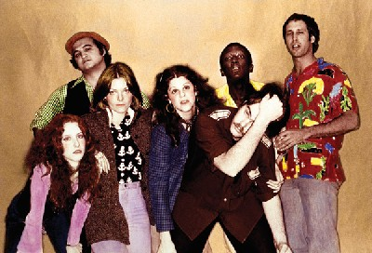
Chapter 10 Performance
Original Cast of SNL
People join with others in groups get things done. Groups are the world’s workers, protectors, builders, decision makers, and problem solvers. When individuals combine their talents and energies in groups, they accomplish goals that would overwhelm individuals. People working collectively inevitably encounter problems coordinating their efforts and maximizing effort, but groups are the crucible for creativity.
Do people work better alone or with others?
Do people work as hard when in groups as they do when working by themselves?
Why are groups more successful when working on some tasks and not on others?
What steps can be taken to encourage creativity in groups?

Slide 2
Performance and Productivity
Social Facilitation
Research
Theory
Process Loss
Ringelmann Effect
Process Gains
Brainstorming
Application
Social Loafing
Coordination and Task Demands
Brainstorming rules
Be expressive
Postpone evaluation
Seek quantity
Piggyback ideas
Additive
Steiner Taxonomy of Tasks
Compensatory
Disjunctive
Conjunctive
Discretionary

Slide 3
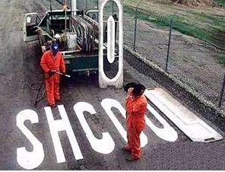
Working Together in Groups
What happens when people join with others on the most simple of tasks?
Do many hands make light the work?
Are people prone to “free ride?”
Are we better (smarter, more clever, more creative) together?

Slide 4
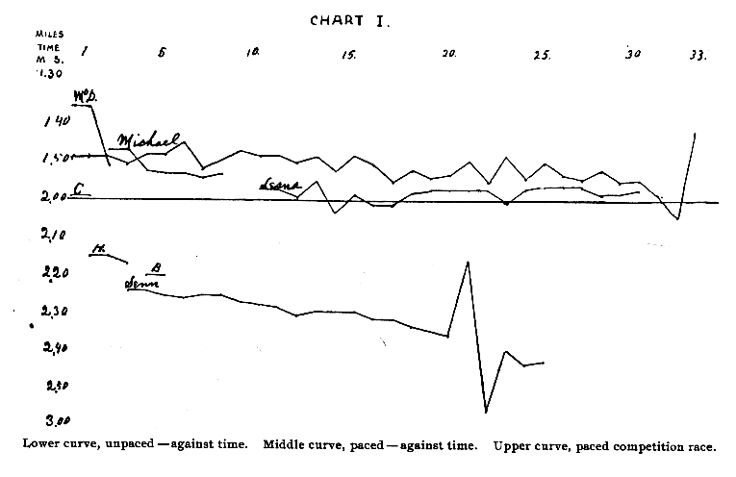
Social Facilitation
Social facilitation: improvement in performance in the presence of others (both audience and coaction)
Triplett’s (1898) early studies

Slide 5
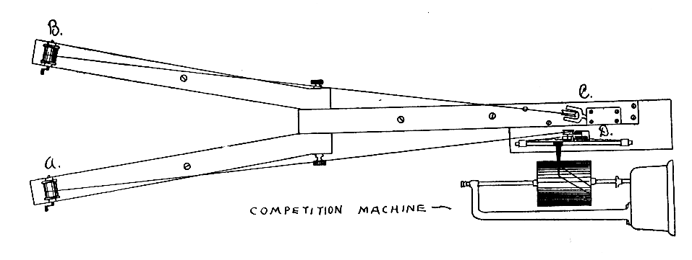
Triplett, 1898
First laboratory study of a group process (maybe: Ringelmann may have done his research earlier)

Slide 6
Zajonc’s motivational analysis of social facilitation (1965)
social facilitation occurs on simple tasks that require dominant responses
social impairment occurs for complex tasks that require nondominant responses
If task requires
dominant
response
Dominant
responses
increase and
nondominant
responses
decrease
Social
facilitation
Presence of
others
If task requires
nondominant
response
Social
interference

Slide 7
Zajonc’s Cockroach Study
Speed in seconds
Type of Maze

Slide 8
Markus’ “getting dressed” study, 1978
Secs.
Type of Task

Slide 9
Theories of social facilitation
Drive process: Zajonc suggests compresence leads to arousal
Motivational processes: Cotrell’s evaluation apprehension theory (also, self-presentation theory)
Cognitive processes: distraction-conflict theory

Slide 10
Applications
Eating in groups
Prejudice as a dominant response
Electronic performance monitoring
Study groups

Slide 11
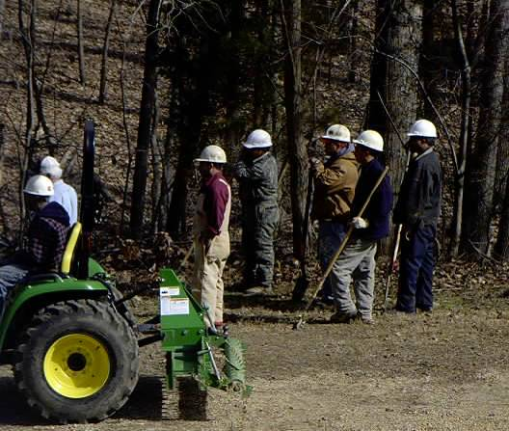
Process Loss on Collective Tasks
How productive are people when they work on simple group tasks?

Slide 12
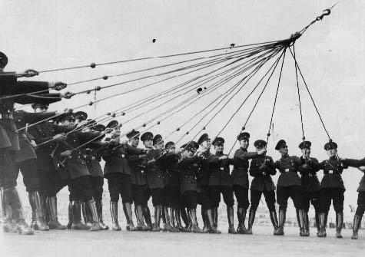
The Ringelmann Effect
People become less productive when they work with others
Loss increases as group become larger

Slide 13
Causes of the Loss of Productivity
Coordination problems
Reduction of effort
Latané, Williams, & Harkins (1979) called the loss of effort “social loafing”
600
500
400
300
200
100

Slide 14
Potential
Productivity
600
500
Pseudo
groups
400
300
Actual
groups
200
100
Alone
Dyads
6-person
groups

Slide 15
Ways to Increase Social Motivation
Increase identifiability
Minimize free-riding
Set goals
Increase involvement
Increase social compensation
Identification with the group: Social identity

Slide 16
Coordination problems
Steiner’s taxonomy of tasks and task demands
Task divisibility: divisible versus unitary tasks
Type of output desired: maximizing versus optimizing tasks

Slide 17
When Are Groups More Productive Than Individuals?
Groups outperform individuals on additive tasks and compensatory tasks.
Groups perform well on disjunctive tasks if the group includes at least one individual who knows the correct solution (truth-wins rule on Eureka problems)
Groups rarely perform better than the best member (synergy, or an assembly bonus effect)
Groups perform poorly on conjunctive tasks unless less skilled members increase their efforts (the Köhler effect) or the task can be subdivided.
The effectiveness of groups working on discretionary tasks covaries with the method chosen to combine individuals’ inputs.

Slide 18
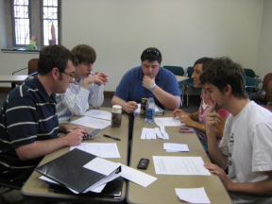
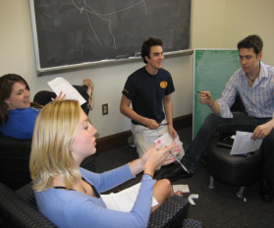
What about Brainstorming?
Brainstorming rules
Be expressive
Postpone evaluation
Seek quantity
Piggyback ideas

Slide 19
Don’t Brainstorm!
Brainstorming groups are not as creative as nominal groups due to
Social loafing
Production blocking
Social matching
Illusion of productivity.
Other methods: brainwriting, synectics, the nominal‑group technique (NGT), and electronic brainstorming (EBS), offer advantages over traditional brainstorming.

