Slide 1


Slide 2

1
Introduction to Group Dynamics
Group dynamics are the influential actions, processes, and changes that occur within and between groups. Groups come in all shapes and sizes and their functions are many and varied, but their influence is universal. The tendency to join with others in groups is perhaps the single most important characteristic of humans, and the processes that unfold within these groups leave an indelible imprint on their members and on society. To understand people, one must understand groups and their dynamics.
What is a group?
What are some common characteristics of groups?
Are there different types of groups, and do people distinguish between these groups?
What assumptions guide researchers in their studies of groups and their dynamics?
Why study groups and their dynamics?
What topics are included in the scientific study of group dynamics?

Slide 3
Introduction to Group Dynamics
Preview
The Nature of Groups
The Nature of Group Dynamics
Defining Groups
Types of Groups
Perceiving Groups
The Scientific Study of Groups
The Significance of Groups
Topics in Contemporary Group Dynamics
Group Dynamics is Dynamic
Describing Groups
A Multilevel Approach to the Study of Groups

Slide 4
The Nature of Groups
Defining Groups
  Two or more individuals who are connected by and within social relationships.
But note: As social identity theory explains, in many cases broad social categories can become psychologically meaningful to members, and in those cases social categories function very much like dynamic, socially based groups
Out
In
Members are connected—linked—together; these relationships are memberships
Unlike networks, groups usually have boundaries that define who is in the group and who is not
Unlike categories, members are socially connected, not just in the same grouping or collection (e.g., all men, bricklayers…)
Groups vary in size from dyads and triads to very large aggregations, such as mobs and audiences.

Slide 5
The Nature of Groups
Interaction
Goals
Interdependence
Structure
Unity
Describing Groups

Slide 6
Interaction
Goals
Interdependence
Structure
Unity
Describing Groups
  Interaction: What people do in groups
Task interaction (problem solving, providing guidance, coordination, etc.).
Relationship interaction (sustaining relationships, encouraging others, complaining, etc.).

Slide 7
Interaction
Goals
Interdependence
Structure
Unity
Describing Groups
McGrath’s Circumplex Model of group tasks is based on 2 key dimensions: Choosing vs. Executing (Doing) and Generating vs. Negotiating
Generate
Choose
Execute
Negotiate

Slide 8
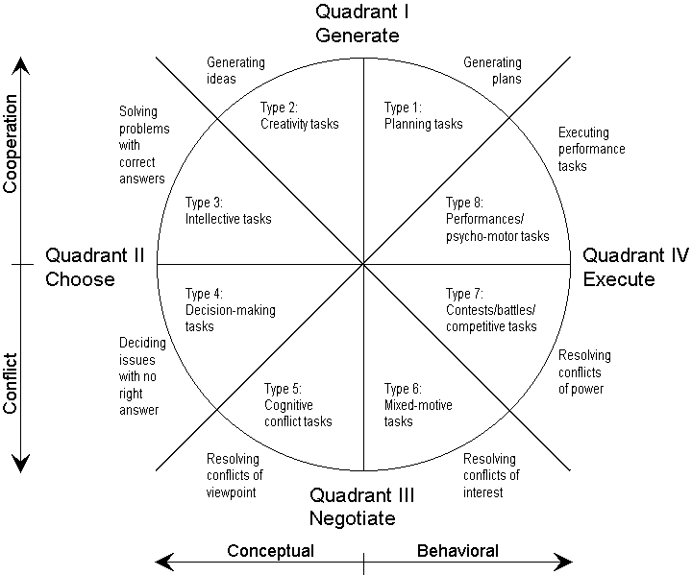
McGrath’s task circumplex

Slide 9
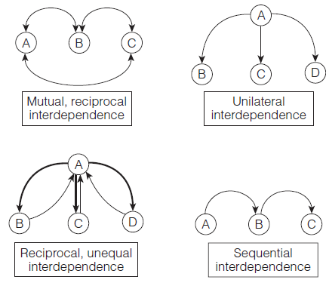
Interaction
Goals
Interdependence
Structure
Unity
Describing Groups
Interdependence: The state of being dependent to some degree on other people

Slide 10
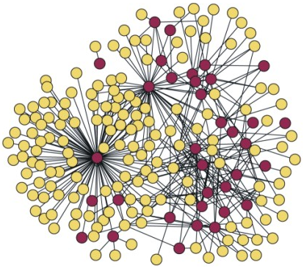
Interaction
Goals
Interdependence
Structure
Unity
Describing Groups
Structure: The underlying pattern of roles, norms, and relations among members that organizes groups

Slide 11
Interaction
Goals
Interdependence
Structure
Unity
Describing Groups
Group cohesion
Unity
Strength of bonds
Entitativity: Perceived to be a group
Common fate
Similarity
Proximity
Thomas Theorem applied to groups
If people define groups as real, they are real in their consequences
Essentialism

Slide 12
The Nature of Groups
Types of Groups
Primary groups
Social groups
Categories
Collectives

Slide 13
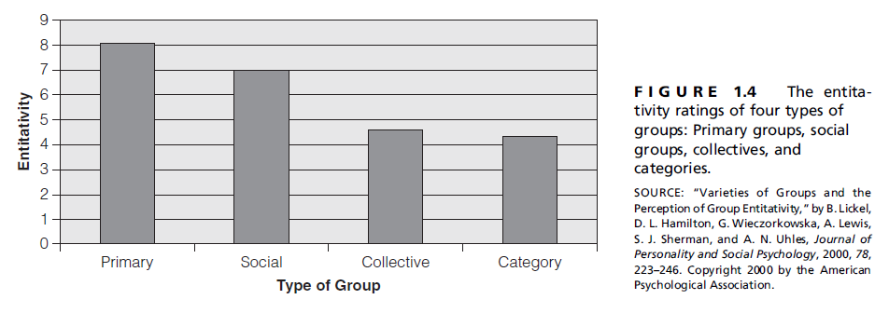
Types of Groups
  Perceiving groups: people intuitively draw distinctions between groups—some look groupier than others
Primary groups
Social groups
Categories
Collectives
1 (not at all a group) to 9 (very much a group)

Slide 14


Introduction to Group Dynamics
The Nature of Groups
Definition
Characteristics
The Nature of Group Dynamics
Types
Are Groups Real?
The Multilevel Perspective
Applications and Topics
Are Groups Dynamic?
  … a "field of inquiry dedicated to advancing knowledge about the nature of groups"
  (Cartwright & Zander, 1968, p. 7).
The Nature of Group Dynamics
Are Groups Real?
The Multilevel Perspective
Applications and Topics
Are Groups Dynamic?
“Doc” Cartwright
Alvin Zander

Slide 15
Are Groups Real?
Gustave Le Bon, Psychologie des Foules
Wilhelm Wundt, Volkerpsychologie
Emile Durkheim, collective consciousness
Floyd Allport, level of analysis
Kurt Lewin, interactionism
B = f (P, E)
Varying perspectives on the reality of groups

Slide 16

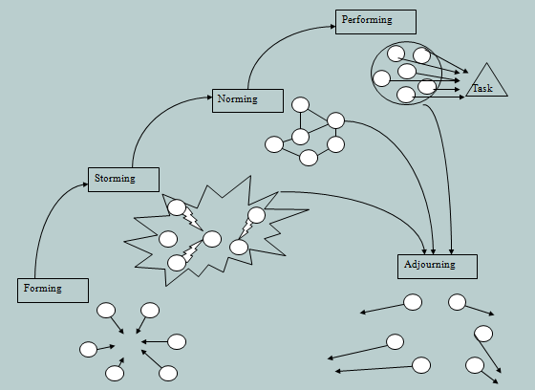
Are Groups Dynamic?
The Nature of Group Dynamics
Groups influence their members
Groups influence society
Groups are living systems

Slide 17
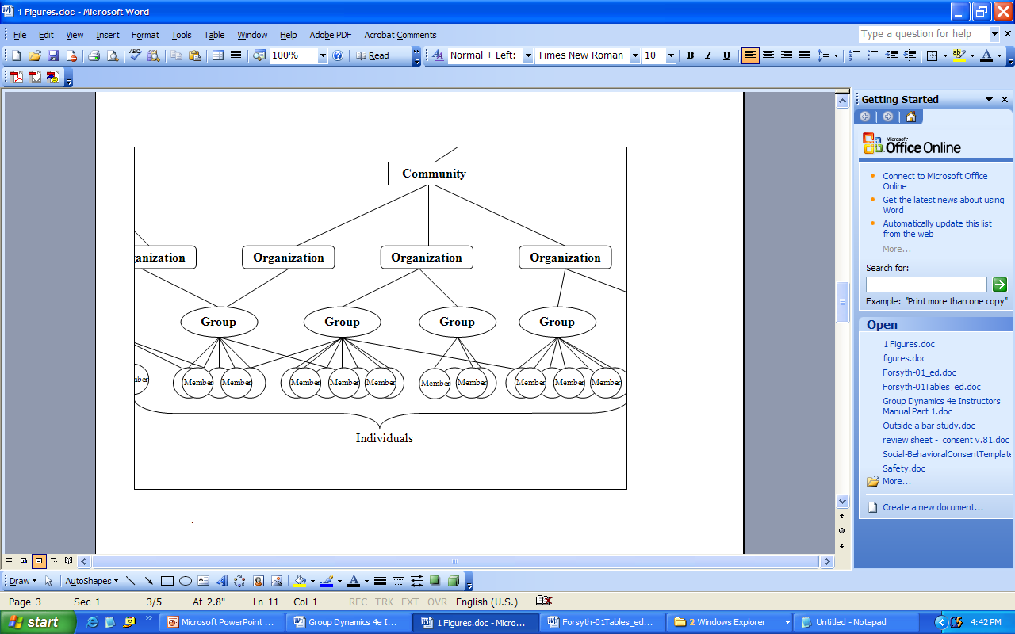
The Multilevel Perspective
The Nature of Group Dynamics
Individual level: focus on the individual (psychological)
Group level: focus on the group and social context (sociological)
Multilevel: adopts multiple perspectives on groups

Slide 18
Applications and Topics
The Nature of Group Dynamics
Interdisciplinary Applications
Anthropology Architecture
Topics
Formation & Development
Influence
Business & Industry Communication
Criminal justice Education
Engineering Mental Health
Political Science Psychology
Social Work Sociology
Sports & Recreation
Performance
Groups in Context
Details →

Slide 19
Topics
Introduction to Group Dynamics
Research Methods
Inclusion & Identity
Group Formation
Cohesion and Development
Structure
Influence
Power
Leadership
Performance
Decision Making
Teams
Conflict within and between groups
Groups in Context
Groups and Change
Crowds and Collective Behavior

Slide 20


Welcome to the Study of Groups!
The Nature of Groups
Definition
Characteristics
The Nature of Group Dynamics
Types
Are Groups Real?
The Multilevel Perspective
Applications and Topics
Are Groups Dynamic?
Groups

